Slide 1
Epidemic Cards
How To Play
E²M²
Ranomafana, Madagascar
January 2020

Slide 2




The Set-Up
26 Red Cards
FACE DOWN
“population” pile
26 Black Cards
FACE UP
“replacement” pile
“current” pile
(EMPTY)
Notes:
See email re: use of the term “replenishment” in this context, and why I discourage it

Slide 3

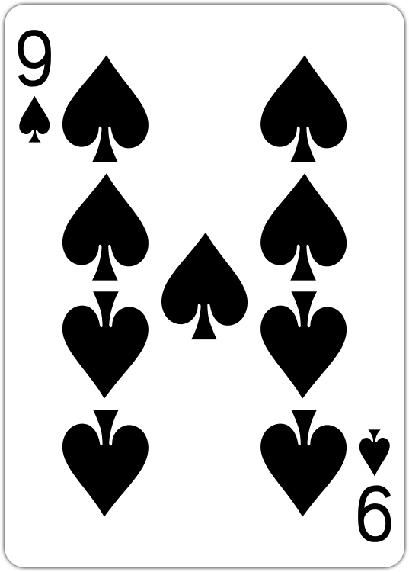
The Set-Up
“current” pile
(EMPTY)
26 Red Cards
FACE DOWN
26 Black Cards
FACE UP

Slide 4
The Set-Up
The Set-Up
“current” pile
(EMPTY)
The population pile must ALWAYS maintain exactly 26 cards.

Slide 5
The Set-Up
The Set-Up
“current” pile
(EMPTY)
The population pile must ALWAYS maintain exactly 26 cards.
What is the equivalent assumption in defining a model world to represent an epidemic?
Notes:
Not sure I love this wording for the question either. See note in email re: providing additional framing for them before asking this question.

Slide 6
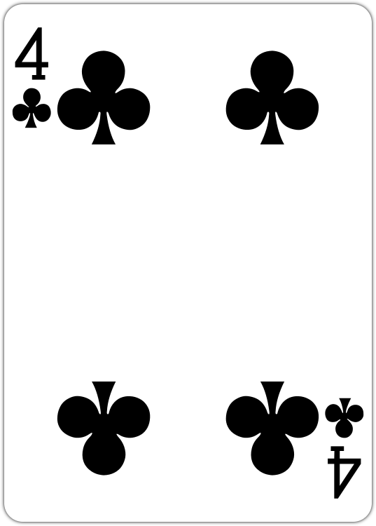
Round One
“current” pile
(EMPTY)
26 Red Cards
FACE DOWN
26 Black Cards
FACE UP

Slide 7
Round One
“current” pile
Draw one card from the population pile and move, FACE UP, to the current pile.

Slide 8
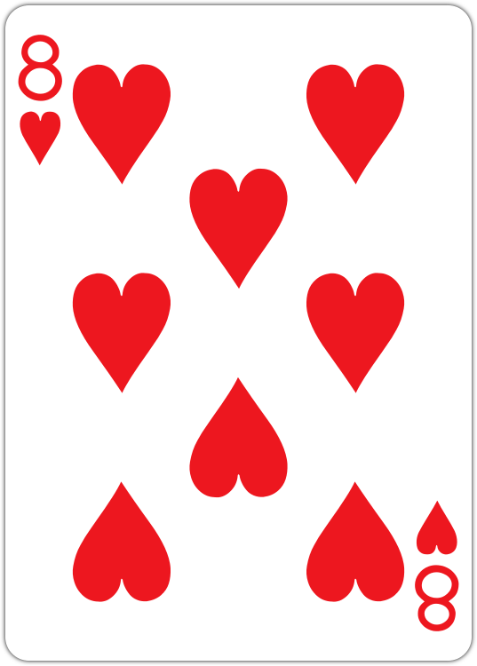
Round One
Draw one card from the population pile and move, FACE UP, to the current pile.

Slide 9
Round One
l
Replace the drawn card from the population pile with a black card from the replacement pile.
Draw one card from the population pile and move, FACE UP, to the current pile.

Slide 10
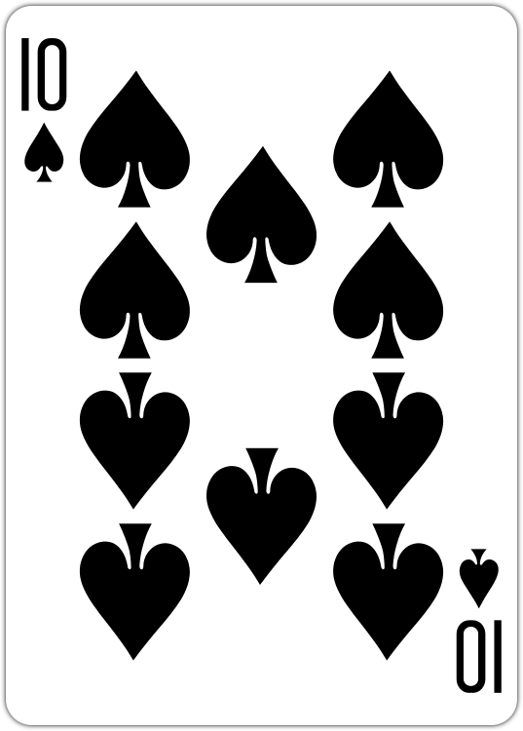
Round One
l
Replace the drawn card from the population pile with a black card from the replacement pile.
Draw one card from the population pile and move, FACE UP, to the current pile.

Slide 11
Round One
l
Replace the drawn card from the population pile with a black card from the replenish pile.
l
R
Now count.
S = # red cards in population pile
I = # red cards in current pile
Draw one card from the population pile and move, FACE UP, to the current pile.

Slide 12
Round One
25 Red Cards +
1 Black Card=
25 Susceptibles
1 Red Card=
1 Infected/Infectious
l
R
Now count.
S = # red cards in population pile
I = # red cards in current pile

Slide 13
Round One
Timestep | Infecteds | Susceptibles | Trial | R0
1 | 1 | 25 | 1 | 2
2 |  |  | 1 | 2
3 |  |  | 1 | 2
4 |  |  | 1 | 2
5 |  |  | 1 | 2
6 |  |  | 1 | 2
7 |  |  | 1 | 2
8 |  |  | 1 | 2
9 |  |  | 1 | 2
10 |  |  | 1 | 2

Slide 14
Round One
1 2 3 4 5 6 7 8 9 10
# of New Infecteds
1 2 3 4 5 6 7 8 9 10
Timestep

Slide 15
Before Round Two
Shuffle!
“current” pile
25 Red Cards +
1 Black Card
FACE DOWN
“population” pile
25 Black Cards
FACE UP
“replacement” pile

Slide 16

Before Round Two
Shuffle!
“current” pile
2. Discard!

Slide 17
Before Round Two
Shuffle!
“current” pile
2. Discard!
Model assumption:
Our Infecteds are only infectious for one timestep

Slide 18
Before Round Two
Model assumption: One infectious individual can cause a potential of two new infectious in a completely susceptible population.
“current” pile
Draw R0*I new cards.
Move all red cards from the draw to the current pile.
Return any black cards to the population pile, since they are now immune (“Recovered”).

Slide 19
Round One
l
Replace the drawn card from the population pile with a black card from the replenish pile.
l
R
Now count.
S = # red cards in population pile
I = # red cards in current pile

Slide 20
Round One
23 Red Cards +
3 Black Card=
23 Susceptibles
2 Red Card=
2 Infected/Infectious
l
R
Now count.
S = # red cards in population pile
I = # red cards in current pile

Slide 21
Before Round Two
Shuffle!
“current” pile
2. Discard!

Slide 22
Moving Forward
Repeat until you no longer draw infecteds or you run out of cards in the replenish pile.
Then, play a second round and plot on the same chart. Is the epidemic trajectory the same as in the first round?
Then, play a third round, except, this time, allow each individual to infect a potential of three susceptibles.
Notes:
LOVE THIS!!

