Slide 1

The University of Chicago
Study Abroad Program in Global Health
January 2024

Slide 2
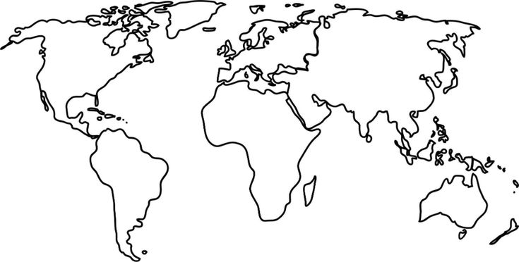
The University of Chicago visits AIGHD

Slide 3
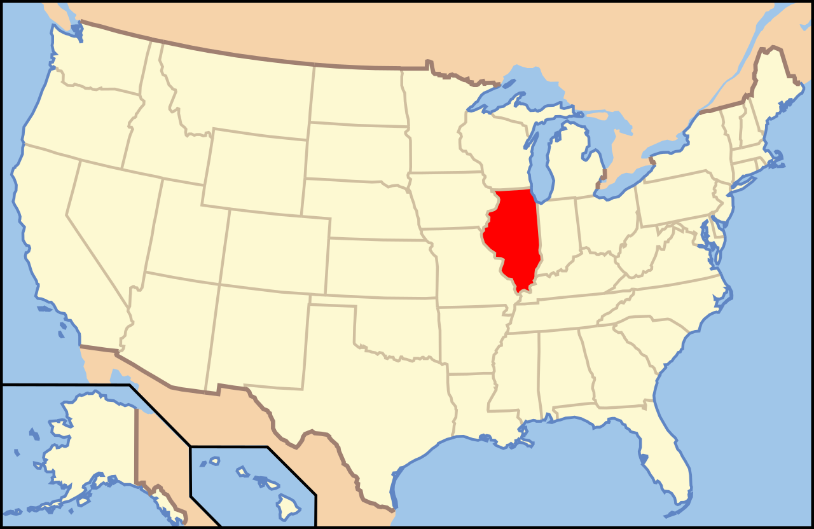

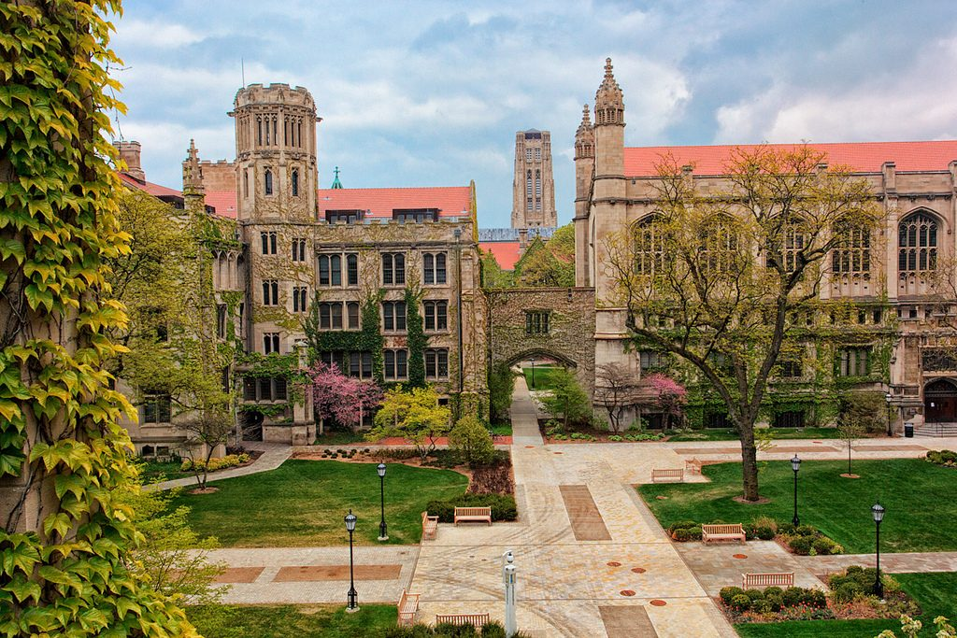
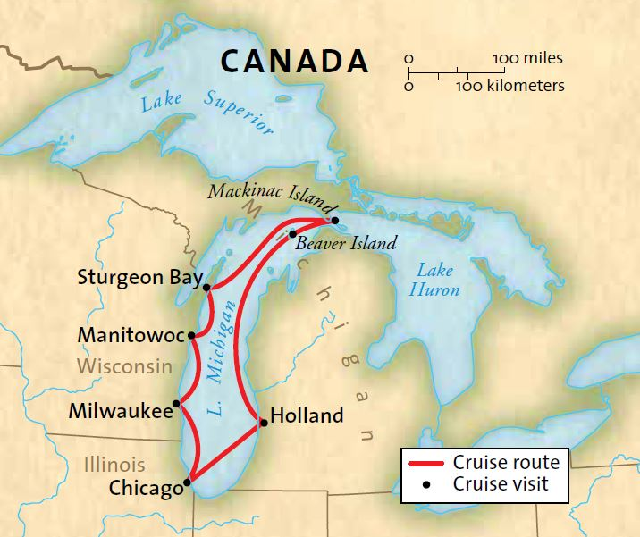
Notes:
Private research university founded in 1890
Land donation by department store magnate Marshall Field
monetary donation from oil tycoon John D. Rockefeller
Notable alumni: Oracle CEO and founder Larry Ellison, writers Philip Roth, Saul Bellow, Kurt Vonnegut, economist Milton Friedman, Astronomer Carl Sagan

Slide 4

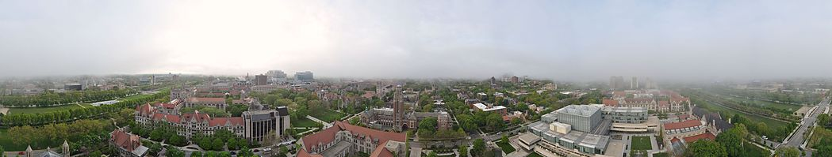
Notes:
Llaw school, business school, medical school, as well as numerous graduate research divisions, and the undergraduate college with 52 majors (courses taught by faculty in graduate research divisions and a few select scholars who teach a core undergraduate curriculum)

Slide 5


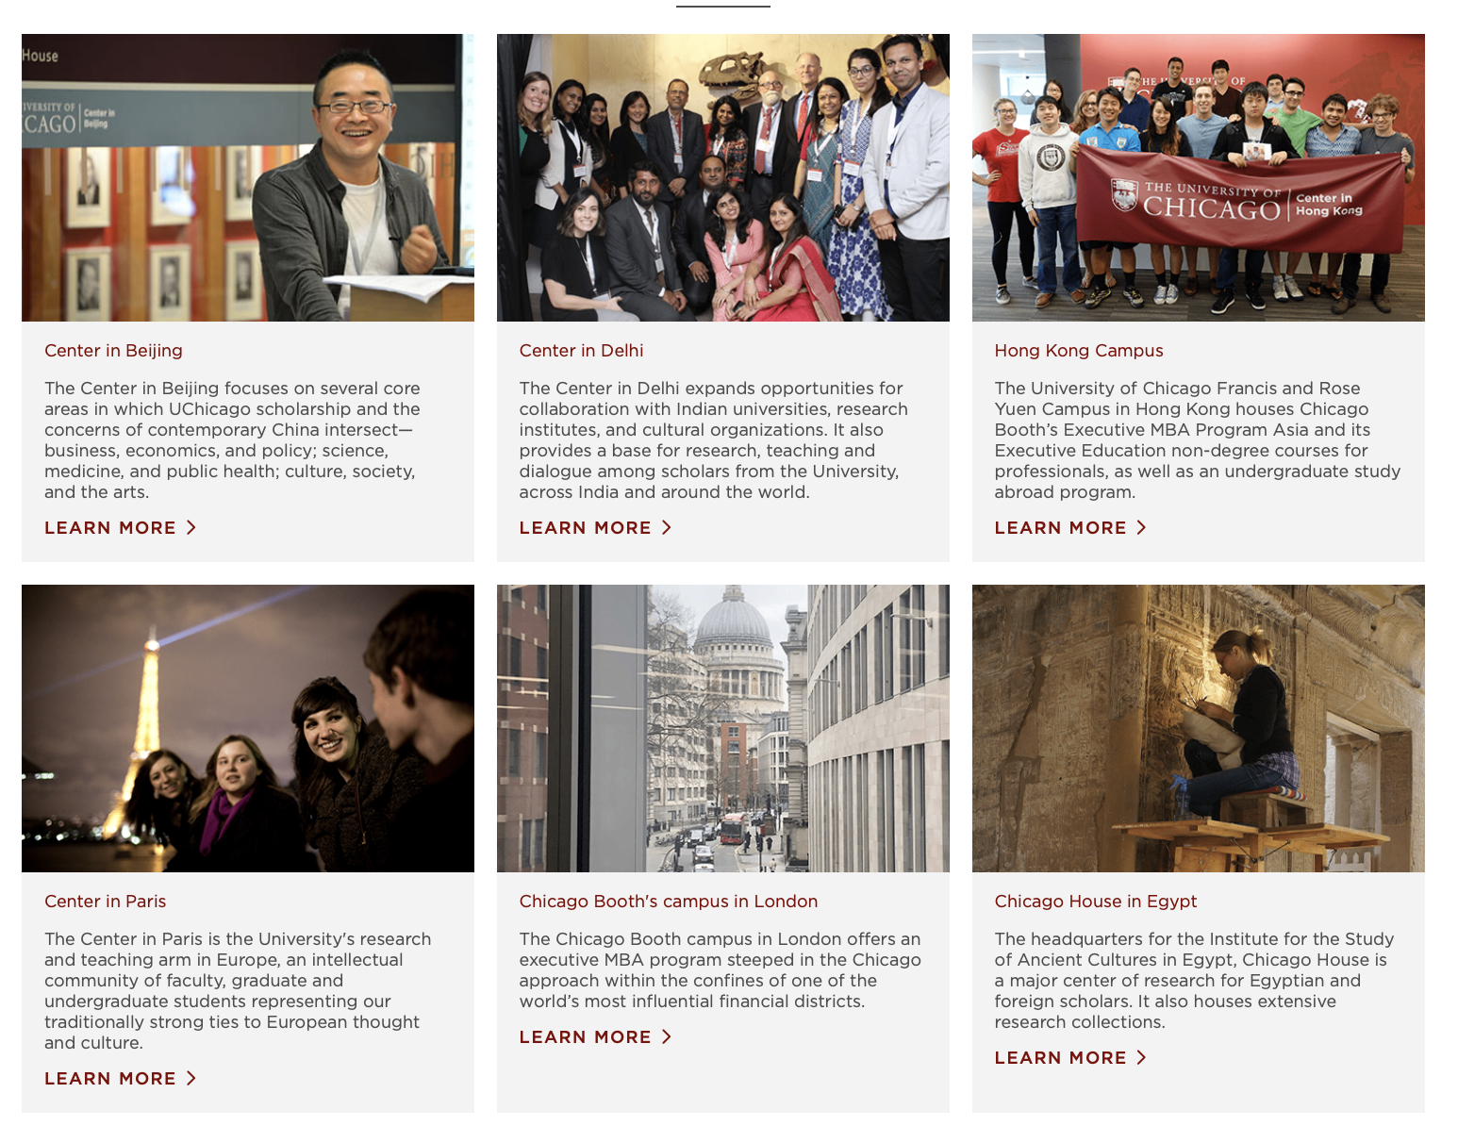

Study Abroad
6 international campuses
45 faculty-led programs
A variety of program locations and themes
Notes:
4 International campuses: Paris (flagship), Delhi, Beijing, Hong Kong.
45 faculty-led programs abroad, with the majority based out of international centers but others hosted in different locations ranging from Dakar to Mexico to Barcelona to Florence
Each program has a theme, on topics as diverse as Greek antiquity to African civilizations to Mathematics to Neurosceince to Global Health

Slide 6
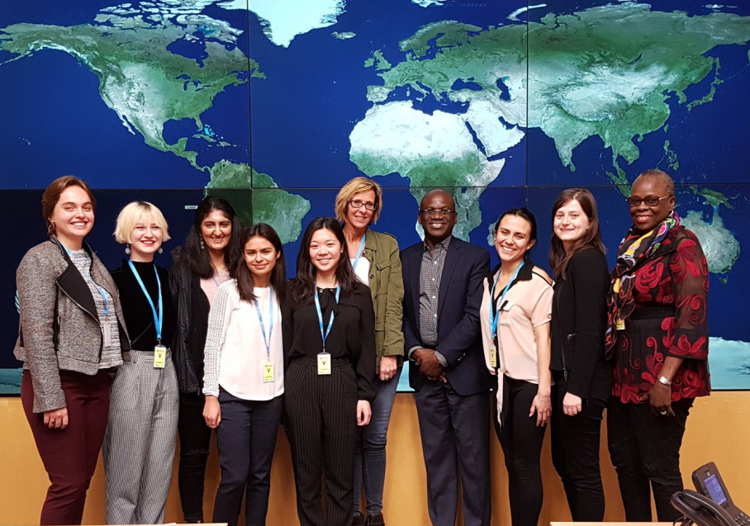
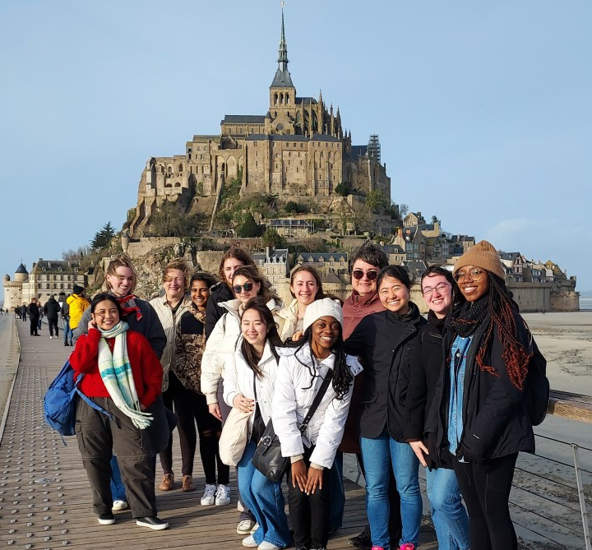

Study Abroad Program in Global Health
Based in Paris
3-Course Sequence:
Biology
Policy
Sociology
Friday excursions

Slide 7



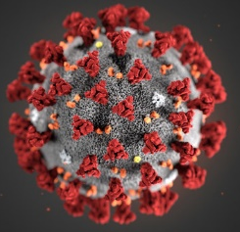
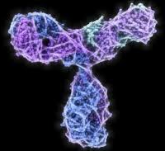
BIOS27816: Population biology of infectious diseases of global health concern
β
γ
S
Susceptible
I
Infectious
R
Recovered
β = transmission rate
γ = recovery rate

