Slide 1
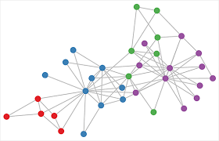

Network analysis in epidemiology/ecology
Fidisoa Rasambainarivo, DVM MSc, PhD

Slide 2
Outline
What is a network? Why use Network?
How can networks be used to study disease transmission?
What can network analysis tell us?
Basic concepts
Further analysis from a network
MRQAP
Building a network in R: Interactions between researchers at Valbio

Slide 3
Why use a network in epidemiological studies?
In epidemiology we want to understand:
Dynamics in the spreading of a disease
How do contagions spread in populations?
Will a disease become an epidemic?
Who to vaccinate?
…

Slide 4
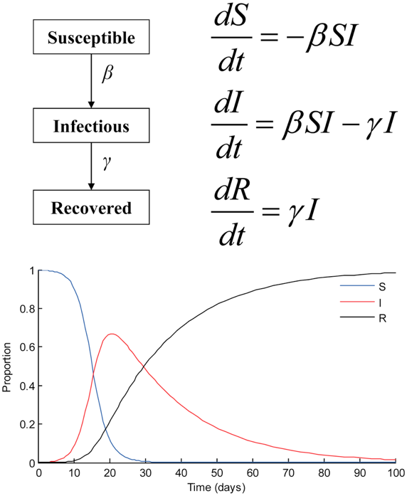
Why use a network in epidemiological studies?
Classic epidemiological models

Slide 5
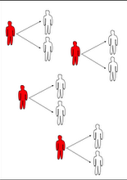
Why use a network in epidemiological studies?
Classic epidemiological models.
Calculate R0
Major assumption:
Full mixing

Slide 6
Why use a network in epidemiological studies?

Slide 7
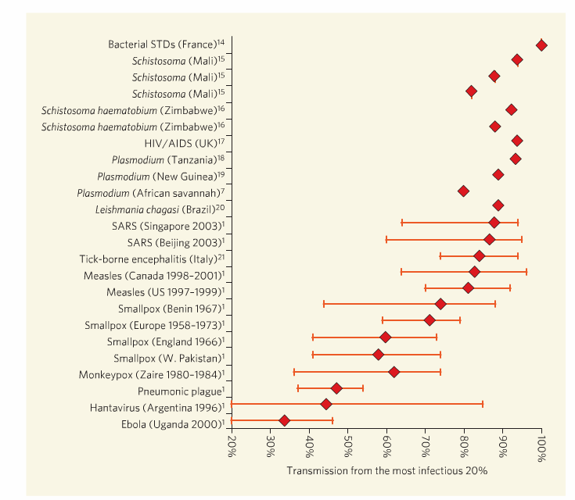
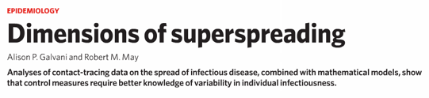
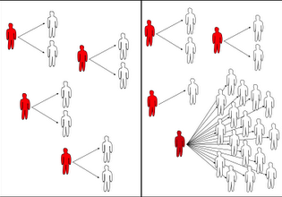
Why use a network in epidemiological studies?
In reality, heterogeneities…
Pareto principle: 20/80

Slide 8
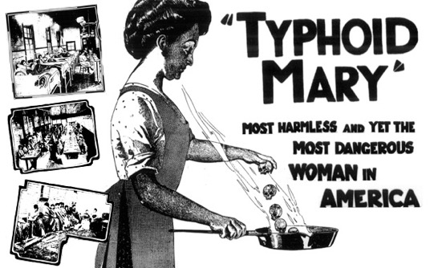
Why use a network in epidemiological studies?

Slide 9
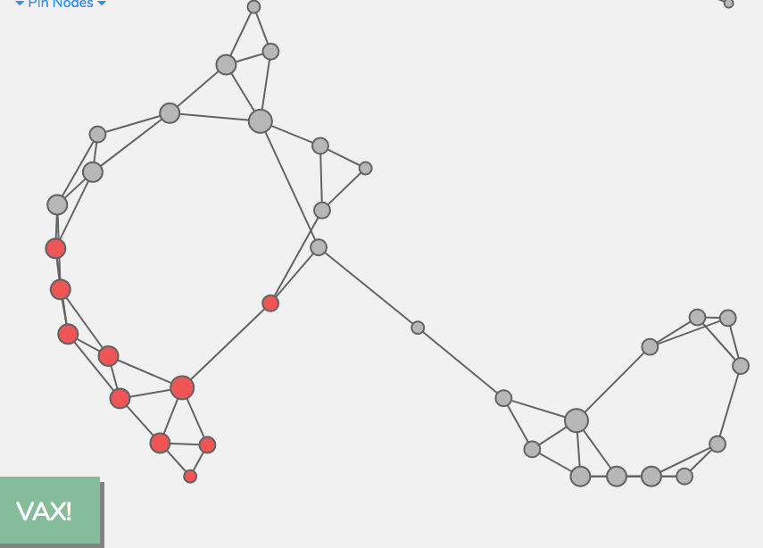
Why use a network in epidemiological studies?
Which individuals/species constitute a bridge between other individuals

Slide 10
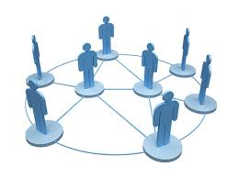

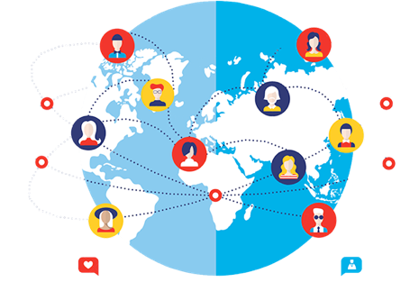
What is a network
A (social) network: social structure made up of actors that are interacting
Each actor (individual/village) is called a vertex (plural: vertices)
Ties or link between two (dyad) vertices is called an edge and may represent sharing information, photographs, resources, space, pathogen… whatever…

Slide 11
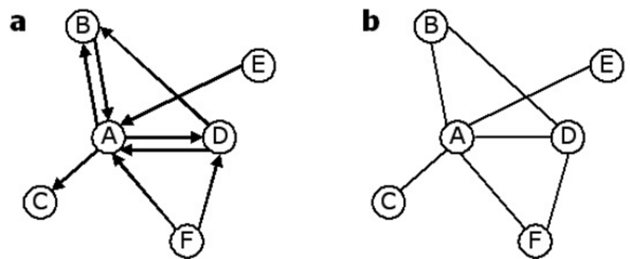
Network: basic terms and concepts
Directed, undirected,

Slide 12
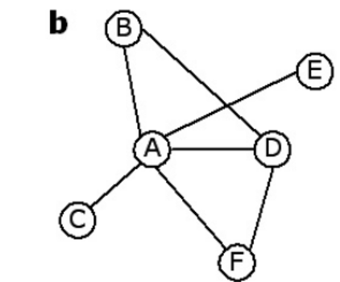
Network: basic terms and concepts
Weighted, unweighted

Slide 13
Network: basic metrics
Network density

Slide 14
Network: basic metrics
Degree (k)
Individual | Degree
A | 4
B | 2
C | 1
D | 3
E | 1
F | 2

Slide 15
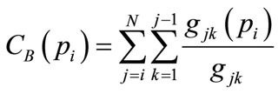
Network: basic metrics
Betweenness
Number of shortest paths that go through a node

Slide 16
To analyze and compare multiple networks…
For example, are two individuals of the same group more likely to share another characteristic?
A very simple approach to Network Analysis would be to use OLS (or, if the data were binary, to use logistic regression—or if the data were a count, to use a negative binomial, etc.)

Slide 17
To analyze and compare multiple networks…
For example, are two individuals of the same group more likely to share another characteristic?
A very simple approach to find out would be to use GLM/GLMM (or, if the data were binary, to use logistic regression—or if the data were a count, to use a negative binomial, etc.)
E.g: If two individuals both have a or both do not have a disease, we note it 1, then measure geographic distance two individuals and we could run GLM…

Slide 18
To analyze and compare multiple networks…
For example, are two individuals of the same group more likely to share another characteristic?
A very simple approach to analyze would be to use GLM/GLMM (or, if the data were binary, to use logistic regression—or if the data were a count, to use a negative binomial, etc.)
But there is a problem…

Slide 19
To analyze and compare multiple networks…
Network inherently examines relationship: Violating assumptions of independence.

Slide 20
To analyze and compare multiple networks…
Network inherently examines relationship: Violating assumptions of independence.

Slide 21
To analyze and compare multiple networks…
Network inherently examines relationship: Violating assumptions of independence.
Many statistical social network models MRQAP
ERG

Slide 22
MRQAP (Quadratic Assignment Procedure)
Multiple Regression Quadratic Assignment Procedure
Basically logistic regression analysis applied to matrix data.
Is your response variable linked to explanatory variable 1 while controlling for all other variables?

Slide 23
MRQAP (Quadratic Assignment Procedure)
Multiple Regression Quadratic Assignment Procedure
Basically logistic regression analysis applied to matrix data.
Is your response variable linked to explanatory variable 1 while controlling for all other variables?

Slide 24
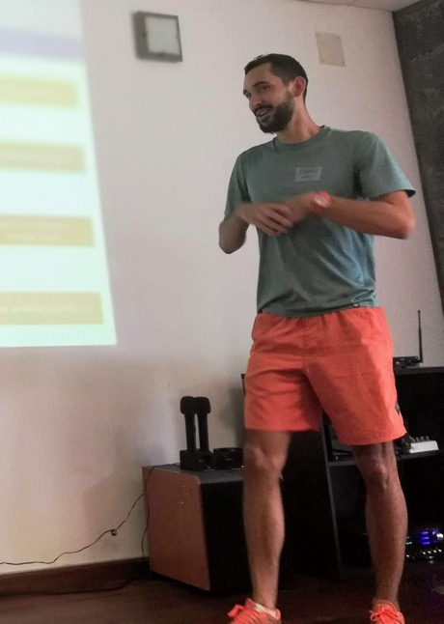
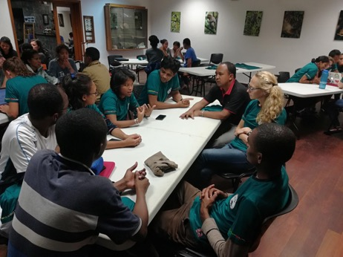
Working example:
Cases of unknown pathogen are threatening the Great Republic of E2M2 (cases detected in a nearby community). Public health officials launch a research project to evaluate the risks of spread of the disease in the community and help mitigate the risks.
Specifically:
Dr Benny Vary would like to know if there is a group of individuals in this community that have more (or less) interactions with other individuals?
Because of the apparent social structure in the community, Dr Vary is interested in knowing, are individuals of the same sex, individuals from the institution (“students”, “mentors”, “instructors”) or individuals with same sex more likely to interact with each other?
79 E2M2 citizens record whether they spent time with another individual of the Republic in the previous 3 days.

Slide 25
Now that we are Epi Network Experts, let’s play a game!
A volunteer?
You are the representative of the ministry of health of the Democratic republic of E2M2.
You are tasked to prepare for an outbreak by vaccinating individuals.
Let’s save lives!

Slide 26



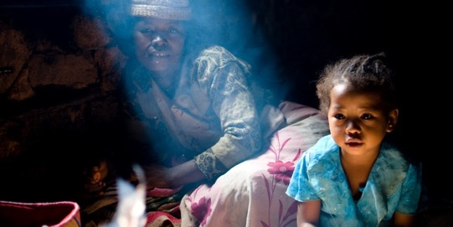
Thank you!

