Slide 1
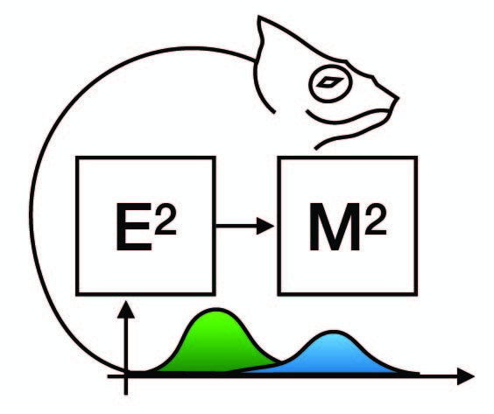
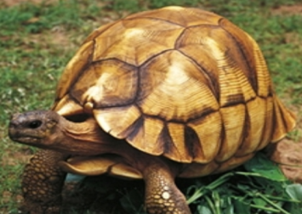

Ecological and Epidemiological Modelling in Madagascar
(E2M2 2020)
Combating ploughshare tortoises poaching in Baly Bay National Park
Liantsoa Rasoanarivo, MSc
Conservation Biologist, Durrell Wildlife Conservation Trust
Astrochelys yniphora

Slide 2
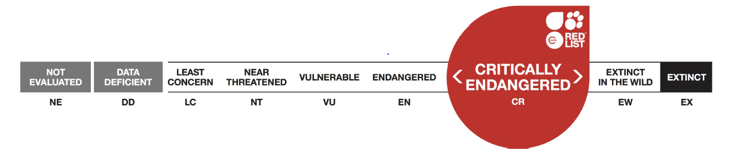
Introduction – Methods – Results – Discussion
Astrochelys yniphora, ploughshare tortoise, angonoka
Background
Classified as critically endangered (CR) into the IUCN RedList (Leuteritz et al, 2008)
Native habitat : Baly Bay National Park, Northwestern Madagascar
Habitat : bamboo scrubs
Threats : - illegal exportation and pet trade (Mandimbihasina et al, 2018)
- habitat destruction
- fire
Tortoise conservation :
tortoise captive breeding centre at Ampijoroa, Madagascar (Reid et al, 1989)
Monitoring in BBNP (Terry et al, 2016)

Slide 3
Introduction – Methods – Results – Discussion
Objectives
Evaluate the presence of anthropogenic pressures on ploughshare tortoise population
Study the viability of the ploughshare tortoise population in BBNP
Detect the presence of pathogens in wild tortoises

Slide 4
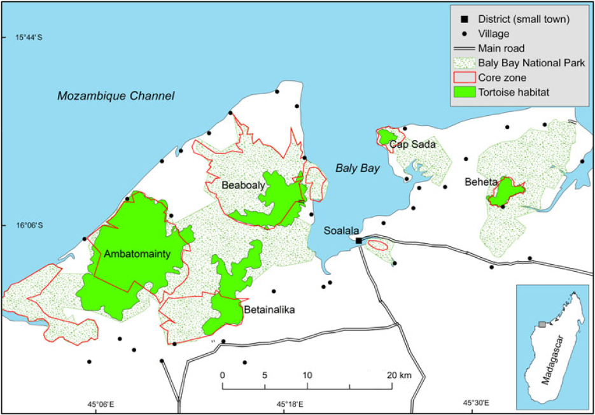
Introduction – Methods – Results – Discussion
Research site
Baly Bay National Park (BBNP) map with the boundaries of the tortoise habitat
(Mandimbihasina et al, 2018)

Slide 5




Introduction – Methods – Results – Discussion
Evaluate the presence of anthropogenic pressures on ploughshare tortoise population
Collect geolocalized data : patrol surveys in BBNP
Number of tortoises
Anthropigenic pressures : fire, traffic in the Protected Area (footprint, firewood, rubbish…)
Analyze data
Patrol data analysis : SMART tool
Statistical analysis : R and R studio
→ Model used: Generalized additive model (GAM)
Spatial analysis : qGIS

Slide 6
Introduction – Methods – Results – Discussion
2. Study the viability of the ploughshare tortoise population
Model : Leslie matrix model
b_{J}
a
T_{J}
T_{A}
µ_{J}
µ_{A}
T_{j} = juvenile tortoises
T_{j} = adult tortoises
b_{J} = birth (→ juveniles)
a = aging
µ_{J} = death rate of juveniles
µ_{A} = death rate of adults
S_{j} = juvenile survivals
S_{a} = adult survivals
b_{J} - µ_{J} = S_{J}
= S_{a} (inverse of mortality rate)
1
µ_{A}
Notes:
Ici, nous avons une MATRICE DE TYPE « LESLIE MATRIX MODEL »
C’est une matrice qui possède DEUX LIGNES ET DEUX COLONNES
Les lignes représentent les lignes représentent LA FECONDITE ET LA SURVIE DE TORTUES
Les colonnes représentent la classe des tortues, dans la première colonne on trouve les DONNEES DES TORTUES JUVENILES et dans la deuxième colonne les DONNEES DES TORTUES ADULTES
LA VALEUR PROPRE DE CETTE MATRICE représente de TAUX DE SURVIE DE LA POPULATION DES TORTUES DANS LA FORET

Slide 7
Introduction – Methods – Results – Discussion
2. Study the viability of the ploughshare tortoise population
Model : Leslie matrix model
0 S_{a}F_{a}
S_{j} S_{a}
A = Leslie transition matrix
S_{a} = adult survival rate
F_{a} = adult fecondity
(average number of babies per year)
i = multiplier to get juvenile survival from adult
A =
S_{j} = survival in juveniles
S_{j} = i * S_{a}
1 - S_{a}
F_{a} S_{a}ª
a = interbirth interval (IBI)
i =
Age of first reproduction = 15 – 20 years
Adult annual survival = 0.97
Juvenile annual survival = 0.40 – 0.96 (size dependant) (Leuteritz et al, 2008)
Notes:
Ici, nous avons une MATRICE DE TYPE « LESLIE MATRIX MODEL »
C’est une matrice qui possède DEUX LIGNES ET DEUX COLONNES
Les lignes représentent les lignes représentent LA FECONDITE ET LA SURVIE DE TORTUES
Les colonnes représentent la classe des tortues, dans la première colonne on trouve les DONNEES DES TORTUES JUVENILES et dans la deuxième colonne les DONNEES DES TORTUES ADULTES
LA VALEUR PROPRE DE CETTE MATRICE représente de TAUX DE SURVIE DE LA POPULATION DES TORTUES DANS LA FORET

Slide 8
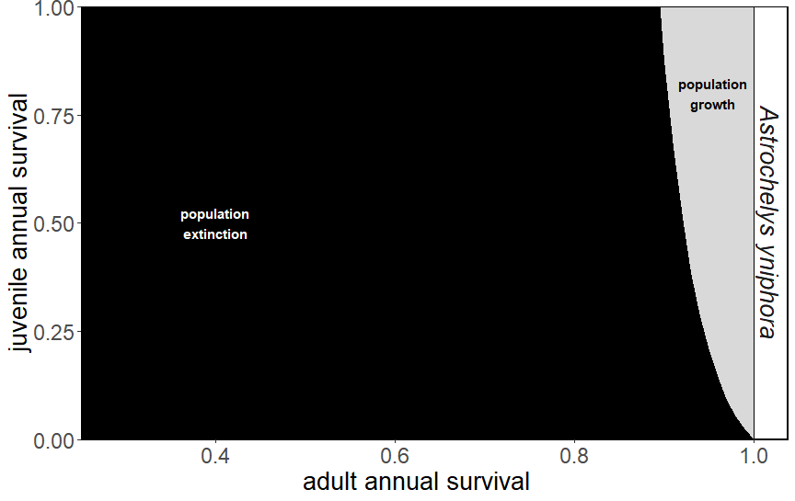
Introduction – Methods – Results – Discussion
2. Study the viability of the ploughshare tortoise population
Model : Leslie matrix model
IBI = 1
Age of first reproduction = 15 – 20 years
Adult annual survival = 0.97
F_{a} = 4.3
Juvenile annual survival = 0.40 – 0.96 (size dependant) (Leuteritz et al, 2008)
Notes:
EN NOIR : LAMDA < 1 , la population est en voie d’extinction
EN GRIS : LAMDA > 1 , la population s’accroie

Slide 9
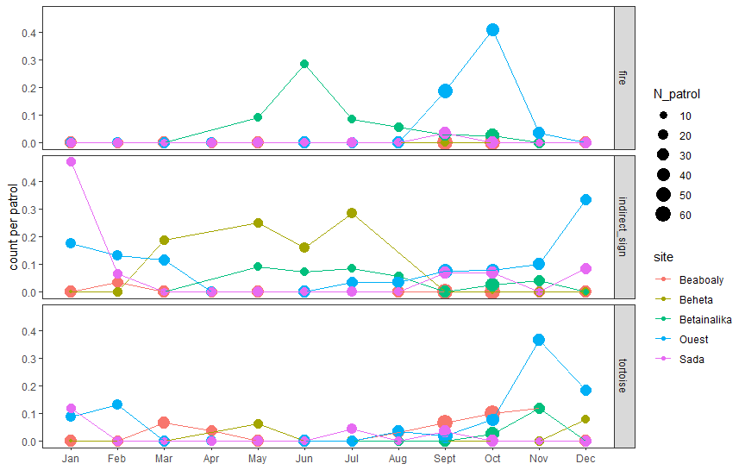
Introduction – Methods – Results – Discussion
1. Evaluation of the presence of anthropogenic pressures on ploughshare tortoise population
Patrol data collected : October 2018 – October 2019
Data observations : number of tortoises, indirect signs, fire
Notes:
Visualisation des données de patrouilles pour un an dans les sites de Baie de Baly

Slide 10
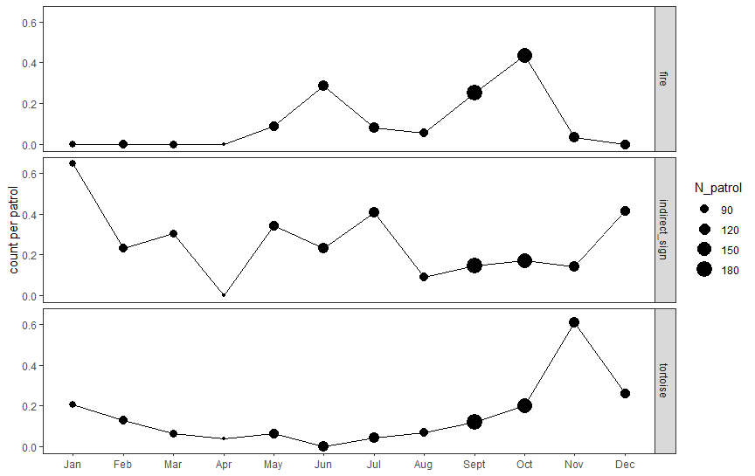
Introduction – Methods – Results – Discussion
1. Evaluation of the presence of anthropogenic pressures on ploughshare tortoise population
Data visualization
Notes:
Sans aucune analyse statistique, nous pouvons voir que les tortues sont plus observées pendant leur période d’activité

Slide 11
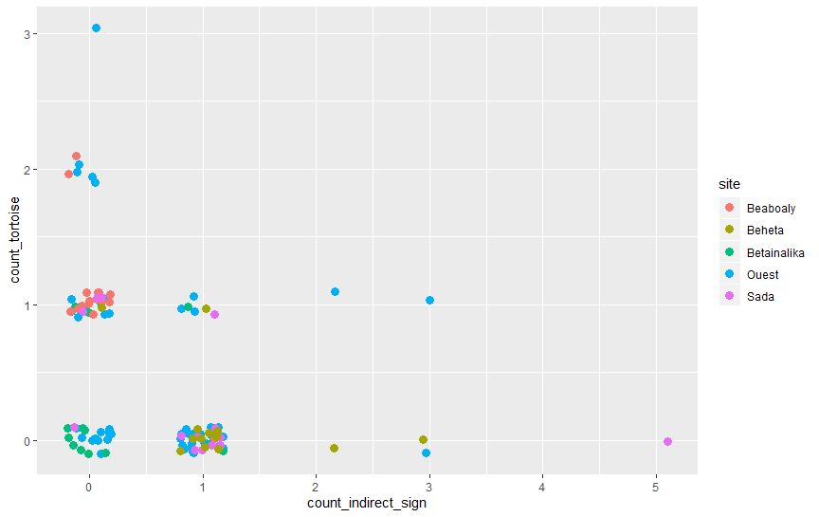
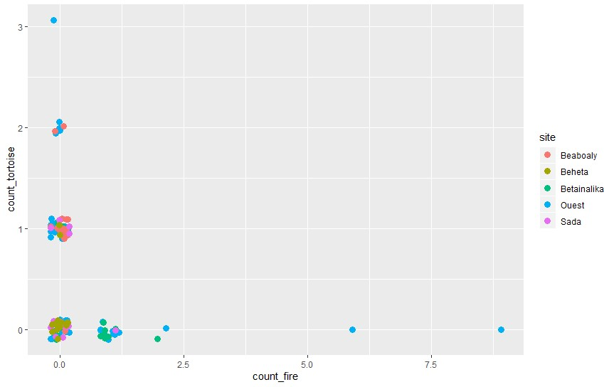
Introduction – Methods – Results – Discussion
1. Evaluation of the presence of anthropogenic pressures on ploughshare tortoise population
Data visualization
Number of tortoises = f(indirect signs)
Number of tortoises = f(fire observations)
Notes:
En voyant les points sur les graphes, il semble qu’il y a une corrélation négative entre les pressions anthropiques et l’observation des tortues dans la forêt

Slide 12
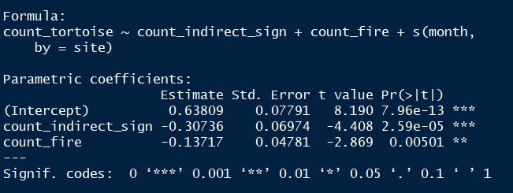
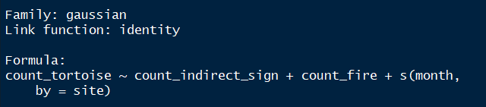
Introduction – Methods – Results – Discussion
1. Evaluation of the presence of anthropogenic pressures on ploughshare tortoise population
Statistical analysis using GAM model
Notes:
En voyant les points sur les graphes, il semble qu’il y a une corrélation négative entre les pressions anthropiques et l’observation des tortues dans la forêt

Slide 13
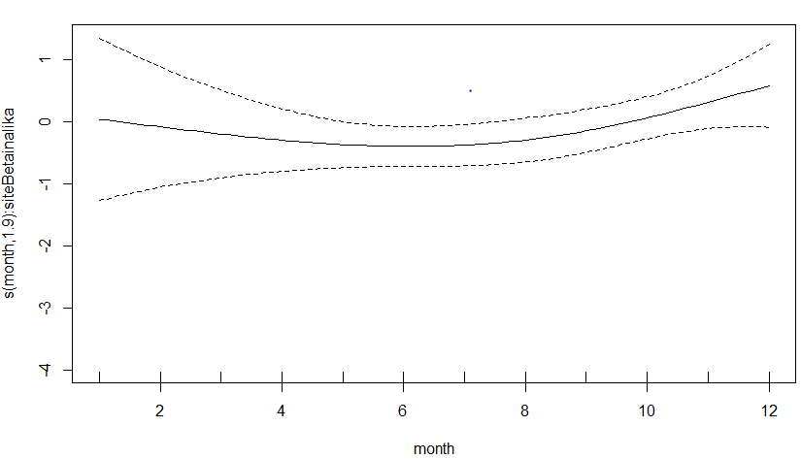
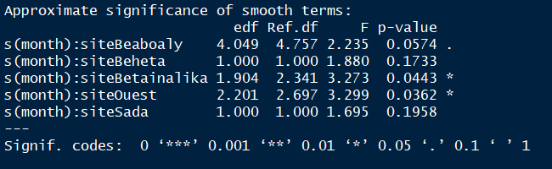
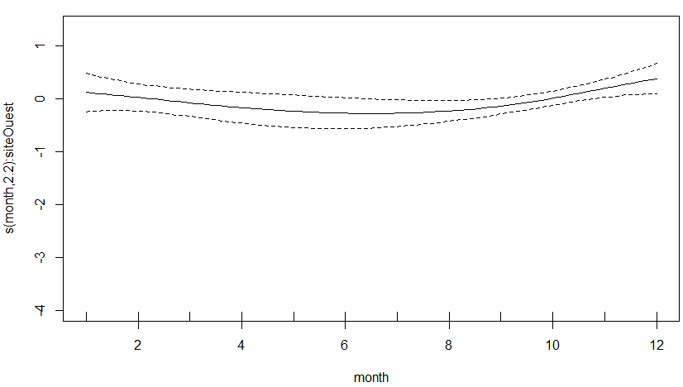
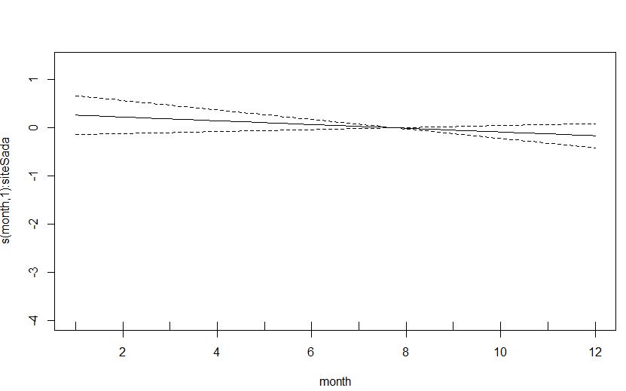
Introduction – Methods – Results – Discussion
1. Evaluation of the presence of anthropogenic pressures on ploughshare tortoise population
Statistical analysis using GAM model
Notes:
En voyant les points sur les graphes, il semble qu’il y a une corrélation négative entre les pressions anthropiques et l’observation des tortues dans la forêt

Slide 14
Introduction – Methods – Results - Discussion
Discussion
No much significant relation between tortoise observations and anthropogenic pressures
Tortoise and pressure observations in the forest follow the tortoise activity period
We have to collect more data in all sites and increase the number of patrols
Compare the use of Leslie matrix model with the study of population viability for Madagascar lemurs (Brook et al, 2018)
Next steps
Collect more data
Study the presence of anthropogenic pressures in each site in BBNP
Estimate the population size of the ploughshare tortoise species
Detect the presence of pathogens in wild tortoises
Conclusion
Poaching which is the major cause of the extinction of the ploughshare tortoise species persists in Baly Bay National Park
It seems that there is less individuals of ploughshare tortoises in the wild
We have to find suitable strategies to fight against poaching before a reintroduction of the ploughshare tortoise species in the wild

Slide 15
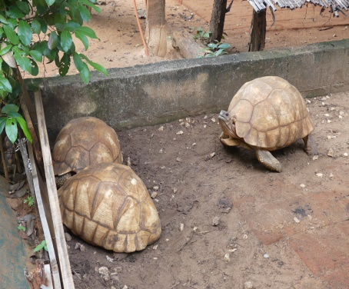
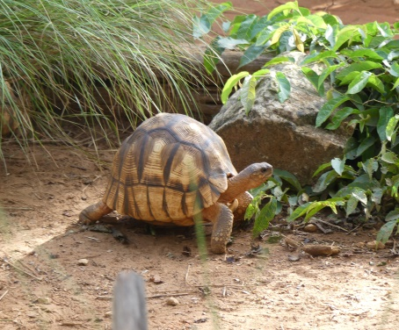

Acknowledgments
E2M2 2019 and 2020 instructors
THANK YOU!

