Slide 1
Exploring and visualizing data in R
Hafaliana Christian Ranaivoson
Virology Unit, Intitut Pasteur de Madagascar
Mention of Zoology and Animal Biodiversity
Faculty of Sciences, Univeristy of Antananarivo
Ecological and Epidemiological Modeling Madagascar
ValBio, Ranomafana
Fianarantsoa, Madagascar
10-21 January 2019

Slide 2
Exploring and visualizing data in R
R and RStudio software
Importing Data
Exploring and cleaning Data
Visualizing Data
Tutorial
Database: « e2m2_FB.csv »

Slide 3
R software ( a statistical tool)
It is free!
Powerful analysis capability
Versatile, flexible, open source
Raw data
Import
Re-import
csv,xls,xlsx
Stata.dta
SPSS.sav
Text.txt
- New data
- Results
(.Rhistory)
(.RData)
Export
R script (.R)
Overwrite
Explore
Analyze
Manipulate
Visualize
Other Software
R Software
Other Software

Slide 4
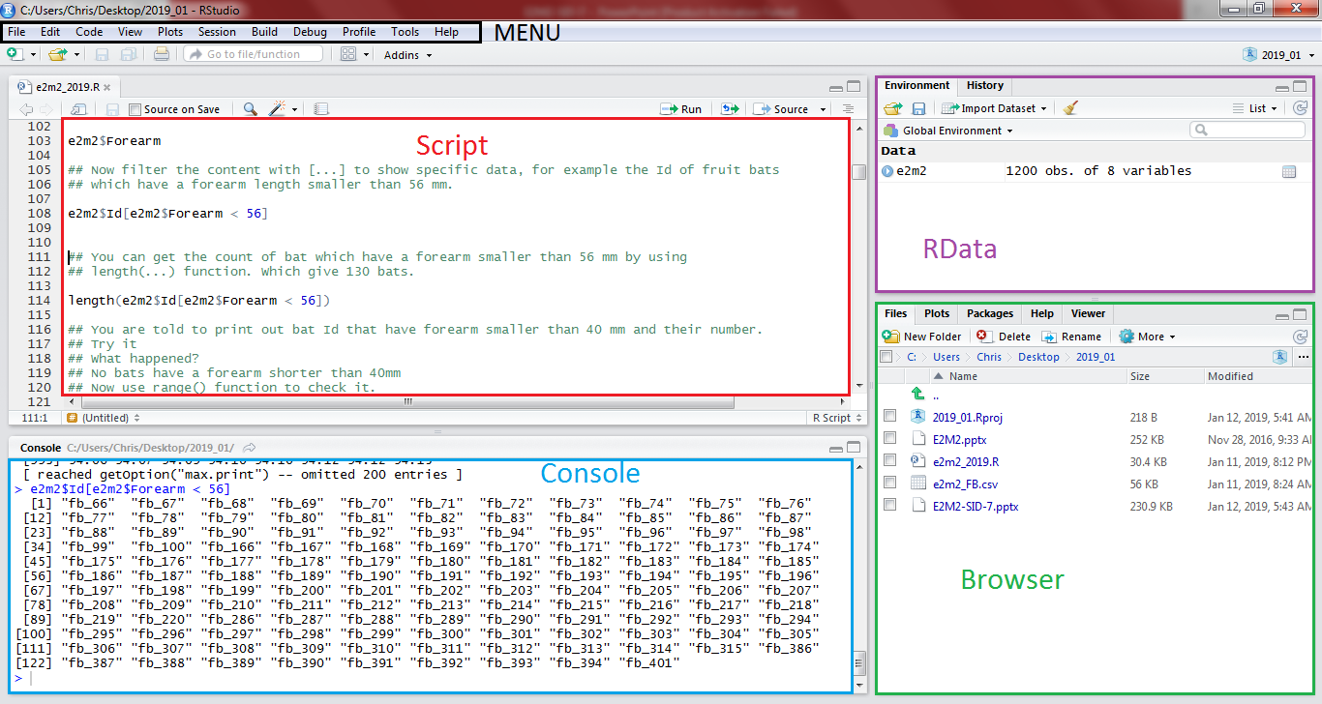
RSTUDIO
An interface for R software

Slide 5
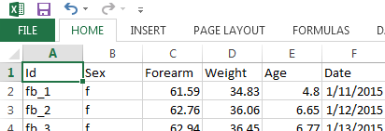
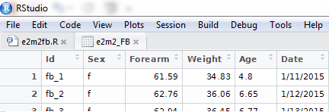
Importing Data (loading data into R environment)
Set working directory (Where to put all files?)
getwd()
setwd(“Folder path”)
?getwd
Import data (read the data source and pack it within RData)
e2m2_FB <- read.csv(“e2m2_FB.csv”, header=T, stringsAsFactors=F)
View(e2m2_FB)

Slide 6
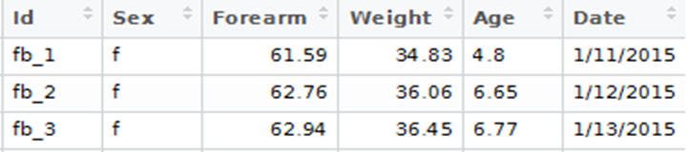
Exploring and cleaning Data (look at the dataset)
Data overview
Data frame=
e2m2_FB
Variables= Column (names)
Value= Contents
Cases= Row (length)
> dim(e2m2_FB)
[1] 100 6
How big is the data frame?
> names(e2m2_FB)
[1] "Id" "Sex" "Forearm" "Weight" "Age" "Date"
What are the variables?

Slide 7
Exploring and cleaning Data (Dive into the dataset)
Accessing dataset contents (From Outside to Inside!)
> e2m2_FB$Id
[1] "fb_1" "fb_2" "fb_3" "fb_4”
[12] "fb_12" "fb_13" "fb_14”...
[100] "fb_100"
Data frame > Variables > Contents
Dataset name $ Variable name
> e2m2_FB$Id[e2m2_FB$Forearm < 56]
[1] "fb_64" "fb_65"
Filter Contents […]
Data frame name $ Variable name [Filter]
Get the Bat Id with Weight > 75
> length(e2m2_FB$Id[e2m2_FB$Forearm < 56])
[1] 2
Get the count with length(…)

Slide 8
Exploring and cleaning Data (look at the dataset structure)
Variable types and error str(…)
> str(e2m2_FB)
$ Id : chr "fb_1" "fb_2" "fb_3" "fb_4“…
$ Sex : chr "f" "f" "f" "F" "f " ...
$ Weight : num 34.8 36.1 36.5 36.6 38.9 ...
$ Age : chr "one" "6.65" "6.77" "seven" ...
$ Date : chr "1/11/2015" "1/12/2015 "…
Categorical: Factor (n levels)
Continuous: Numeric (Range)
Time: Date (Range)
Binary: logic (T,F)
Missing Value: NA
as.factor(…)
as.Date(…) "%Y-%m-%d"
as.numeric(…)
> as.factor(e2m2_FB$Sex)
Levels: f F f m
> as.numeric(e2m2_FB$Age)
Warning message:
NAs introduced by coercion
> as.Date(e2m2_FB$Date,"%m/%d/%Y")
Needed format -> Re-format
Value error -> Correct value
Missing error -> Handle NA values

Slide 9
Exploring and cleaning Data (clean the dataset)
Correcting Values
(Wrong value <- Right Value)
> e2m2_FB$Age[e2m2$Age== “one"] <- “1" > e2m2_FB$Age[e2m2$Sex== "F"] <- "f"
> e2m2_FB$Age[e2m2$Sex== "f "] <- "f"
> as.factor(e2m2_FB$Sex)
Levels: f m
> as.numeric(e2m2_FB$Age)
[1] 4.80 6.65 6.77 7.00
Save the format to the variable
> e2m2_FB$Sex <- as.factor(e2m2_FB$Sex)
> e2m2_FB$Age <- as.numeric(e2m2_FB$Age)
> e2m2_FB$Date <- as.Date(e2m2_FB$Date,"%m/%d/%Y")
> str(e2m2_FB)
$ Id : chr "fb_1" "fb_2" "fb_3" "fb_4" ...
$ Sex : Factor w/ 2 levels "f","m": 1 1 1 1 2
$ Age : num 4.8 6.65 6.77 7 8.89 ...
$ Date : Date, format: "2015-01-11"
> e2m2_FB$NewVar <- as.factor(e2m2_FB$Sex)
> e2m2_FB$NewVar <- e2m2_FB$Forearm/2
Or create new variable

Slide 10
Visualizing Data (Play with data)
Install and Load Library
Install.packages(“…”)
Installed.packages()
> library(dplyr)
> library(ggplot2)
Data summarizing (“dplyr”)
> fb_male <-filter(e2m2_FB,Sex=="m")
> length(fb_male$Forearm)
> mean(fb_male$Forearm)
> sd(fb_male$Forearm)
Sex mean_forearm sd_forearm nbr
(fctr) (dbl) (dbl) (int)
1 f 59.6040 11.90278 60
2 m 60.9985 14.12073 40
gp_fb <- group_by(e2m2_FB,Sex)
gp_fb_stat <- summarise(gp_fb,
mean_forearm=mean(Forearm,na.rm=T),
sd_forearm=sd(Forearm,na.rm=T),
nbr=n())

Slide 11
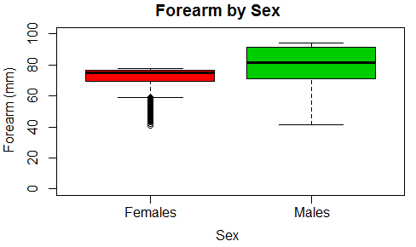
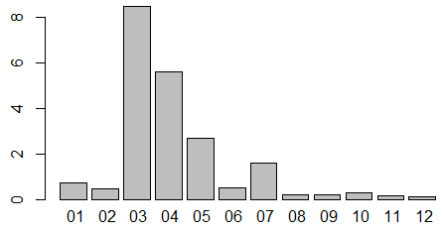
R base graphical function
Visualizing Data (Present de data)
boxplot(Forearm~Sex,
names=c("Females","Males"),
col=c(2:3),
main="Forearm by Sex",
xlab="Sex",
ylab="Forearm (mm)",
ylim=c(0,100))
PLoad <- tapply(e2m2$ParLoad,factor(format(e2m2$Date,"%m")),mean)
barplot(PLoad)

Slide 12
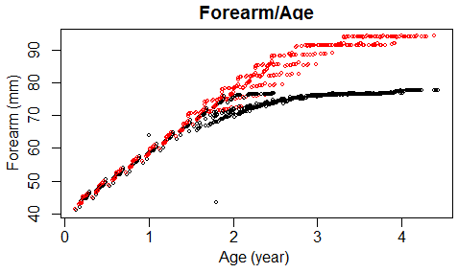
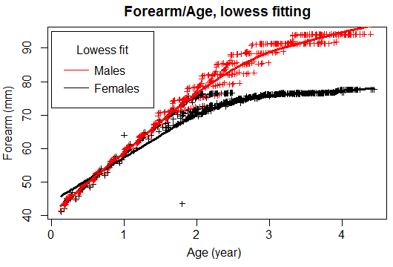
R plot() function
Visualizing Data (Present de data)
plot(Forearm~Age,main = "Forearm/Age",
ylab ="Forearm (mm)",xlab = "Age (year)",
col=Sex)
fitfem <- lowess(datfem$Forearm~datfem$Age)
fitmal <- lowess(datmal$Forearm~datmal$Age)
plot(e2m2$Forearm~e2m2$Age,
main="Forearm/Age, lowess fitting",
xlab="Age (year)",ylab="Forearm (mm)",
type="p",pch=3,cex=0.7,
col=e2m2$Sex)
lines(fitfem,col="black",lwd=3)
lines(fitmal,col="red",lwd=3)
legend(x=0, y=95,legend=c("Males","Females"),
col=c("red","black"),title="Lowess fit",
lty=1,x.intersp = .5,y.intersp = .8)

Slide 13
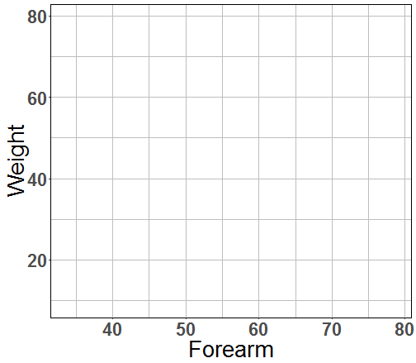

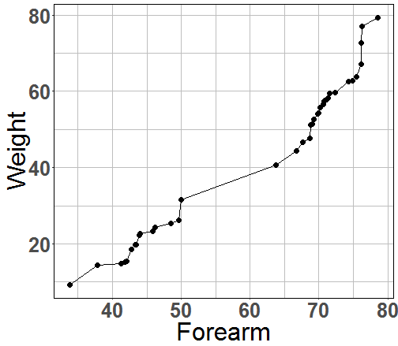
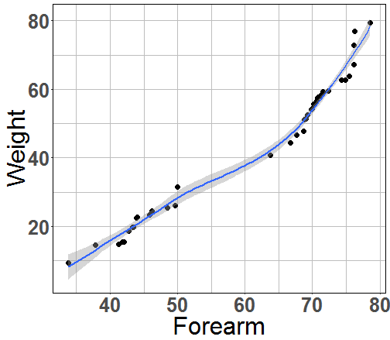
Visualizing Data (Present de data)
Data Plotting (ggplo2)
Base plot
ggplot(data,aes(x,y))
geom
geom_line()
geom_point()
geom_boxplot()
geom_bar()
+
ggplot(fb_male,aes(Forearm,Weight))
+ geom_line()
+ geom_point()
+ geom_smooth()

Slide 14
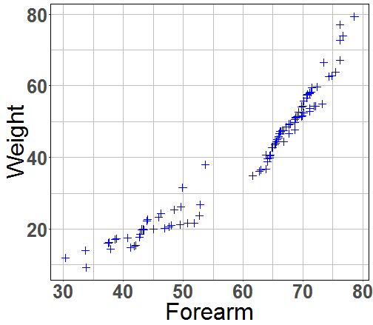
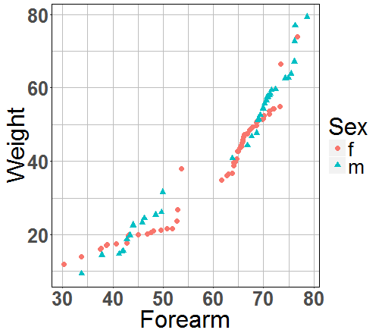
Visualizing Data (Present de data)
Mapping aesthetic vs fixed value
ggplot(e2m2_FB,aes(Forearm,Weight)) +
geom_point(color=“blue”, shape=3)
ggplot(e2m2_FB,aes(Forearm,Weight)) +
geom_point(aes(color=Sex, shape=Sex))

Slide 15
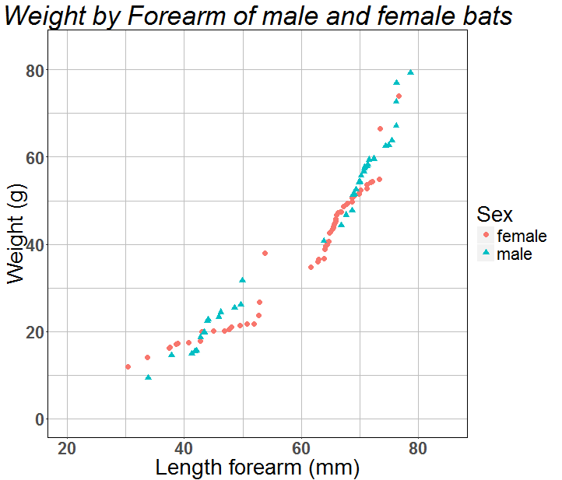
Visualizing Data (Present de data)
Polish the plot
ggtitle("Weight by Forearm of male and female")+
scale_x_continuous(name="Length forearm (mm)",
limits=c(20,85))+
scale_y_continuous(name="Weight (g)",
limits=c(0,85))+
scale_color_discrete(name="Sex",
breaks=c("f","m"),
label=c("female","male"))+
scale_shape_discrete(name="Sex",
breaks=c("f","m"),
label=c("female","male"))

Slide 16
Conclusion
R software:
Powerful data management
Simple syntax
Large graphic vocabularies
Packages to fit needs

