Slide 1
Writing For Loops, If-Else Statements, and Functions in R
Institut Pasteur de Madagascar
January 2020
E²M²: Ecological and Epidemiological Modeling in Madagascar

Slide 2
The Power of Programming
So far, much of what we saw demonstrates how to use R like an extremely smart calculator.
We write commands and it executes them.

Slide 3
The Power of Programming
So far, much of what we saw demonstrates how to use R like an extremely smart calculator.
The true power of the program comes from allowing R to query large datasets and make decisions for you.

Slide 4
The Power of Programming
So far, much of what we saw demonstrates how to use R like an extremely smart calculator.
The true power of the program comes from allowing R to query large datasets and make decisions for you.
Three key programming tools are helpful:
If-else statements
For-loops
Functions

Slide 5
The Power of Programming
So far, much of we learned demonstrates how to use R like an extremely smart calculator.
The true power of the program comes from allowing R to query large datasets and make decisions for you.
Three key programming tools are helpful:
If-else and ifelse statements
For-loops
Allow you to control the flow of our programming and cause different things to happen depending on the value of tests
3. Functions

Slide 6
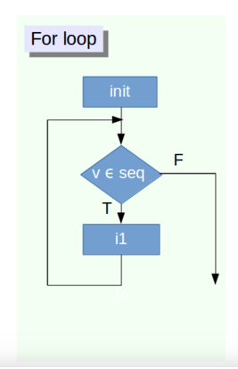
For-Loops
for (variable in vector)
{ do something }
For (i in 1:10) {print i}

Slide 7
For-loops
“Looping”, “cycling”, “iterating” is nothing more than automating a multi-step process by organizing sequences of actions or ‘batch’ processes and by grouping the parts that need to be repeated.
For loops execute for a prescribed number of times, as controlled by a counter or an index, incremented at each iteration cycle.

Slide 8
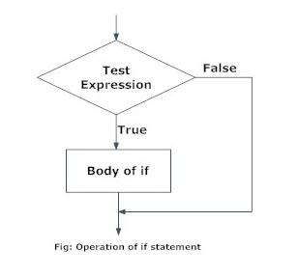
If Statements
If condition is TRUE, then perform some action; otherwise do not perform that action.
if (condition is TRUE)
{ do something }

Slide 9
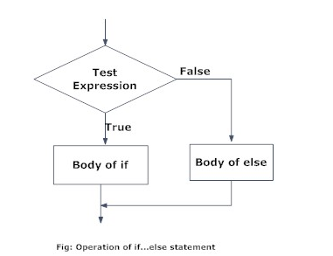
If-Else Statements
If condition is TRUE, then perform some action; otherwise do not perform that action.
if (condition is TRUE)
{ do something }
else { do different thing }

Slide 10
If-Else Statements
If condition is TRUE, then perform some action; otherwise do not perform that action.
if (condition is TRUE)
{ do something } else
{ do different thing }
It is important to note that else must be in the same line as the closing braces of the if statement.

Slide 11
Functions
A function is a piece of code written to carry out a specified task;
mean(x), sum(x),….rep(x,y)
Lots of pre-written functions organized in multitude of packages.
If you can not find a function in R to do what you need, you can write your own function

Slide 12
Functions
Avoid writing repetitive lines of codes:
Reduce workload
Help avoid errors
Make it easy to reuse and share task for different data sets/ users

Slide 13
Functions
function_name <- function(arguments) {
body }
where the code in between the curly braces is the body of the function.

Slide 14
Functions
Things to consider:
Function allows you to define exactly what you want to do
Name your user defined function.
Make sure that the name that you choose for the function is not an R reserved word. This means that you, for example, don’t want to pick the name of an existing function for your own UDF.

Slide 15
Let’s try it out in R
Open: “ForLoops_FunctionsWorkingScript.R”

