Slide 1
Writing For Loops, If-Else Statements, and Functions in R
Institut Pasteur de Madagascar
January 2020
E²M²: Ecological and Epidemiological Modeling in Madagascar

Slide 2
The Power of Programming
So far, much of what we saw demonstrates how to use R like an extremely smart calculator.
We write commands and it executes them.

Slide 3
The Power of Programming
So far, much of what we saw demonstrates how to use R like an extremely smart calculator.
The true power of the program comes from allowing R to query large datasets and make decisions for you.

Slide 4
The Power of Programming
So far, much of what we saw demonstrates how to use R like an extremely smart calculator.
The true power of the program comes from allowing R to query large datasets and make decisions for you.
Three key programming tools are helpful:
If-else statements
For-loops
Functions

Slide 5
The Power of Programming
So far, much of we learned demonstrates how to use R like an extremely smart calculator.
The true power of the program comes from allowing R to query large datasets and make decisions for you.
Three key programming tools are helpful:
If-else and ifelse statements
For-loops
Allow you to control the flow of our programming and cause different things to happen depending on the value of tests
3. Functions

Slide 6
For-loops
“Looping”, “cycling”, “iterating” is nothing more than automating a multi-step process by organizing sequences of actions or ‘batch’ processes and by grouping the parts that need to be repeated.
For loops execute for a prescribed number of times, as controlled by a counter or an index, incremented at each iteration cycle.

Slide 7
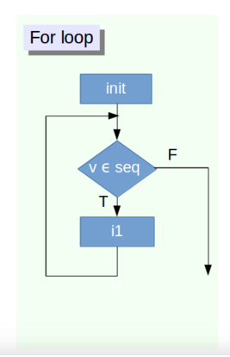
For-Loops
for (variable in vector)
{ do something }

Slide 8
for (i in 1:20) {
print(paste("I am student",i))
}

Slide 9
Tells the loop how many times to run
for (i in 1:20) {
print(paste("I am student",i))
}

Slide 10
Tells the loop how many times to run
for (i in 1:20) {
print(paste("I am student",i))
}
Function to be run i times

Slide 11
for (i in 1:20) {
print(paste("I am student",i))
}
The print command is very important.
Without it the functions will only run internal to the loop

Slide 12
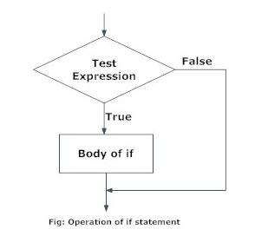
If Statements
If condition is TRUE, then perform some action; otherwise do not perform that action.
if (condition is TRUE)
{ do something }

Slide 13
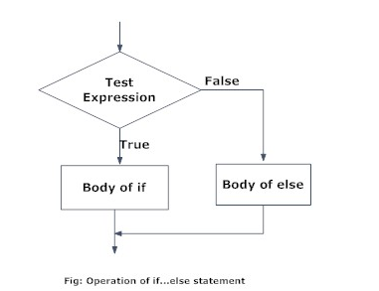
If-Else Statements
If condition is TRUE, then perform some action; otherwise do not perform that action.
if (condition is TRUE)
{ do something }
else { do different thing }

Slide 14
If-Else Statements
If condition is TRUE, then perform some action; otherwise do not perform that action.
if (condition is TRUE)
{ do something } else
{ do different thing }
It is important to note that else must be in the same line as the closing braces of the if statement.

Slide 15
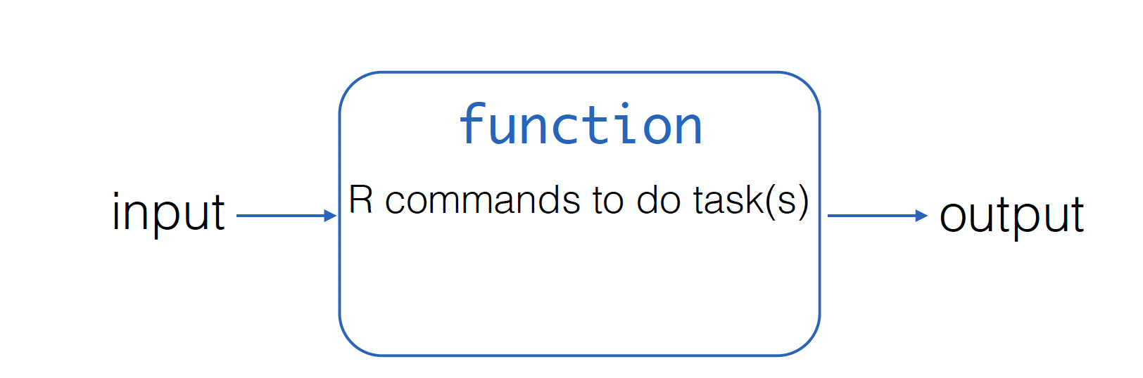
Functions
A function is a piece of code written to carry out a specified task;
mean(x), sum(x),….rep(x,y)
Lots of pre-written functions organized in multitude of packages.
If you can not find a function in R to do what you need, you can write your own function

Slide 16
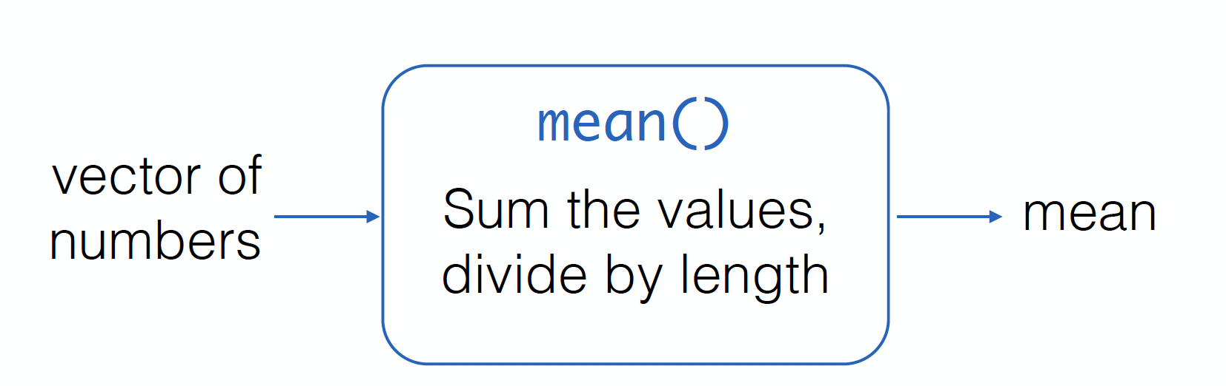
Functions
A function is a piece of code written to carry out a specified task;
mean(x), sum(x),….rep(x,y)
Lots of pre-written functions organized in multitude of packages.
If you can not find a function in R to do what you need, you can write your own function

Slide 17
Functions
A function is a piece of code written to carry out a specified task;
mean(x), sum(x),….rep(x,y)
Lots of pre-written functions organized in multitude of packages.
If you can not find a function in R to do what you need, you can write your own function

Slide 18
Why write functions?
Any time you find yourself wanting to do the same thing many times
Editing data
Repeating similar analyses on different variables
Creating a similar graph from different variables
Running simulations
Lots of other reasons I’m sure…

Slide 19
Functions
function_name <- function(argument1, argument2) {
command
return(output)}
where the code in between the curly braces is the body of the function.

Slide 20
Functions
Things to consider:
Function allows you to define exactly what you want to do
Name your User Defined Function.
Make sure that the name that you choose for the function is not an R reserved word. This means that you, for example, don’t want to pick the name of an existing function for your own UDF.

Slide 21
Start with a very simple version of what you want to accomplish and build from there
You want to make sure each little piece works before you invest the time to create a complex thing:
Remember: you can always try to run any line of code you are confused about!

Slide 22
We want to simulate a coin toss
We want to simulate a coin toss and find the probability of having exactly x tails when we run 5,000 replicates of n tosses.

Slide 23
coin<-function(n){
Tail<-rbinom(n,1,.5)
numTail<-sum(Tail)
return(numTail)
}

Slide 24
coin<-function(n){
conduct n toss trials with a 50% prob. of getting tail
Tail<-rbinom(n,1,.5)
numTail<-sum(Tail)
return(numTail)
}

Slide 25
coin<-function(n){
conduct n toss trials with a 50% prob. of getting tail
Tail<-rbinom(n,1,.5)
count number of Tails
numTail<-sum(Tail)
return(numTail)
}

Slide 26
coin<-function(n){
conduct n toss trials with a 50% prob. of getting tail
Tail<-rbinom(n,1,.5)
count number of Tails
numTail<-sum(Tail)
return(numTail)
}
return() determines what the product of the function is

Slide 27
coin<-function(n){
conduct n toss trials with a 50% prob. of getting tail
Tail<-rbinom(n,1,.5)
count number of Tails
numTail<-sum(Tail)
return(numTail)
}
Help me add flexibility to this by allowing me to change the probability of getting tails

Slide 28
coin<-function(n){
conduct n toss trials with a 50% prob. of getting tail
Tail<-rbinom(n,1,.5)
count number of Tails
numTail<-sum(Tail)
return(numTail)
}
Help me add flexibility to this by allowing me to change the probability of getting tails

Slide 29
Take home messages
Start small and build up
Work out the kinks bit by bit before investing too much time into writing a big function
Things that can look very complex at first can be broken down into small parts, which makes them less threatening
Writing functions and simulations is not that hard, you have all the tools already!

Slide 30
Take home messages
Start small and build up
Work out the kinks bit by bit before investing too much time into writing a big function
Things that can look very complex at first can be broken down into small parts, which makes them less threatening
Writing functions and simulations is not that hard, you have all the tools already!

Slide 31
Take home messages
Start small and build up
Work out the kinks bit by bit before investing too much time into writing a big function

Slide 32
Take home messages
Start small and build up
Work out the kinks bit by bit before investing too much time into writing a big function
Things that can look very complex at first can be broken down into small parts, which makes them less threatening

Slide 33
Take home messages
Start small and build up
Work out the kinks bit by bit before investing too much time into writing a big function
Things that can look very complex at first can be broken down into small parts, which makes them less threatening
Writing functions and simulations is not that hard, you have all the tools already!

