Slide 1
Data cleaning and visualization with R
Ecological and Epidemiological Modeling Madagascar (E2M2)
Institut Pasteur de Madagascar, Antananarivo, Madagascar
ValBio, Ranomafana, Fianarantsoa, Madagascar
09-17 Décembre 2022
Hafaliana Christian Ranaivoson, PhD
Ecology and Evolution
University of Chicago, Illinois, USA
Laboratoire de Biologie des Populations Parasitaires
Mention of Zoology and Animal Biodiversity
Faculty of Sciences, University of Antananarivo

Slide 2
Cleaning and visualizing data in R
R and RStudio softwares
Importing data
Exploring and cleaning data
Visualizing data
Tutorial
Database: « e2m2_FB.csv »

Slide 3
R software ( a statistical tool)
It is free!
Powerful analysis capability
Versatile, flexible, open source
Raw data
Import
Re-import
csv,xls,xlsx
Stata.dta
SPSS.sav
Text.txt
- New data
- Results
(.Rhistory)
(.RData)
Export
R script (.R)
Overwrite
Explore
Analyze
Manipulate
Visualize
Other Software
R Software
Other Software

Slide 4
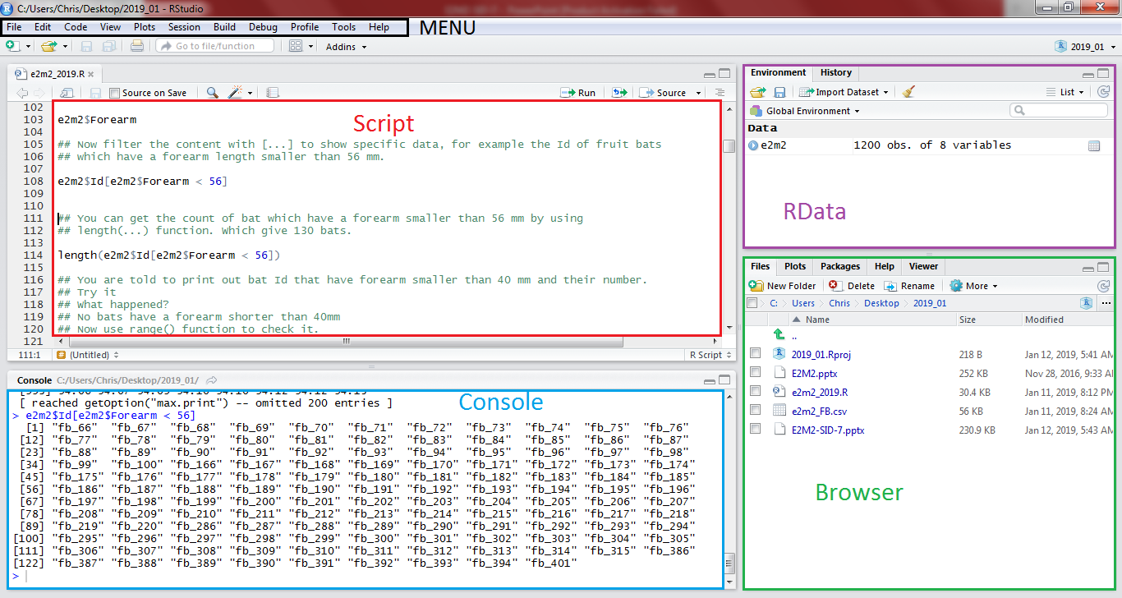
RSTUDIO
An interface for R software

Slide 5
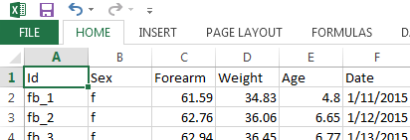
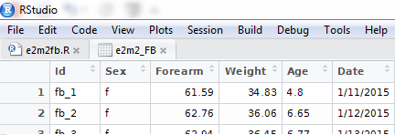
Importing Data (loading data into R environment)
Set working directory (Where to put all files?)
getwd()
setwd(“Folder path”)
?getwd
Import data (read the data source and load it into RData)
e2m2_FB <- read.csv(“e2m2_FB.csv”, header=T, stringsAsFactors=F)
View(e2m2_FB)

Slide 6
Exploring and cleaning Data (look at the dataset)
Data cleaning steps
Raw Data
Formatted
data
Usable
data
Initial data
Technically correct
Consistent

Slide 7
Exploring and cleaning Data (look at the dataset)
Consistent data
Give a sense to your data
Important step for good data interpretation
Need a good comprehension of each variables
Should be reproductible
Extreme values will affect the outcome
Make a consistent link between each variable
No cheating
Cleaning is not inventing

Slide 8
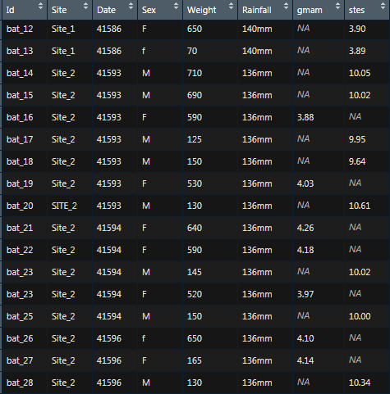
Exploring and cleaning Data (look at the dataset)
Consistent data
What is wrong with this data?

Slide 9
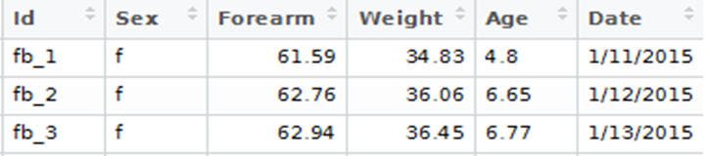
Exploring and cleaning Data (look at the dataset)
Data overview
Data frame=
e2m2_FB
Variables= Column (names)
Value= Contents
Cases = Row (length)
> dim(e2m2_FB)
[1] 100 6
How big is the data frame?
> names(e2m2_FB)
[1] "Id" "Sex" "Forearm" "Weight" "Age" "Date"
What are the variables?

Slide 10
Exploring and cleaning Data (look at the dataset)
Accessing dataset contents (From Outside to Inside!)
> e2m2_FB$Id
[1] "fb_1" "fb_2" "fb_3" "fb_4”
[12] "fb_12" "fb_13" "fb_14”...
[100] "fb_100"
Data frame > Variables > Contents
Dataset name $ Variable name
> e2m2_FB$Id[e2m2_FB$Forearm < 56]
[1] "fb_64" "fb_65"
Filter Contents […]
Data frame name $ Variable name [Filter]
Get the Bat Id with Weight > 75
> length(e2m2_FB$Id[e2m2_FB$Forearm < 56])
[1] 2
Get the count with length(…)

Slide 11
Exploring and cleaning Data (look at the dataset)
Variable types and error str(…)
> str(e2m2_FB)
$ Id : chr "fb_1" "fb_2" "fb_3" "fb_4“…
$ Sex : chr "f" "f" "f" "F" "f " ...
$ Weight : num 34.8 36.1 36.5 36.6 38.9 ...
$ Age : chr "one" "6.65" "6.77" "seven" ...
$ Date : chr "1/11/2015" "1/12/2015 "…
Categorical: Factor (n levels)
Continuous: Numeric (Range)
Time: Date (Range)
Binary: logic (T,F)
Missing Value: NA
as.factor(…)
as.Date(…) "%Y-%m-%d"
as.numeric(…)
> as.factor(e2m2_FB$Sex)
Levels: f F f m
> as.numeric(e2m2_FB$Age)
Warning message:
NAs introduced by coercion
> as.Date(e2m2_FB$Date,"%m/%d/%Y")
Needed format -> Re-format
Value error -> Correct value
Missing error -> Handle NA values

Slide 12
Exploring and cleaning Data (look at the dataset)
Correcting Values
(Wrong value ← Right Value)
> e2m2_FB$Age[e2m2$Age== “one"] <- “1" > e2m2_FB$Sex[e2m2$Sex== "F"] <- "f"
> e2m2_FB$Sex[e2m2$Sex== "f "] <- "f"
> as.factor(e2m2_FB$Sex)
Levels: f m
> as.numeric(e2m2_FB$Age)
[1] 4.80 6.65 6.77 7.00
Save the format to the variable
> e2m2_FB$Sex <- as.factor(e2m2_FB$Sex)
> e2m2_FB$Age <- as.numeric(e2m2_FB$Age)
> e2m2_FB$Date <- as.Date(e2m2_FB$Date,"%m/%d/%Y")
> str(e2m2_FB)
$ Id : chr "fb_1" "fb_2" "fb_3" "fb_4" ...
$ Sex : Factor w/ 2 levels "f","m": 1 1 1 1 2
$ Age : num 4.8 6.65 6.77 7 8.89 ...
$ Date : Date, format: "2015-01-11"
> e2m2_FB$NewVar <- as.factor(e2m2_FB$Sex)
> e2m2_FB$NewVar <- e2m2_FB$Forearm/2
Or create new variable

Slide 13
Visualizing Data (Play with data)
Install and Load Library
Install.packages(“…”)
Installed.packages()
> library(dplyr)
> require(ggplot2)
Data summarizing (“dplyr”)
> fb_male <-filter(e2m2_FB,Sex=="m")
> range(fb_male$Forearm)
> mean(fb_male$Forearm)
> sd(fb_male$Forearm)
Sex mean_forearm sd_forearm nbr
(fctr) (dbl) (dbl) (int)
1 f 59.6040 11.90278 60
2 m 60.9985 14.12073 40
gp_fb <- group_by(e2m2_FB,Sex)
gp_fb_stat <- summarise(gp_fb,
mean_forearm=mean(Forearm,na.rm=T),
sd_forearm=sd(Forearm,na.rm=T),
nbr=n())

Slide 14
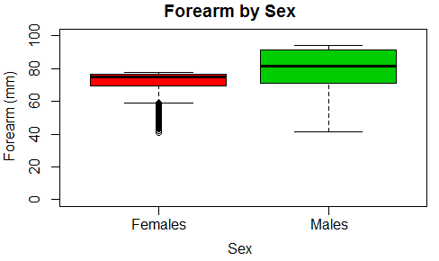
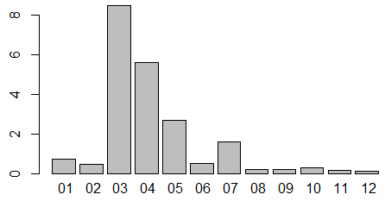
R base graphical function
Visualizing Data (Play with data)
boxplot(Forearm~Sex,
names=c("Females","Males"),
col=c(2:3),
main="Forearm by Sex",
xlab="Sex",
ylab="Forearm (mm)",
ylim=c(0,100))
PLoad <- tapply(e2m2$ParLoad,factor(format(e2m2$Date,"%m")),mean)
barplot(PLoad)

Slide 15
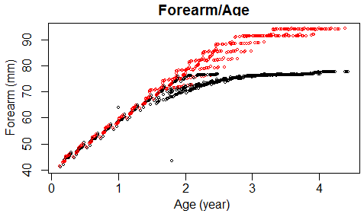
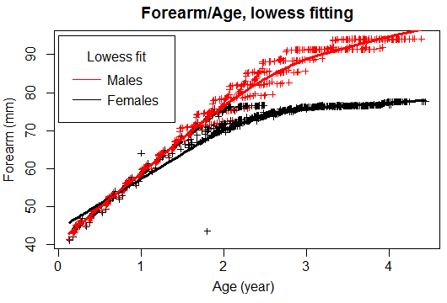
R plot() function
Visualizing Data (Present de data)
plot(e2m2$ Forearm~ e2m2$Age,
main = "Forearm/Age",
ylab ="Forearm (mm)", xlab = "Age (year)",
col=Sex)
fitfem <- lowess(datfem$Forearm~datfem$Age)
fitmal <- lowess(datmal$Forearm~datmal$Age)
plot(e2m2$Forearm~e2m2$Age,
main="Forearm/Age, lowess fitting",
xlab="Age (year)",ylab="Forearm (mm)",
type="p",pch=3,cex=0.7,
col=e2m2$Sex)
lines(fitfem,col="black",lwd=3)
lines(fitmal,col="red",lwd=3)
legend(x=0, y=95,legend=c("Males","Females"),
col=c("red","black"),title="Lowess fit",
lty=1,x.intersp = .5,y.intersp = .8)

Slide 16
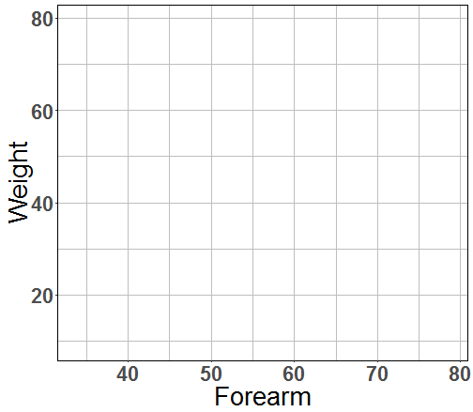

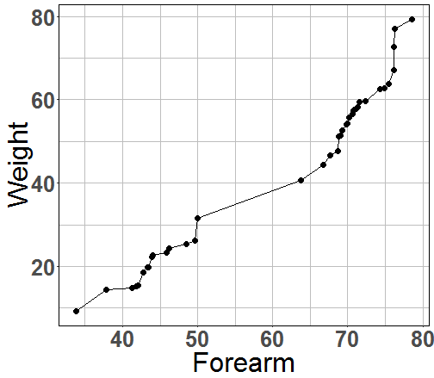
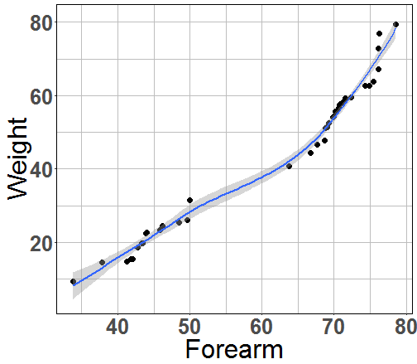
Visualizing Data (Present de data)
Data Plotting with (ggplo2)
Base plot
ggplot(data,aes(x,y))
+
geom
geom_line()
geom_point()
geom_boxplot()
geom_bar()
ggplot(fb_male,aes(Forearm,Weight))
+ geom_line()
+ geom_point()
+ geom_smooth()

Slide 17
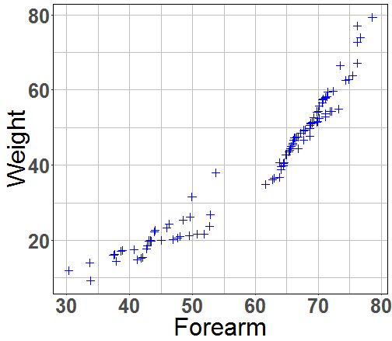
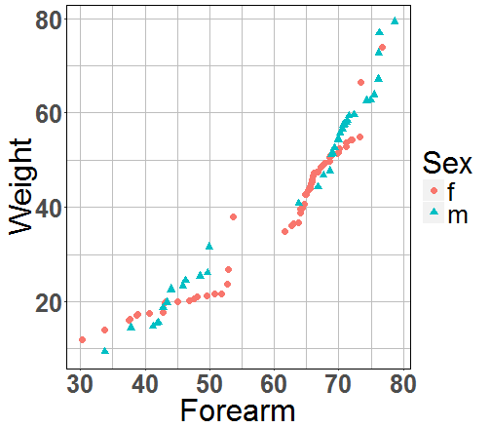
Visualizing Data (Present de data)
Mapping aesthetic vs fixed value
ggplot(e2m2_FB,aes(Forearm,Weight)) +
geom_point(color=“blue”, shape=3)
ggplot(e2m2_FB,aes(Forearm,Weight)) +
geom_point(aes(color=Sex, shape=Sex))

Slide 18
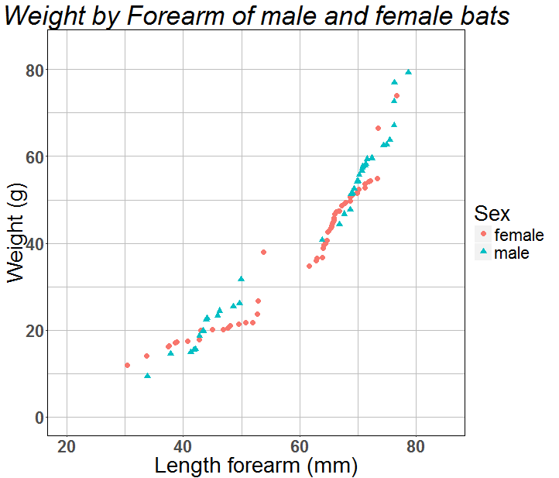
Visualizing Data (Present de data)
Polish the plot
ggtitle("Weight by Forearm of male and female")+
scale_x_continuous(name="Length forearm (mm)",
limits=c(20,85))+
scale_y_continuous(name="Weight (g)",
limits=c(0,85))+
scale_color_discrete(name="Sex",
breaks=c("f","m"),
label=c("female","male"))+
scale_shape_discrete(name="Sex",
breaks=c("f","m"),
label=c("female","male"))

Slide 19
Conclusion
R software:
Powerful data management
Simple syntax
Large graphic vocabularies
Packages to fit needs

