Slide 1

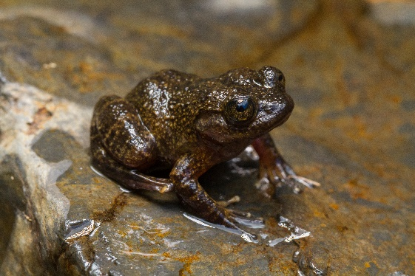
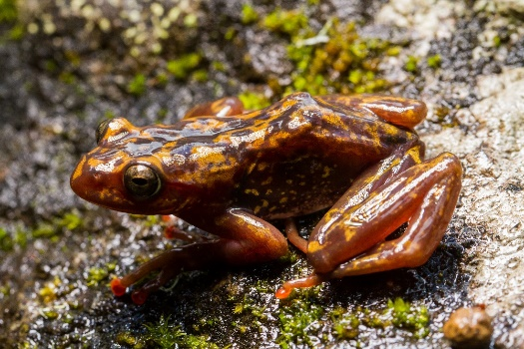





TWO CRITICALLY ENDANGERED AMPHIBIANS FROM ANKARATRA: HOW CAN WE SAVE THEM?
CURRENT SITUATIONS
Distribution: restricted & fragmented
Population and habitat: declining
PREVIOUSLY REPORTED THREATS
Habitat loss and fragmentation
(wildfire, excessive logging, charcoal)
Erosion & pollution of the breeding streams
AIM: To improve the knowledge about two mountain-stream frog’s ecology, population, health status and threats whilst motivating the community to get involved in conservation actions
FIELD-BASED RESEARCH
Refine the current distribution
Estimate population size
Assess habitat characteristics
NEXT STEP: LABORATORY WORK
Collection of swabs for chytrid-screening
Collection of biological samples for genetic study
SOCIAL DIMENSION
Questionnaire-survey, interviews
Awareness campaings
Capacity building

