Slide 1
Exploring and visualizing data with R
Ecological and Epidemiological Modeling Madagascar, (E2M2)
ValBio, Ranomafana
Fianarantsoa, Madagascar
03-14 January 2020
Hafaliana Christian Ranaivoson
Virology Unit, Intitut Pasteur de Madagascar
Mention of Zoology and Animal Biodiversity
Faculty of Sciences, Univeristy of Antananarivo

Slide 2
Exploring and visualizing data in R
R and RStudio software
Importing data
Exploring and cleaning data
Visualizing data
Tutorial
Database: « e2m2_FB.csv »

Slide 3
R software ( a statistical tool)
It is free!
Powerful analysis capability
Versatile, flexible, open source
Raw data
Import
Re-import
csv,xls,xlsx
Stata.dta
SPSS.sav
Text.txt
- New data
- Results
(.Rhistory)
(.RData)
Export
R script (.R)
Overwrite
Explore
Analyze
Manipulate
Visualize
Other Software
R Software
Other Software

Slide 4
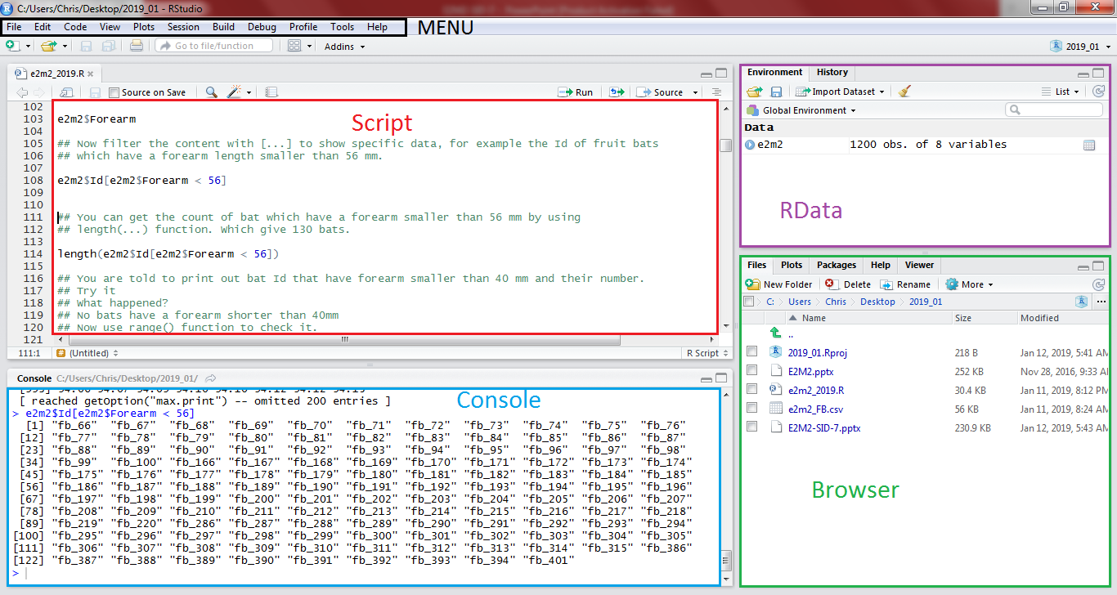
RSTUDIO
An interface for R software

Slide 5
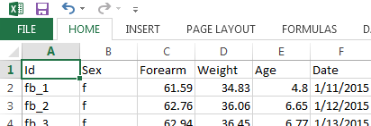
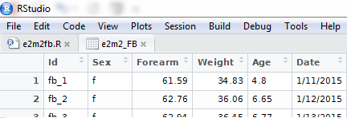
Importing Data (loading data into R environment)
Set working directory (Where to put all files?)
getwd()
setwd(“Folder path”)
?getwd
Import data (read the data source and pack it within RData)
e2m2_FB <- read.csv(“e2m2_FB.csv”, header=T, stringsAsFactors=F)
View(e2m2_FB)

Slide 6
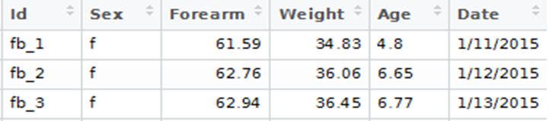
Exploring and cleaning Data (look at the dataset)
Data overview
Data frame=
e2m2_FB
Variables= Column (names)
Value= Contents
Cases= Row (length)
> dim(e2m2_FB)
[1] 100 6
How big is the data frame?
> names(e2m2_FB)
[1] "Id" "Sex" "Forearm" "Weight" "Age" "Date"
What are the variables?

Slide 7
Exploring and cleaning Data (Dive into the dataset)
Accessing dataset contents (From Outside to Inside!)
> e2m2_FB$Id
[1] "fb_1" "fb_2" "fb_3" "fb_4”
[12] "fb_12" "fb_13" "fb_14”...
[100] "fb_100"
Data frame > Variables > Contents
Dataset name $ Variable name
> e2m2_FB$Id[e2m2_FB$Forearm < 56]
[1] "fb_64" "fb_65"
Filter Contents […]
Data frame name $ Variable name [Filter]
Get the Bat Id with Weight > 75
> length(e2m2_FB$Id[e2m2_FB$Forearm < 56])
[1] 2
Get the count with length(…)

Slide 8
Exploring and cleaning Data (look at the dataset structure)
Variable types and error str(…)
> str(e2m2_FB)
$ Id : chr "fb_1" "fb_2" "fb_3" "fb_4“…
$ Sex : chr "f" "f" "f" "F" "f " ...
$ Weight : num 34.8 36.1 36.5 36.6 38.9 ...
$ Age : chr "one" "6.65" "6.77" "seven" ...
$ Date : chr "1/11/2015" "1/12/2015 "…
Categorical: Factor (n levels)
Continuous: Numeric (Range)
Time: Date (Range)
Binary: logic (T,F)
Missing Value: NA
as.factor(…)
as.Date(…) "%Y-%m-%d"
as.numeric(…)
> as.factor(e2m2_FB$Sex)
Levels: f F f m
> as.numeric(e2m2_FB$Age)
Warning message:
NAs introduced by coercion
> as.Date(e2m2_FB$Date,"%m/%d/%Y")
Needed format -> Re-format
Value error -> Correct value
Missing error -> Handle NA values

Slide 9
Exploring and cleaning Data (clean the dataset)
Correcting Values
(Wrong value <- Right Value)
> e2m2_FB$Age[e2m2$Age== “one"] <- “1" > e2m2_FB$Sex[e2m2$Sex== "F"] <- "f"
> e2m2_FB$Sex[e2m2$Sex== "f "] <- "f"
> as.factor(e2m2_FB$Sex)
Levels: f m
> as.numeric(e2m2_FB$Age)
[1] 4.80 6.65 6.77 7.00
Save the format to the variable
> e2m2_FB$Sex <- as.factor(e2m2_FB$Sex)
> e2m2_FB$Age <- as.numeric(e2m2_FB$Age)
> e2m2_FB$Date <- as.Date(e2m2_FB$Date,"%m/%d/%Y")
> str(e2m2_FB)
$ Id : chr "fb_1" "fb_2" "fb_3" "fb_4" ...
$ Sex : Factor w/ 2 levels "f","m": 1 1 1 1 2
$ Age : num 4.8 6.65 6.77 7 8.89 ...
$ Date : Date, format: "2015-01-11"
> e2m2_FB$NewVar <- as.factor(e2m2_FB$Sex)
> e2m2_FB$NewVar <- e2m2_FB$Forearm/2
Or create new variable

Slide 10
Visualizing Data (Play with data)
Install and Load Library
Install.packages(“…”)
Installed.packages()
> library(dplyr)
> require(ggplot2)
Data summarizing (“dplyr”)
> fb_male <-filter(e2m2_FB,Sex=="m")
> range(fb_male$Forearm)
> mean(fb_male$Forearm)
> sd(fb_male$Forearm)
Sex mean_forearm sd_forearm nbr
(fctr) (dbl) (dbl) (int)
1 f 59.6040 11.90278 60
2 m 60.9985 14.12073 40
gp_fb <- group_by(e2m2_FB,Sex)
gp_fb_stat <- summarise(gp_fb,
mean_forearm=mean(Forearm,na.rm=T),
sd_forearm=sd(Forearm,na.rm=T),
nbr=n())

Slide 11
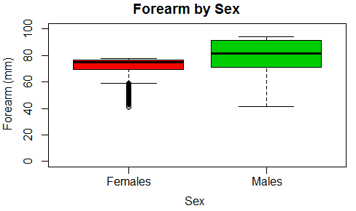
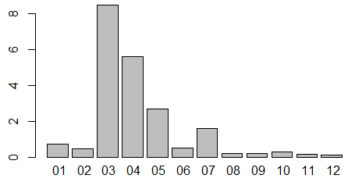
R base graphical function
Visualizing Data (Present de data)
boxplot(Forearm~Sex,
names=c("Females","Males"),
col=c(2:3),
main="Forearm by Sex",
xlab="Sex",
ylab="Forearm (mm)",
ylim=c(0,100))
PLoad <- tapply(e2m2$ParLoad,factor(format(e2m2$Date,"%m")),mean)
barplot(PLoad)

Slide 12
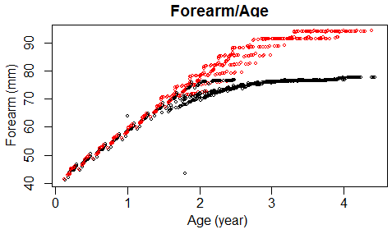
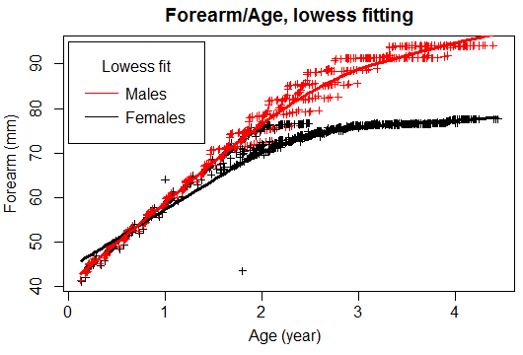
R plot() function
Visualizing Data (Present de data)
plot(e2m2$ Forearm~ e2m2$Age,
main = "Forearm/Age",
ylab ="Forearm (mm)", xlab = "Age (year)",
col=Sex)
fitfem <- lowess(datfem$Forearm~datfem$Age)
fitmal <- lowess(datmal$Forearm~datmal$Age)
plot(e2m2$Forearm~e2m2$Age,
main="Forearm/Age, lowess fitting",
xlab="Age (year)",ylab="Forearm (mm)",
type="p",pch=3,cex=0.7,
col=e2m2$Sex)
lines(fitfem,col="black",lwd=3)
lines(fitmal,col="red",lwd=3)
legend(x=0, y=95,legend=c("Males","Females"),
col=c("red","black"),title="Lowess fit",
lty=1,x.intersp = .5,y.intersp = .8)

Slide 13
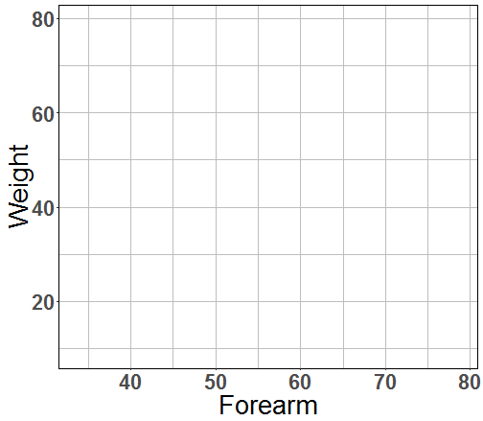

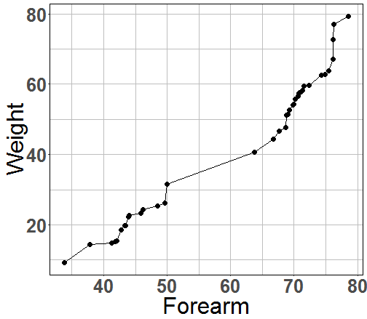
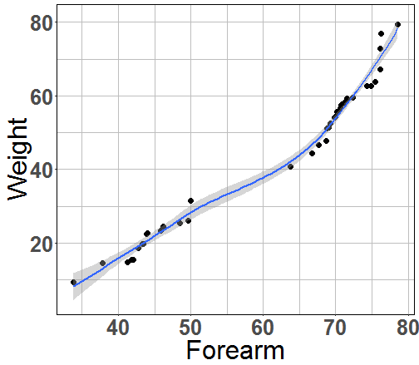
Visualizing Data (Present de data)
Data Plotting with (ggplo2)
Base plot
ggplot(data,aes(x,y))
+
geom
geom_line()
geom_point()
geom_boxplot()
geom_bar()
ggplot(fb_male,aes(Forearm,Weight))
+ geom_line()
+ geom_point()
+ geom_smooth()

Slide 14
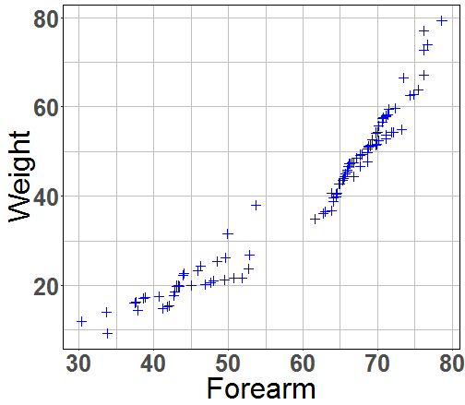
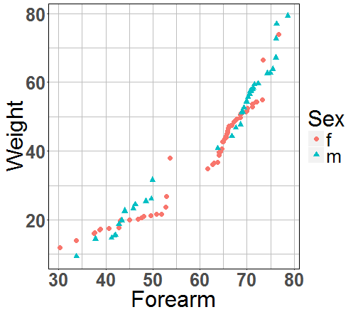
Visualizing Data (Present de data)
Mapping aesthetic vs fixed value
ggplot(e2m2_FB,aes(Forearm,Weight)) +
geom_point(color=“blue”, shape=3)
ggplot(e2m2_FB,aes(Forearm,Weight)) +
geom_point(aes(color=Sex, shape=Sex))

Slide 15
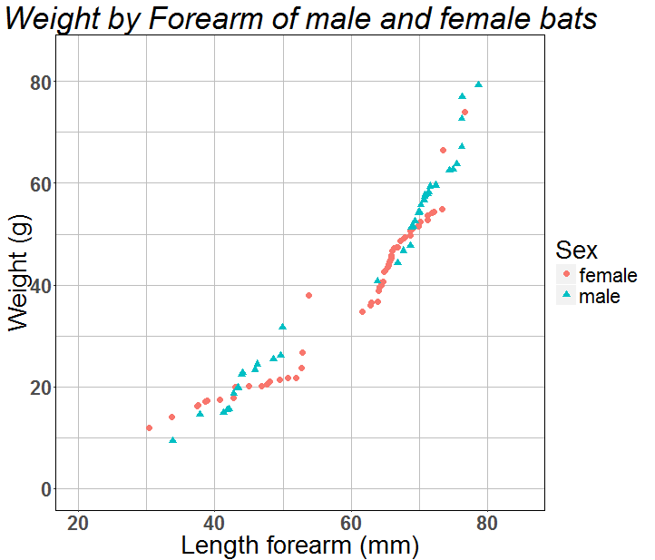
Visualizing Data (Present de data)
Polish the plot
ggtitle("Weight by Forearm of male and female")+
scale_x_continuous(name="Length forearm (mm)",
limits=c(20,85))+
scale_y_continuous(name="Weight (g)",
limits=c(0,85))+
scale_color_discrete(name="Sex",
breaks=c("f","m"),
label=c("female","male"))+
scale_shape_discrete(name="Sex",
breaks=c("f","m"),
label=c("female","male"))

Slide 16
Conclusion
R software:
Powerful data management
Simple syntax
Large graphic vocabularies
Packages to fit needs

