Slide 1



CLIMATE IMPACTS ON THE PLAGUE PROLIFERATION IN MADAGASCAR
Parfait RAKOTONINDRAINY
Research Masters, Ecole Nationale d’Informatique, University of Fianarantsoa
E2M2 final symposim - January 5, 2023

Slide 2
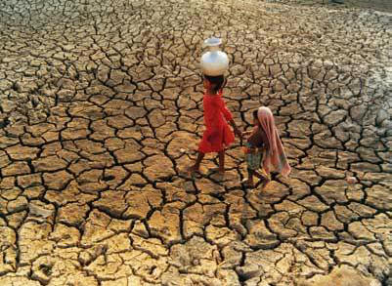
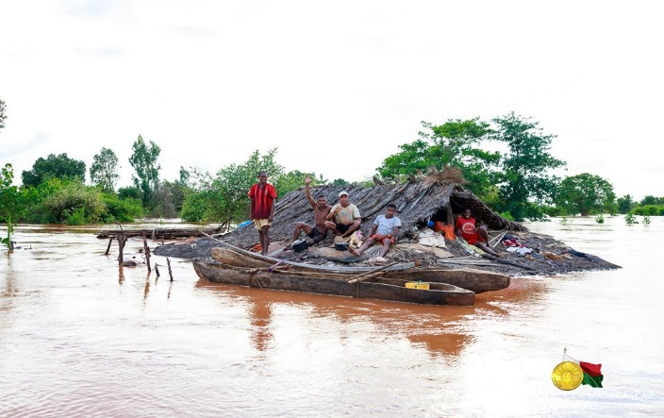
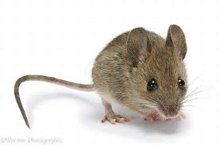
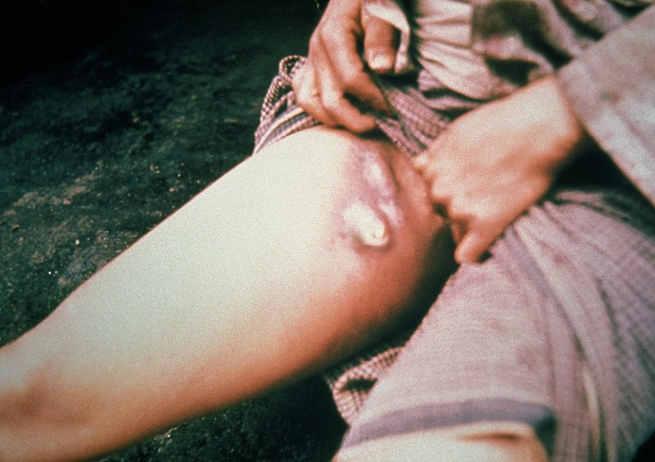
Introduction
Statistical model
Dynamical model
Next steps
Madagascar 3rd most vulnerable country in the world to climate change (World Meteorological Service report, 2016)
Plague, endemic disease in Madagascar with 75% of global plague cases reported to WHO
What is the impact of climate change on proliferation of plague in Madagascar?
How does climate change impact plague proliferation in Madagascar?

Slide 3
Introduction
Statistical model
Dynamical model
Next steps
Question :
What is the impact of climate change on proliferation of plague in Madagascar?
Hypothesis :
Variation of climatics factors influences the proliferation of plague in Madagascar
Predictor variables :
Temperature, rainfall, time, elevation
Response variables :
Human cases plague
Family :
Poisson – Link function Log
glmer ( Cases plague ~ temperature + rainfall + time + elevation + ( 1 | site / urban – rural ), family = « Poisson », link = log, data = dat)
R function :

Slide 4
Introduction
Statistical model
Dynamical model
Next steps
Question :
How does climate change impact plague proliferation in Madagascar?
Population
States
b_{H}
S_{H}
ß_{H}
I_{H}
α_{H}
Human
Rat
Fleas
S_{H} = Susceptible
humans
I_{H} = Infected
humans
S_{R} = Susceptible
rats
I_{R} = Infected
rats
µ_{H}
b_{R (T,P)}
S_{F} = Susceptible
fleas
I_{F} = Infected
fleas
S_{R}
ß_{R}
I_{R}
α_{R}
Processes
µ_{R}
b_{H} = Human birth rate
b_{F}
S_{F}
ß_{F}
I_{F}
ß_{H} = Human transmission rate
α_{H} = Infection induced mortality
µ_{F}
µ_{H} = Natural human death rate
dS_{H} / dt = b_{H} ( S_{H} + I_{H}) - µ_{H} S_{H} – ß_{H} S_{H} ( I_{H} + I_{F})
b_{R (T,P)} = Birth rate rats due to temperature +
precipitation
dI_{F} / dt = ß_{F} S_{F} ( I_{R}) - µ_{H} I_{F}

Slide 5
Introduction
Statistical model
Dynamical model
Next steps
Literature review related to the theme of climate change and health risks, in particular the plague
Choice of study sites (rural and urban) and study period
Collection of climatics data and cases of plague according to the sites and period of study chosen
Design, realization and validation of the model
Writing the article

Slide 6
MISAOTRA

