Slide 1
Data cleaning with R
Ecological and Epidemiological Modeling Madagascar (E2M2)
ValBio, Ranomafana
Fianarantsoa, Madagascar
03-14 January 2020
Hafaliana Christian Ranaivoson
Virology Unit, Intitut Pasteur de Madagascar
Mention of Zoology and Animal Biodiversity
Faculty of Sciences, Univeristy of Antananarivo

Slide 2
Data cleaning with R
Data cleaning steps
Raw Data
Formatted
data
Usable
data
Initial data
Technically correct
Consistent

Slide 3
Data cleaning with R
Formatted data,
Variable types and errors
> str(e2m2_FB)
$ Id : chr "fb_1" "fb_2" "fb_3" "fb_4“…
$ Sex : chr "f" "f" "f" "F" "f " ...
$ Weight : num 34.8 36.1 36.5 36.6 38.9 ...
$ Age : chr "one" "6.65" "6.77" "seven" ...
$ Date : chr "1/11/2015" "1/12/2015 "…
Categorical: Factor (n levels)
Continuous: Numeric (Range)
Time: Date (Range)
Binary: logic (T,F)
Missing Value: NA
as.factor(…)
as.Date(…) "%Y-%m-%d"
as.numeric(…)
> as.factor(e2m2_FB$Sex)
Levels: f F f m
> as.numeric(e2m2_FB$Age)
Warning message:
NAs introduced by coercion
> as.Date(e2m2_FB$Date,"%m/%d/%Y")
Needed format -> Re-format
Value error -> Correct value
Missing error -> Handle NA values

Slide 4
Data cleaning with R
Consistent data
Give a sense to your data
Extreme values will affect the outcome
Make a consistent link between each variable
No cheating
Cleaning is not inventing

Slide 5
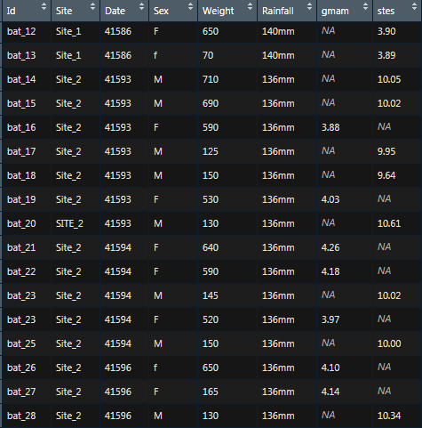
Data cleaning with R
Consistent data
What is wrong with this data frame?

Slide 6
Data cleaning with R
Conclusion
Important step for good data interpretation
Need a good comprehension of each variables
Should be reproductible
Thank you all!

