Slide 1




The use of Generalized Linear Mixed Models for the study of dynamical systems
Andrés Garchitorena
Researcher, Institut de Recherche pour le Développement
Associate Scientific Director, PIVOT Madagascar
E²M² Workshop
Ranomafana, January 2020

Slide 2
1. Univariate
Linear Models
2. Multivariate
Linear Models
3. Generalized
Linear Models
4. Generalized Linear
Mixed Models
Introduction to Generalized
Linear Mixed Models

Slide 3
Assumption and limitation of glms
all observations are considered independent

Slide 4
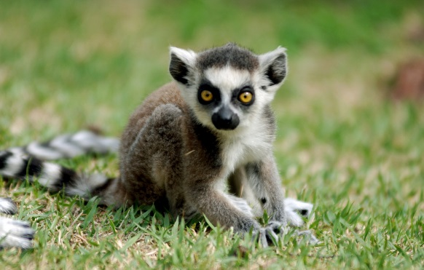
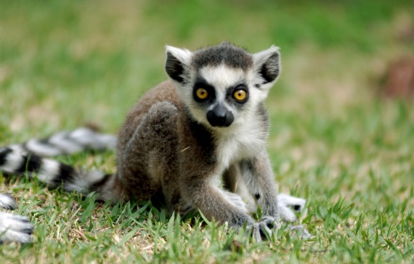
What if…?
taille
age

Slide 5
Why use GLMMs?
Generalized linear mixed models include both fixed effects and random effects in order to allow for:
Repeated measures
Temporal correlation
Spatial correlation
Heterogeneity
Nested data
yi = Xiβ + Zibi + εi
Fixed
Effects
Random
Effects
The R function to fit a generalized linear mixed model is glmer() which uses the form
fitted.model <- glmer(formula, family=“model family”, data=data.frame)

Slide 6
Repeated measures
Legend
District
CSB1
CSB2 PAUSENS
CSB2 PAUSENS + PIVOT
Model predictions with program(s)
Model predictions without program(s)
Health center 1
Health center 2
Health center 3
Month 1
Month 2
Month 3
Month 4
Month 5
PIVOT Program
Pausens Program
2013
2014
2015

Slide 7
Spatial correlation
District
Cluster 1
Cluster 2
Cluster 3
HH 1
HH 2
HH 3
HH 4
HH 5

Slide 8
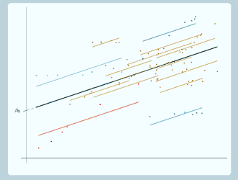
Random intercept
The intercept is different for each individual/site
Accounts for baseline differences in the response variable between individuals/sites

Slide 9
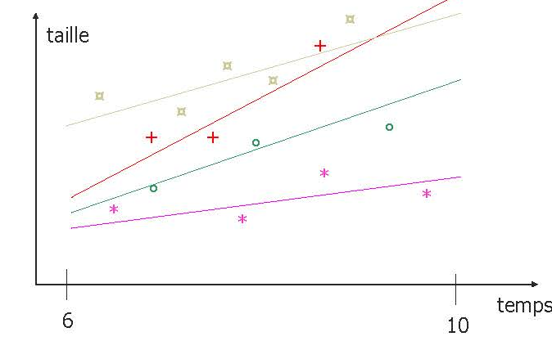
Random slope
The effect of a variable (b) is different for each individual/site
Accounts for baseline differences in the relationship response-explanatory variable between individuals/sites

Slide 10
1. Univariate
Linear Models
2. Multivariate
Linear Models
3. Generalized
Linear Models
4. Generalized Linear
Mixed Models
5. Evaluating trends and effects over time
Now that we can model repeated observations over time…

Slide 11
3
Introducing time-dependent trends
a) Linear trends (days, months, years)
Time = 1, 2, 3, 4, …, N
Where N is the total number of observations for each individual or site (including NAs)
y
time
y
time

Slide 12
3
Introducing time-dependent trends
a) Linear trends
b) Seasonal trends
Season=sin(2*pi*(month_{i}-shift)/period)
Season=cos(2*pi*(month_{i}-shift)/period)

Slide 13
3
Evaluating abrupt and progressive changes over time
Immediate impact
0 before the event happened
1 after the event happened
Impact =
Event
y
time

Slide 14
3
Evaluating abrupt and progressive changes over time
a) Immediate impact
b) Progressive impact
0 before the event happened
1, 2, 3, 4, …, N
after the event happened
Impact =
Event
y
time

Slide 15
3
Back to the initial example

Slide 16
The use of Generalized Linear Mixed Models for the study of dynamical systems
Andrés Garchitorena
Researcher, Institut de Recherche pour le Développement
Associate Scientific Director, PIVOT Madagascar
E²M² Workshop
Ranomafana, January 2020

