Slide 1
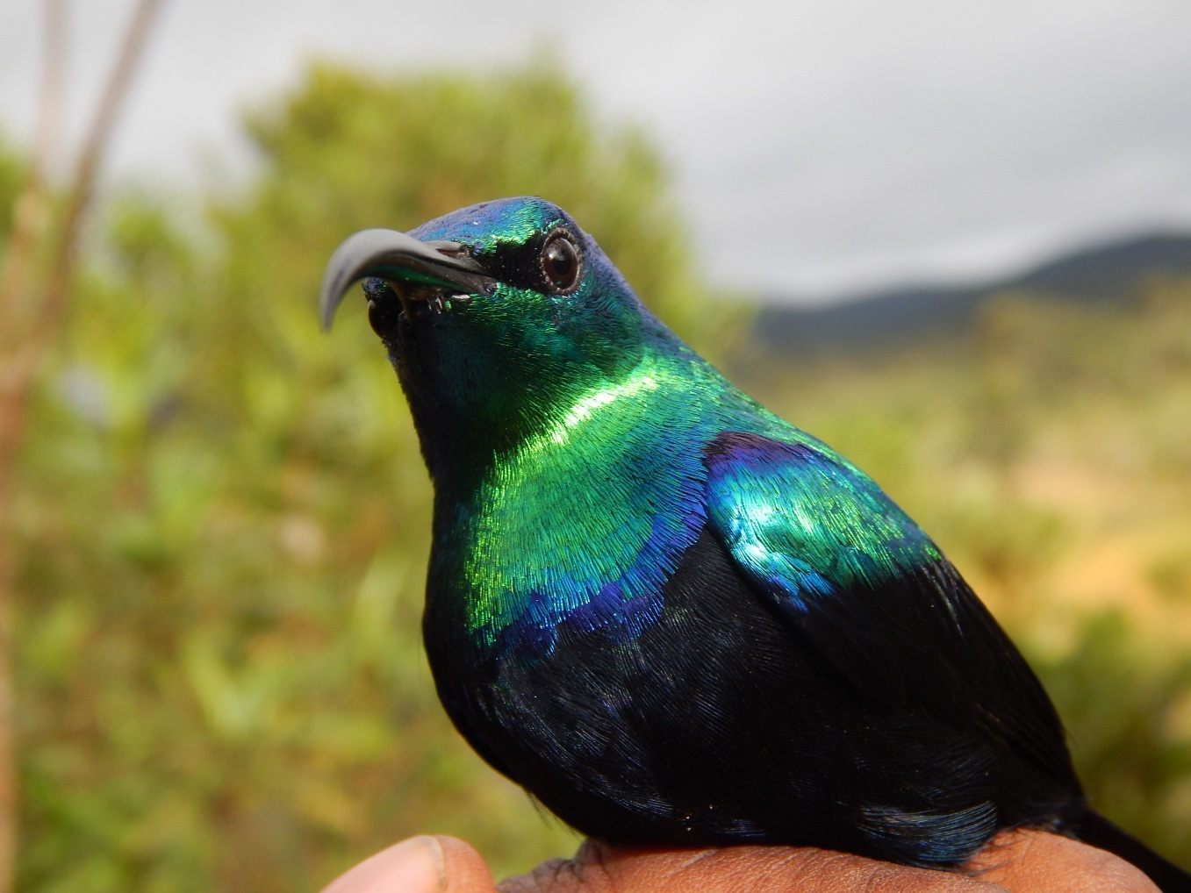
West Nile Virus seroprevalence and risk factors in wild birds in Madagascar
²
RASAMOELINA Voahangielisoa Miatrana

Slide 2
INTRODUCTION
West Nile virus (WNV) emerging zoonotic virus and
wild birds is natural reservoirs of WNV.
Only two studies report WNV circulation in wild birds in Madagascar.
Aims :
With a focus on wild birds in Madagascar:
Estimate its seroprevalence
Identify risk factors of infection
May be determine dynamic of the disease in region scale

Slide 3
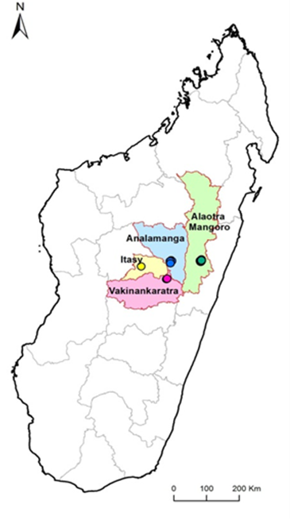
METHODS
Sites:
abundance or diversity of birds
Edge of a stable
pesence of forest or
wetland within 500m
Period: May 2016 – Apr 2017
Serological analysis: competitive ELISA
(ID-Vet® kit) for IgG antibody detection
Statistical analysis: logistic
regression models
Notes:
to identify
risk factors associated with
bird serological status

Slide 4
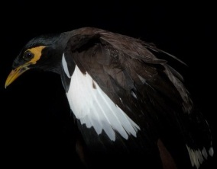
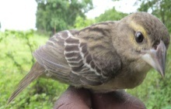
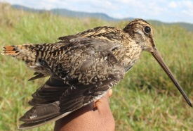
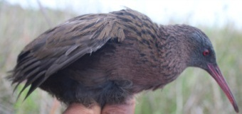
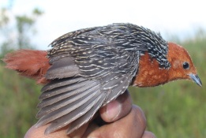
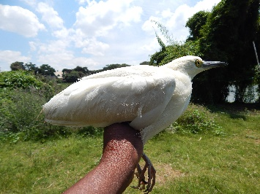
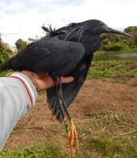
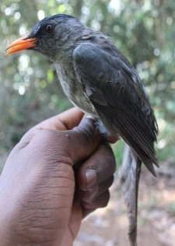
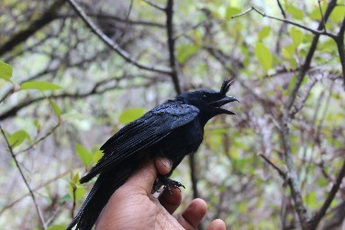
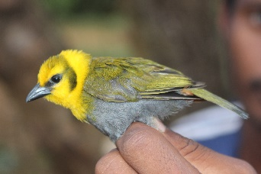
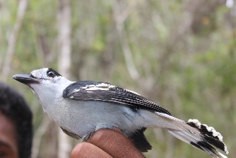
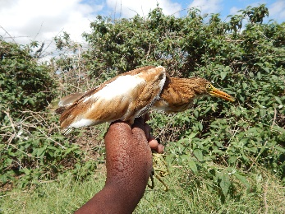
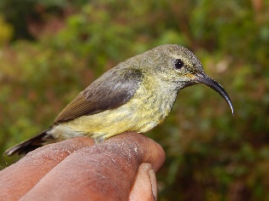
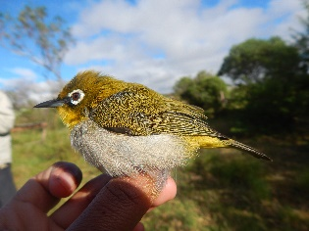

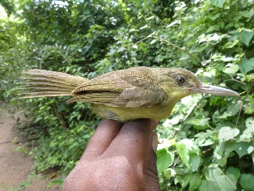
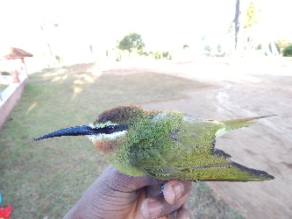
RESULT
Seroprevalence: 12.5% (44/352) of birds [95%CI: 11.0-14.0]
19 birds species identify in contact with WNV

Slide 5
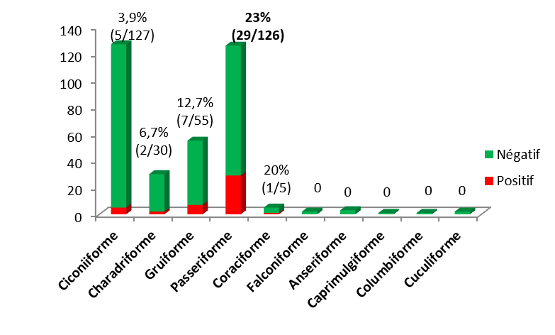
Seroprevalence by taxonomic order

Slide 6
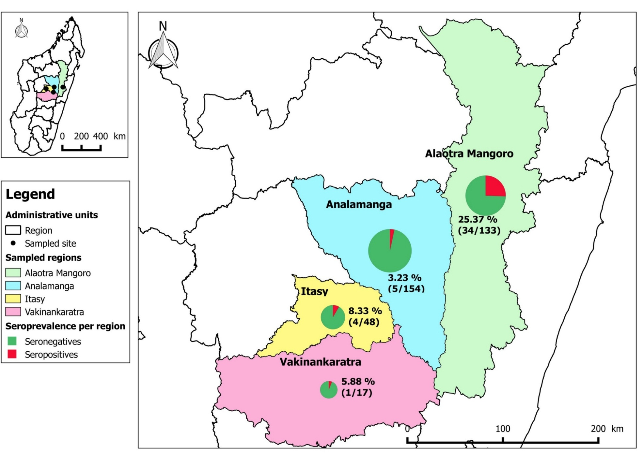
Seroprevalence per region
Notes:
TAKE A NEW PICTURE

Slide 7
WNV exposure factors
Variables |  | Odds Ratio | 95%CI OR |  | p
Proximity to wetlands | Yes | 1 |  |  | 0.021 *
 | No | 8.19 | [1.2 - | 165.1]
Order | Other orders | 1 |  |  | 0.023 *
 | Ciconiiformes | 2.53 | [0.26 - | 29.52]
 | Passeriformes | 4.99 | [1.58 - | 16.25]
Distribution area | Widespread | 1 |  |  | 0.0002 ***
 | Africa | 31.90 | [5.47 - | 313.11]
 | Endemic to Madagascar | 1.07 | [0.29 - | 4.79]
 | Endemic to Indian Ocean | 2.57 | [0.54 - | 14.31]
Region | Analamanga | 1 |  |  | 5E-06 ***
 | Alaotra Mangoro | 41.44 | [6.16 - | 610.69]
 | Itasy | 9.19 | [1.17 - | 115.29]
 | Vakinankaratra | 1.56 | [0.03 - | 41.64]

Slide 8
DISCUSSION
First study assessing seroprevalence in wild birds and identifying WNV exposure factors in Madagascar
Seroprevalence of 12.5% → circulation of WNV in avifauna
At least 19 species in contact with the WNV,especially the order Passeriformes
two epidemiological landscapes:
forest environment with high circulation of virus
wetlands with low viral circulation.

Slide 9
Build mechanistical model in Alaotra Mangoro region
BIRDS
λB
λB
λB
λB
β b
ϒb
α b
Birth
S
E
I
R
µd
µd
µd
µd
MOSQUITOES
β M
ϒ M
S
E
I
S: Susceptible bird
E: Exposed bird
I: Infected bird
R: Recovered bird
S: Susceptible mosquito
E: Exposed mosquito
I: Infectious mosquito
λB: bird migration rate (0 when there is no migration)
βb: transmisssion rate in birds
ϒb: incubation rate in birds
αb: recovery rate in birds
µd: death rate in birds
β M: transmission rate in mosquito
ϒ M: incubation rate in mosquito (extrinsic incubation rate)

Slide 10
Conclusion
Seroprevalence differs according to the taxonomic of bird and by the regions too
19 species in contact with WNV
Two epidemiological landscapes in Madagascar

Slide 11
Next step
Need to assess the clinical impact of WNV in wild birds, especially among threatened species.
WNV monitoring program in birds could help address conservation issues and act as an early warning tool
Do a fieldwork to test the mechanistical model

Slide 12













Aknowlegments
E2M2 Team 2019 and 2020
E2M2 Roomate

