Slide 1
Epigenetic clock figures

Slide 2
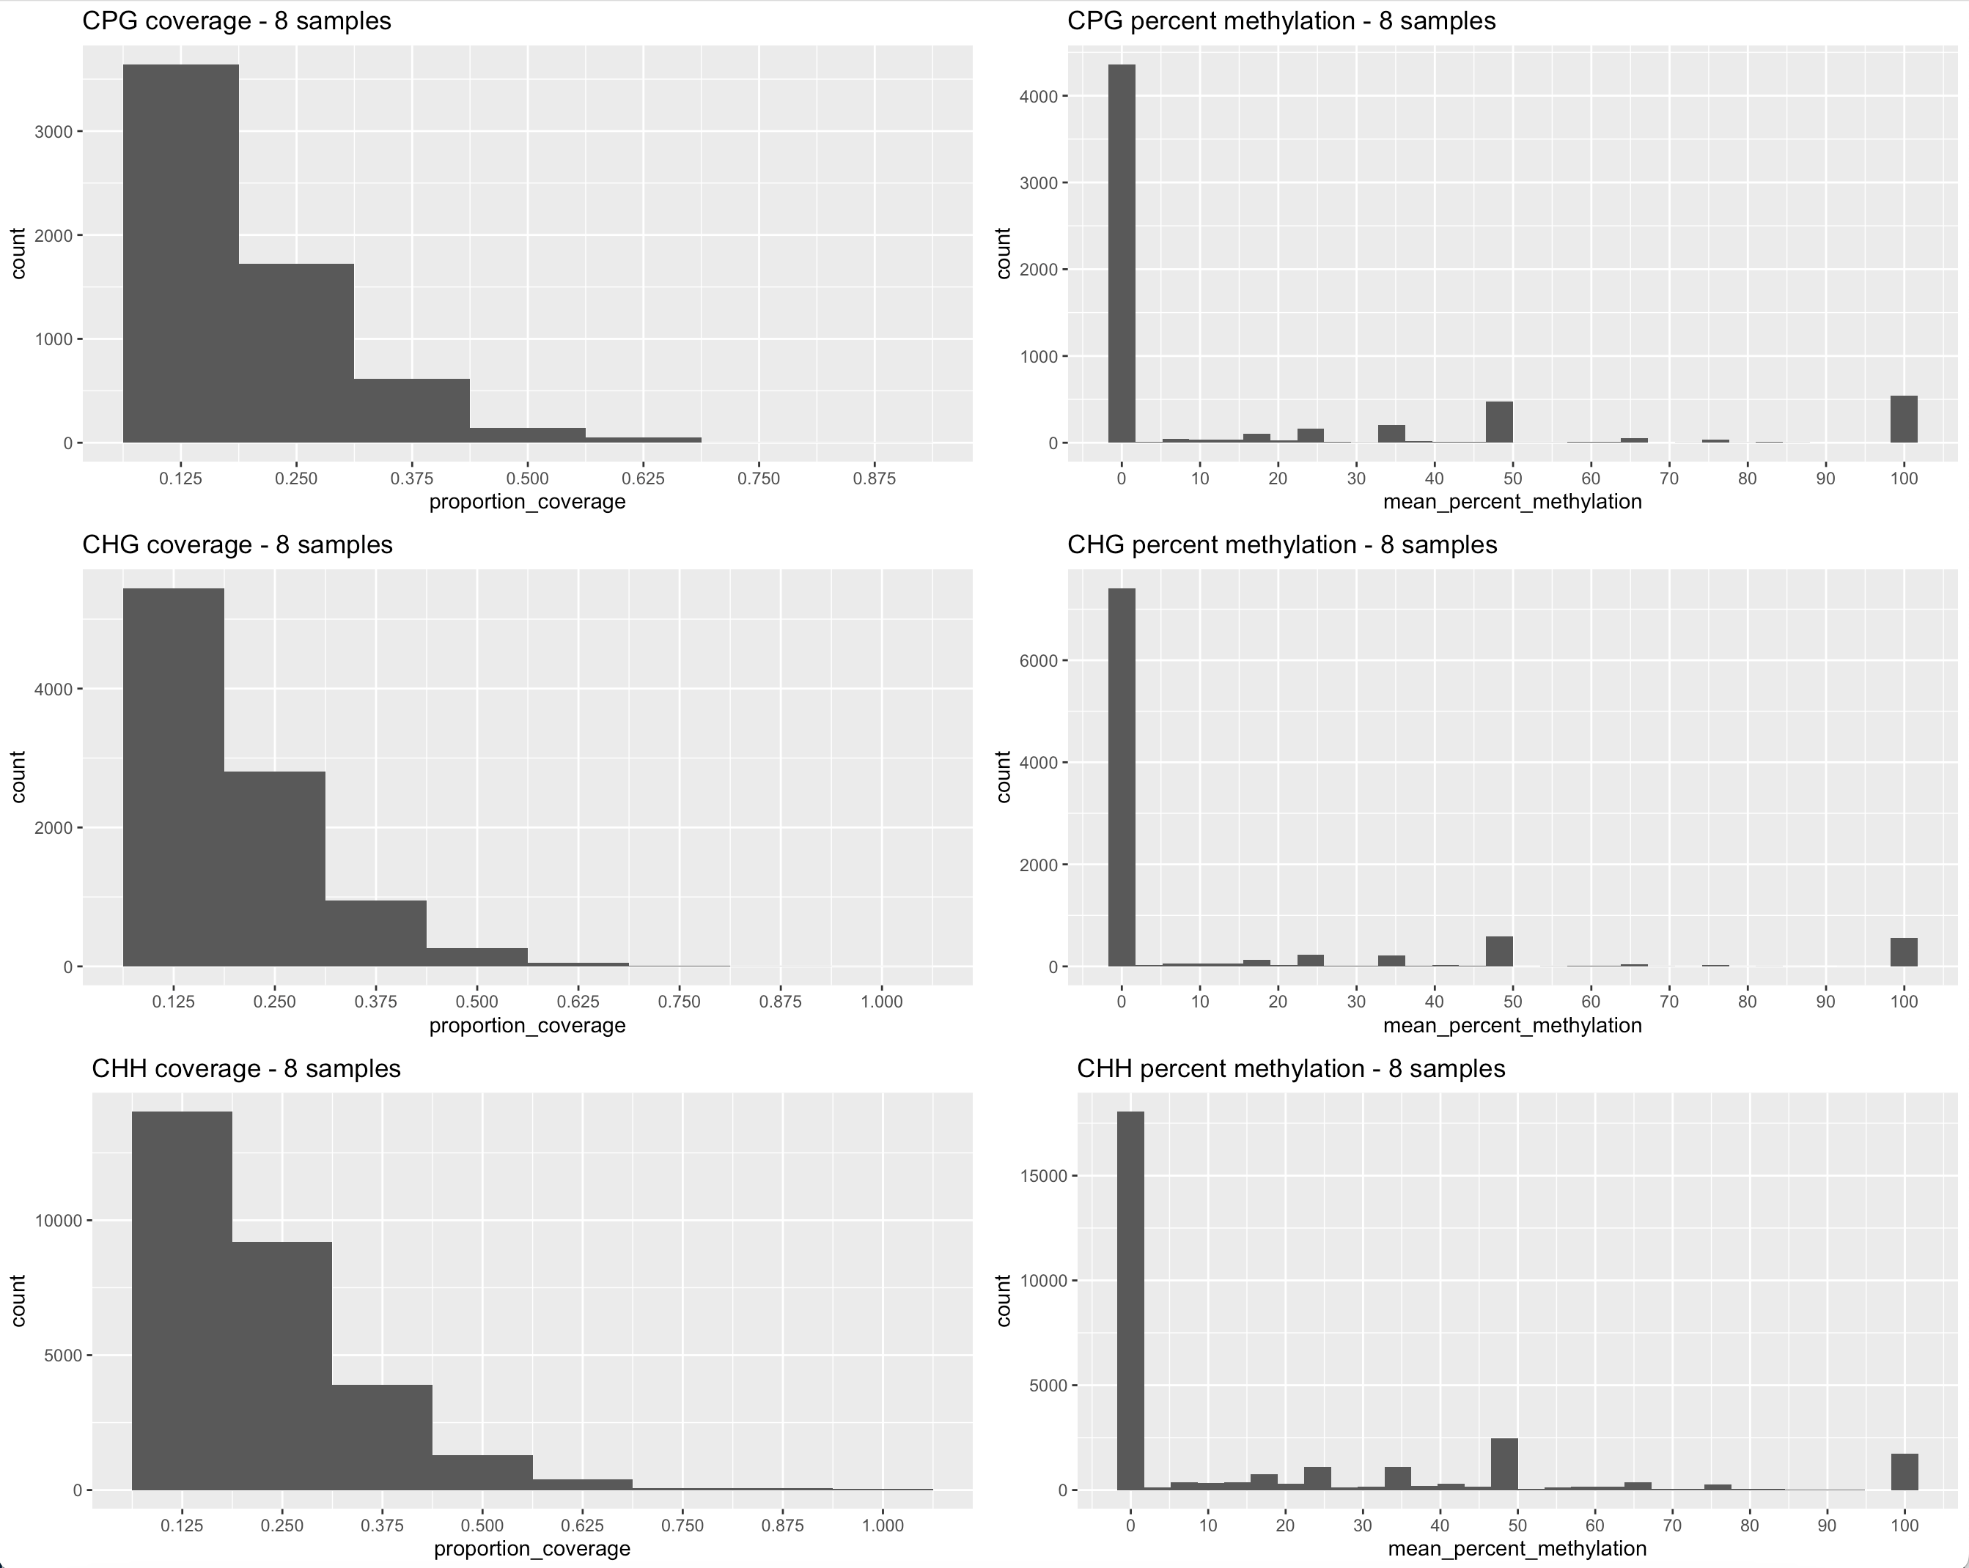
Myotis samples
Coverage proportion (number of bats where the site matched)
Mean Percent methylation (across bats that did detect the site, what was the average methylation)
Generated using buildDataframes_WIP.R
SH

