Slide 1
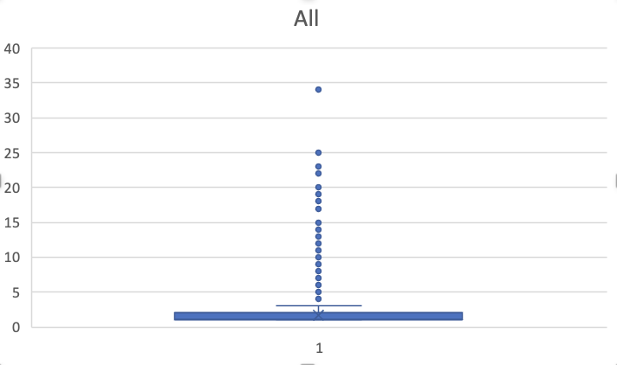
cpg
Notes:
Should we use CHH and CHG? I’ve never seen that in the literature

