Slide 1
Data and Models
C4C: Coding For Conservation
Week 1: June 2022

Slide 2
Goals for this lecture
To explain what we’re doing here

Slide 3
Goals for this lecture
To explain what we’re doing here
To define “science”

Slide 4
Goals for this lecture
To explain what we’re doing here
To define “science”
To define “data”

Slide 5
Goals for this lecture
To explain what we’re doing here
To define “science”
To define “data”
To define “models”

Slide 6
Goals for this lecture
To explain what we’re doing here
To define “science”
To define “data”
To define “models”
To introduce many different types of models

Slide 7
Goals for this lecture
To explain what we’re doing here
To define “science”
To define “data”
To define “models”
To introduce many different types of models
Statistical

Slide 8
Goals for this lecture
To explain what we’re doing here
To define “science”
To define “data”
To define “models”
To introduce many different types of models
Statistical
Mathematical

Slide 9
All course materials are available at:
coding4conservation.org/syllabus

Slide 10
What is science?
the systematic observation of natural events and conditions in order to discover facts about them and to formulate laws and principles based on these facts.
– Academic Press Dictionary of Science & Technology

Slide 11
Observations and Laws and Principles

Slide 12
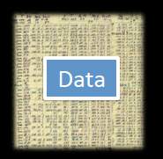
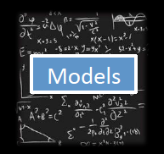
Data and Models
Models

Slide 13
Data and Models
What is data?

Slide 14
Data and Models
What is data?
Backbone of science

Slide 15
What is science?
the systematic observation of natural events and conditions in order to discover facts about them and to formulate laws and principles based on these facts.
– Academic Press Dictionary of Science & Technology

Slide 16
Data vs. Models
What is data?
Backbone of science
Evidence to support a claim

Slide 17
Data or not data?
19

Slide 18
Data or not data?
19
19 = total number of fingers and toes

Slide 19
Data or not data?
19
19 = total number of fingers and toes
19 = total number of fingers and toes of Andry Rajoelina

Slide 20
Data or not data?
19
19 = total number of fingers and toes
19 = total number of fingers and toes of Andry Rajoelina
This is a fact. It becomes data when we use it to support a claim.
There is a negative correlation between the number of years someone has served as president of Madagascar and their total number of fingers and toes.

Slide 21
Data or not data?
5, 11, 27

Slide 22
Data or not data?
5, 11, 27
5, 11, 27 = respective # of children belonging to Mahandry, Ginot, & Tsiry

Slide 23
Data or not data?
5, 11, 27
5, 11, 27 = respective # of children belonging to Mahandry, Ginot, & Tsiry
5, 11, 27 = respective # of children belonging to Mahandry, Ginot, & Tsiry
Mahandry, Ginot, & Tsiry are the names of tenrecs at Duke Lemur Center

Slide 24
Data or not data?
5, 11, 27
5, 11, 27 = respective # of children belonging to Mahandry, Ginot, & Tsiry.
5, 11, 27 = respective # of children belonging to Mahandry, Ginot, & Tsiry.
Mahandry, Ginot, & Tsiry are the names of tenrecs at Duke Lemur Center.
This is a fact.

Slide 25
Data or not data?
5, 11, 27
5, 11, 27 = respective # of children belonging to Mahandry, Ginot, & Tsiry
5, 11, 27 = respective # of children belonging to Mahandry, Ginot, & Tsiry.
Mahandry, Ginot, & Tsiry are the names of tenrecs at Duke Lemur Center.
This is data to support the claim:
Tenrecs have high fecundity rates.

Slide 26
What is data?
Backbone of science
Evidence to support a claim
A relationship between at least two variables
x: explanatory, control, driver, independent variable(s)
y: response, dependent variable(s)
x and y should be clearly defined
with respect to the question!

Slide 27
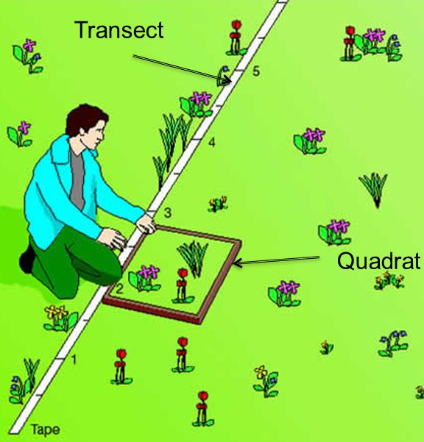
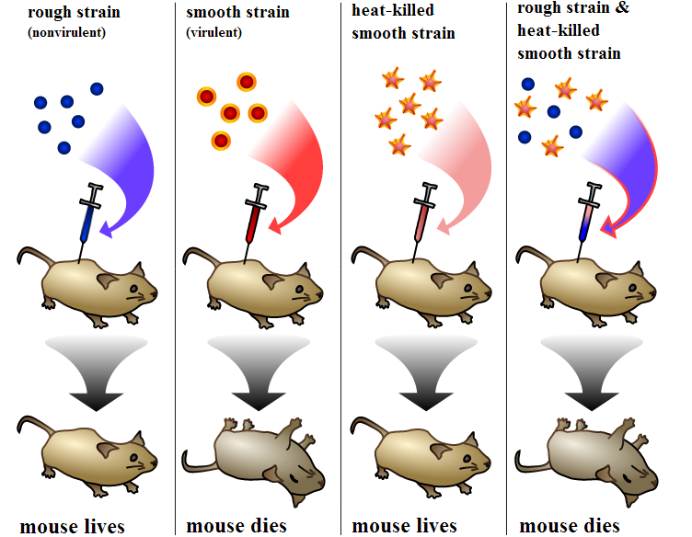
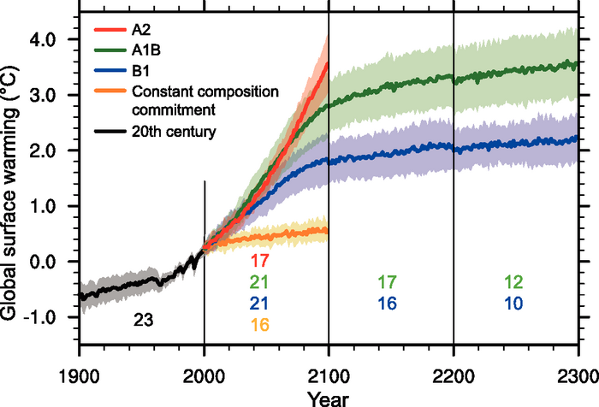
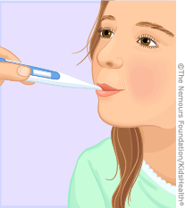
Data: Sources of x and y
Observational | Experimental | Simulated
- Just measure x and y | - Interfere with x or the relationship between x and y | - Create a relationship between x and y
Empirical data

Slide 28
Data: Types
Numerical
Categorical

Slide 29
Data: Types
Numerical
A variable is numerical when you can transform it with mathematical operation
Examples?
Categorical

Slide 30
Data: Types
Numerical
A variable is numerical when you can transform it with mathematical operation
Examples?
Integer, real number, multi-dimensional number
Categorical

Slide 31
Data: Types
Numerical
A variable is numerical when you can transform it with mathematical operation
Examples?
Integer, real number, multi-dimensional number
Categorical
A variable is categorical when it is not numerical but a categorical can be numerical?
Examples?

Slide 32
Data: Types
Numerical
A variable is numerical when you can transform it with mathematical operation
Examples:
Integer, real number, multi-dimensional number
Categorical
A variable is categorical when it is not numerical but a categorical can be numerical?
Examples:
Colors, (blood) types, species name

Slide 33
Data: Things to consider
Data acquisition

Slide 34
Data: Things to consider
Data acquisition
Impossible, example?

Slide 35
Data: Things to consider
Data acquisition
Impossible, example?
Theoretically possible but practically unfeasible, examples?

Slide 36
Data: Things to consider
Data acquisition
Impossible, example?
Theoretically possible but practically unfeasible, examples?
Data quality and quantity
In practice there is always a trade-off

Slide 37
Data: Things to consider
Data acquisition
Impossible, example?
Theoretically possible but practically unfeasible, examples?
Data quality and quantity
In practice there is always a trade-off
Example: monetary cost, human effort -> power analysis, sampling design etc.

Slide 38
Data: Things to consider
Data acquisition
Impossible, example?
Theoretically possible but practically unfeasible, examples?
Data quality and quantity
In practice there is always a trade-off
Example: monetary cost, human effort -> power analysis, sampling design etc.
Reproducibility

Slide 39
Data: Things to consider
Data acquisition
Impossible, example?
Theoretically possible but practically unfeasible, examples?
Data quality and quantity
In practice there is always a trade-off
Example: monetary cost, human effort -> power analysis, sampling design etc.
Reproducibility
Measurement errors

Slide 40
Data: Things to consider
Data acquisition
Impossible, example?
Theoretically possible but practically unfeasible, examples?
Data quality and quantity
In practice there is always a trade-off
Example: monetary cost, human effort -> power analysis, sampling design etc.
Reproducibility
Measurement errors
Examples?

Slide 42
Data and Models
Models

Slide 43
Data vs. Models
Models
What is a model?

Slide 44
What is science?
the systematic observation of natural events and conditions in order to discover facts about them and to formulate laws and principles based on these facts.
– Academic Press Dictionary of Science & Technology

Slide 45
Laws and Principles
Models
A theory = a declaration to explain a phenomenon
Logical and falsifiable
A model = an abstract representation of a phenomenon
A hypothesis = a testable declaration that is derived from a theory

Slide 46
Theory, Models, Hypotheses
Theory General
Model
Hypothesis Specific

Slide 47

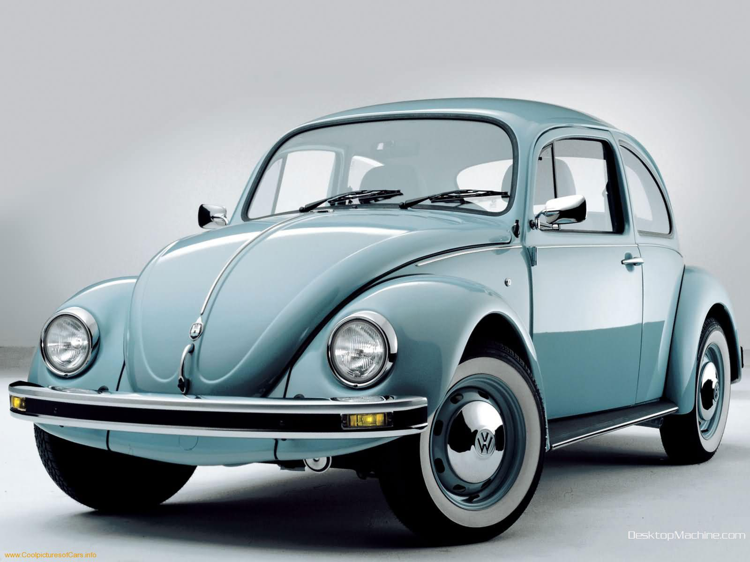
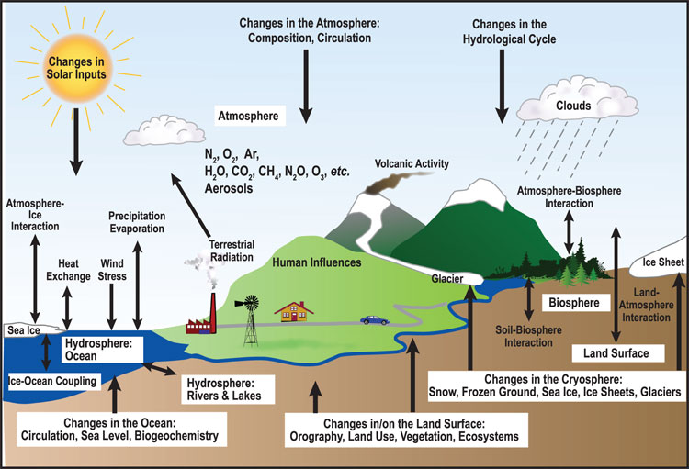

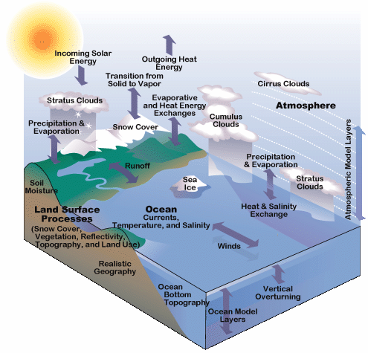
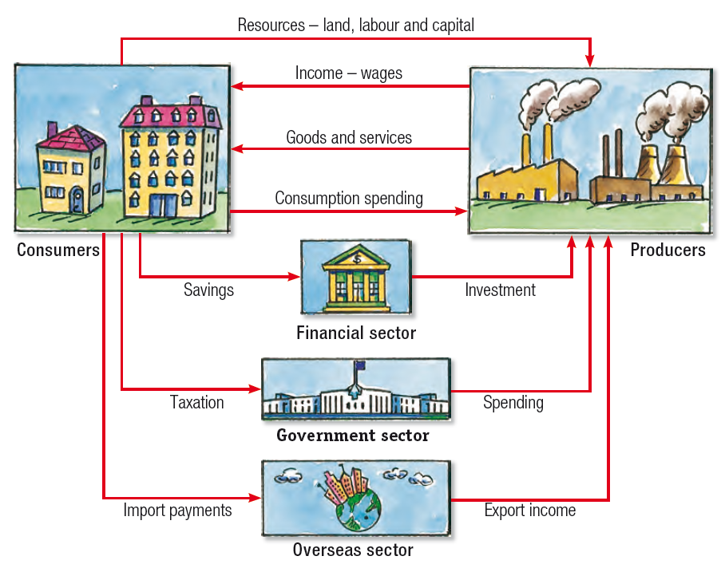
Models: many types
Human
Car
Ecosystem
Ecology & Evolution
Climate
Economy

Slide 48
When you make a model,
you include the
elements that you feel are most important to explain a phenomenon.

Slide 49
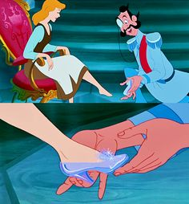
When you make a model,
you include the
elements that you feel are most important to explain a phenomenon.
Generally, we try to make models
that can reproduce real-world data

Slide 50
When you make a model,
you include the
elements that you feel are most important to explain a phenomenon.
Generally, we try to make models
that can reproduce real-world data
In C4C, we distinguish between statistical and mechanistic models

Slide 51
Statistical vs. Mathematical Model
The choice depends on the research question!

Slide 52
Statistical Models
Goal: To rigorously assess the strength of relationship between x and y
Find a significant relationship using a p-value as a measure of relationship strength
Statistical models can demonstrate correlations.

Slide 53
Statistical Models
Goal: To rigorously assess the strength of relationship between x and y (describe patterns)
Find a significant relationship using a p-value as a measure of relationship strength
Statistical models can demonstrate correlations.
Steps:
Formulate a research question
Formulate a hypothesis
Develop a model to demonstrate your hypothesis.
Collect data (required!!!)
Evaluate hypothesis with appropriate statistical tools
t-test, Chi-square, ANOVA
Ordination (PCA)
Regression (LM, GLM, GLMM, GAM)

Slide 54
1. Example Question: What is the trajectory of Malagasy population size through time?
Source: World Bank

Slide 55
1. Example Question: What is the trajectory of Malagasy population size through time?
2. Hypothesis: Malagasy population size increases with time
Source: World Bank

Slide 56

1. Example Question: What is the trajectory of Malagasy population size through time?
2. Hypothesis: Malagasy population size increases with time
3. Statistical Model:
$$y=mx+b$$
Linear Regression
Source: World Bank

Slide 57
1. Example Question: What is the trajectory of Malagasy population size through time?
4. Data:
2. Hypothesis: Malagasy population size increases with time
3. Statistical Model:
$$y=mx+b$$
Linear Regression
Source: World Bank

Slide 58




1. Example Question: What is the trajectory of Malagasy population size through time?
4. Data:
2. Hypothesis: Malagasy population size increases with time
3. Statistical Model:
5. Evaluation
Linear Regression
$$y=mx+b$$
$$m= .372 million$$
$$p= .003$$
$$R2= .96$$
What can we conclude from this fitted model?
Source: World Bank

Slide 59




1. Example Question: What is the trajectory of Malagasy population size through time?
7. Adapt your model and re-evaluate:
Exponential Regression
$$y=e^{mx+b}$$
Exponential Regression
$m=0.029$ mil.
$$p<.001$$
$$R2= .99$$
What can we conclude from this fitted model?
Source: World Bank

Slide 60
Statistical Models: Beware!
Statistical models and tests are based on specific assumptions
data normally distributed
y and y independent
etc.

Slide 61
Statistical Models: Beware!
Statistical models and tests are based on specific assumptions
data normally distributed
y and y independent
etc.
Assessing a model means you need to make sure the assumptions are not violated.

Slide 62

Statistical Models: Beware!
Statistical models and tests are based on specific assumptions
data normally distributed
y and y independent
etc.
Assessing a model means you need to make sure the assumptions are not violated.
There are so many statistical models…

Slide 63
Statistical vs. Mathematical Model
The choice depends on the research question!

Slide 64
Mechanistic Models
Goal: To demonstrate the processes that underlie a relationship between x and y
Find a significant relationship using a p-value as a measure of relationship strength
Mechanistic models can demonstrate causation.
Steps:
Formulate a research question
Formulate a hypothesis
Develop a model to demonstrate your hypothesis.
Collect data (for certain questions)
Evaluate the extent to which your model-simulated data matches that from the real world.

Slide 65
1. Example Question: How does Malagasy population size change with time?
2. Hypothesis: Malagasy population size increases because people are having children.
Can you think of an alternative hypothesis?
4. Data:
Source: World Bank

Slide 66

1. Example Question: How does Malagasy population size change with time?
2. Hypothesis: Malagasy population size increases because people are having children.
3. Mechanistic Model:
4. Data:
Population
birth
death
$$P_{t+1}=P_{t}+b∗P_{t} −d∗P_{t}$$
$$P_{t+1}=P_{t}+r∗P_{t}$$
Source: World Bank

Slide 67

1. Example Question: How does Malagasy population size change with time?
2. Hypothesis: Malagasy population size increases because people are having children.
3. Mechanistic Model:
5. Evaluation:
4. Data:
Population
birth
death
$r= .3$49/person/yr
What can we conclude from this fitted model?

Slide 68
Mechanistic Models: Beware!
Parameters used in the mechanistic models sometimes are not measurable!

Slide 69
Mechanistic Models: Beware!
Parameters used in the mechanistic models sometimes are not measurable!
Simulations can be computationally intensive

Slide 70
Mechanistic Models: Beware!
Parameters used in the mechanistic models sometimes are not measurable!
Simulations can be computationally intensive
Advances in computational power often inspire development of more complex models which are not necessarily better

Slide 71
Mechanistic Models: Beware!
Parameters used in the mechanistic models sometimes are not measurable!
Simulations can be computationally intensive
Advances in computational power often inspire development of more complex models which are not necessarily better
“All models are wrong but some are useful…”
-George Box

Slide 72
Mechanistic Models: Beware!
Parameters used in the mechanistic models sometimes are not measurable!
Simulations can be computationally intensive
Advances in computational power often inspire development of more complex models which are not necessarily better
“All models are wrong but some are useful…”
-George Box
We use models to both predict and explain.

Slide 73
It is ideal when statistical and mechanistic models meet:
Mechanistic model
Process
Pattern
Statistical model

Slide 74

A Tool for C4C
Computer power keeps increasing
Language/software
Fortran, C, C++
Julia, Java, Python
Matlab, Maple, Mathematica,
SAS, SPSS, Stata
Specific programs
Vortex, RAMAS, NetLogo for IBM
NicheMapper for physiology, iLand for forest dynamics
MaxEnt for species distribution modeling
Zonation for reserve selection etc…
The compromise: R---very powerful for
Visualization
Data formatting and sorting
Statistical analyses
Simulation (mechanistic model)

