Slide 1
Telemetry figs

Slide 2
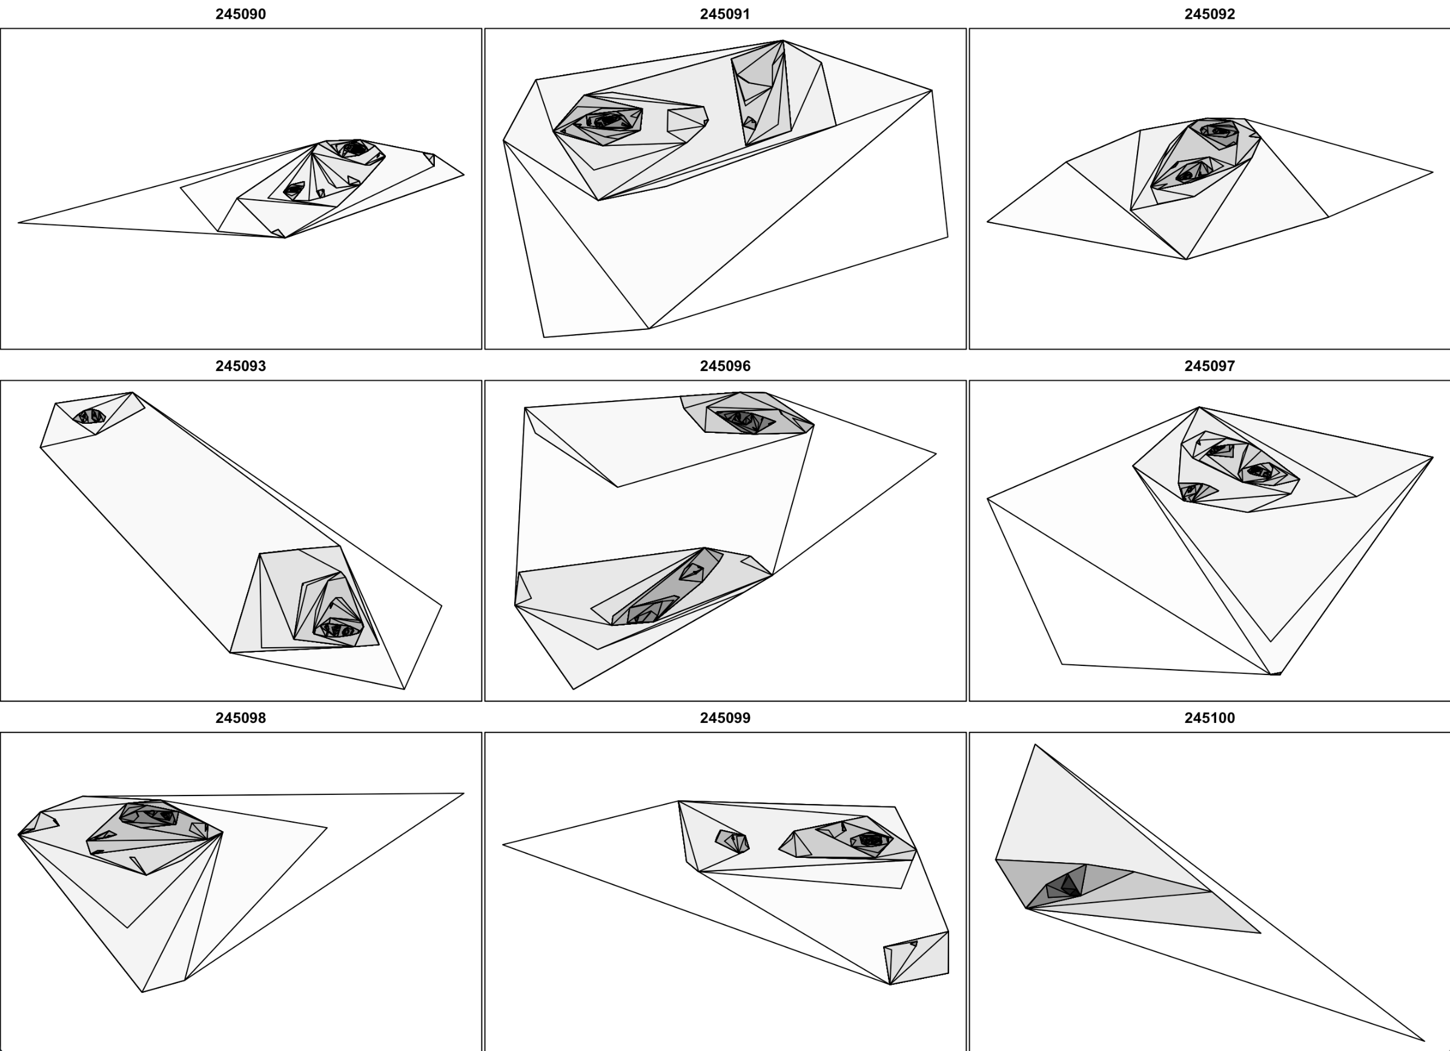
Cluster analysis of home ranges for some tagged bats
Sept 28, 2023

