Slide 1








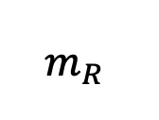

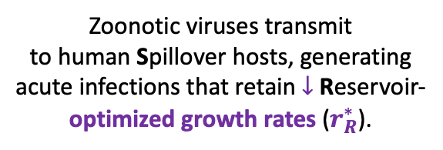
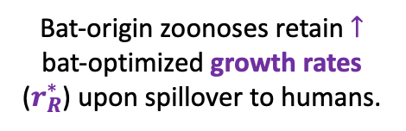





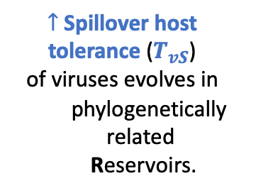

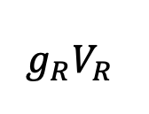

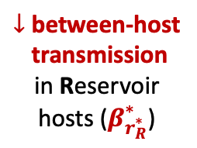
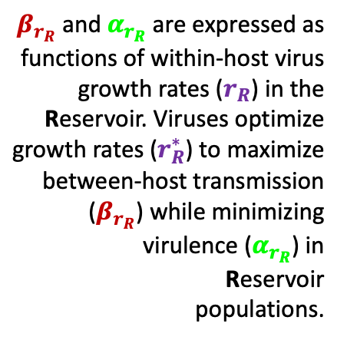
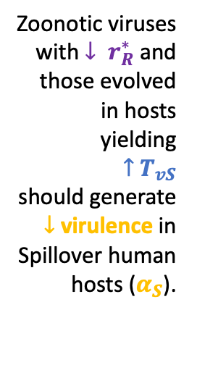







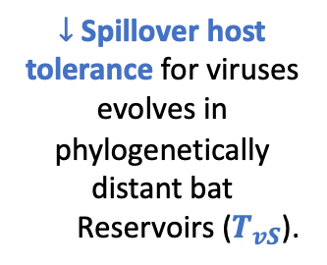

$$α_{r_{R}}$$
A
Within-host viral dynamics in Reservoir:
$β_{r_{R}}$ and $α_{r_{R}}$ are expressed as functions of within-host virus growth rates $\text{(}r_{R}\text{)}$ in the Reservoir. Viruses optimize $\text{growth} \text{rates}\text{ (}r_{R}^{∗}\text{)}$ to maximize between-host transmission ($β_{r_{R}}$) while minimizing virulence ($α_{r_{R}}$) in
Reservoir
populations.
$$b_{R}$$
Virus
$$c_{R}$$
S
$$β_{r_{R}}$$
I
$$r_{R}$$
$$_{R}$$
$$_{R}$$
$$g_{R}V_{R}$$
Leukocyte
$$m_{R}$$
Population-level Reservoir dynamics:
$${g0}_{R}$$
$↓$virulence in Spillover hosts
($α_{S}$)
B
$↓$ between-host
transmission
in Reservoir hosts ($β_{r_{R}^{∗}}^{∗}$)
$↑$ Spillover host tolerance ($T_{vS}$)
of viruses evolves in phylogenetically related Reservoirs.
$↓$optimal virus growth rates evolve
in most Reservoir hosts
($r_{R}^{∗}$).
Zoonotic viruses with $↓ r_{R}^{∗}$ and those evolved
in hosts
yielding
$↑$ $T_{vS}$
should generate $↓$ virulence in Spillover human
hosts ($α_{S}$).
$↓$virulence in Reservoir hosts
($α_{r_{R}^{∗}}^{∗}$)
Zoonotic viruses transmit
to human Spillover hosts, generating acute infections that retain $↓$Reservoir-optimized growth rates $\text{(}r_{R}^{∗}\text{)}$.
…while causing $↓ \text{virulence} \text{(}α_{r_{R}^{∗}}^{∗}\text{)} \text{in} \text{b}\text{at} \text{hosts}$
$↑$virulence in Spillover hosts
($α_{S}$)
C
Unique features of bat immunology and life history evolved in conjunction with flight enable the evolution of $↑$ growth rate viruses ($r_{R}^{∗}$).
$↓$Spillover host tolerance for viruses evolves in phylogenetically distant bat
Reservoirs ($T_{vS}$).
$↑$ $r_{R}^{∗}$
and
$↓T_{vS}$ combine
to yield
$↑$ virulence
in Spillover hosts ($α_{S}$).
Bat-origin zoonoses retain $↑$ bat-optimized growth rates $\text{(}r_{R}^{∗}\text{)}$ upon spillover to humans.
Bat-evolved $↑$ $r_{R}^{∗}$ viruses maximize
between-host transmission (${↑β}_{r_{R}^{∗}}^{∗}$) …

