Slide 1







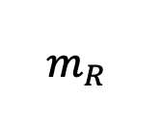


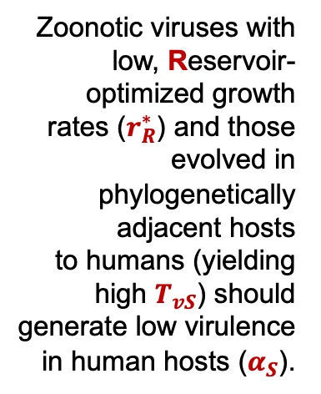

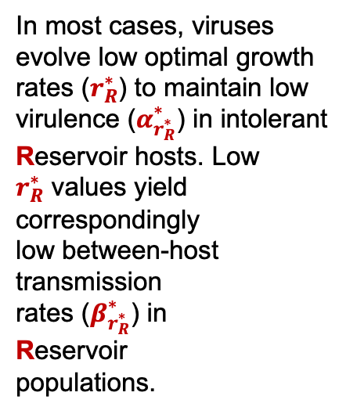
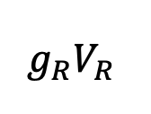




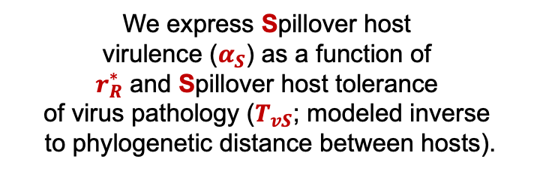



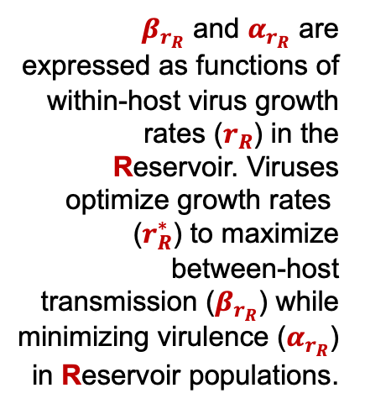










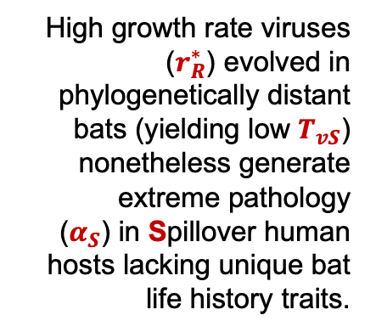
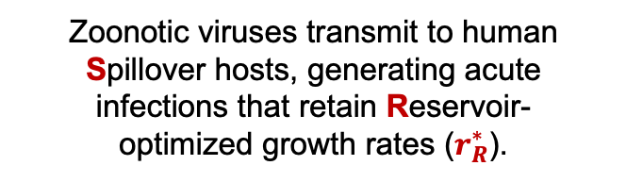
$$α_{r_{R}}$$
A
Within-host viral dynamics in Reservoir:
$β_{r_{R}}$ and $α_{r_{R}}$ are expressed as functions of within-host virus growth rates $\text{(}r_{R}\text{)}$ in the Reservoir. Viruses optimize $\text{growth} \text{rates}\text{ (}r_{R}^{∗}\text{)}$ to maximize between-host transmission ($β_{r_{R}}$) while minimizing virulence ($α_{r_{R}}$) in Reservoir populations.
$$b_{R}$$
$$c_{R}$$
S
$$β_{r_{R}}$$
I
Virus
$$r_{R}$$
$$_{R}$$
$$_{R}$$
$$g_{R}V_{R}$$
Leukocyte
$$m_{R}$$
$${g0}_{R}$$
Population-level Reservoir dynamics:
B
Zoonotic viruses transmit to human Spillover hosts, generating acute
infections that retain Reservoir-
optimized growth rates $\text{(}r_{R}^{∗}\text{)}$.
Zoonotic viruses with low, Reservoir-optimized growth
rates ($r_{R}^{∗}$) and those evolved in phylogenetically adjacent hosts
to humans (yielding
high $T_{vS}$) should
generate low virulence in human hosts ($α_{S}$).
In most cases, viruses evolve low optimal growth rates $\text{(}r_{R}^{∗}\text{)}$ to maintain low virulence ($α_{r_{R}^{∗}}^{∗}$) in intolerant Reservoir hosts. Low
$r_{R}^{∗}$ values yield correspondingly
low between-host
transmission
rates ($β_{r_{R}^{∗}}^{∗}$) in
Reservoir
populations.
We express Spillover host
virulence ($α_{S}$) as a function of
$r_{R}^{∗}$ and Spillover host tolerance
of virus pathology ($T_{vS}$; modeled inverse
to phylogenetic distance between hosts).
$$r_{R}^{∗}$$
$$β_{r_{R}^{∗}}^{∗}$$
$$α_{r_{R}^{∗}}^{∗}$$
$$r_{R}^{∗}$$
$$T_{vS}$$
$$α_{S}$$
C
Unique features of bat immunology and life history evolved in conjunction with flight enable the evolution of high growth rate viruses ($r_{R}^{∗}$),
which maximize gains in between-host transmission ($β_{r_{R}^{∗}}^{∗}$) while
causing only minimal
virulence ($α_{r_{R}^{∗}}^{∗}$) in
bat Reservoir hosts.
High growth rate viruses ($r_{R}^{∗}$) evolved in phylogenetically distant bats (yielding low $T_{vS}$) nonetheless generate extreme pathology
($α_{S}$) in Spillover human hosts lacking unique bat life history traits.
$$r_{R}^{∗}$$
$$β_{r_{R}^{∗}}^{∗}$$
$$α_{r_{R}^{∗}}^{∗}$$
$$r_{R}^{∗}$$
$$T_{vS}$$
$$α_{S}$$

