Slide 1
Data and Models
E²M²: Ecological and Epidemiological Modeling in Madagascar
Hôtel Cyperus
Andasibe National Park, Madagascar
May 2025

Slide 2



Thanks to our sponsors!
Lecture contributions from:
Tanjona Ramiadantsoa
Steve Bellan

Slide 3
Goals for this lecture
To explain what we’re doing here

Slide 4
Goals for this lecture
To explain what we’re doing here
To define “science”

Slide 5
Goals for this lecture
To explain what we’re doing here
To define “science”
To define “data”

Slide 6
Goals for this lecture
To explain what we’re doing here
To define “science”
To define “data”
To define “models”

Slide 7
Goals for this lecture
To explain what we’re doing here
To define “science”
To define “data”
To define “models”
To introduce many different types of models

Slide 8
Goals for this lecture
To explain what we’re doing here
To define “science”
To define “data”
To define “models”
To introduce many different types of models
  Statistical

Slide 9
Goals for this lecture
To explain what we’re doing here
To define “science”
To define “data”
To define “models”
To introduce many different types of models
  Statistical
  Mathematical

Slide 10
Goals for this lecture
To explain what we’re doing here
To define “science”
To define “data”
To define “models”
To introduce many different types of models
  Statistical
  Mathematical
To introduce the “E” in E²M²

Slide 11
Goals for this lecture
To explain what we’re doing here
To define “science”
To define “data”
To define “models”
To introduce many different types of models
  Statistical
  Mathematical
To introduce the “E” in E²M²
  Ecology

Slide 12
Goals for this lecture
To explain what we’re doing here
To define ”science”
To define ”data”
To define “models”
To introduce many different types of models
  Statistical
  Mathematical
To introduce the “E” in E²M²
  Ecology
  Epidemiology

Slide 13
All course materials are available at:
E2M2.org

Slide 14
What is science?

Slide 15
What is science?
the systematic observation of natural events and conditions in order to discover facts about them and to formulate laws and principles based on these facts.
– Academic Press Dictionary of Science & Technology

Slide 16
What is science?
the systematic observation of natural events and conditions in order to discover facts about them and to formulate laws and principles based on these facts.
– Academic Press Dictionary of Science & Technology

Slide 17
Observations and Laws and Principles

Slide 18
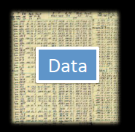
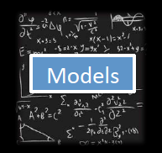
Data and Models
Models

Slide 19
Data and Models
What are data?

Slide 20
Data and Models
What are data?
  Backbone of science
  Evidence to support a claim

Slide 21
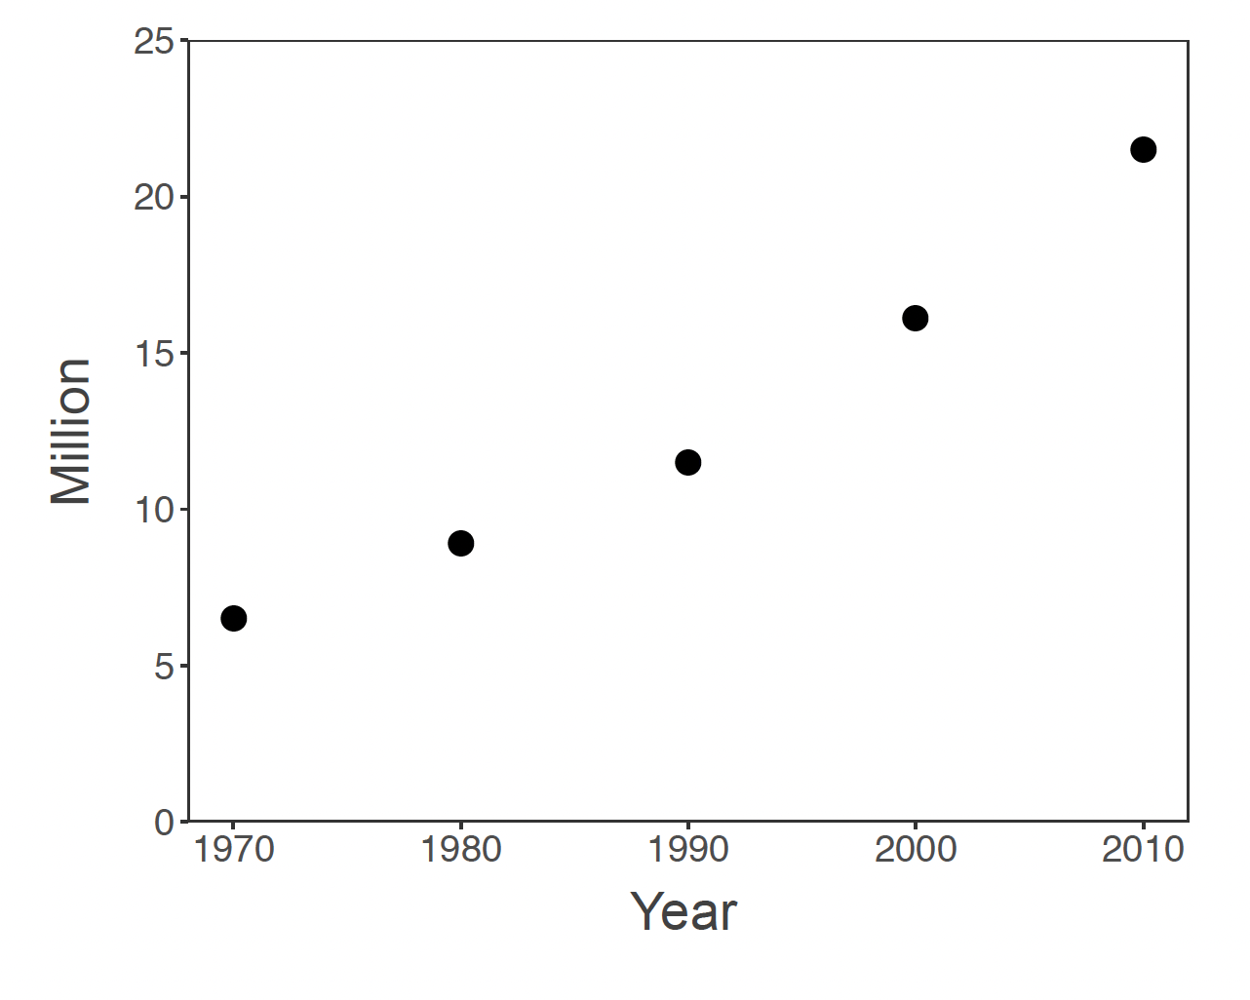
Are these data?

Slide 22
Are these data?
What do we need to make these data?

Slide 23
Are these data?

Slide 24
Are these data?

Slide 25
Are these data?

Slide 26
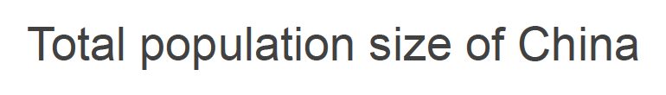
Are these data?

Slide 27

Are these data?

Slide 28

Are these data?

Slide 29
What are data?
  A relationship between at least two variables
    x: explanatory, control, driver, independent variable(s)
    y: response, dependent variable(s)
  x and y should be clearly defined
    with respect to the question!
  Backbone of science
  Evidence to support a claim

Slide 30
What are data?
  A relationship between at least two variables
    x: explanatory, control, driver, independent variable(s)
    y: response, dependent variable(s)
  x and y should be clearly defined
    with respect to the question!
  Backbone of science
  Evidence to support a claim

Slide 31
What are data?
  A relationship between at least two variables
    x: explanatory, control, driver, independent variable(s)
    y: response, dependent variable(s)
  x and y should be clearly defined
    with respect to the question!
  Evidence to support a claim

Slide 32
Data provide evidence to support a claim.
  Backbone of science
  CLAIM: The population size of Madagascar has increased throughout the past 50 years

Slide 33
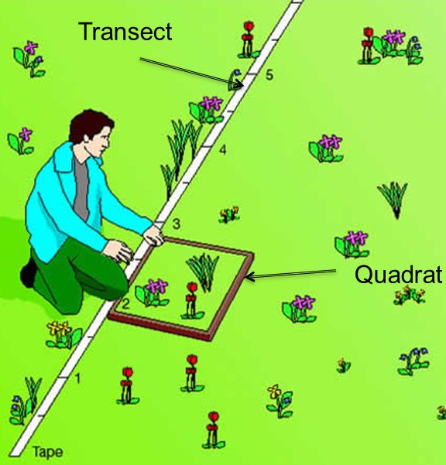
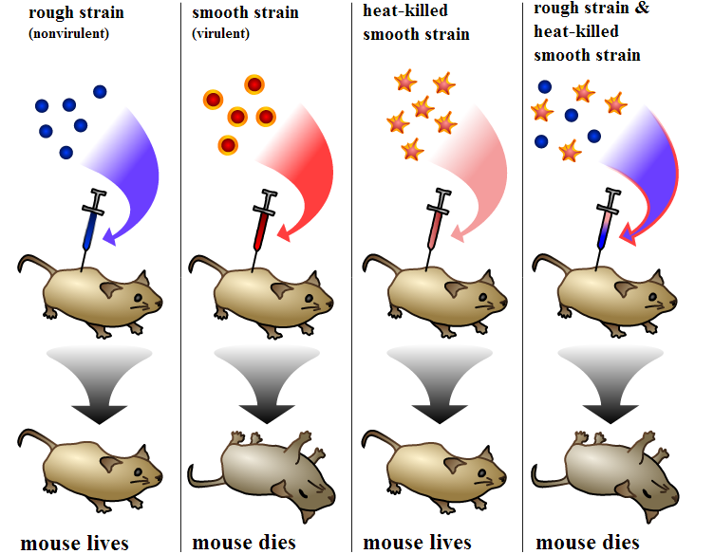
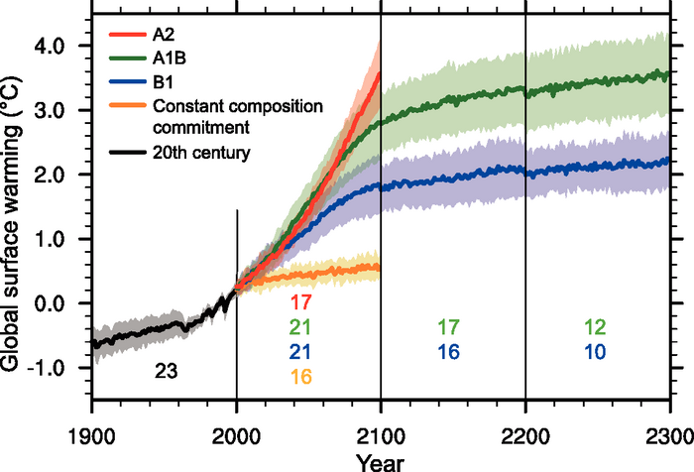
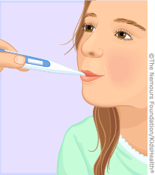
Data: Sources of x and y
Observational | Experimental | Simulated
- Just measure x and y | - Interfere with x or the relationship between x and y | - Create a relationship between x and y
Empirical data

Slide 34
Data: Types
Numerical
Categorical

Slide 35
Data: Types
Numerical
A variable is numerical when you can transform it with mathematical operation
Examples?
Categorical

Slide 36
Data: Types
Numerical
A variable is numerical when you can transform it with mathematical operation
Examples:
Integer, real number, multi-dimensional number
Categorical

Slide 37
Data: Types
Numerical
A variable is numerical when you can transform it with mathematical operation
Examples:
Integer, real number, multi-dimensional number
Categorical
A variable is categorical when it is not numerical but a categorical can be numerical?
Examples?

Slide 38
Data: Types
Numerical
A variable is numerical when you can transform it with mathematical operation
Examples:
Integer, real number, multi-dimensional number
Categorical
A variable is categorical when it is not numerical but a categorical can be numerical?
Examples:
Colors, (blood) types, species name

Slide 39
Data and Models
Models

Slide 40
Data and Models
Models
What is a model?

Slide 41
What is science?
the systematic observation of natural events and conditions in order to discover facts about them and to formulate laws and principles based on these facts.
– Academic Press Dictionary of Science & Technology

Slide 42
Laws and Principles
Theory General
Model
Hypothesis Specific
a declaration to explain a phenomenon
an abstract representation of a phenomenon
a testable declaration that is derived from a theory

Slide 43
Laws and Principles
Theory General
Model
Hypothesis Specific
a declaration to explain a phenomenon
an abstract representation of a phenomenon
a testable declaration that is derived from a theory

Slide 44
Laws and Principles
Theory General
Model
Hypothesis Specific
a declaration to explain a phenomenon
an abstract representation of a phenomenon
a testable declaration that is derived from a theory

Slide 45
Laws and Principles
Theory General
Model
Hypothesis Specific
a declaration to explain a phenomenon
an abstract representation of a phenomenon
a testable declaration that is derived from a theory

Slide 46

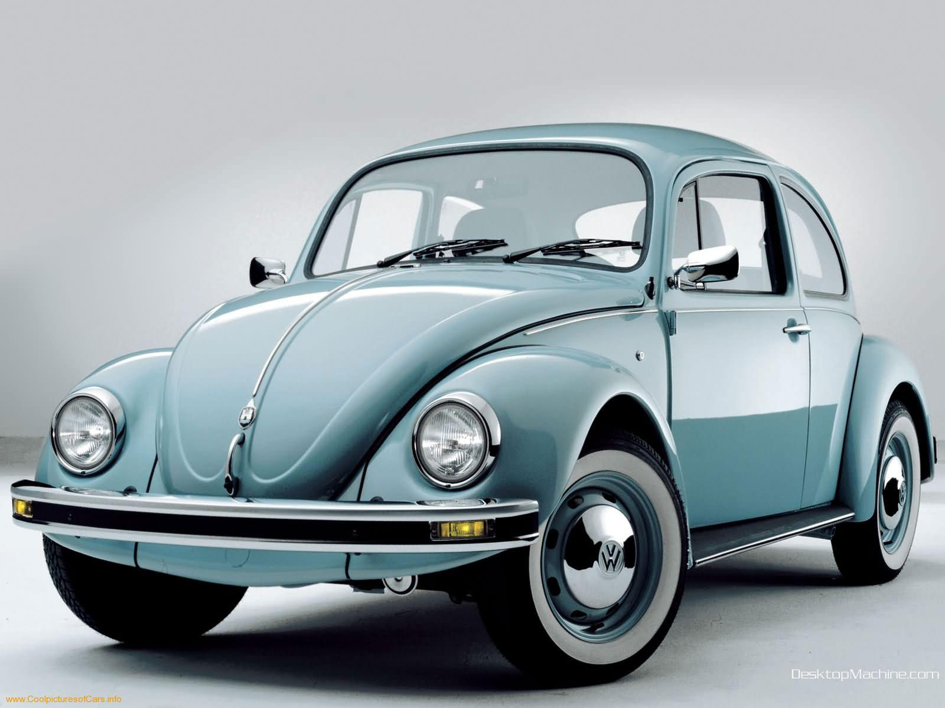
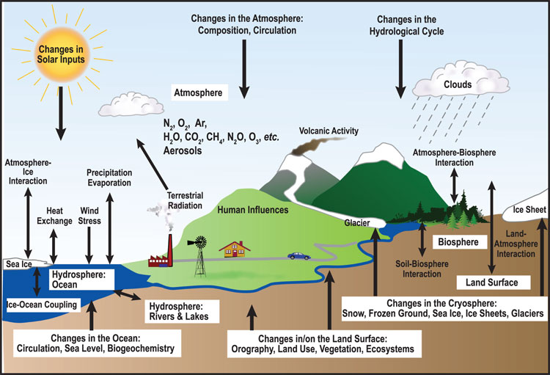
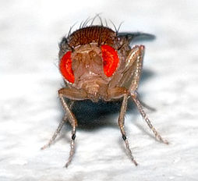
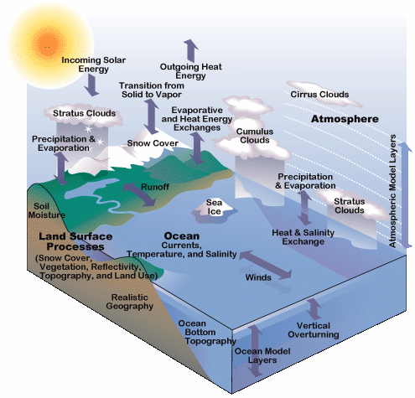
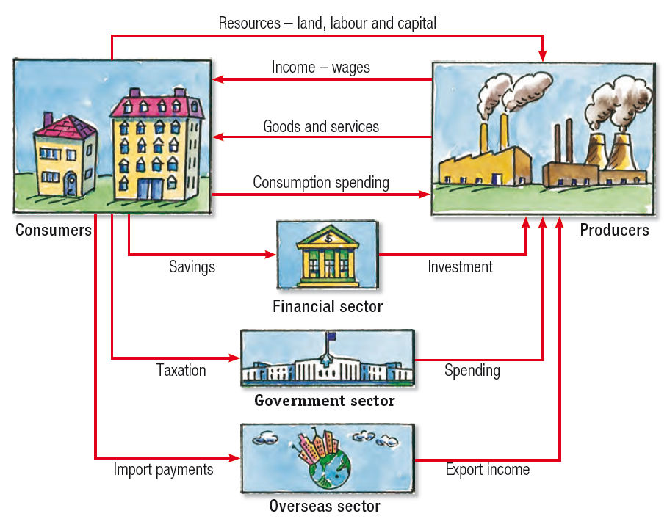
Models: many types
Human
Car
Ecosystem
Ecology & Evolution
Climate
Economy

Slide 47
When you make a model,
you include the
elements that you feel are most important to explain a phenomenon.

Slide 48
When you make a model,
you include the
elements that you feel are most important to explain a phenomenon.
Generally, we try to make models
that can reproduce real-world data

Slide 49
When you make a model,
you include the
elements that you feel are most important to explain a phenomenon.
Generally, we try to make models
that can reproduce real-world data
In E²M², we distinguish between statistical and mechanistic models

Slide 50
Statistical vs. Mathematical Model
The choice depends on the research question!

Slide 51
Statistical Models
Goal: To rigorously assess the strength of relationship between x and y

Slide 52
Statistical Models
Goal: To rigorously assess the strength of relationship between x and y
  Find a significant relationship using a p-value as a measure of relationship strength

Slide 53
Statistical Models
Goal: To rigorously assess the strength of relationship between x and y
  Find a significant relationship using a p-value as a measure of relationship strength
  Statistical models can demonstrate correlations.

Slide 54
Statistical Models
Goal: To rigorously assess the strength of relationship between x and y (describe patterns)
  Find a significant relationship using a p-value as a measure of relationship strength
  Statistical models can demonstrate correlations.
Steps:
  Formulate a research question
  Formulate a hypothesis
  Develop a model to demonstrate your hypothesis.
  Collect data (required!!!)
  Evaluate hypothesis with appropriate statistical tools
    t-test, Chi-square, ANOVA
    Ordination (PCA)
    Regression (LM, GLM, GLMM, GAM)

Slide 55
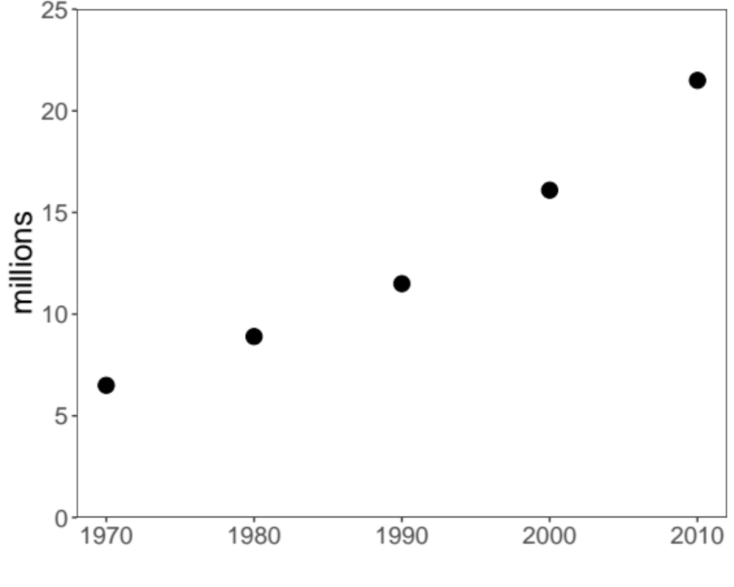
1. Example Question: What is the trajectory of Malagasy population size through time?
Source: World Bank

Slide 56
1. Example Question: What is the trajectory of Malagasy population size through time?
2. Hypothesis: Malagasy population size increases with time
Source: World Bank

Slide 57
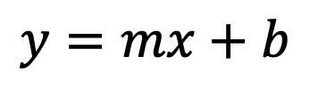
1. Example Question: What is the trajectory of Malagasy population size through time?
2. Hypothesis: Malagasy population size increases with time
3. Statistical Model:
$$y=mx+b$$
Linear Regression
Source: World Bank

Slide 58
1. Example Question: What is the trajectory of Malagasy population size through time?
4. Data:
2. Hypothesis: Malagasy population size increases with time
3. Statistical Model:
$$y=mx+b$$
Linear Regression
Source: World Bank

Slide 59
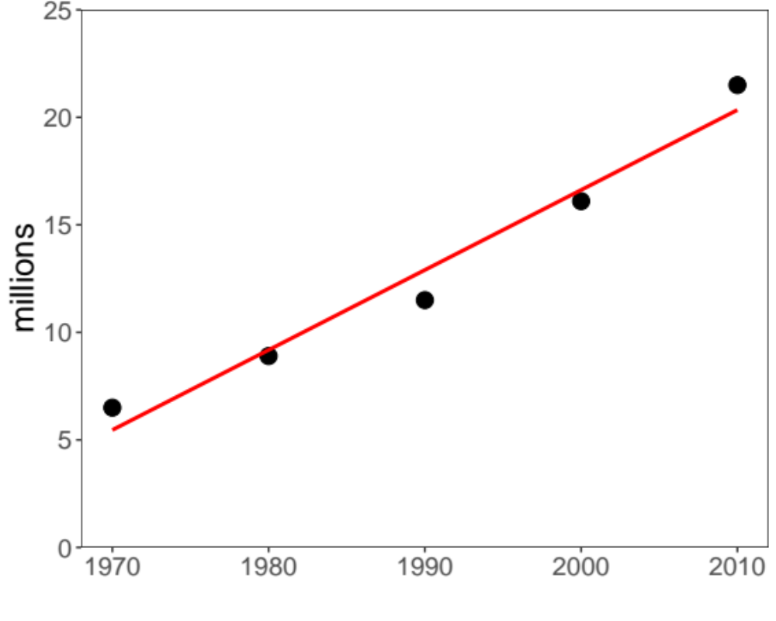
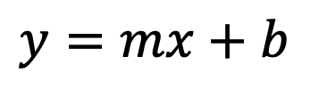


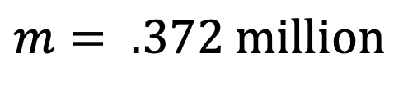
1. Example Question: What is the trajectory of Malagasy population size through time?
4. Data:
2. Hypothesis: Malagasy population size increases with time
3. Statistical Model:
5. Evaluation
Linear Regression
$$y=mx+b$$
$$m= .372 million$$
$$p= .003$$
$$R2= .96$$
What can we conclude from this fitted model?
Source: World Bank

Slide 60
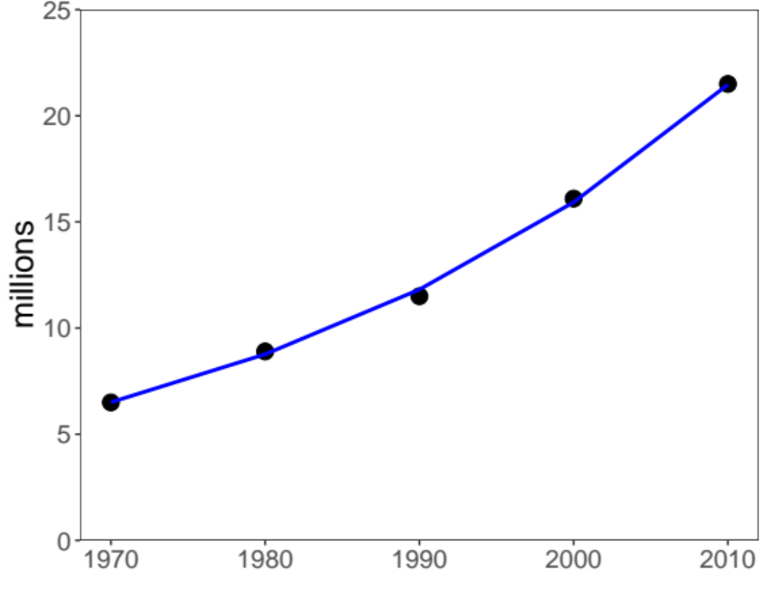



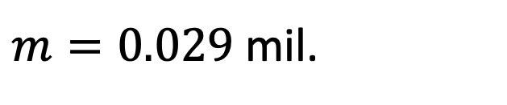
1. Example Question: What is the trajectory of Malagasy population size through time?
6. Adapt your model and re-evaluate:
Exponential Regression
$$y=e^{mx+b}$$
Exponential Regression
$m=0.029$ mil.
$$p<.001$$
$$R2= .99$$
What can we conclude from this fitted model?
Source: World Bank

Slide 61
Statistical Models: Beware!
Statistical models and tests are based on specific assumptions
  data normally distributed
  x and y independent

Slide 62
Statistical Models: Beware!
Statistical models and tests are based on specific assumptions
  data normally distributed
  x and y independent
Assessing a model means you need to make sure the assumptions are not violated.

Slide 63

Statistical Models: Beware!
Statistical models and tests are based on specific assumptions
  data normally distributed
  x and y independent
Assessing a model means you need to make sure the assumptions are not violated.
There are so many statistical models…

Slide 64
Statistical vs. Mathematical Model
The choice depends on the research question!

Slide 65
Mechanistic Models
Goal: To demonstrate the processes that underlie a relationship between x and y

Slide 66
Mechanistic Models
Goal: To demonstrate the processes that underlie a relationship between x and y
  Find a significant relationship using a p-value as a measure of relationship strength.

Slide 67
Mechanistic Models
Goal: To demonstrate the processes that underlie a relationship between x and y
  Find a significant relationship using a p-value as a measure of relationship strength
  Mechanistic models can demonstrate causation.

Slide 68
Mechanistic Models
Goal: To demonstrate the processes that underlie a relationship between x and y
  Find a significant relationship using a p-value as a measure of relationship strength
  Mechanistic models can demonstrate causation.
Steps:
  Formulate a research question
  Formulate a hypothesis
  Develop a model to demonstrate your hypothesis.
  Collect data (for certain questions)
  Evaluate the extent to which your model-simulated data matches that from the real world.

Slide 69
1. Example Question: How does Malagasy population size change with time?
2. Hypothesis: Malagasy population size increases because people are having children.
Can you think of an alternative hypothesis?
Source: World Bank

Slide 70

1. Example Question: How does Malagasy population size change with time?
2. Hypothesis: Malagasy population size increases because people are having children.
3. Mechanistic Model:
Population
birth
death
$$P_{t+1}=P_{t}+b∗P_{t} −d∗P_{t}$$
$$P_{t+1}=P_{t}+r∗P_{t}$$
Source: World Bank

Slide 71
1. Example Question: How does Malagasy population size change with time?
2. Hypothesis: Malagasy population size increases because people are having children.
3. Mechanistic Model:
4. Data:
Population
birth
death
$$P_{t+1}=P_{t}+b∗P_{t} −d∗P_{t}$$
$$P_{t+1}=P_{t}+r∗P_{t}$$
Source: World Bank

Slide 72
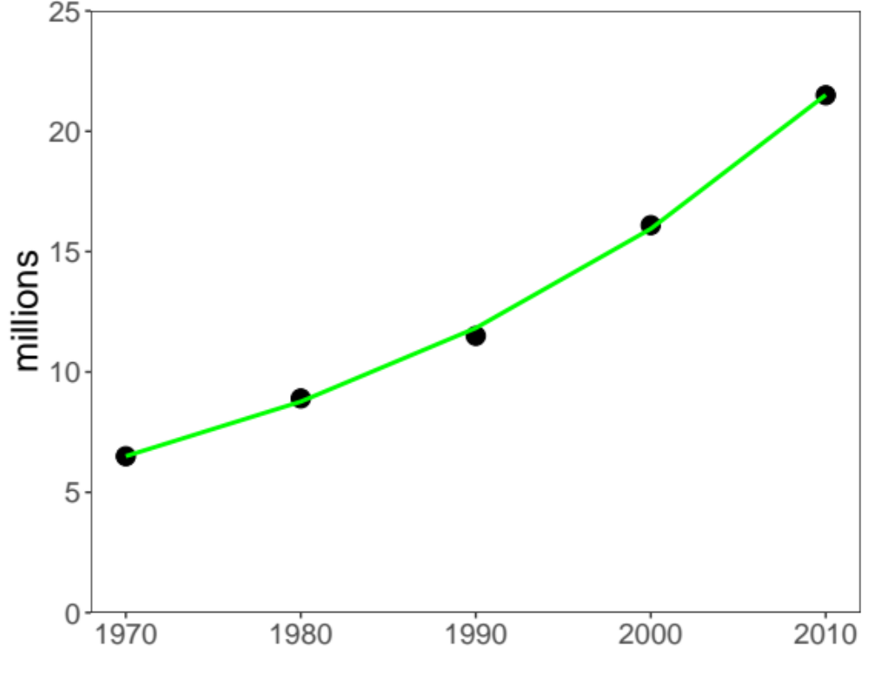
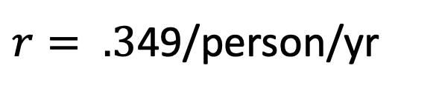
1. Example Question: How does Malagasy population size change with time?
2. Hypothesis: Malagasy population size increases because people are having children.
3. Mechanistic Model:
5. Evaluation:
4. Data:
Population
birth
death
$r= .3$49/person/yr
What can we conclude from this fitted model?

Slide 73
Mechanistic Models: Beware!
Parameters used in the mechanistic models sometimes are not measurable!

Slide 74
Mechanistic Models: Beware!
Parameters used in the mechanistic models sometimes are not measurable!
Simulations can be computationally intensive

Slide 75
Mechanistic Models: Beware!
Parameters used in the mechanistic models sometimes are not measurable!
Simulations can be computationally intensive
Advances in computational power often inspire development of more complex models which are not necessarily better

Slide 76
Mechanistic Models: Beware!
Parameters used in the mechanistic models sometimes are not measurable!
Simulations can be computationally intensive
Advances in computational power often inspire development of more complex models which are not necessarily better
“All models are wrong but some are useful…”
-George Box

Slide 77
Mechanistic Models: Beware!
Parameters used in the mechanistic models sometimes are not measurable!
Simulations can be computationally intensive
Advances in computational power often inspire development of more complex models which are not necessarily better
“All models are wrong but some are useful…”
-George Box
We use models to both predict and explain.

Slide 78
It is ideal when statistical and mechanistic models meet:
Mechanistic model
Process
Pattern
Statistical model

Slide 79

A Tool for E²M²
Computer power keeps increasing
Language/software
  Fortran, C, C++
  Julia, Java, Python
  Matlab, Maple, Mathematica,
  SAS, SPSS, Stata
Specific programs
  Vortex, RAMAS, NetLogo for IBM
  NicheMapper for physiology, iLand for forest dynamics
  MaxEnt for species distribution modeling
  Zonation for reserve selection etc…
The compromise: R---very powerful for
  Visualization
  Data formatting and sorting
  Statistical analyses
  Simulation (mechanistic model)

Slide 81
Goals for this lecture
To explain what we’re doing here
To define ”science”
To define ”data”
To define “models”
To introduce many different types of models
  Statistical
  Mathematical
To introduce the “E” in E²M²
  Ecology
  Epidemiology

Slide 82
Goals for this lecture
To explain what we’re doing here
To define ”science”
To define ”data”
To define “models”
To introduce many different types of models
  Statistical
  Mathematical
To introduce the “E” in E²M²
  Ecology
  Epidemiology

Slide 83
What is Epidemiology?
“the study of what is on the people”
  – coined in 1802 to describe diseases in the Spanish population
Emphasis on the study and analysis of the distribution and determinants of health and disease (“risk factors”)

Slide 84
Models in Epidemiology
Sickness caused by an imbalance in the four humors (Hippocrates)

Slide 85
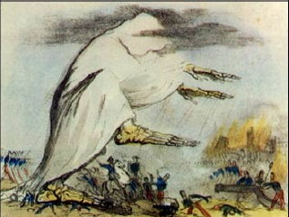
Models in Epidemiology
Sickness caused by an imbalance in the four humors (Hippocrates)
Miasmatic theory of disease (1500s)
  Sickness results from emanations of ‘bad air’

Slide 86
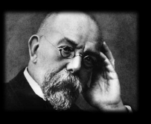
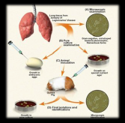
Models in Epidemiology
Sickness caused by an imbalance in the four humors (Hippocrates)
Miasmatic theory of disease (1500s)
  Sickness results from emanations of ‘bad air’
Germ theory of disease
  Leeuwenhoek’s microscope (1675)
  Koch’s postulates (1890)

Slide 87
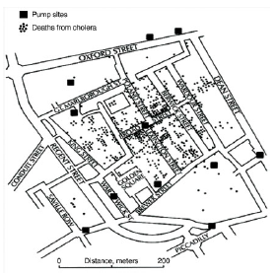
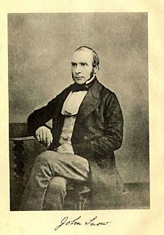
Models in Epidemiology
Sickness caused by an imbalance in the four humors (Hippocrates)
Miasmatic theory of disease (1500s)
  Sickness results from emanations of ‘bad air’
Germ theory of disease
  Leeuwenhoek’s microscope (1675)
  Koch’s postulates (1890)
Classical epidemiology
  John Snow and London cholera (1854)

Slide 88
Models in Epidemiology
Sickness caused by an imbalance in the four humors (Hippocrates)
Miasmatic theory of disease (1500s)
  Sickness results from emanations of ‘bad air’
Germ theory of disease
  Leeuwenhoek’s microscope (1675)
  Koch’s postulates (1890)
Classical epidemiology
  John Snow and London cholera (1854)
Mathematical epidemiology
  Kermack and McKendrik (1927)
γ
S
βI or
βI/N
I
R
Susceptible
Infectious
Recovered

Slide 89
What is Ecology?
The study of the interactions of organisms and their environment
  Coined in 1866 by German scientist Ernst Haeckel
  Nile crocodiles opening mouths for sandpipers (Herodotus)
Emphasis on explaining dynamical processes in nature

Slide 90
Models in Ecology
Origins in plant biology and succession
  Clements and Gleason (1910s-20s)

Slide 91
Models in Ecology
Origins in plant biology and succession
  Clements and Gleason (1910s-20s)
Food Chains
  - Charles Elton (1920s)

Slide 92
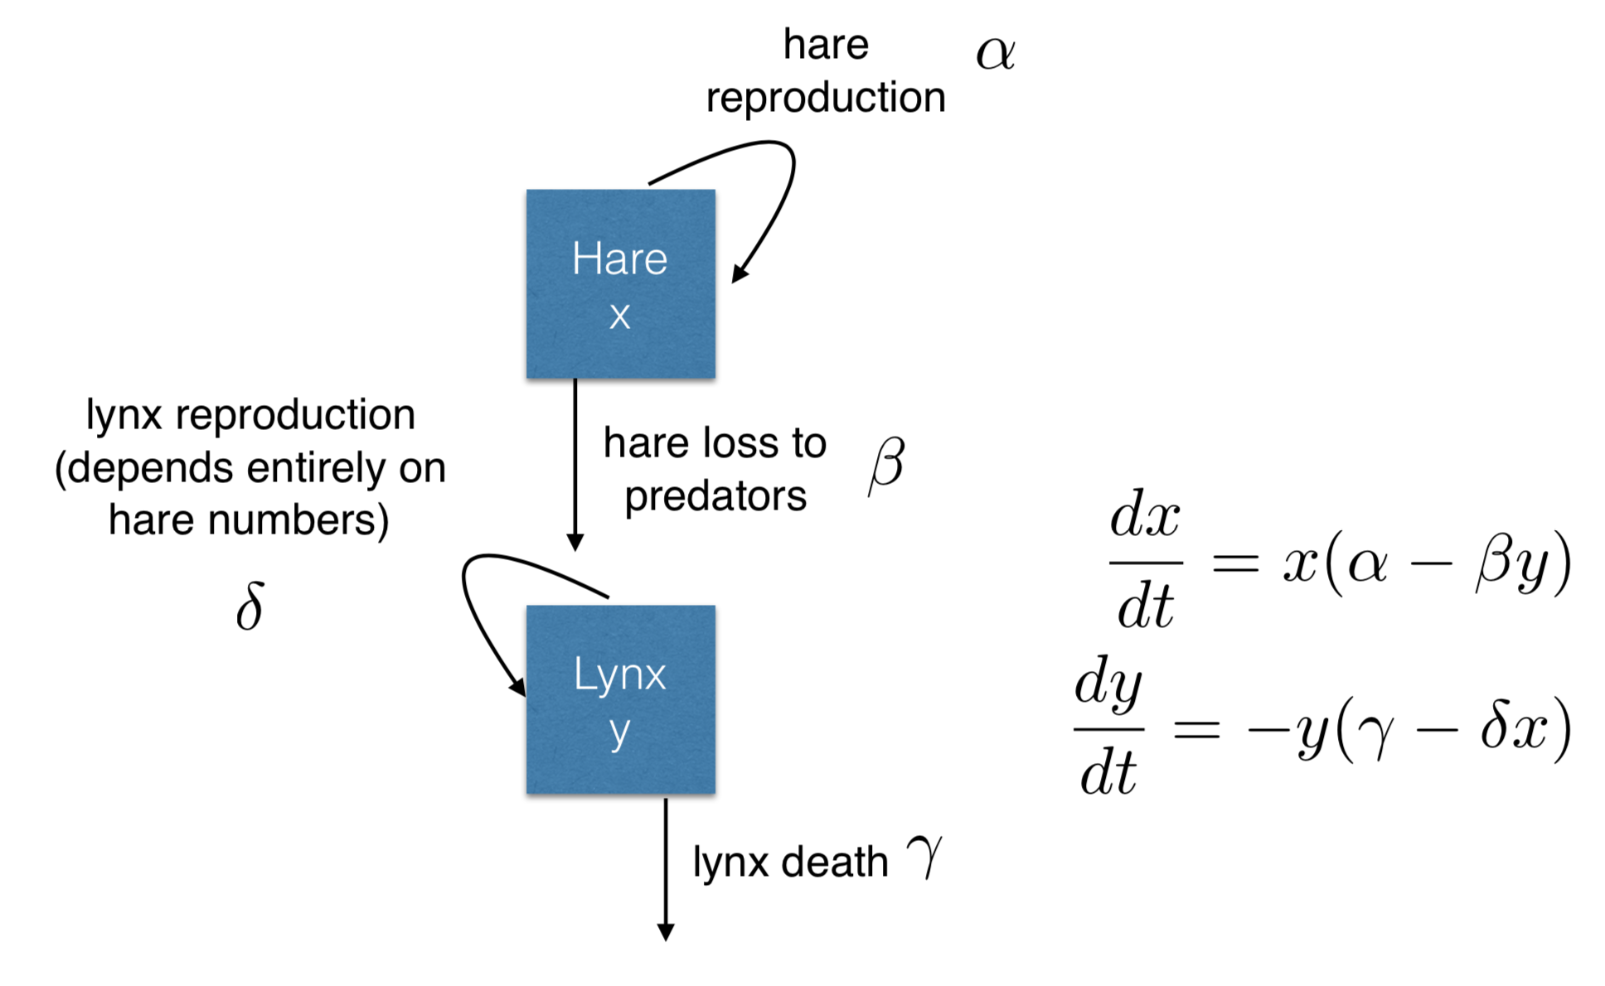
Models in Ecology
Origins in plant biology and succession
  Clements and Gleason (1910s-20s)
Food Chains
  - Charles Elton (1920s)
Predator-Prey Dynamics
  - Lotka-Voltera (1920s)

Slide 93
Models in Ecology
Origins in plant biology and succession
  Clements and Gleason (1910s-20s)
Food Chains
  - Charles Elton (1920s)
Predator-Prey Dynamics
  - Lotka-Voltera (1920s)
Mathematical Ecology
  Robert MacArthur (1950s)
  Island biogeography

Slide 94
Models in Ecology
Origins in plant biology and succession
  Clements and Gleason (1910s-20s)
Food Chains
  - Charles Elton (1920s)
Predator-Prey Dynamics
  - Lotka-Voltera (1920s)
Mathematical Ecology
  Robert MacArthur (1950s)
  Island biogeography
Disease Ecology
  Anderson and May (1980s)
  Island biogeography
γ
S
βI or
βI/N
I
R
Susceptible
Infectious
Recovered

Slide 95
Misaotra!

