Slide 1
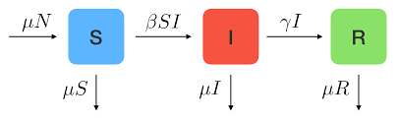
Introduction to Compartmental Models
Introduction aux modèles à compartiments
Adapted from slides by:
Cara Brook, University of Chicago
Amy Wesolowski, Johns Hopkins University
Jessica Metcalf, Princeton University
Sophia Horigan, University of Chicago
Sophie Lockwood
University of Chicago
E2M2 2025

Slide 2
Goals for this lecture
Understand the difference between statistical and compartmental models Comprendre la différence entre les modèles statistiques et les modèles à compartiments
Understand the difference between parameters and state variables Comprendre la différence entre les paramètres et les variables d’état
Understand the difference between discrete-time and continuous-time models Comprendre la différence entre les modèles à temps discret et les modèles à temps continu
Understand how to formalize and conceptualize compartmental models Comprendre comment formaliser et conceptualiser les modèles à compartiments

Slide 3
Compartmental/Mechanistic/Mathematical Models
Populations are divided into compartments Les populations sont subdivisées en compartiments
Individuals within a compartment are homogenously mixed Les individus d’un compartiment sont mélangés de manière homogène
Compartments and transition rates are determined by biological systems Les compartiments et les taux de transition sont determinés par les systèmes biologiques
Rates of transfer between compartments are expressed mathematically Les taux de transition entre les compartiments sont exprimés mathématiquement

Slide 4
Compartmental/Mechanistic/Mathematical Models
Populations are divided into compartments Les populations sont subdivisées en compartiments
Individuals within a compartment are homogenously mixed Les individus d’un compartiment sont mélangés de manière homogène
Compartments and transition rates are determined by biological systems Les compartiments et les taux de transition sont determinés par les systèmes biologiques
Rates of transfer between compartments are expressed mathematically Les taux de transition entre les compartiments sont exprimés mathématiquement

Slide 5
Compartmental/Mechanistic/Mathematical Models
Populations are divided into compartments Les populations sont subdivisées en compartiments
Individuals within a compartment are homogenously mixed Les individus d’un compartiment sont mélangés de manière homogène
Compartments and transition rates are determined by biological systems Les compartiments et les taux de transition sont determinés par les systèmes biologiques
Rates of transfer between compartments are expressed mathematically Les taux de transition entre les compartiments sont exprimés mathématiquement

Slide 6
Compartmental/Mechanistic/Mathematical Models
Populations are divided into compartments Les populations sont subdivisées en compartiments
Individuals within a compartment are homogenously mixed Les individus d’un compartiment sont mélangés de manière homogène
Compartments and transition rates are determined by biological systems Les compartiments et les taux de transition sont determinés par les systèmes biologiques
Rates of transfer between compartments are expressed mathematically Les taux de transition entre les compartiments sont exprimés mathématiquement

Slide 7
How are these different from statistical models? En quoi sont-elles différentes des modèles statistiques?

Slide 8
How are these different from statistical models? En quoi sont-elles différentes des modèles statistiques?
Compartmental models make explicit hypotheses about biological mechanisms that drive dynamics (may not be realistic, but still explicit)
Les modèles à compartements font des hypothèses explicites sur les mécanismes biologiques qui régissent la dynamique (peut ne pas être réalistes, mais toujours explicites)

Slide 9
1. Simple Population Models Les modèles simples de population

Slide 10
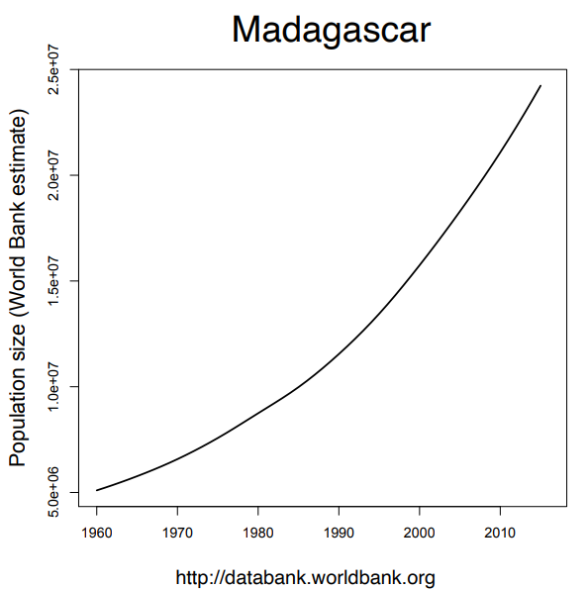
What can we say about the population of Madagascar?
How would a model help us? What kind of model should we use?

Slide 11
The basic population model
How does the population of Madagascar grow over time?
Comment est-ce que la population de Madagascar augmente avec le passage du temps ?

Slide 12
The basic population model
Compartmental models (mechanistic models)
Populations are divided into compartments
Individuals within a compartment are homogenously mixed
Compartments and transition rates are determined by biological systems
Rates of transferring between compartments are expressed mathematically
Les modèles à compartiments (les modèles mécaniste)
Les populations sont subdivisées en compartiments
Les individus d’un compartiment sont mélangés de manière homogène
Les compartiments et les taux de transition sont déterminés par les systèmes biologiques
Les taux de transition entre les compartiments sont exprimés mathématiquement

Slide 13
The basic population model
Compartmental models (mechanistic models)
Populations are divided into compartments
Individuals within a compartment are homogenously mixed
Compartments and transition rates are determined by biological systems
Rates of transferring between compartments are expressed mathematically
Square = compartment
Madagascar
(N)
N = state variable = the data we want to explain

Slide 14
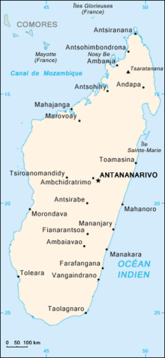
The basic population model
Compartmental models (mechanistic models)
Populations are divided into compartments
Individuals within a compartment are homogenously mixed
Compartments and transition rates are determined by biological systems
Rates of transferring between compartments are expressed mathematically
Madagascar
(N)

Slide 15
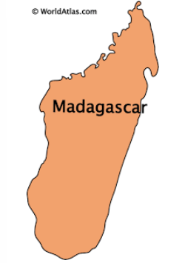
The basic population model
Compartmental models (mechanistic models)
Populations are divided into compartments
Individuals within a compartment are homogenously mixed
Compartments and transition rates are determined by biological systems
Rates of transferring between compartments are expressed mathematically
Madagascar
(N)

Slide 16
The basic population model
Compartmental models (mechanistic models)
Populations are divided into compartments
Individuals within a compartment are homogenously mixed
Compartments and transition rates are determined by biological systems
Rates of transferring between compartments are expressed mathematically
Madagascar
(N)
How does the population grow?
Comment est-ce que la population augmente?

Slide 17
The basic population model
Compartmental models (mechanistic models)
Populations are divided into compartments
Individuals within a compartment are homogenously mixed
Compartments and transition rates are determined by biological systems
Rates of transferring between compartments are expressed mathematically
births
Madagascar
(N)

Slide 18
The basic population model
Compartmental models (mechanistic models)
Populations are divided into compartments
Individuals within a compartment are homogenously mixed
Compartments and transition rates are determined by biological systems
Rates of transferring between compartments are expressed mathematically
Madagascar
(N)
How does the population decrease?
Comment est-ce que la population diminue ?

Slide 19
The basic population model
Compartmental models (mechanistic models)
Populations are divided into compartments
Individuals within a compartment are homogenously mixed
Compartments and transition rates are determined by biological systems
Rates of transferring between compartments are expressed mathematically
births
Madagascar
(N)
deaths

Slide 20
The basic population model
Compartmental models (mechanistic models)
Populations are divided into compartments
Individuals within a compartment are homogenously mixed
Compartments and transition rates are determined by biological systems
Rates of transferring between compartments are expressed mathematically
births
Madagascar
(N)
What is a big assumption we are making here?
C’est quoi une hypothèse importante que nous faisons ici ?
deaths

Slide 21
The basic population model
Compartmental models (mechanistic models)
Populations are divided into compartments
Individuals within a compartment are homogenously mixed
Compartments and transition rates are determined by biological systems
Rates of transferring between compartments are expressed mathematically
births
Madagascar
(N)
Homogenous mixing La mélange homogène
No immigration Sans immigration
Same birth and death rate for each person Les mêmes taux de natalité et de mortalité pour chaque personne
deaths

Slide 22
The basic population model
Compartmental models (mechanistic models)
Populations are divided into compartments
Individuals within a compartment are homogenously mixed
Compartments and transition rates are determined by biological systems
Rates of transferring between compartments are expressed mathematically
births
Madagascar
(N)
deaths
N_{t+1}=

Slide 23
The basic population model
Compartmental models (mechanistic models)
Populations are divided into compartments
Individuals within a compartment are homogenously mixed
Compartments and transition rates are determined by biological systems
Rates of transferring between compartments are expressed mathematically
births
Madagascar
(N)
deaths
N_{t+1}=(births)*N_{t}

Slide 24
The basic population model
Compartmental models (mechanistic models)
Populations are divided into compartments
Individuals within a compartment are homogenously mixed
Compartments and transition rates are determined by biological systems
Rates of transferring between compartments are expressed mathematically
births
Madagascar
(N)
deaths
N_{t+1}=(births)*N_{t} – (deaths)*N_{t}

Slide 25
The basic population model
Compartmental models (mechanistic models)
Populations are divided into compartments
Individuals within a compartment are homogenously mixed
Compartments and transition rates are determined by biological systems
Rates of transferring between compartments are expressed mathematically
births
Madagascar
(N)
deaths
N_{t+1}=(births)*N_{t} – (deaths)*N_{t}
N_{t+1}=(births-deaths)*N_{t}

Slide 26
The basic population model
Compartmental models (mechanistic models)
Populations are divided into compartments
Individuals within a compartment are homogenously mixed
Compartments and transition rates are determined by biological systems
Rates of transferring between compartments are expressed mathematically
births
Madagascar
(N)
deaths
N_{t+1}=(births)*N_{t} – (deaths)*N_{t}
N_{t+1}=(births-deaths)*N_{t}
N_{t+1}=λ*N_{t}
λ = pop intrinsic growth rate

Slide 27
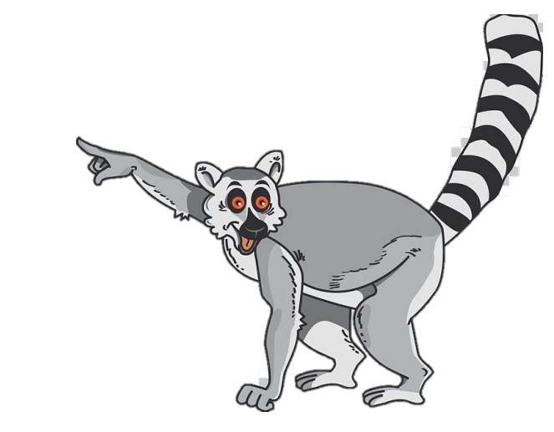
Checking In
What are the main assumptions of a single population model? Quelles sont les principales hypothèses d’un modèle d’une seule population?
What does lambda represent? Que représente le lambda?

Slide 28
Checking In
What are the main assumptions of a single population model?
No immigration (sans immigration)
Homogenous mixing (mélange homogène)
Same birth and death rate for each person (les mêmes taux de natalité et de mortalité pour chaque personne)
What is lambda?
Population intrinsic growth rate (taux de croissance intrinsèque)

Slide 29
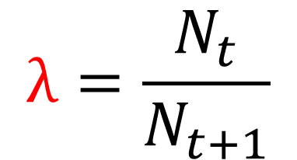
The basic population model
births
Madagascar
(N)
$$λ=\frac{N_{t}}{N_{t+1}}$$
pop size at t
deaths
pop size at t+1
This is for one time step, how do we generalize this equation to work for all time steps?
C’est pour un pas de temps, comment généraliser cette équation pour tous les pas de temps?

Slide 30
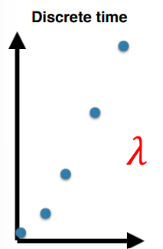
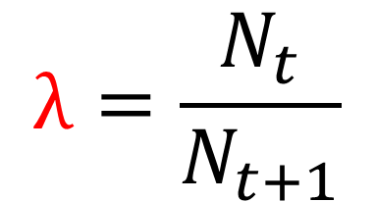
The basic population model
births
Madagascar
(N)
$$λ=\frac{N_{t}}{N_{t+1}}$$
deaths
N₁ =
N₂ =
N₃ =
N_{t} =

Slide 31
The basic population model
births
Madagascar
(N)
$$λ=\frac{N_{t}}{N_{t+1}}$$
deaths
N₁ = N₀λ
N₂ =
N₃ =
N_{t} =

Slide 32
The basic population model
births
Madagascar
(N)
$$λ=\frac{N_{t}}{N_{t+1}}$$
deaths
N₁ = N₀λ
N₂ = N₁λ = [N₀λ]λ = λ²N₀
N₃ =
N_{t} =

Slide 33
The basic population model
births
Madagascar
(N)
$$λ=\frac{N_{t}}{N_{t+1}}$$
deaths
N₁ = N₀λ
N₂ = N₁λ = [N₀λ]λ = λ²N₀
N₃ = λ³N₀
N_{t} =

Slide 34
The basic population model
births
Madagascar
(N)
$$λ=\frac{N_{t}}{N_{t+1}}$$
deaths
N₁ = N₀λ
N₂ = N₁λ = [N₀λ]λ = λ²N₀
N₃ = λ³N₀
N_{t} = λ^{t}N₀

Slide 35

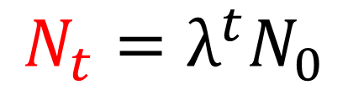
The basic population model
births
Madagascar
(N)
deaths
What if we want to know the population size for any time t?
Not just where we have data?
$$λ=\frac{N_{t}}{N_{t+1}}$$
$$N_{t}=λ^{t}N_{0}$$

Slide 36
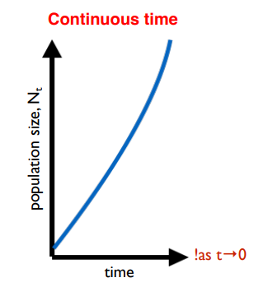
The basic population model
births
Madagascar
(N)
deaths
$$λ=\frac{N_{t}}{N_{t+1}}$$
$$N_{t}=λ^{t}N_{0}$$

Slide 37
The basic population model
births
Madagascar
(N)
deaths
$$λ=\frac{N_{t}}{N_{t+1}}$$
$$N_{t}=λ^{t}N_{0}$$
How do we get the same type of equation for continuous time?

Slide 38



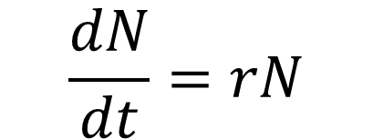
The basic population model
births
Madagascar
(N)
deaths
$$r=\frac{N_{t}−N_{0}}{t}$$
$$λ=\frac{N_{t}}{N_{t+1}}$$
$$\frac{dN}{dt}=rN$$
$$N_{t} =λ^{t}N_{0}$$

Slide 39
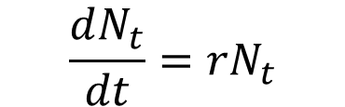

The basic population model
Continuous time
$$\frac{dN_{t}}{dt}={rN}_{t}$$
$$N_{t} =λ^{t}N_{0}$$

Slide 40
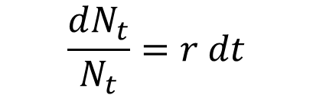
The basic population model
Continuous time
$$\frac{dN_{t}}{dt}={rN}_{t}$$
Separation of variables
$$\frac{dN_{t}}{N_{t}}=r dt$$
$$N_{t} =λ^{t}N_{0}$$

Slide 41

The basic population model
Continuous time
$$\frac{dN_{t}}{dt}={rN}_{t}$$
Separation of variables
$$\frac{dN_{t}}{N_{t}}=r dt$$
Integrate both sides
$$\int_{N_{0}}^{N_{t}}{\frac{dN_{t}}{N_{t}}=r\int_{0}^{t}{dt}}$$
$$N_{t} =λ^{t}N_{0}$$

Slide 42


The basic population model
Continuous time
By definition
$$\frac{dN_{t}}{dt}={rN}_{t}$$
$$\ln{N_{t}}−\ln{N_{0}=rt}$$
$$\ln{\frac{N_{t}}{N_{0}}}={rN}_{t}$$
Separation of variables
$$\frac{dN_{t}}{N_{t}}=r dt$$
Integrate both sides
$$\int_{N_{0}}^{N_{t}}{\frac{dN_{t}}{N_{t}}=r\int_{0}^{t}{dt}}$$
$$N_{t} =λ^{t}N_{0}$$

Slide 43

The basic population model
Continuous time
By definition
$$\frac{dN_{t}}{dt}={rN}_{t}$$
$$\ln{N_{t}}−\ln{N_{0}=rt}$$
$$\ln{\frac{N_{t}}{N_{0}}}={rN}_{t}$$
Separation of variables
$$\frac{dN_{t}}{N_{t}}=r dt$$
Exponentiate
$$\frac{N_{t}}{N_{0}} =e^{rt}$$
Integrate both sides
$$\int_{N_{0}}^{N_{t}}{\frac{dN_{t}}{N_{t}}=r\int_{0}^{t}{dt}}$$
$$N_{t} =λ^{t}N_{0}$$

Slide 44

The basic population model
Continuous time
By definition
$$\frac{dN_{t}}{dt}={rN}_{t}$$
$$\ln{N_{t}}−\ln{N_{0}=rt}$$
$$\ln{\frac{N_{t}}{N_{0}}}={rN}_{t}$$
Separation of variables
$$\frac{dN_{t}}{N_{t}}=r dt$$
Exponentiate
$$\frac{N_{t}}{N_{0}} =e^{rt}$$
Integrate both sides
$$\int_{N_{0}}^{N_{t}}{\frac{dN_{t}}{N_{t}}=r\int_{0}^{t}{dt}}$$
Solve for N(t):
$$N_{t} =λ^{t}N_{0}$$
$$N_{t} =N_{0}e^{rt}$$

Slide 45


The basic population model
births
Madagascar
(N)
deaths
$$N_{t}=λ^{t}N_{0}$$
$$N_{t}=N_{0}e^{rt}$$

Slide 46
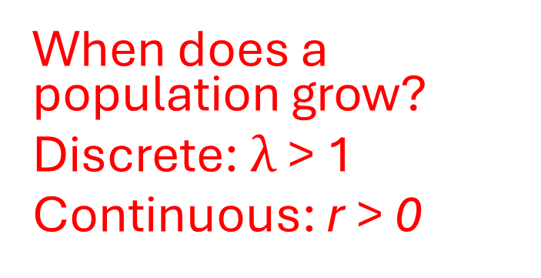
The basic population model
births
Madagascar
(N)
deaths
When does a population grow?
Discrete: $λ$ > 1
Continuous: r > 0
$$N_{t}=λ^{t}N_{0}$$
$$N_{t}=N_{0}e^{rt}$$

Slide 47
The basic population model
births
Madagascar
(N)
deaths
Discrete
Continuous
Continuous models can be discretized; discrete models can be approximated by continuous ones. The appropriate choice may depend on the data/question.
Les modèles à temps continu peuvent être discrétisés; les modèles à temps discret peuvent être approximés par ceux à temps continu. Le choix approprié peut dépender des données/de la question.

Slide 48
Checking In
What is the difference between discrete and continuous models? Quelle est la différence entre les modèles à temps discret et à temps continu?
What math is used in discrete population models? Continuous population models? Quel type de mathématique est utilisé dans les modèles à temps discret et à temps continu?

Slide 49
Checking In
What is the difference between discrete and continuous models?
Discrete: state variable only changes at distinct time steps
Continuous: state variables change continuously (tiny tiny time steps)
What math is used in discrete population models? Continuous population models?
Algebra, Calculus

Slide 50
The basic population model
births
What about these rates?
Are they the same every year? And in every person?
Why might they be different?
Madagascar
(N)
deaths

Slide 51
The basic population model
births
What about these rates?
Are they the same every year? And in every person?
Why might they be different?
Madagascar
(N)
deaths
Reproductive age (âge de procréer)
Death rate increases with age (le taux de mortalité s’accroît avec l’ âge)
Diseases/other health factors (les maladies / d’autres facteurs de santé)

Slide 52
The basic population model
births
What about these rates?
Are they the same every year? And in every person?
Why might they be different?
Madagascar
(N)
deaths
Reproductive age (âge de procréer)
Death rate increases with age (le taux de mortalité s’accroît avec l’ âge)
Diseases/other health factors (les maladies / d’autres facteurs de santé)
How do we incorporate random variation in these rates?
Comment intégrer la variation aléatoire de ces taux ?

Slide 53
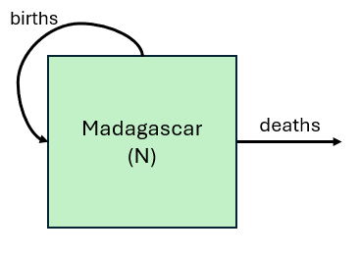

The basic population model
starting population
if deterministic “always the same”
probability of death = 0.5

Slide 54
The basic population model
starting population
if deterministic “always the same”
probability of death = 0.5
starting population
if stochastic “up to chance”
probability of death = 0.5

Slide 55
The basic population model
starting population
if deterministic “always the same”
probability of death = 0.5
starting population
if stochastic “up to chance”
probability of death = 0.5

Slide 56
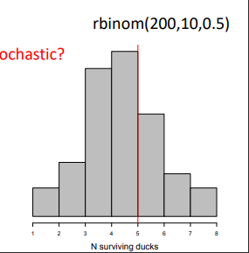
The basic population model
starting population
if deterministic “always the same”
probability of death = 0.5
starting population
if stochastic
probability of death = 0.5

Slide 57
The basic population model
starting population
if deterministic “always the same”
probability of death = 0.5
If you test your 10 ducks many times, on average you get 5
starting population
if stochastic
probability of death = 0.5

Slide 58
Checking In
What is the difference between deterministic and stochastic? Quelle est la difference entre déterministe et stochastique?

Slide 59
Checking In
What is the difference between deterministic and stochastic?
Deterministic = always the same
Stochastic = up to chance

Slide 60
Key concepts
Compartmental / mechanistic / mathematical models Modèles à compartiments
Continuous vs. discrete models Les modèles à temps discret et les modèles à temps continu
Deterministic vs. stochastic models Modèles détérministe vs. stochastique

Slide 61
2. Structured Population Models Les modèles de la population structurées

Slide 62
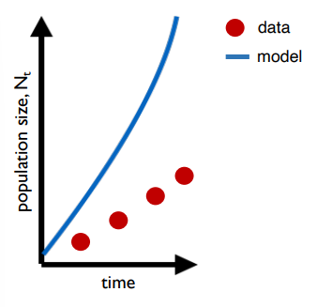
The structured population model
Why does the model perform poorly?

Slide 63
The structured population model
Why does the model perform poorly?
We need population structure!
That means distinguishing babies from adults.

Slide 64
The basic population model
Compartmental models (mechanistic models)
Populations are divided into compartments
Individuals within a compartment are homogenously mixed
Compartments and transition rates are determined by biological systems
Rates of transferring between compartments are expressed mathematically
How does the population of Madagascar grow over time?
Comment est-ce que la population de Madagascar croît avec le passage du temps ?

Slide 65
The basic population model
Compartmental models (mechanistic models)
Populations are divided into compartments
Individuals within a compartment are homogenously mixed
Compartments and transition rates are determined by biological systems
Rates of transferring between compartments are expressed mathematically
Babies
Adults

Slide 66
The basic population model
Compartmental models (mechanistic models)
Populations are divided into compartments
Individuals within a compartment are homogenously mixed
Compartments and transition rates are determined by biological systems
Rates of transferring between compartments are expressed mathematically
Babies
Adults

Slide 67
The basic population model
Compartmental models (mechanistic models)
Populations are divided into compartments
Individuals within a compartment are homogenously mixed
Compartments and transition rates are determined by biological systems
Rates of transferring between compartments are expressed mathematically
births
Babies
Adults
aging
deaths
deaths

Slide 68


The basic population model
Compartmental models (mechanistic models)
Populations are divided into compartments
Individuals within a compartment are homogenously mixed
Compartments and transition rates are determined by biological systems
Rates of transferring between compartments are expressed mathematically
$$N_{t+1}=λN_{t}$$
pop size at t+1
pop size at t
births (B)
$$n_{t+1}=An_{t}$$
Babies
Adults
aging (a)
matrix of rates
vector of population sizes
deaths
deaths
*discrete time

Slide 69

The basic population model
Compartmental models (mechanistic models)
Populations are divided into compartments
Individuals within a compartment are homogenously mixed
Compartments and transition rates are determined by biological systems
Rates of transferring between compartments are expressed mathematically
$$n_{t+1}=An_{t}$$
A
n_{t}
n_{t+1}
births (B)
s_{b}(1-a) | B
S_{b}a | s_{a}
n_{b}
n_{a}
s_{b}(1-a)n_{b}+bn_{a}
S_{b}an_{b}+s_{a}n_{a}
Babies
Adults
x
=
aging (a)
deaths
deaths

Slide 70

The basic population model
Compartmental models (mechanistic models)
Populations are divided into compartments
Individuals within a compartment are homogenously mixed
Compartments and transition rates are determined by biological systems
Rates of transferring between compartments are expressed mathematically
$$n_{t+1}=An_{t}$$
A
n_{t}
n_{t+1}
births (B)
s_{b}(1-a) | B
S_{b}a | s_{a}
n_{b}
n_{a}
s_{b}(1-a)n_{b}+bn_{a}
S_{b}an_{b}+s_{a}n_{a}
Babies
Adults
x
=
aging (a)
Population growth will depend on population structure!
La croissance démographique dépendra de la structure de la population
deaths
deaths

Slide 71
Key concepts
Compartmental / mechanistic / mathematical models Modèles à compartiments
Continuous vs. discrete models Les modèles à temps discrets et les modèles à temps continu
Deterministic vs. stochastic models Modèles détérministe vs. stochastique
Structured models Modèles structurés

Slide 72
Checking In
How do we modify a basic population model to make it structured? Comment modifier un modèle de population pour le structurer?

Slide 73
Checking In
How do we modify a basic population model to make it structured?
Two compartments (adults and babies)
Vector/matrix of values

Slide 74
3. Two-population model Les modèles de deux populations

Slide 75
The predator-prey model
Compartmental models (mechanistic models)
Populations are divided into compartments
Individuals within a compartment are homogenously mixed
Compartments and transition rates are determined by biological systems
Rates of transferring between compartments are expressed mathematically
How does the population of fossa regulate the population of lemurs in Ranomafana?
Comment la population de fossa régule la population de lémuriens à Ranomafana?

Slide 76
The predator-prey model
Compartmental models (mechanistic models)
Populations are divided into compartments
Individuals within a compartment are homogenously mixed
Compartments and transition rates are determined by biological systems
Rates of transferring between compartments are expressed mathematically
Lemur
(x)
Fossa
(y)

Slide 77
The predator-prey model
Compartmental models (mechanistic models)
Populations are divided into compartments
Individuals within a compartment are homogenously mixed
Compartments and transition rates are determined by biological systems
Rates of transferring between compartments are expressed mathematically
Lemur
(x)
Fossa
(y)

Slide 78
The predator-prey model
Compartmental models (mechanistic models)
Populations are divided into compartments
Individuals within a compartment are homogenously mixed
Compartments and transition rates are determined by biological systems
Rates of transferring between compartments are expressed mathematically
lemur reproduction
fossa reproduction
Lemur
(x)
Fossa
(y)
lemur death
fossa death

Slide 79
The predator-prey model
Compartmental models (mechanistic models)
Populations are divided into compartments
Individuals within a compartment are homogenously mixed
Compartments and transition rates are determined by biological systems
Rates of transferring between compartments are expressed mathematically
lemur reproduction
fossa reproduction
fossa reproduction depends on lemur population
Lemur
(x)
Fossa
(y)
lemur death
fossa death

Slide 80
The predator-prey model
Compartmental models (mechanistic models)
Populations are divided into compartments
Individuals within a compartment are homogenously mixed
Compartments and transition rates are determined by biological systems
Rates of transferring between compartments are expressed mathematically
lemur reproduction
fossa reproduction
fossa reproduction depends on lemur population
Lemur
(x)
Fossa
(y)
lemur death depends on fossa population
lemur death
fossa death

Slide 81
The predator-prey model
Compartmental models (mechanistic models)
Populations are divided into compartments
Individuals within a compartment are homogenously mixed
Compartments and transition rates are determined by biological systems
Rates of transferring between compartments are expressed mathematically
Parameters
α | lemur rep. rate
β | lemur death rate
δ | fossa rep. rate
γ | fossa death rate
lemur reproduction
fossa reproduction
fossa reproduction depends on lemur population
Lemur
(x)
Fossa
(y)
lemur death depends on fossa population
lemur death
fossa death

Slide 82
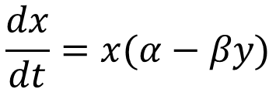
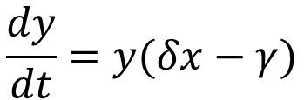
The predator-prey model
Compartmental models (mechanistic models)
Populations are divided into compartments
Individuals within a compartment are homogenously mixed
Compartments and transition rates are determined by biological systems
Rates of transferring between compartments are expressed mathematically
Parameters
α | lemur rep. rate
β | lemur death rate
𝛿 | fossa rep. rate
γ | fossa death rate
lemur reproduction α
fossa reproduction 𝛿
$$\frac{dx}{dt}=x(α−βy)$$
fossa reproduction depends on lemur population
Lemur
(x)
Fossa
(y)
lemur death depends on fossa population
$$\frac{dy}{dt}=y(δx−γ)$$
lemur death β
fossa death γ

Slide 83
The predator-prey model
Compartmental models (mechanistic models)
Populations are divided into compartments
Individuals within a compartment are homogenously mixed
Compartments and transition rates are determined by biological systems
Rates of transferring between compartments are expressed mathematically
Some Assumptions:
The lemur has unlimited food supply
The lemur only dies from being eaten by a fossa
The fossa is totally dependent on a single prey species as its only food supply
lemur reproduction α
fossa reproduction δ
$$\frac{dx}{dt}=x(α−βy)$$
fossa reproduction depends on lemur population
Lemur
(x)
Fossa
(y)
lemur death depends on fossa population
$$\frac{dy}{dt}=y(δx−γ)$$
lemur death β
fossa death γ

Slide 84
The predator-prey model
Compartmental models (mechanistic models)
Populations are divided into compartments
Individuals within a compartment are homogenously mixed
Compartments and transition rates are determined by biological systems
Rates of transferring between compartments are expressed mathematically
Quelques hypothèses:
Les lémuriens ont une source de nourriture illimitée
Les lémuriens ne meurent qu’à cause de consummation par les fossas
Les fossas dépendent totalement sur une seule espèce de proie comme source de nourriture
lemur reproduction α
fossa reproduction δ
$$\frac{dx}{dt}=x(α−βy)$$
La procréation des fossas depend de la population des lémuriens
Lemur
(x)
Fossa
(y)
$$\frac{dy}{dt}=y(δx−γ)$$
Le décès des lémuriens depend de la population des fossas
lemur death β
fossa death γ

Slide 85
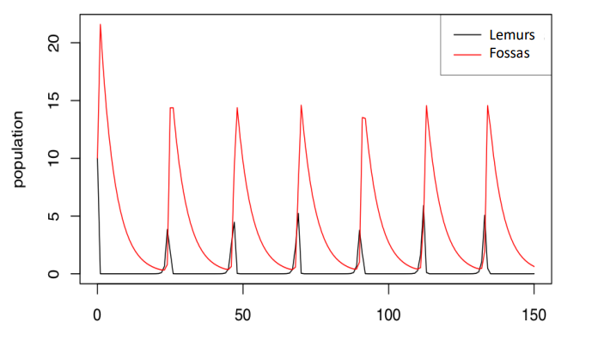
The predator-prey model

Slide 86
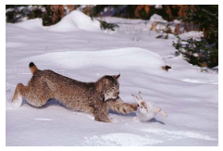
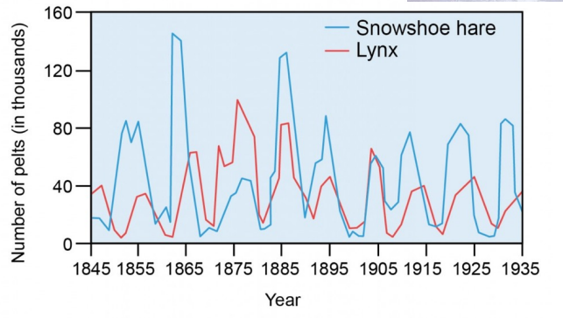
The predator-prey model

Slide 87
Key concepts
Compartmental / mechanistic / mathematical models Modèles à compartiments
Continuous vs. discrete models Les modèles à temps discrets et les modèles à temps continu
Deterministic vs. stochastic models Modèles détérministe vs. stochastique
Structured models Modèles structurés
Two population models Modèles des deux populations

Slide 88
Checking In
What pattern can we see in simple predator-prey relationships? Quel motif est visible dans les relations simples prédateur-proie ?
What could we modify to make this model more complex/realistic? Qu’est-ce qu’on peut modifier pour rendre ce modele plus complexe/réaliste ?

Slide 89
Checking In
What pattern can we see in simple predator-prey relationships?
Cycles / oscillations
What could we modify to make this model more complex/realistic?
Lemurs can die of other causes
Fossas can eat other things

Slide 90
4. SIR models Les modèles SIR

Slide 91


Slide 92
The SIR model
Compartmental models (mechanistic models)
Populations are divided into compartments
Individuals within a compartment are homogenously mixed
Compartments and transition rates are determined by biological systems
Rates of transferring between compartments are expressed mathematically
How does measles transmit through Antananarivo?
Comment la rougéole se transmet-elle à Antananarivo?

Slide 93
The SIR model
Compartmental models (mechanistic models)
Populations are divided into compartments
Individuals within a compartment are homogenously mixed
Compartments and transition rates are determined by biological systems
Rates of transferring between compartments are expressed mathematically
susceptible
infectious
recovered
S
I
R

Slide 94
The SIR model
Compartmental models (mechanistic models)
Populations are divided into compartments
Individuals within a compartment are homogenously mixed
Compartments and transition rates are determined by biological systems
Rates of transferring between compartments are expressed mathematically
susceptible
infectious
recovered
S
I
R
What are the big assumptions here?
Quelles sont les grandes hypothèses?

Slide 95
The SIR model
Compartmental models (mechanistic models)
Populations are divided into compartments
Individuals within a compartment are homogenously mixed
Compartments and transition rates are determined by biological systems
Rates of transferring between compartments are expressed mathematically
susceptible
infectious
recovered
S
I
R
Everyone is either:

Slide 96
The SIR model
Compartmental models (mechanistic models)
Populations are divided into compartments
Individuals within a compartment are homogenously mixed
Compartments and transition rates are determined by biological systems
Rates of transferring between compartments are expressed mathematically
susceptible
infectious
recovered
S
I
R
Everyone is either:
people mix uniformly (mass action)

Slide 97
The SIR model
Compartmental models (mechanistic models)
Populations are divided into compartments
Individuals within a compartment are homogenously mixed
Compartments and transition rates are determined by biological systems
Rates of transferring between compartments are expressed mathematically
susceptible
infectious
recovered
S
I
R
Everyone is either:
people mix uniformly (mass action)
no latent period (infectious when infected)

Slide 98
The SIR model
Compartmental models (mechanistic models)
Populations are divided into compartments
Individuals within a compartment are homogenously mixed
Compartments and transition rates are determined by biological systems
Rates of transferring between compartments are expressed mathematically
susceptible
infectious
recovered
S
I
R
Everyone is either:
people mix uniformly (mass action)
no latent period (infectious when infected)
recovery is permanent

Slide 99
The SIR model
Compartmental models (mechanistic models)
Populations are divided into compartments
Individuals within a compartment are homogenously mixed
Compartments and transition rates are determined by biological systems
Rates of transferring between compartments are expressed mathematically
susceptible
infectious
recovered
S
I
R
Everyone is either:
infection
recovery
people mix uniformly (mass action)
no latent period (infectious when infected)
recovery is permanent

Slide 100
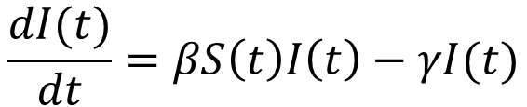
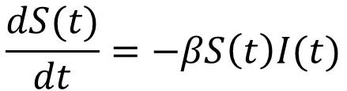
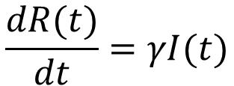
The SIR model
Compartmental models (mechanistic models)
Populations are divided into compartments
Individuals within a compartment are homogenously mixed
Compartments and transition rates are determined by biological systems
Rates of transferring between compartments are expressed mathematically
$$\frac{dS(t)}{dt}=−βS\left(t\right)I(t)$$
$$\frac{dI(t)}{dt}=βS\left(t\right)I\left(t\right)−γI(t)$$
$$\frac{dR(t)}{dt}=γI(t)$$
susceptible
infectious
recovered
S
I
R
Infection
β
recovery
γ
β = transmission rate
taux de transmission
γ = recovery rate
taux de guérison

Slide 101
The SIR model
Compartmental models (mechanistic models)
Populations are divided into compartments
Individuals within a compartment are homogenously mixed
Compartments and transition rates are determined by biological systems
Rates of transferring between compartments are expressed mathematically
$$\frac{dS(t)}{dt}=−βS\left(t\right)I(t)$$
$$\frac{dI(t)}{dt}=βS\left(t\right)I\left(t\right)−γI(t)$$
$$\frac{dR(t)}{dt}=γI(t)$$
S
I
R
Infection
β
recovery
γ
We keep track of the change in the number or proportion of susceptible, infected, and recovered individuals over time

Slide 102
The SIR model
Compartmental models (mechanistic models)
Populations are divided into compartments
Individuals within a compartment are homogenously mixed
Compartments and transition rates are determined by biological systems
Rates of transferring between compartments are expressed mathematically
$$\frac{dS(t)}{dt}=−βS\left(t\right)I(t)$$
$$\frac{dI(t)}{dt}=βS\left(t\right)I\left(t\right)−γI(t)$$
$$\frac{dR(t)}{dt}=γI(t)$$
S
I
R
Infection
β
recovery
γ
We keep track of the change in the number or proportion of susceptible, infected, and recovered individuals over time

Slide 103
The SIR model
Compartmental models (mechanistic models)
Populations are divided into compartments
Individuals within a compartment are homogenously mixed
Compartments and transition rates are determined by biological systems
Rates of transferring between compartments are expressed mathematically
$$\frac{dS(t)}{dt}=−βS\left(t\right)I(t)$$
$$\frac{dI(t)}{dt}=βS\left(t\right)I\left(t\right)−γI(t)$$
$$\frac{dR(t)}{dt}=γI(t)$$
S
I
R
Infection
β
recovery
γ
We keep track of the change in the number or proportion of susceptible, infected, and recovered individuals over time

Slide 104
The SIR model
Compartmental models (mechanistic models)
Populations are divided into compartments
Individuals within a compartment are homogenously mixed
Compartments and transition rates are determined by biological systems
Rates of transferring between compartments are expressed mathematically
$$\frac{dS(t)}{dt}=−βS\left(t\right)I(t)$$
$$\frac{dI(t)}{dt}=βS\left(t\right)I\left(t\right)−γI(t)$$
$$\frac{dR(t)}{dt}=γI(t)$$
S
I
R
Infection
β
recovery
γ
infected numbers influence the transmission rate
le nombre d’infectés influence le taux de transmission

Slide 105
The SIR model
Compartmental models (mechanistic models)
Populations are divided into compartments
Individuals within a compartment are homogenously mixed
Compartments and transition rates are determined by biological systems
Rates of transferring between compartments are expressed mathematically
$$\frac{dS(t)}{dt}=−βS\left(t\right)I(t)$$
$$\frac{dI(t)}{dt}=βS\left(t\right)I\left(t\right)−γI(t)$$
$$\frac{dR(t)}{dt}=γI(t)$$
S
I
R
Infection
β
recovery
γ
All people are accounted for as they move through compartments.

Slide 106
The SIR model
Compartmental models (mechanistic models)
Populations are divided into compartments
Individuals within a compartment are homogenously mixed
Compartments and transition rates are determined by biological systems
Rates of transferring between compartments are expressed mathematically
$$\frac{dS(t)}{dt}=−βS\left(t\right)I(t)$$
$$\frac{dI(t)}{dt}=βS\left(t\right)I\left(t\right)−γI(t)$$
$$\frac{dR(t)}{dt}=γI(t)$$
S
I
R
Infection
β
recovery
γ
What will the dynamics look like?
À quoi ressemblera la dynamique?

Slide 107
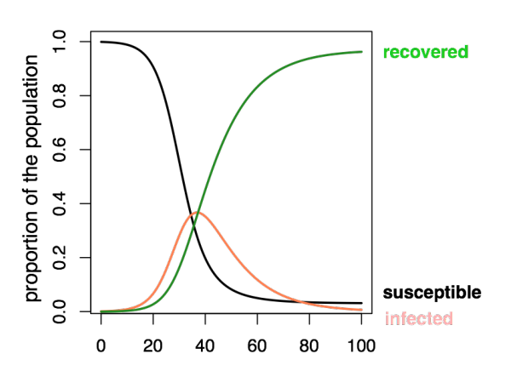
The SIR model

Slide 108
The SIR model
I
transmission
βSI
recovery
γ
How do we describe how an infection moves through a population?
Comment décrire le moyen dont une infection se transmet dans une population ?

Slide 109

The SIR model
Set I=1
I
transmission
βSI
recovery
γ
$$R_{0}=βN/γ$$
The average number of persons infected by an infectious individual when everyone is susceptible (S=100%, or S=1, start of an epidemic)
Le nombre moyen de personnes infectés par un individu infectueux quand tout le monde est sensible (S=100%, au début d’une épidémie)

Slide 110
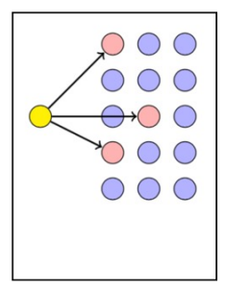
The SIR model
What is the value of R₀?
Quelle est la valeur de R₀?

Slide 111
The SIR model
R₀=3

Slide 112
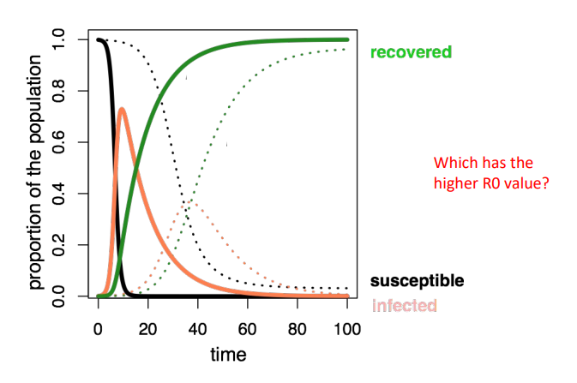
The SIR model
Which has the higher R₀, the dotted line or the solid line?
Qui a le R₀ le plus élevé, ligne pointillé ou ligne continue?

Slide 113
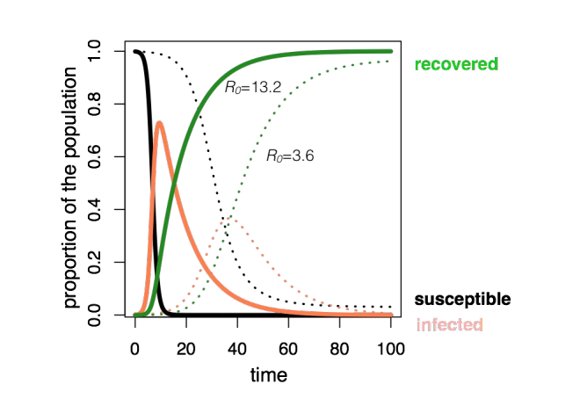
The SIR model

Slide 114
Checking In
What is R₀? C’est quoi, R₀?
How could you modify this simple SIR model to represent COVID-19? Comment pourriez-vous modifier ce modèle SIR simple pour représenter COVID-19?

Slide 115
Checking In
What is R₀?
The average number of secondary infections from the first infections individual
How could you modify this simple SIR model to represent COVID-19?
Re-infection, incubation period, social distancing, vaccination

Slide 116
The SIR model : vaccination
S
I
R
Infection
β
recovery
γ
Vaccination moves people out of susceptibles into the immune (recovered) class.
La vaccination éloigne les personnes sensibles de la maladie dans la classe immunitaire (rétablie).

Slide 117
The SIR model : vaccination
S
I
R
Infection
β
recovery
γ
vaccination
Vaccination moves people out of susceptibles into the immune (recovered) class.
La vaccination éloigne les personnes sensibles de la maladie dans la classe immunitaire (rétablie).

Slide 118
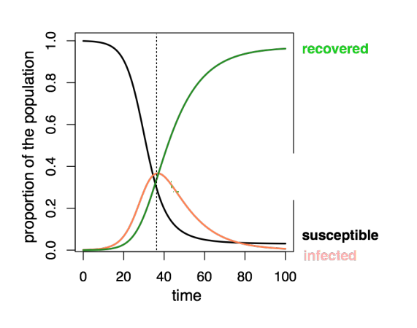
The SIR model : vaccination

Slide 119
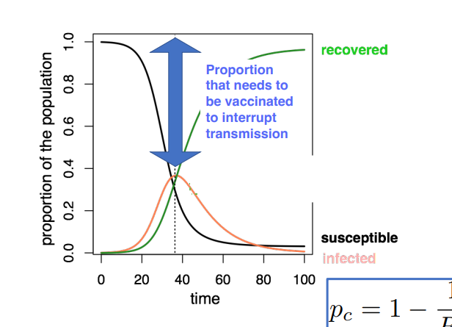

The SIR model : vaccination
$$p_{c}=1−\frac{1}{R_{0}}$$

Slide 120
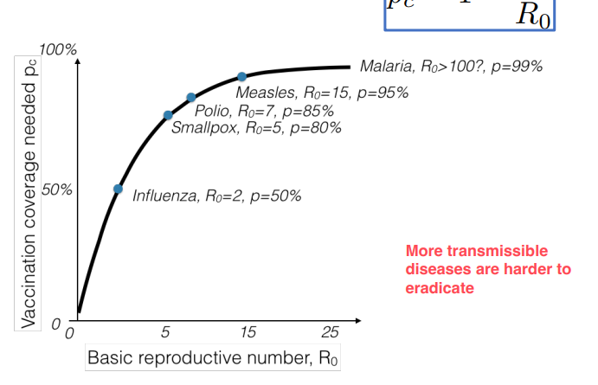

The SIR model : vaccination
$$p_{c}=1−\frac{1}{R_{0}}$$
More transmissible diseases are harder to eradicate
Les maladies les plus transmissibles sont plus difficiles à éradiquer

Slide 121
The SIR model : extensions
vaccination
S
I
R
Infection
recovery
What do we change if we incorporate births and deaths? Que change-t-on si on inclut des naissances et des décès?

Slide 122
The SIR model : extensions
vaccination, p
S
I
R
births, μ
Infection
recovery
deaths, μ
deaths, μ
deaths, μ

Slide 123
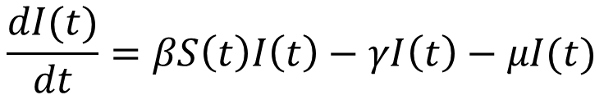
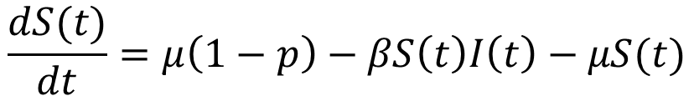
The SIR model : extensions
vaccination, p
S
I
R
births, μ
Infection
recovery
deaths, μ
deaths, μ
deaths, μ
$$\frac{dS(t)}{dt}=μ\left(1−p\right)−βS\left(t\right)I\left(t\right)−μS(t)$$
$$\frac{dI(t)}{dt}=βS\left(t\right)I\left(t\right)−γI\left(t\right)−μI(t)$$

Slide 124
The SIR model : extensions
vaccination, p
S
I
R
births, μ
Infection
recovery
deaths, μ
deaths, μ
deaths, μ
$$\frac{dS(t)}{dt}=μ\left(1−p\right)−βS\left(t\right)I\left(t\right)−μS(t)$$
How will births impact dynamics?
$$\frac{dI(t)}{dt}=βS\left(t\right)I\left(t\right)−γI\left(t\right)−μI(t)$$

Slide 125
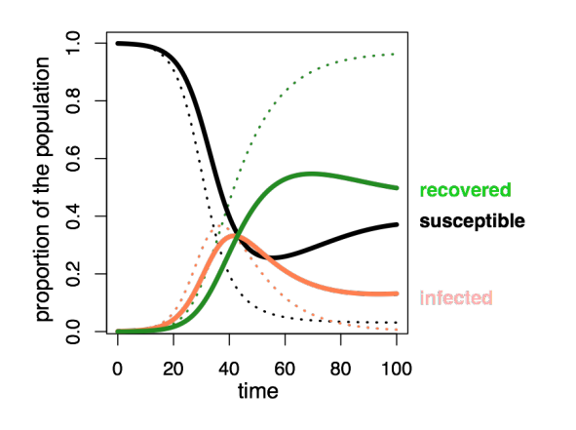
The SIR model : extensions
SIR with births

Slide 126
The SIR model : extensions
vaccination, p
S
I
R
births, μ
Infection
recovery
deaths, μ
deaths, μ
deaths, μ
What do we change if infection is always fatal?
Que change-t-on si l’infection est toujours mortelle?

Slide 127
The SI model
vaccination, p
S
I
births, μ
Infection
deaths, μ
deaths, μ
What do we change if infection is always fatal? No recovered class
Que change-t-on si l’infection est toujours mortelle? Pas d’une classe récuperée

Slide 128
The SIR model : extensions
vaccination, p
S
I
R
births, μ
Infection
recovery
deaths, μ
deaths, μ
deaths, μ
What do we change if immunity wanes?
Que change-t-on si l’immunité diminue?

Slide 129
The SIRS model
waning immunity
vaccination, p
S
I
R
births, μ
Infection
recovery
deaths, μ
deaths, μ
deaths, μ
What do we change if immunity wanes? Recovered individuals become susceptible
Que change-t-on si l’immunité diminue? Les individus récupérés deviennent sensibles

Slide 130
The SIR model : extensions
vaccination, p
S
I
R
births, μ
Infection
recovery
deaths, μ
deaths, μ
deaths, μ
What do we change if people recover at different rates?
Que change-t-on si les taux de récupération diffèrent?

Slide 131
The SIR model : extensions
vaccination, p
I₁
recovery 1
S
R
births, μ
Infection
I₂
recovery 2
deaths, μ
deaths, μ
deaths, μ
What do we change if people recover at different rates?
Que change-t-on si les taux de récupération diffèrent?

Slide 132
Key concepts
Compartmental / mechanistic / mathematical models Modèles à compartiments
Continuous vs. discrete models Les modèles à temps discrets et les modèles à temps continu
Deterministic vs. stochastic models Modèles détérministe vs. stochastique
Structured models Modèles structurés
Two population models Modèles des deux populations
SIR models – and beyond! Modèles SIR – et au délà !

Slide 133
R Tutorial

