Slide 1
Eden II
Gary Chi
Raisa Rabbani
Elon Xie
Jessica Z

Slide 2
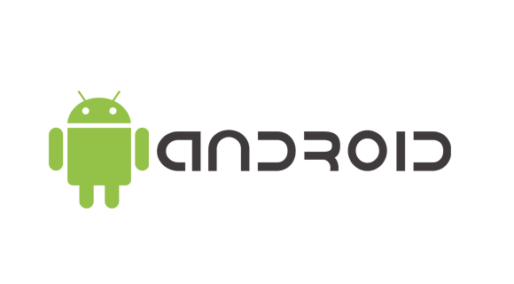
What Is It?
An intuitive and easy to use mobile app that helps caretakers understand kids
Effective solution to retain unique language of each kid made available to caretakers

Slide 3
How it works
Initial: User will input audio data of reoccurring phrases
Translation: Caretaker may record the child speaking and translate it to text
Editing: Meanings of audio data can be edited if wrong

Slide 4
ScreenShots & DEMO

Slide 5
How does it Solve the problem
A server/database retains data for each individual
Compares the audio data with reference audio to maximize accuracy
Each caretaker’s android application has their own pool of kids they attend to

Slide 6
Necessary Work
Security to transfer data between platforms
Easy to use user interface
Accounts for caretakers

Slide 7
Future Improvements
Audio fingerprinting
iOS development
Improve on comparison algorithm
Statistical reports

