Slide 1
Eden II
Gary Chi
Raisa Rabbani
Elon Xie
Jessica Z

Slide 2
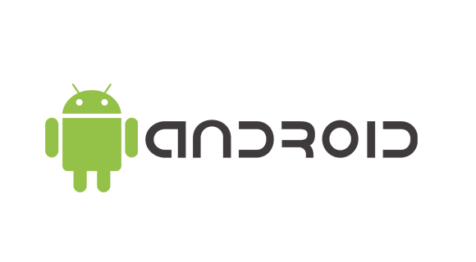
What Is It?
Intuitive and easy to use mobile app
Helps caretakers understand kids
Can retain unique language of each child
All made available to caretakers

Slide 3
How it works
Initial: Users input audio data of phrases
Translation: Caretaker/Parent records the child speaking
This is translated to text
Editing: Translations can be edited if incorrect

Slide 4
ScreenShots & DEMO

Slide 5
How does it Solve the problem
A database retains data for each individual
Compares audio data with reference audio
This maximizes accuracy
Each caretaker’s application has their own pool of children they attend to

Slide 6
Future Improvements
Additional security in data transfer
Improved easy to use user interface
Accounts for caretakers
Heavier Machine Learning

Slide 7
Future Improvements (conti)
Audio fingerprinting
iOS development
Improve on comparison algorithm
Statistical reports

