Slide 1
Draft mock-ups for ideal partner qualification
2013/12/03

Slide 2
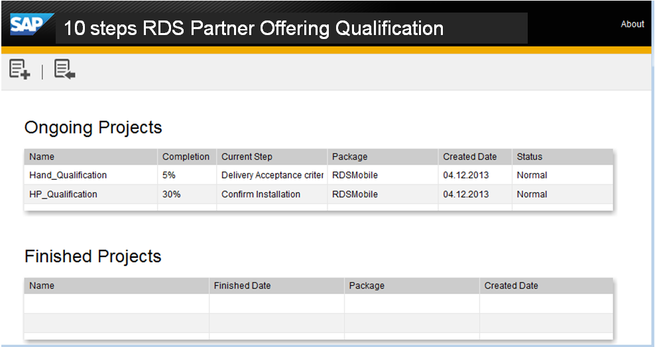
Screen copy of exiting Mobile App. Deployment tools -be reference for mock-up of Partner Qualification

Slide 3
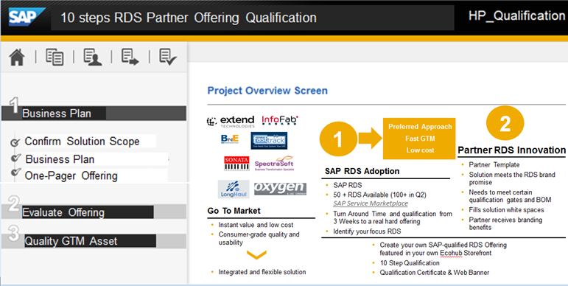
Extend Q-Gate 1 - Cover 3 steps
One-Pager offering
* It may cover more steps if to bring in pre-Qualification into scope

Slide 4
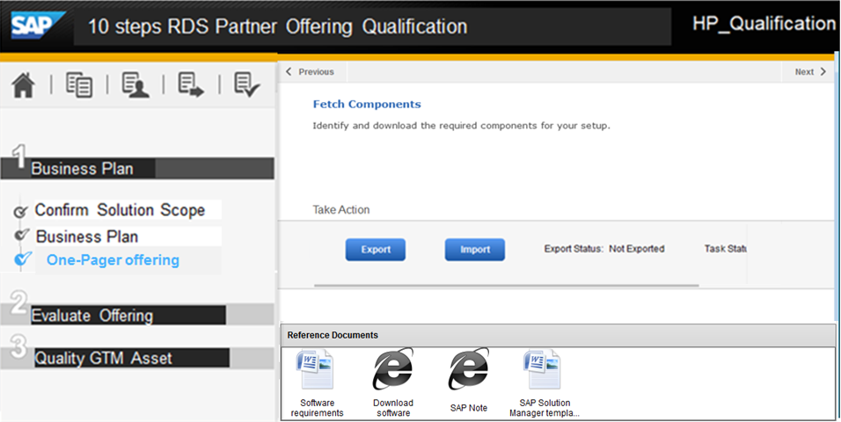
Extend Q-Gate 1 - Choose “One-Pager offering”

Slide 5
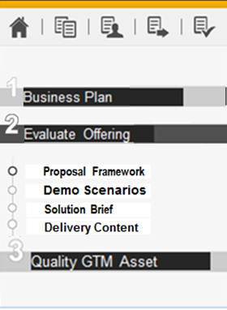
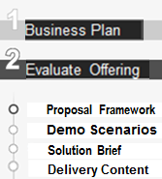

Extend Q-Gate 2 - Cover 4 steps

Slide 6
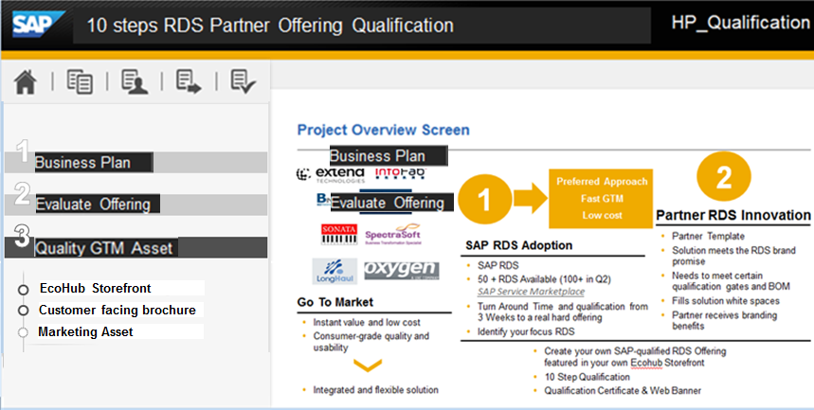
Extend Q-Gate 3 - Cover 3 steps

Slide 7
Benefit to manage all process in one system
Process will be transparent (package number, completion , creation date, status), which can support forward/share/publish actions.
Document Management centrally ( document template can be updated easily)
Integrated as a portal, friendly user experience
Enriched interaction with partners ( partner can access and download the required document, and sent to related contact person for further importing and qualification ).

Slide 8
Open items
Check where to save huge documents( JAM or …), and may do some research for related API. -- Owner: PF team Due: Dec. 13th
Obstacles( technical , potential legal issue and so on) to integrate all these steps/processes into one tools - Owner: PF and E&C Due: Dec. 13th
Draw out details for the qualification process ( input /output/ owner, and whether existing system used) - Owner: E&C Due: Dec. 13th
Effect estimation after previous 3 steps finished .
Owner: PF team Due: Dec. 16th

Slide 9

Appendix for workflow To-Be - Reference from Mobile App. SBS Wizard
Contract
PF
E&C
Metadata persistance (e.g. apps, addons)
1
Meta input
2
Data gathering
Template files
Project input
Project persistance (e.g. systems, users)
3
Template engine
Instance files
Partner Side
SAP Side
Zip project files
6
Emails
4
Email Sending
Result processing
Zip Processing
5
Results

Slide 10
Expectations for the system:
Document management
Upload/Download documents (download just like SAP-inbox function)
Store Documents by partner
Move/Delete documents
Information online view function (provide a link to let partner read-only some information)
Process management
show steps and status
Show tasks assigned by admin
Could keep review comments from different reviewers and share among people
Review management
Key in data in the table required in attached file
Select previous stored documents for review
Select reviewers
Keep review comments
Role Management
Log in with predefined accounts
Role: admin, users, partners
Different roles has different rights

Slide 11
RDS new Qualification Workflow(based on defined RDS):
Collect Business plan and sales flashcard
Upload to the system
First round review by SC, PSD and PAM
Pass?
Y
N
Start
Partner preparation
Or revision
Collect Sales Presentation, White Paper
& Demonstration
N
Pass?
Review Meeting
Y
N
Pass?
Revision Suggestions
Submit to APJ RDS Review Committee
PLDG
Y
Upload to SAP Store
Offer Certificate
Co-prepare
Marketing Asset

