Slide 1
Redux/React Router V3
By Taj English

Slide 2
What is React Router V3?
React Router is the library most React Applications use to render components based on URL path’s.
React Router is a collection of navigational components that compose declaratively with your application.

Slide 3
WHY DO WE NEED ROUTING IF IT’S SINGLE PAGE?
Routing in React is important for multiple “pages/components” because without it we wouldn’t be able to render different views based on the URL path.
Allows us to have protected views.

Slide 4
How does Routing Work in React router?
ReactDOM.render(
<Provider store={store}>
<Router history={history} routes={routes}>
</Provider>,
document.getElementById('app')
);
export default (
<Route path="/" name=”ShoeBillApp" component={App}>
<Route component={AuthLayout}>
<Route path="/login" component={LoginPage} />
<Route path="/signup” component={SignUp} />
</Route>
</Route>
);

Slide 5
Wtf Is redux?
Redux Is a predictable state container for JavaScript apps.
Redux is a centralized location to hold multiple states across your app.
Redux is NOT! Apart of React. It works independently can be used in other JS front-end frameworks.

Slide 6
How does Redux Work?
Redux creates a massive object with your applications data inside of it.
You dispatch Actions on your redux state to modify it.
Redux never directly modifies your state it creates a new copy of it every time.
Redux embraces a Functional Style of programming where everything immutable.

Slide 7
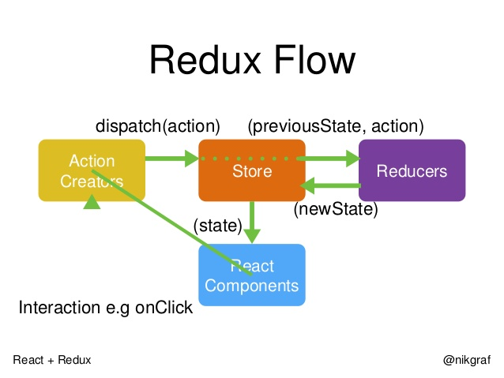
Redux in action

Slide 8
When do you use redux?
You use redux when your applications state becomes unmanageable.
If you find yourself passing state down multiple times to different component. You might want to look into using redux.

Slide 9
Action Creators
Action Creators describe an action in the form of a object that get executed by a Reducer.
Action Creators should not contain any logic!
const ADD_TODO = 'ADD_TODO'
function addTodo(text) {
return {
type: ADD_TODO,
text
}
}

Slide 10
Reducers
function todoApp(state = initialState, action) {
switch (action.type) {
case SET_VISIBILITY_FILTER:
return Object.assign({}, state, {
visibilityFilter: action.filter
})
default: return state
} }
Reducers modify the state based on an action.
We normally use a switch statement inside a reducer to match the action we are passing it.
If no action is found in the switch statement we always return the original non modified state.
Always Remember redux is functional it keeps a record of all the past state changes and always returns a new object with modified data.

