Slide 1
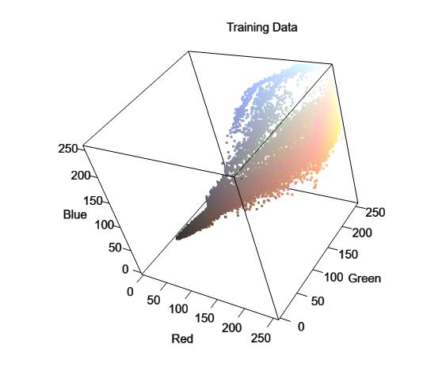
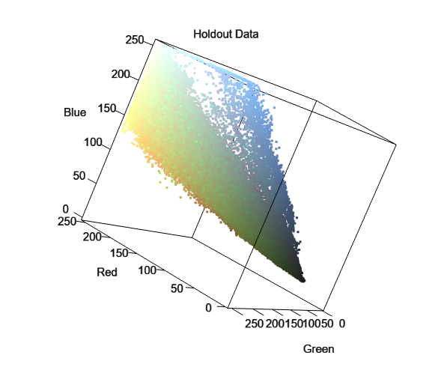
Haiti Earthquake Relief Effort: Finding Blue Tarps II
DS 6030 | Fall 2021 | University of Virginia
Brooks Anderson | gcu6hc@virginia.edu
December 5, 2021

Slide 2
Introduction
In the aftermath of the 2010 Haiti earthquake, rescue workers needed a way to find displaced people from aerial photographs.
Specifically, rescue workers were looking for blue tarps on the landscape which might represent a temporary shelter.
While at Rochester Institute of Technology (RIT), Dr. Bill Basener developed a statistical model which took pixel RGB values as input and returned the probability that a given pixel was a blue tarp [1].
In this project, I expand upon this work and attempt to develop a new model that achieves higher classification accuracy.
I compared seven model types to the original Mahalanobis Distance Classifier.
k-Nearest Neighbors, Linear Discriminant Analysis, Quadratic Discriminant Analysis, Logistic Regression, Random Forest, Support Vector Machine (polynomial kernel), Support Vector Machine (RBF kernel)
The data for this analysis was provided by Dr. Basener. The original images were collected by airplane and transferred to RIT.
Although the main objective of this project is to demonstrate my knowledge of various classification methods, it is my hope that this analysis could improve image detection methods in the event of future disasters.
Introduction | Methods | Results | Conclusions

Slide 3
Methods
This analysis was conducted exclusively in R
I tested eight models
k-Nearest Neighbors (kNN)
Linear Discriminant Analysis (LDA)
Quadratic Discriminant Analysis (QDA)
Logistic Regression
Random Forest (RF)
Support-vector Machine with Polynomial Kernel (SVM-P)
Support-vector Machine with RBF Kernel (SVM-R)
Mahalanobis Distance Classifier
The following packages were used,
Confusion matrices were generated with the confusionMatrix() function from caret
Package | Purpose
tidyverse | Data manipulation
ggplot2 | General Plotting
viridis | Plot color scales
caret | Model tuning & validation
ROCR | ROC curve tools
e1071 | SVM tools
kernlab | SVM tools
Introduction | Methods | Results | Conclusions

Slide 4
Methods
Training & Testing
The dataset from part 1 of the project was used to tune the models. The class labels were suppressed into a binary response variable with labels other and tarp.
I took a 50/50 split of this dataset; allocating one half for training and the other half for testing. Initially, I attempted to use an 80/20 split. However, the training time was prohibitive. My experiments revealed that reducing the training data from 80% to 50% did not lead to a significant drop in accuracy. More importantly, the parameters selected through cross-validation were unchanged at each proportion.
For each model, I performed 10-fold cross-validation five times on the training set. Once the parameters were selected, the models were fit on the entire training set.
10-fold cross-validation was performed on methods without tuning parameters, such as LDA. This was done for the sake of experimental consistency and allowed me to make intermediary comparisons between models.
Following training, predictions were made on the testing subset. Confusion matrices were constructed for each model and the Accuracy, true positive rate (TPR), false positive rate (FPR), and positive predictive value (PPV) were recorded
Introduction | Methods | Results | Conclusions

Slide 5
Methods
Holdout
The raw holdout data was provided in seven .txt files. Unnecessary columns were removed, leaving only the red, green, and blue predictor columns. Binary labels for tarp and other were applied. All seven files were combined into a single dataframe in R. There are approximately 2 million observations in the holdout set.
Each model was used to make predictions on the holdout set. Both, class labels and probabilities were predicted. Confusion matrices were generated from the predicted labels. Accuracy, TPR, FPR, and PPV were recorded. The probabilities were used to plot ROC curves and calculate AUC.
Lastly, I created decision boundary plots for each model. These plots are not useful for comparing model accuracy. However, they illustrate each method’s flexibility and give insight into which class of methods might be best.
Introduction | Methods | Results | Conclusions

Slide 6
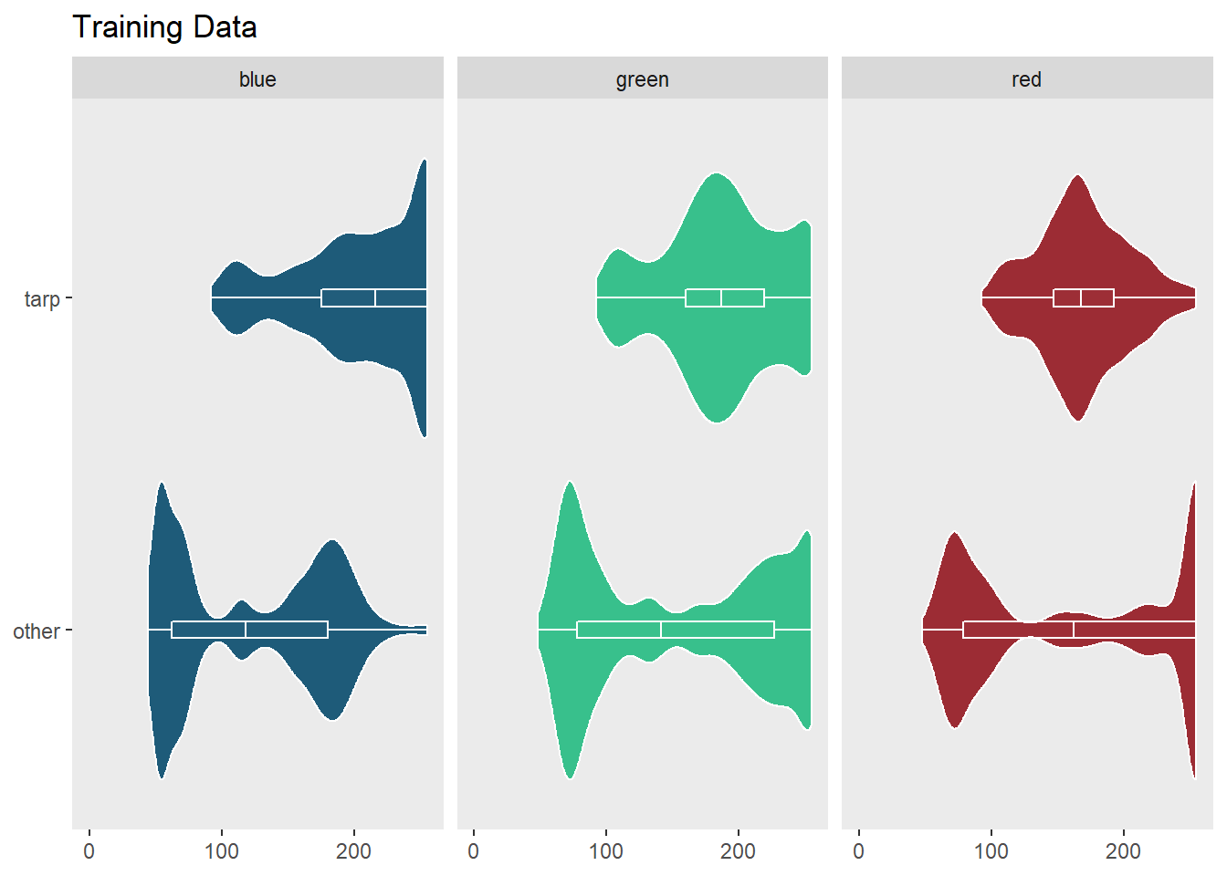
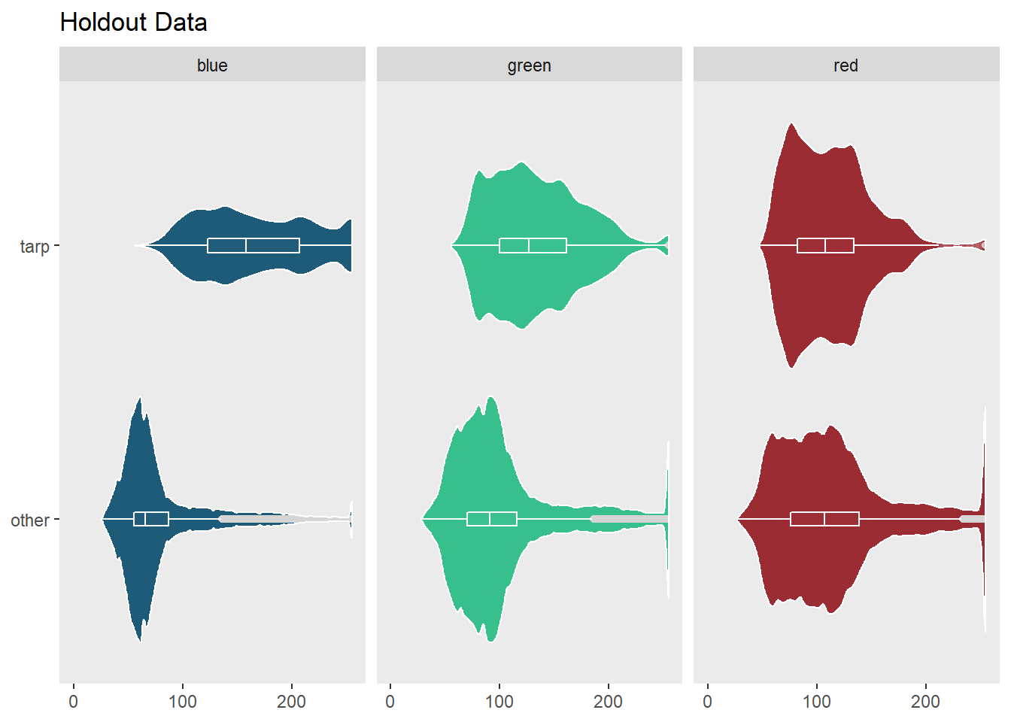
Methods
After both the training and holdout datasets were constructed and processed, I performed preliminary exploration and analysis
The violin plots below were created to view the distribution of each predictor and to determine if normalization or scaling was required
Introduction | Methods | Results | Conclusions

Slide 7
Methods
Preprocessing & Tuning Parameters
Method | PreProcessing | Tuning Parameters
kNN | center and scale | k – number of neighbors
LDA | None | None
QDA | None | None
Logistic Regression | None | None
RF | None | mtry – number of predictors sampled at each step
SVM-Polynomial | center and scale | degree – degree of kernel function C – cost of violation of the margin
SVM-RBF | center and scale | gamma – positive constant in Radial Basis Function C – cost of violation of the margin
Mahalanobis Distance | center and scale | None
Introduction | Methods | Results | Conclusions

Slide 8
Methods
Additional Notes
SVM Polynomial – The out-of-the-box SVM Polynomial Kernel method offered by caret does not match the method demonstrated in An Introduction to Statistical Learning [2]. I created a custom SVM model that better matched the book and could be trained with caret.
Random Forest – The random forest method offered by caret only has one tuning parameter, mtry. We used the default values for the number decision trees (ntrees = 500) and minimum node size (nodesize = 5).
Mahalanobis Classifier – caret does not have a Mahalanobis distance classifier method. Since there are no tuning parameters for this method, I simply used a 50/50 train/test split of the dataset from part I. Then, the means and covariances of the training data were used to calculate distances for the observations in the holdout set. Mahalanobis Distance follows a Χ² distribution. The distances were passed to the pchisq() function to calculate the probability that a given pixel represents a tarp.
Introduction | Methods | Results | Conclusions

Slide 9
Accuracy Results: Train Data Set
Method | Parameters | Accuracy | TPR | FPR | PPV
kNN | k = 5 | 0.9971 | 0.9713 | 0.0020 | 0.9406
LDA |  | 0.9844 | 0.8111 | 0.0099 | 0.7308
QDA |  | 0.9950 | 0.8566 | 0.0004 | 0.9852
Logistic Regression |  | 0.9959 | 0.9021 | 0.0010 | 0.9682
Random Forest | mtry = 2, ntree = 500 | 0.9969 | 0.9595 | 0.0018 | 0.9454
SVM-P | degree = 3, C = 10 | 0.9960 | 0.9179 | 0.0014 | 0.9547
SVM-R | gamma = 5, C= 1000 | 0.9975 | 0.9723 | 0.0017 | 0.9507
Mahalanobis Classifier |  | 0.9883 | 0.7369 | 0.0034 | 0.8785
Introduction | Methods | Results | Conclusions

Slide 10
Accuracy Results: Holdout Data Set
Method | Parameters | Accuracy | TPR | FPR | PPV | AUC
kNN | k = 5 | 0.9916 | 0.8675 | 0.0075 | 0.4570 | 0.9625
LDA |  | 0.9818 | 0.8394 | 0.0172 | 0.2620 | 0.9922
QDA |  | 0.9961 | 0.7142 | 0.0019 | 0.7365 | 0.9927
Logistic Regression |  | 0.9898 | 0.9890 | 0.0102 | 0.4140 | 0.9995
Random Forest | mtry = 2, ntree = 500 | 0.9913 | 0.8387 | 0.0076 | 0.4458 | 0.9799
SVM-P | degree = 3, C = 10 | 0.9942 | 0.9908 | 0.0057 | 0.5566 | 0.9991
SVM-R | gamma = 5, C= 1000 | 0.9907 | 0.7517 | 0.0076 | 0.4195 | 0.9869
Mahalanobis Classifier |  | 0.9932 | 0.0965 | 0.0003 | 0.7064 | 0.7624
Introduction | Methods | Results | Conclusions

Slide 11
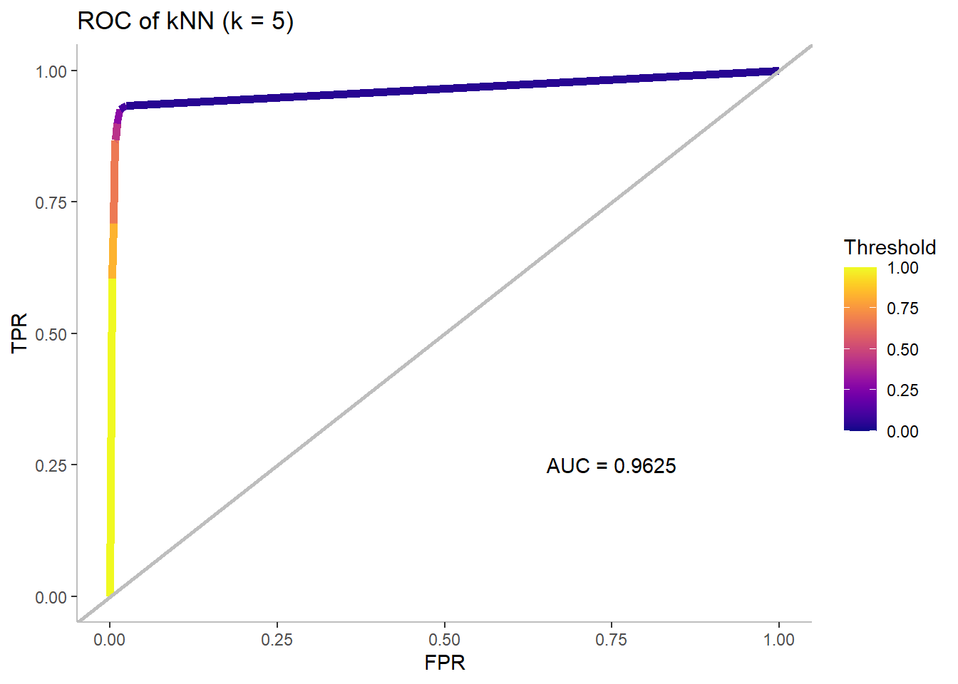
kNN Performance on Holdout Data
 | Reference
Prediction | Tarp | Other
Tarp | 12562 | 14929
Other | 1918 | 1974768
Statistic |  | Training | Holdout
 | Accuracy | 0.9971 | 0.9916
 | TPR | 0.9713 | 0.8675
 | FPR | 0.0020 | 0.0075
 | PPV | 0.9406 | 0.4570
Introduction | Methods | Results | Conclusions

Slide 12
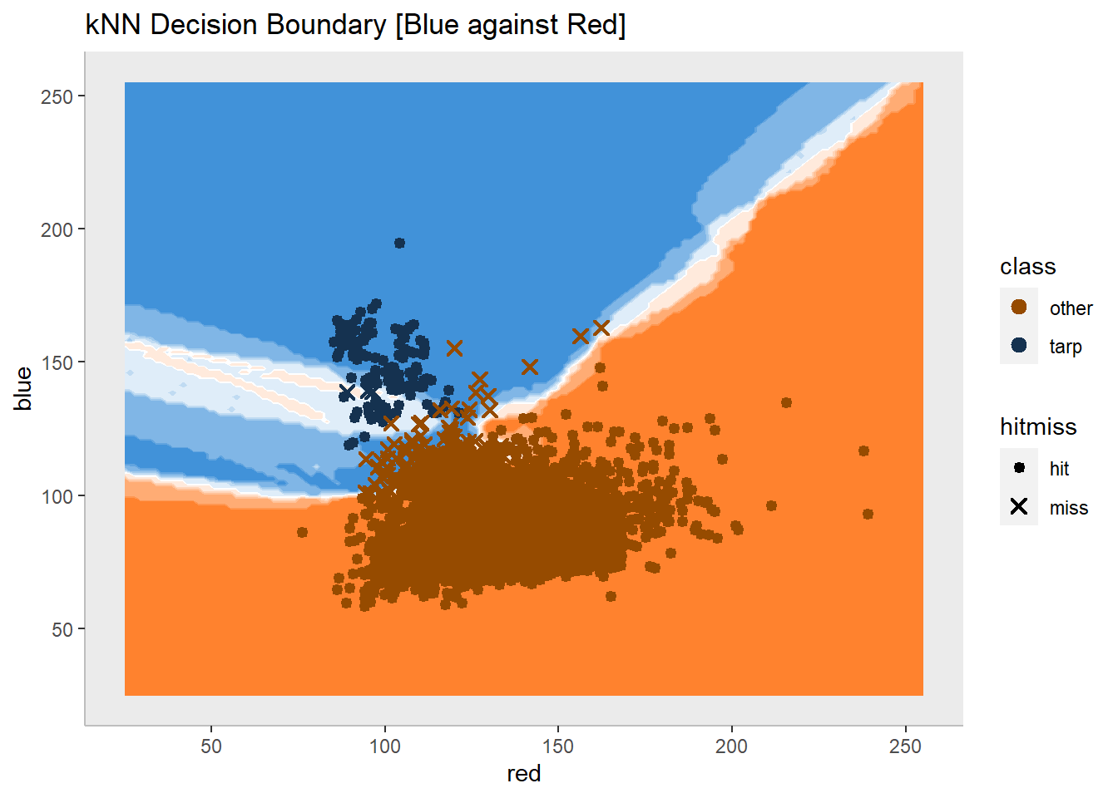
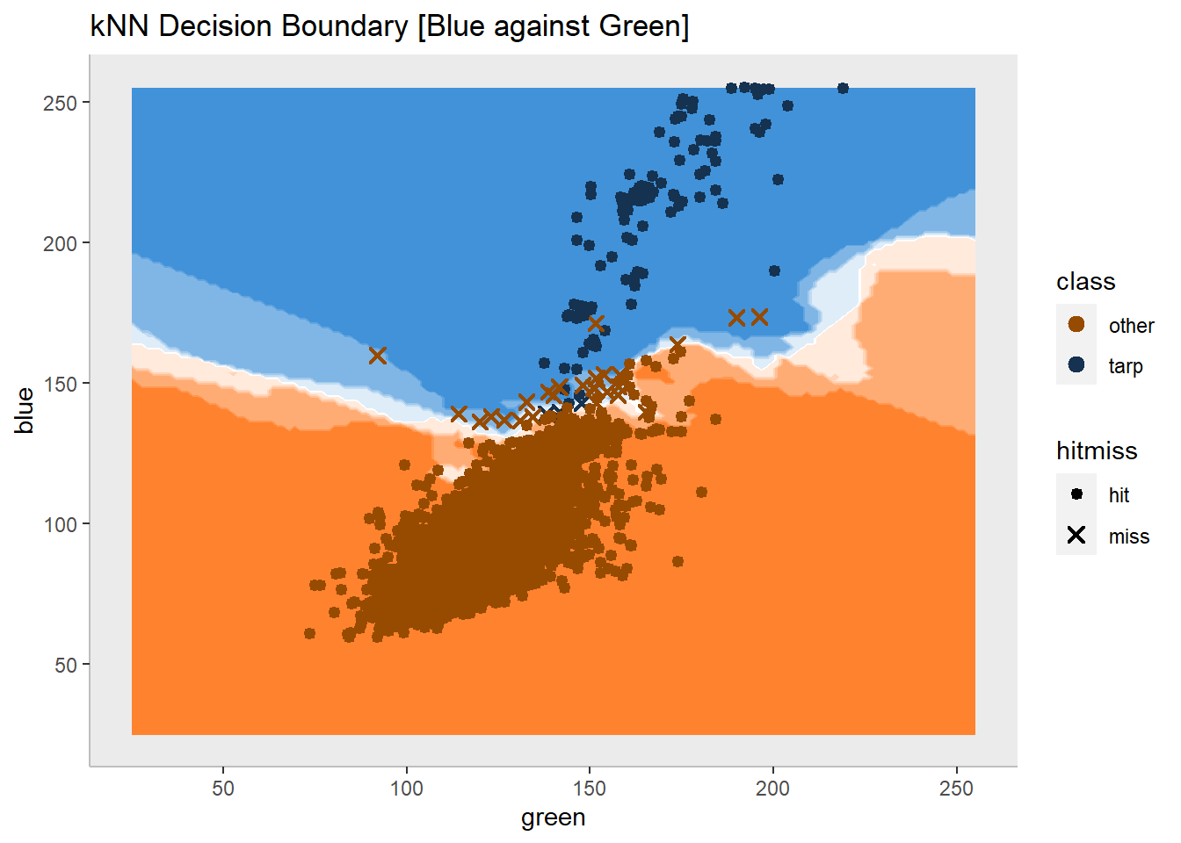
kNN Decision Boundary
Introduction | Methods | Results | Conclusions

Slide 13
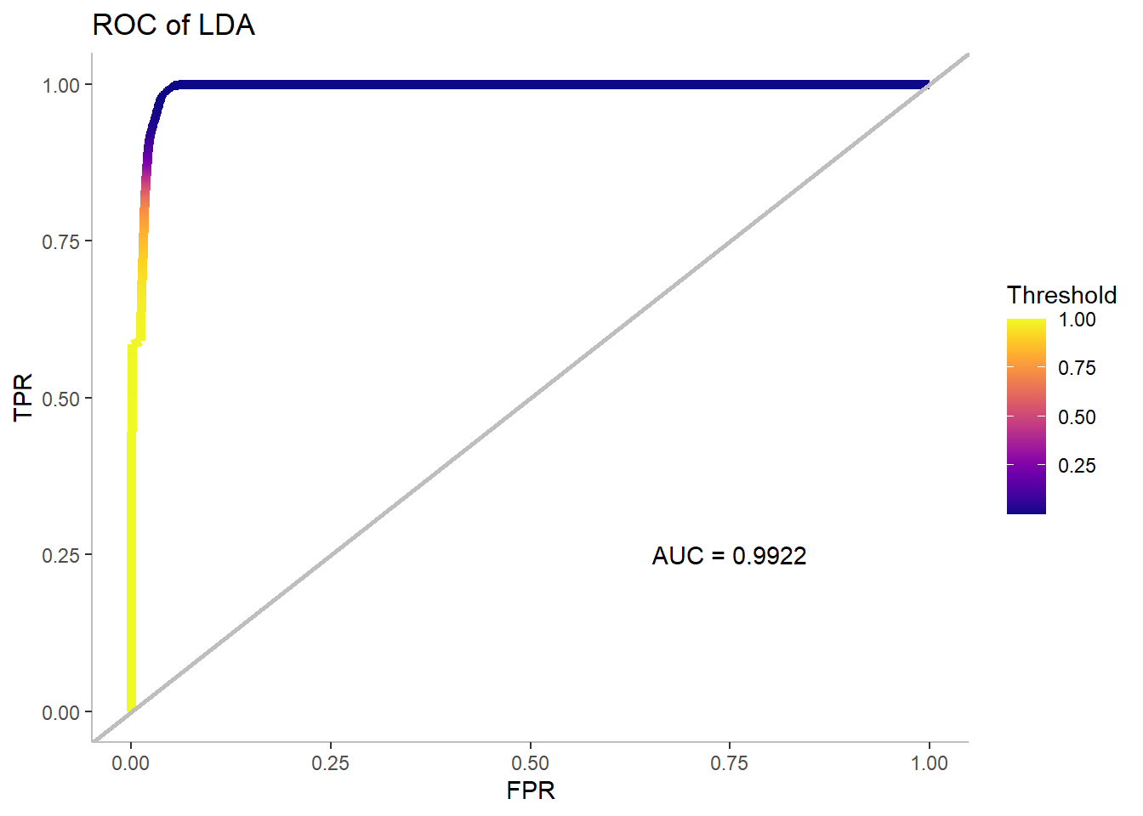
LDA Performance on Holdout Data
 | Reference
Prediction | Tarp | Other
Tarp | 12154 | 34237
Other | 2326 | 1955460
Statistic |  | Training | Holdout
 | Accuracy | 0.9844 | 0.9818
 | TPR | 0.8111 | 0.8394
 | FPR | 0.0099 | 0.0172
 | PPV | 0.7308 | 0.2620
Introduction | Methods | Results | Conclusions

Slide 14
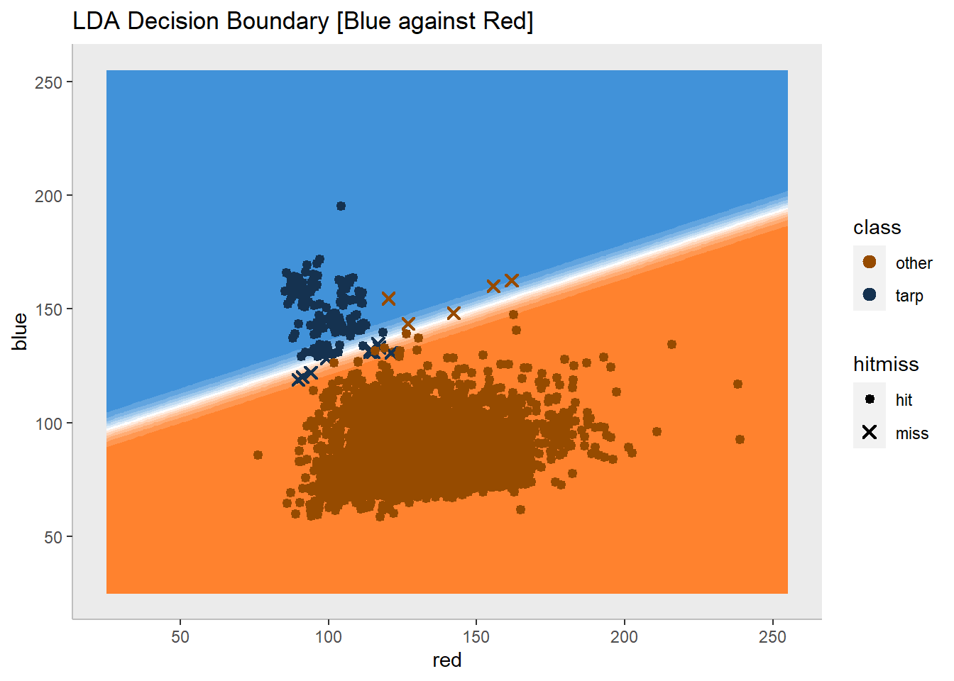
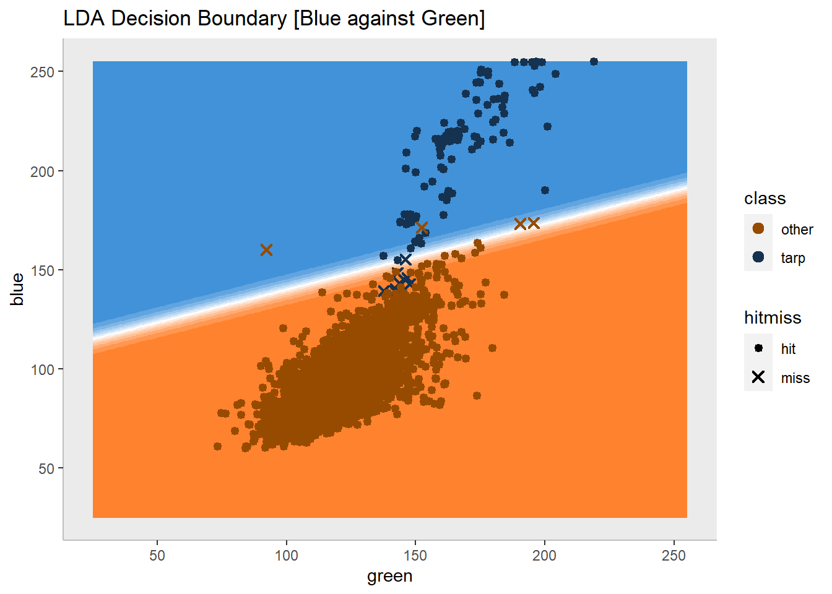
LDA Decision Boundary
Introduction | Methods | Results | Conclusions

Slide 15
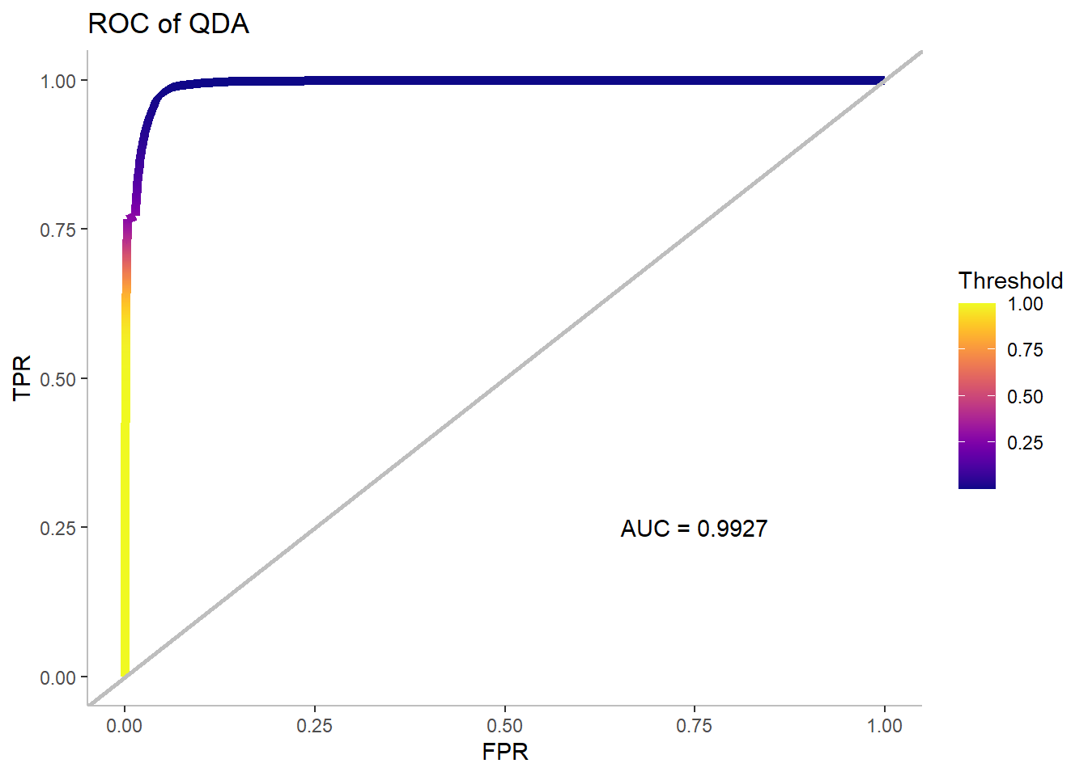
QDA Performance on Holdout Data
 | Reference
Prediction | Tarp | Other
Tarp | 10341 | 3699
Other | 4139 | 1985998
Statistic |  | Training | Holdout
 | Accuracy | 0.9950 | 0.9961
 | TPR | 0.8566 | 0.7142
 | FPR | 0.0004 | 0.0019
 | PPV | 0.9852 | 0.7365
Introduction | Methods | Results | Conclusions

Slide 16
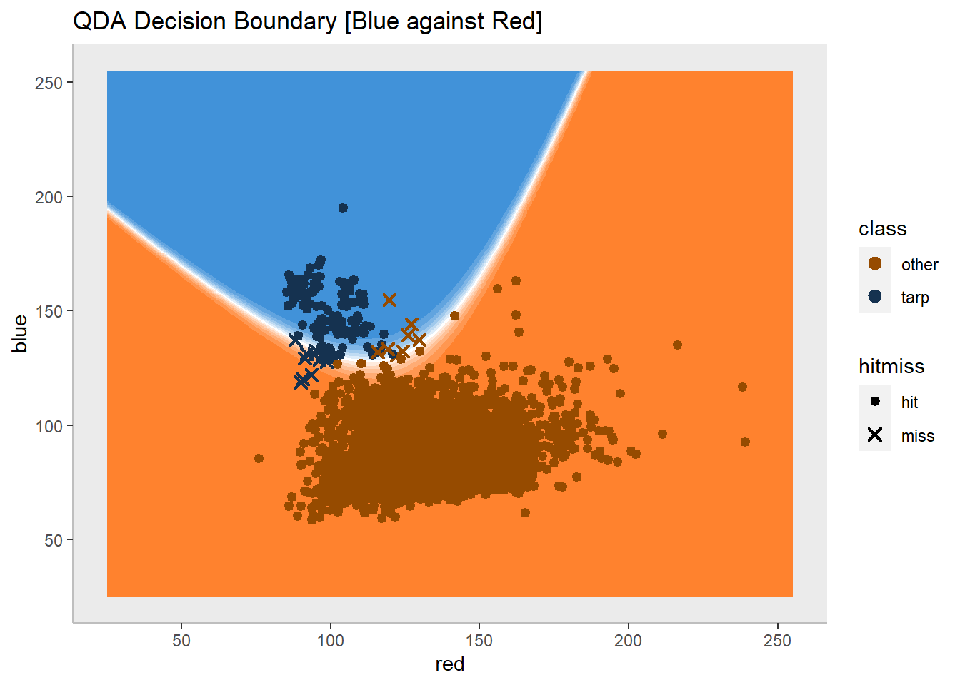
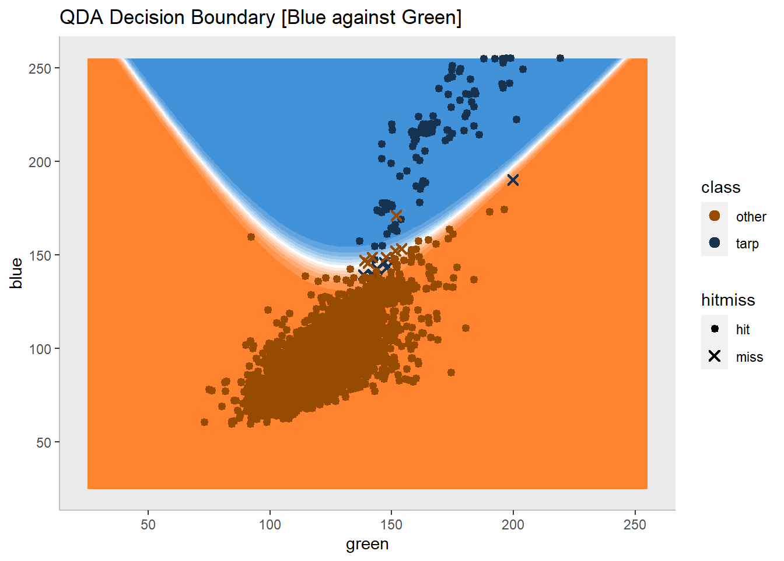
QDA Decision Boundary
Introduction | Methods | Results | Conclusions

Slide 17
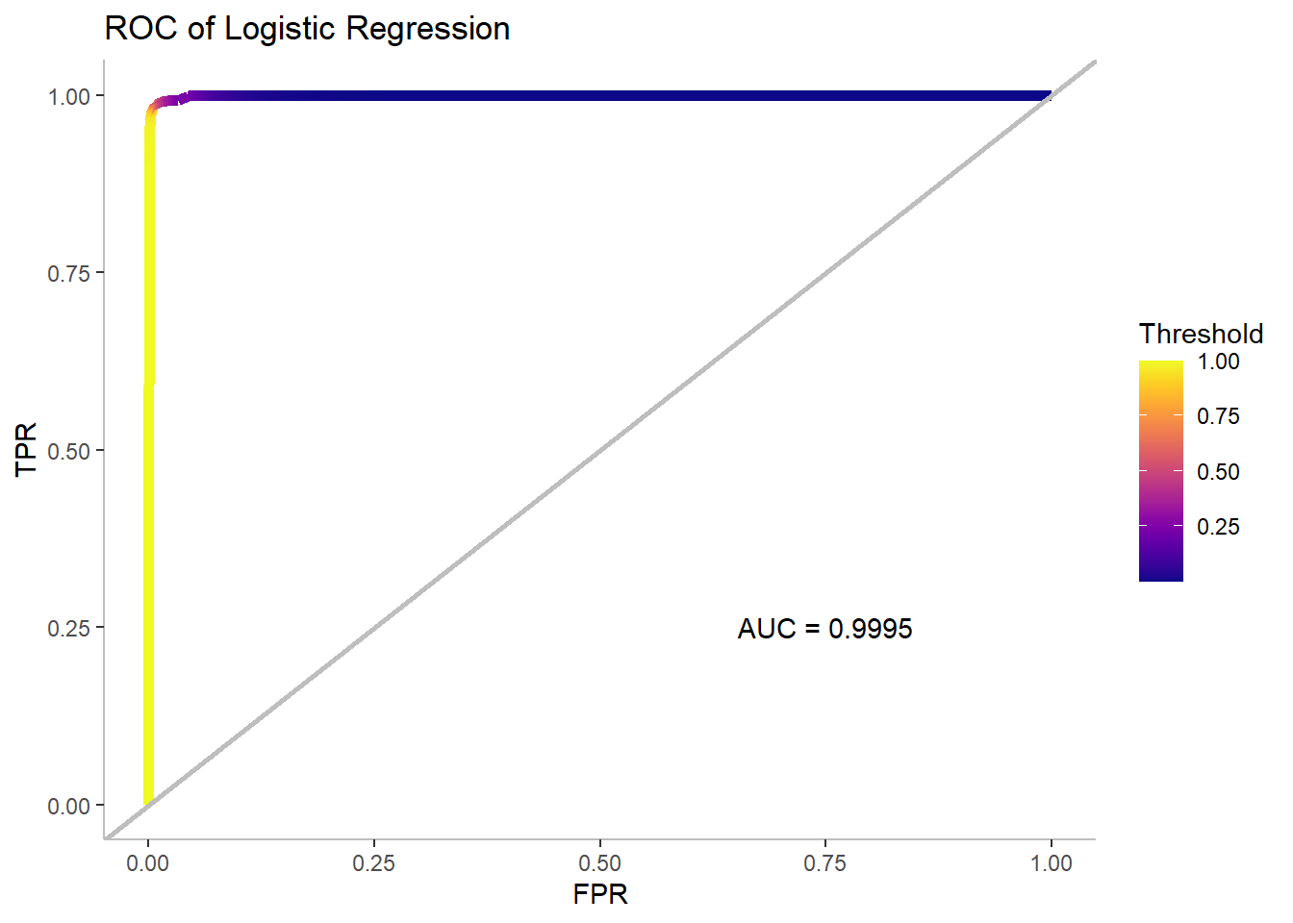
Logistic Regression Performance on Holdout Data
 | Reference
Prediction | Tarp | Other
Tarp | 14321 | 20274
Other | 159 | 1969423
Statistic |  | Training | Holdout
 | Accuracy | 0.9959 | 0.9898
 | TPR | 0.9021 | 0.9890
 | FPR | 0.0010 | 0.0102
 | PPV | 0.9682 | 0.4140
Introduction | Methods | Results | Conclusions

Slide 18
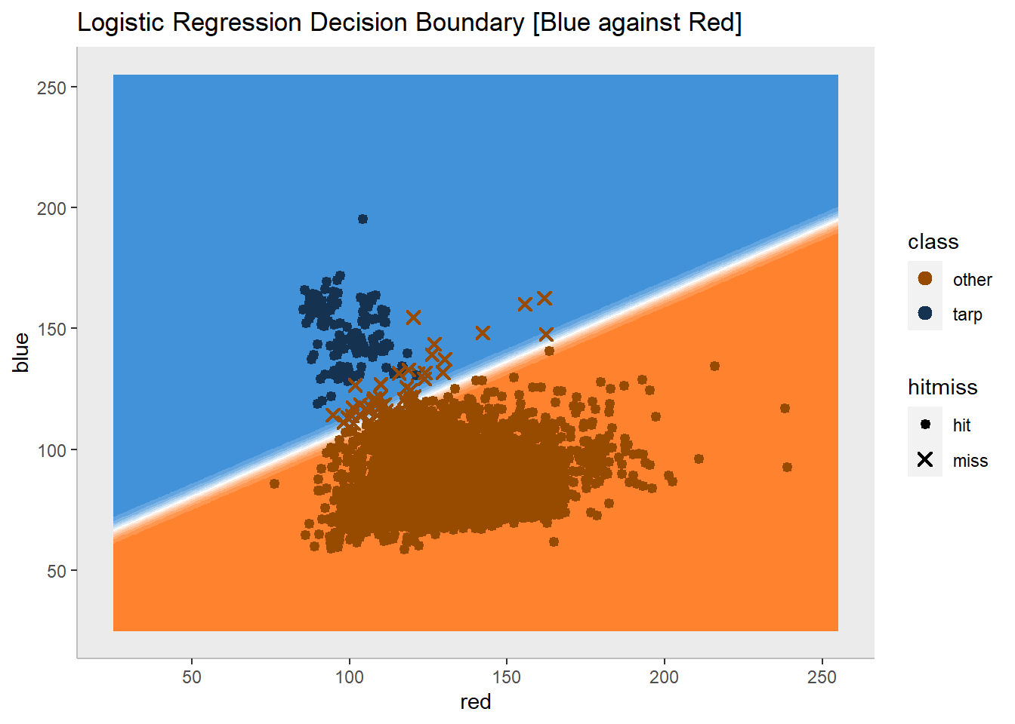
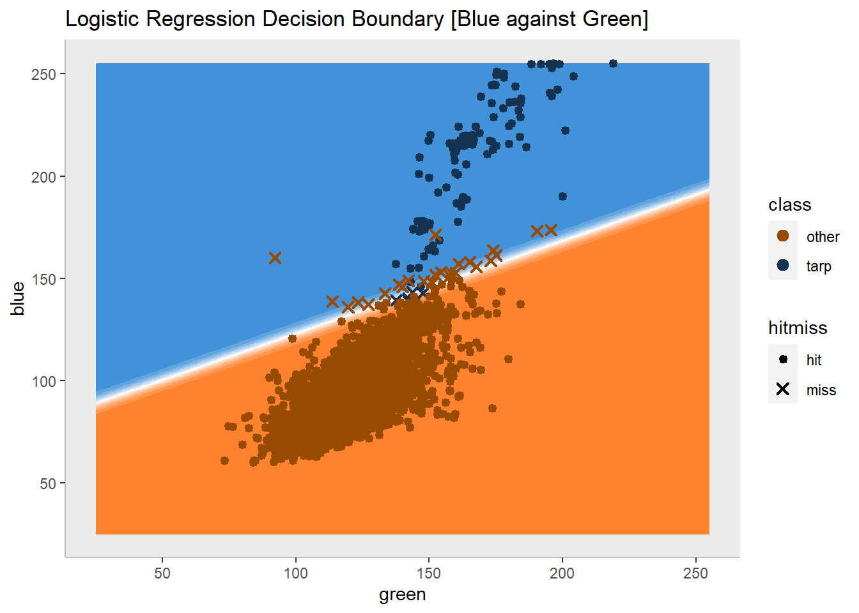
Logistic Regression Decision Boundary
Introduction | Methods | Results | Conclusions

Slide 19
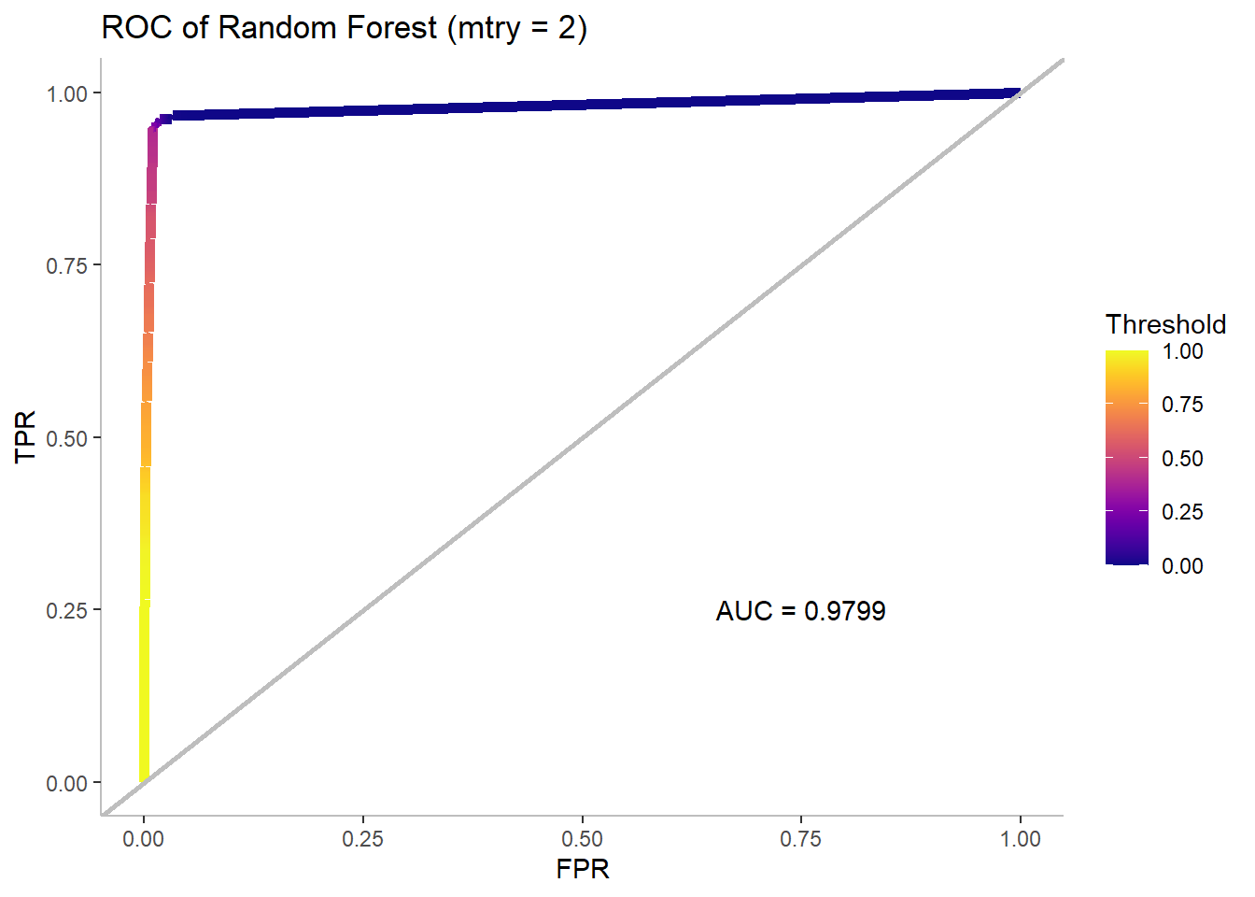
Random Forest Performance on Holdout Data
 | Reference
Prediction | Tarp | Other
Tarp | 12144 | 15094
Other | 2336 | 1974603
Statistic |  | Training | Holdout
 | Accuracy | 0.9969 | 0.9913
 | TPR | 0.9595 | 0.8387
 | FPR | 0.0018 | 0.0076
 | PPV | 0.9454 | 0.4458
Introduction | Methods | Results | Conclusions

Slide 20
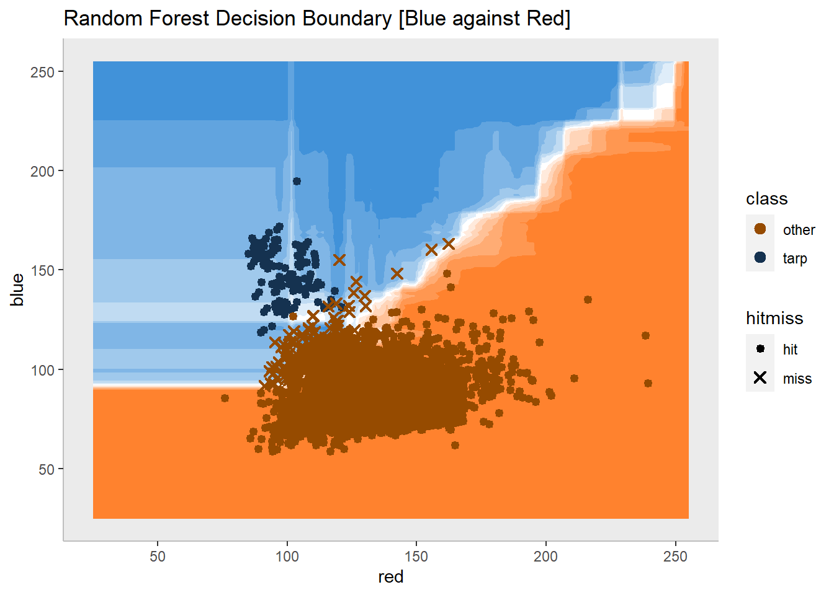
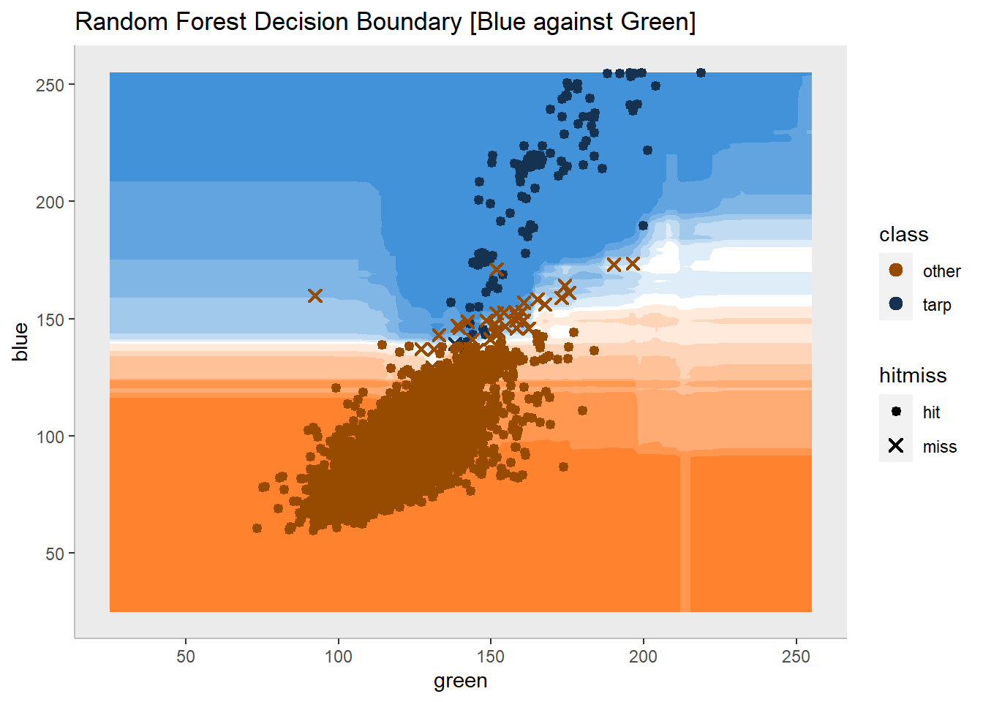
Random Forest Decision Boundary
Introduction | Methods | Results | Conclusions

Slide 21
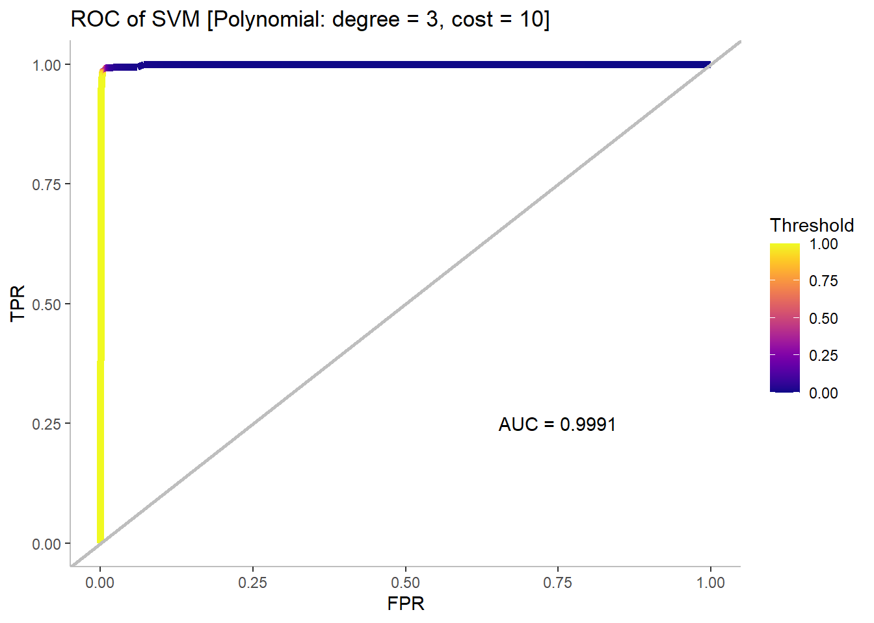
SVM Polynomial Performance on Holdout Data
 | Reference
Prediction | Tarp | Other
Tarp | 14347 | 11427
Other | 133 | 1978270
Statistic |  | Training | Holdout
 | Accuracy | 0.9960 | 0.9942
 | TPR | 0.9179 | 0.9908
 | FPR | 0.0014 | 0.0057
 | PPV | 0.9547 | 0.5566
Introduction | Methods | Results | Conclusions

Slide 22
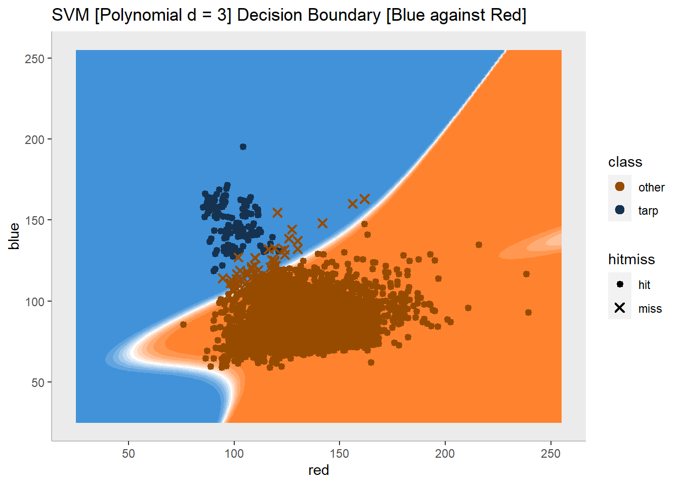
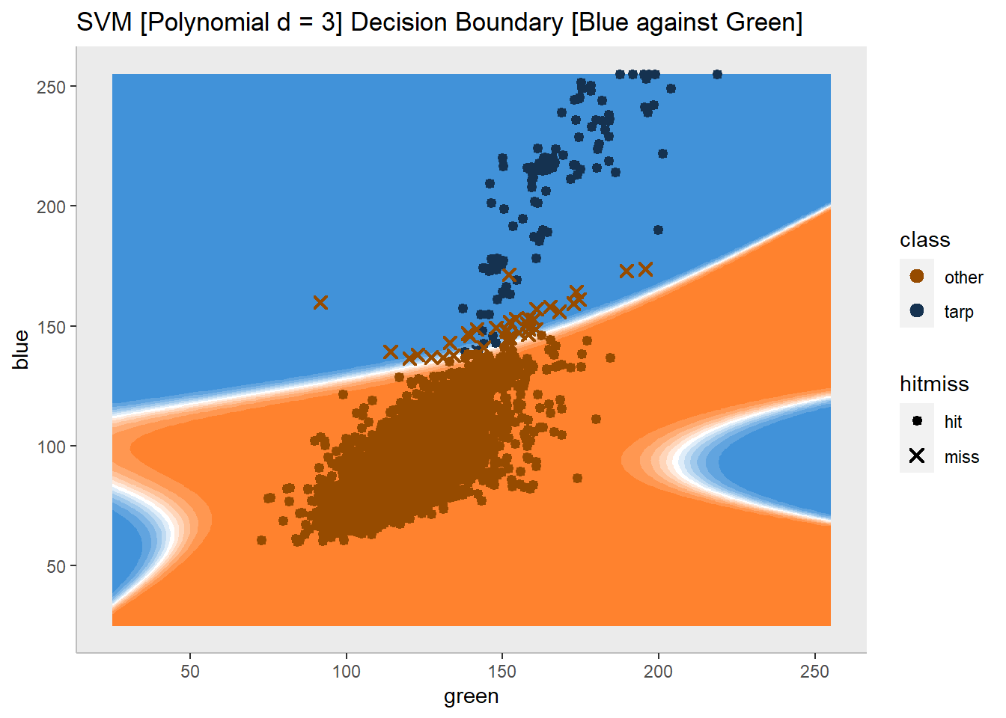
SVM Polynomial Decision Boundary
Introduction | Methods | Results | Conclusions

Slide 23
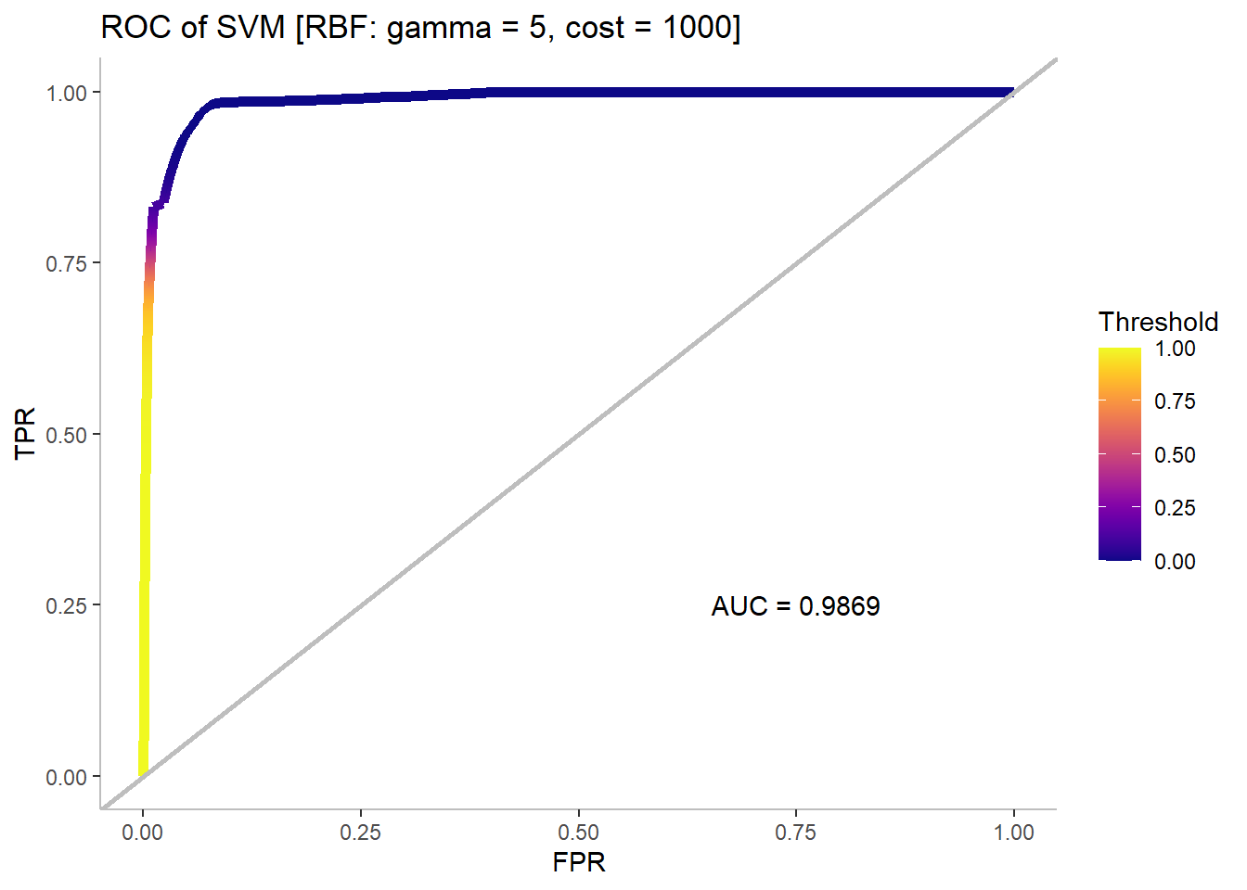
SVM RBF Performance on Holdout Data
 | Reference
Prediction | Tarp | Other
Tarp | 10885 | 15064
Other | 3595 | 1974633
Statistic |  | Training | Holdout
 | Accuracy | 0.9975 | 0.9907
 | TPR | 0.9723 | 0.7517
 | FPR | 0.0017 | 0.0076
 | PPV | 0.9507 | 0.4195
Introduction | Methods | Results | Conclusions

Slide 24
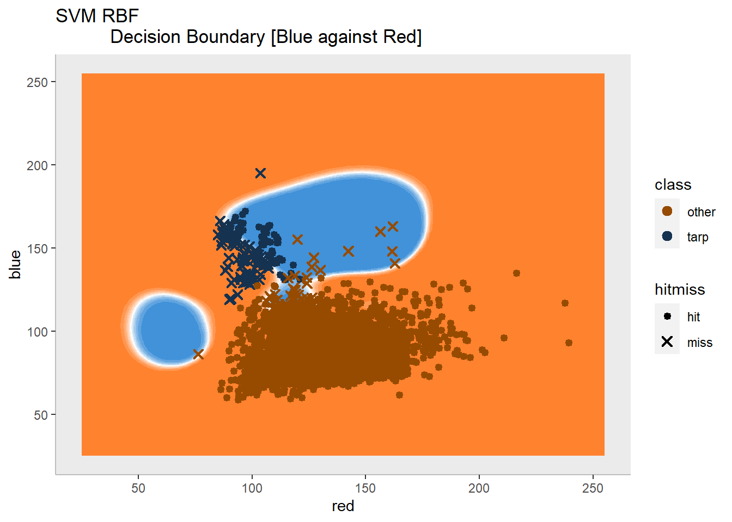
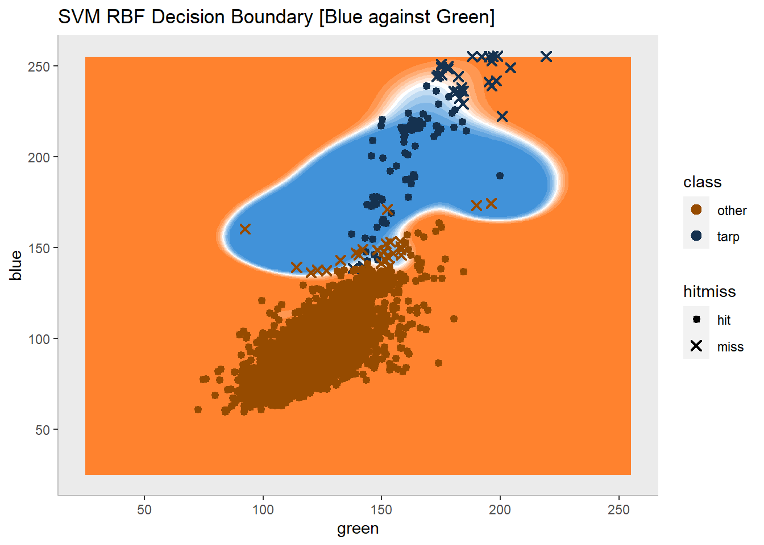
SVM RBF Decision Boundary
Introduction | Methods | Results | Conclusions

Slide 25
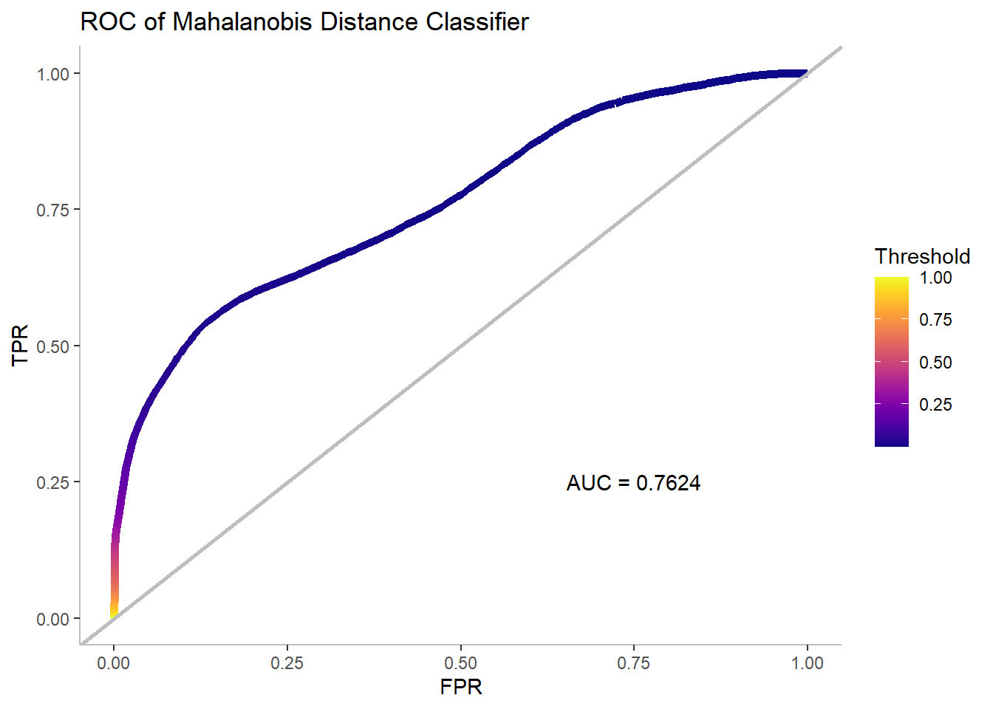
Mahalanobis Performance on Holdout Data
 | Reference
Prediction | Tarp | Other
Tarp | 1398 | 581
Other | 13082 | 1989116
Statistic |  | Training | Holdout
 | Accuracy | 0.9883 | 0.9932
 | TPR | 0.7369 | 0.0965
 | FPR | 0.0034 | 0.0003
 | PPV | 0.8785 | 0.7064
Introduction | Methods | Results | Conclusions

Slide 26
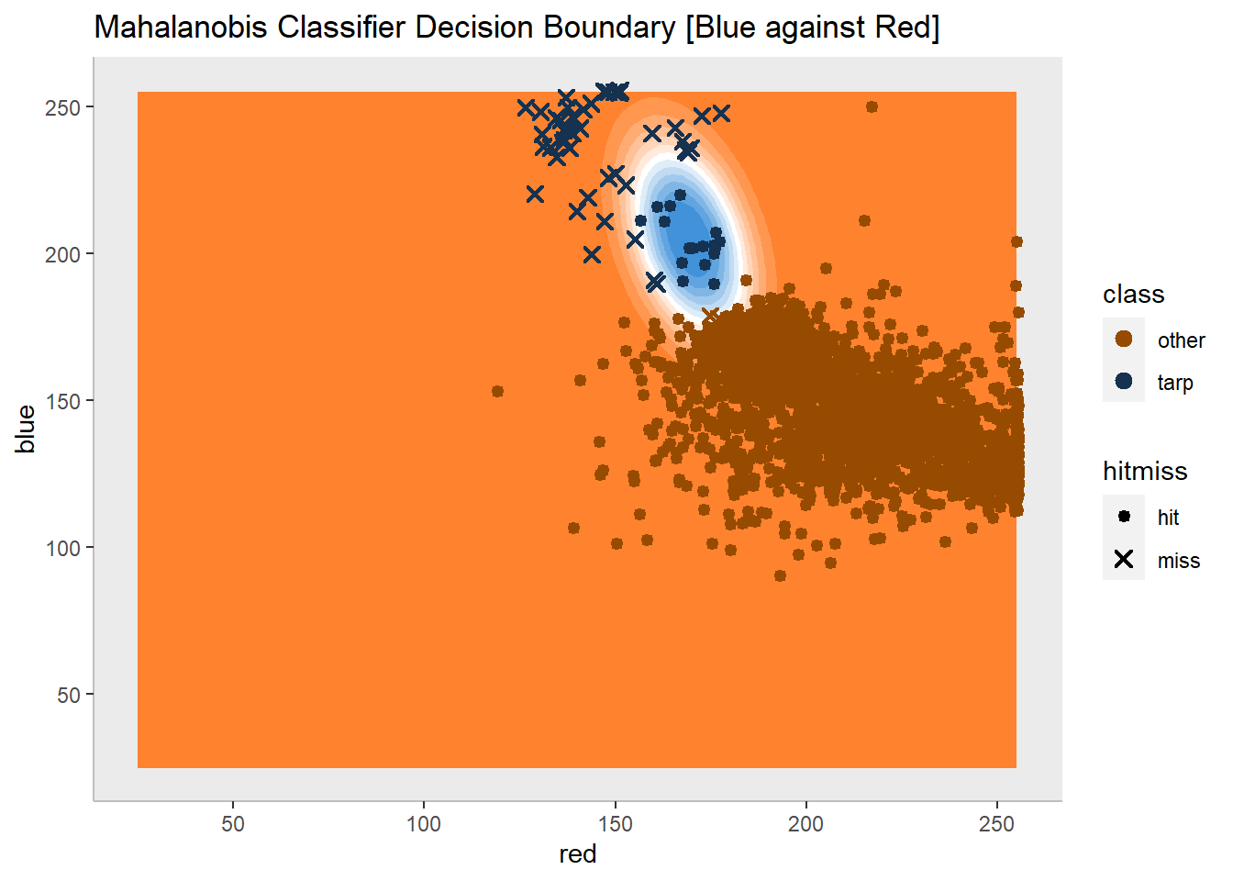
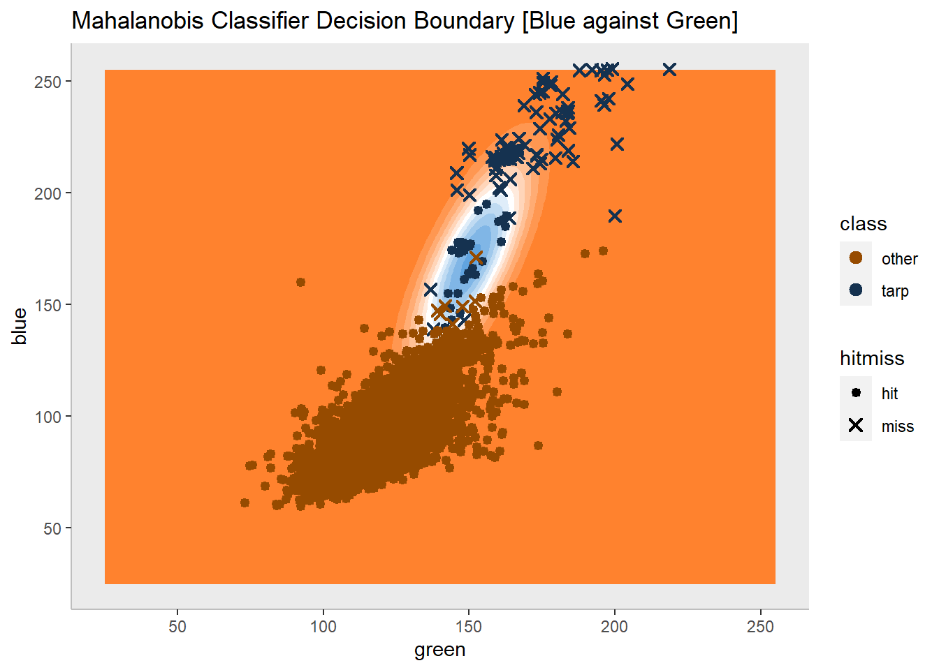
Mahalanobis Classifier Decision Boundary
Introduction | Methods | Results | Conclusions

Slide 27
Conclusions
The best performing method is Quadratic Discriminant Analysis (QDA).
On the holdout set, the QDA model has the highest overall accuracy as well as the highest positive predictive value (PPV).
QDA’s high PPV comes at the cost of a relatively low True Positive Rate (TPR). Some may favor the SVM model with a polynomial kernel as it achieves the highest TPR.
PPV and TPR are the most useful metrics for this problem.
PPV tells us what fraction of predicted tarp pixels are actual tarps. The complement to PPV, false discovery rate, tells us how often a non-tarp pixel is classified as a tarp. In this circumstance, PPV is useful because it prevents rescue workers from traveling to misidentified locations.
TPR tells us the fraction of actual tarp pixels that were properly classified. If this value is small, it means the model is misclassifying many of the actual tarps and rescue workers may not be sent to those locations.
Personally, I favor PPV over TPR since the amount of tarp pixels in each dataset is small. It would be simple to draw a large decision boundary that captures all tarp pixels and achieves a perfect TPR. However, this boundary would also capture a significant number of non-tarp pixels.
Introduction | Methods | Results | Conclusions

Slide 28
Conclusions
For all models, the overall accuracy for both the training and holdout sets is high (>98%). However, other key metrics see a significant drop in performance when the models are applied to the holdout set.
High variance models (kNN, RF, and SVM-R) saw a significant drop in both TPR and PPV. This suggests that the models are overfit to the training data and do a poor job of identifying tarps on a generalized dataset.
Interestingly, high bias models (logistic regression and LDA) saw a modest increase in TPR when applied to the holdout set. This comes at the cost of a 2-fold increase in FPR for LDA and 10-fold increase in FPR for logistic regression, and a substantial decrease in PPV for both. This means that the high bias models are classifying too many pixels as tarps.
The training dataset is not an ideal representative sample of the holdout set.
The violin plots created in the exploratory phase of the analysis show that the RGB values in the training dataset skew higher on average than the holdout set. This essentially means that the images in the training set are brighter. If images are collected at various points throughout the day, the sun’s position could affect the brightness of an image, and even the hue. Hypothetically, a model trained on bright, midday images might have difficulty identifying morning or evening images.
While this discrepancy in predictor distribution poses a problem for all models, the highly flexible models and the Mahalanobis classifier were the most affected. The flexible models and Mahalanobis classifier create a tight decision boundary around the cluster of tarp pixels in the training dataset. When generalized, they may miss tarps in images with different lighting conditions or camera settings.
Introduction | Methods | Results | Conclusions

Slide 29
Conclusions
Generally, the models with linear decisions boundaries (LDA and logistic regression) are poorly suited to this problem.
The linear decision boundary in 3D RGB space can be represented by a hyperplane, where one side of the plane classifies the pixels as tarps, and other side as non-tarps. In actuality, tarp pixels may only exist in a smaller cluster. Suppose, a small body of water is present in an image. To the human eye, water and tarps are visually distinct. However, they may exist on the same side of a linear decision boundary in RGB space. Linear classifiers are likely too rigid.
The Mahalanobis distance classifier offers overall accuracy that is comparable to the more sophisticated models. However, it is the worst—by far—at identifying tarps in the holdout set.
The TPR of the Mahalanobis classifier on the holdout set was only 0.0965, far below the performance on the training set. This method creates a small sphere (or ellipsoid in Euclidean coordinates) around the mean of the tarps in the training set. Points inside the sphere are classified as tarps. The population mean of tarps is likely different from the training sample mean. Thus, the classifier is likely to miss any tarps that are far from the training sample mean.
I conclude that the Mahalanobis classifier is sensitive to training sample. Fortunately, it is a quick method to train and would likely benefit from a larger sample.
Introduction | Methods | Results | Conclusions

Slide 30
Conclusions
Except for the Mahalanobis classifier, each model had a high AUC (>0.96) on the holdout set.
The high values tell us that the models are generally good at separating the two classes. However, AUC is not the most useful metric for distinguishing between models in this scenario where the number of non-tarp observations vastly exceeds the number of tarp observation. A relatively crude classifier, like logistic regression, can achieve a high AUC by over-classifying observations as tarps.
Logistic regression has a high TPR since it correctly classifies most of the true tarps. Unfortunately, it also misclassifies many non-tarps as tarps. The FPR remains low due to the large number of non-tarp observations that are correctly classified. The logistic regression model has the highest AUC, yet it misclassifies far too many non-tarps to be of value.
Another advantage of QDA over other models is speed.
QDA is substantially quicker to train than kNN, random forest, and SVM. Additionally, predictions can be made faster with QDA than with kNN. In this emergency scenario, where time is a factor, a QDA may be preferred to other candidates.
Introduction | Methods | Results | Conclusions

Slide 31
Improvements
I outline some possible improvements and extensions of this analysis.
Transform RGB values to HSB (hue, saturation, and brightness) to be included as features
Test more sophisticated models like gradient boosting and neural networks
Project feature space onto principal components to decorrelate red, green, and blue predictors

Slide 32
References
[1] Aardt, Jan van et al. “Geospatial Disaster Response during the Haiti Earthquake: A Case Study Spanning Airborne Deployment, Data Collection, Transfer, Processing, and Dissemination.” Photogrammetric Engineering and Remote Sensing 77 (2011): 943-952.
[2] Gareth James, Daniela Witten, Trevor Hastie, Robert Tibshirani. An Introduction to Statistical Learning : with Applications in R. New York :Springer, 2013.

