Slide 1
PROJECT REPORT CMPS 470/570
TEAM: Space Something or Other

Slide 2
TEAM MEMBERS & ROLES
Brooks Schafer:
-Coding, emotional support
Melinda McElveen:
-Coding, emotional support

Slide 3
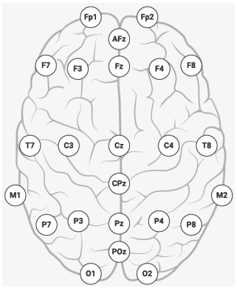
DESCRIPTION OF THE PROJECT
Goal: Identifying subjects using EEG streams by means of ML algorithms ANN, SVM, DT, and K-NN.
Tasks:
Visualize signals
Preprocess signals
Design representation
Extract features
Explore feature distributions
Design and create the model
Conduct model assessment
Display results

Slide 4
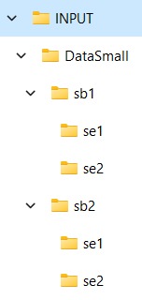
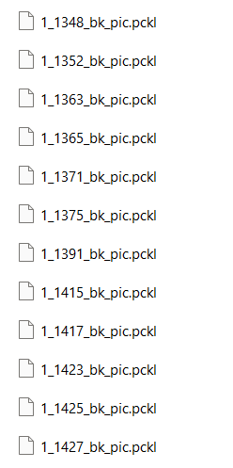
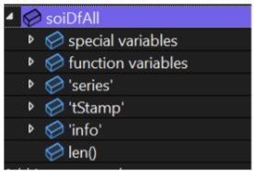
DESCRIPTION OF THE RAW DATA
Data source: DataSmall folder with .pckl files of EEG recordings provided by professor
Attributes and their types:
Attribute | ‘series’ | ‘tStamp’ | ‘info’ | ‘effective_srate’
Data Type | float32 2d array | float64 array | dictionary | float64

Slide 5
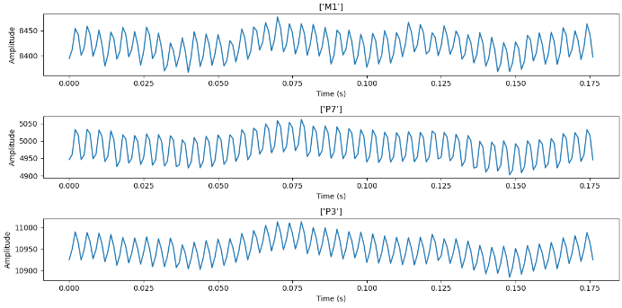
DESCRIPTION OF THE RAW DATA
Distribution of values examples:

Slide 6

PREPROCESSING
For preprocessing the data, we first apply a notch filter at 60, 120, 180 and 240 Hz
Next, we apply impedance filter at 125±1
Next, a bandpass filter at [0.5, 32]
Finally, we apply rereferencing to the data

Slide 7
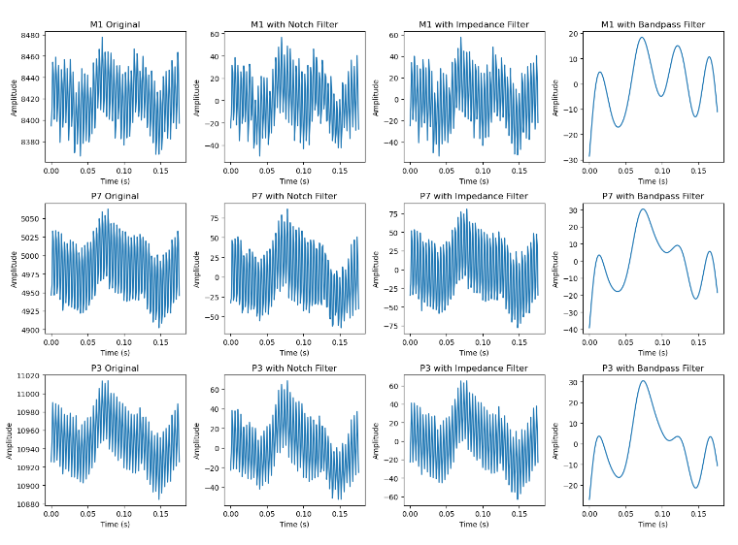
PREPROCESSING
Raw vs Processed Data:

Slide 8
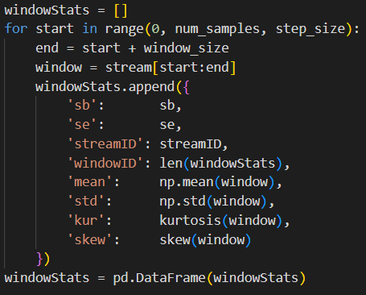
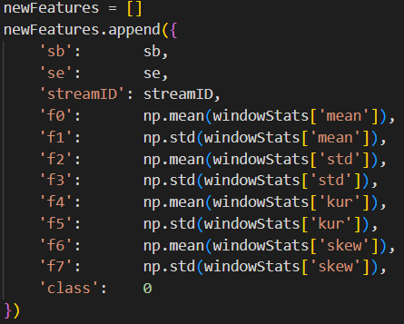
FEATURE EXTRACTION
For feature extraction, we iterate through our streams. We split each stream into windows and get statistics from each window, then we calculate the mean and standard deviation of each stat across all the windows from that particular stream. This gives us our stream features.

Slide 9
DESCRIPTION OF THE FEATURE DATA
Features and their types:
Feature | Data type
‘f0’ | float64
‘f1’ | float64
‘f2’ | float64
‘f3’ | float64
‘f4’ | float64
‘f5’ | float64
‘f6’ | float64
‘f7’ | float64
‘class’ | int
Mean of means
Std dev of means
Mean of std devs
Std dev of std devs
Mean of kurtosis
Std dev of kurtosis
Mean of skews
Std dev of skews
Class label (sb1=0, sb2=1)

Slide 10
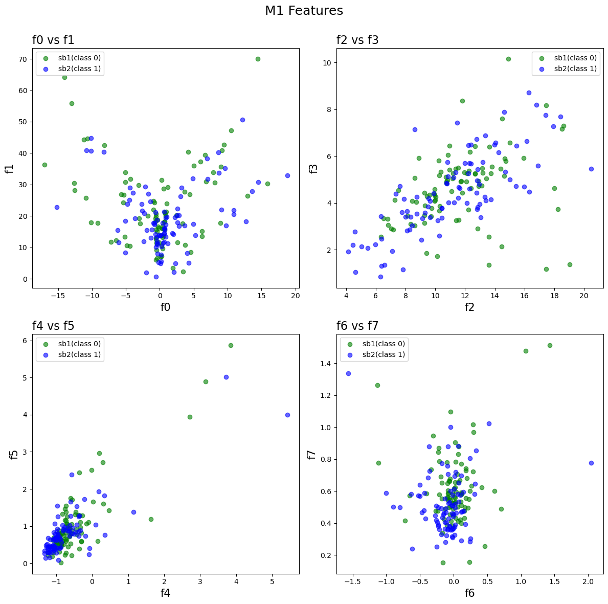
DESCRIPTION OF THE FEATURE DATA
Distribution of features:

Slide 11
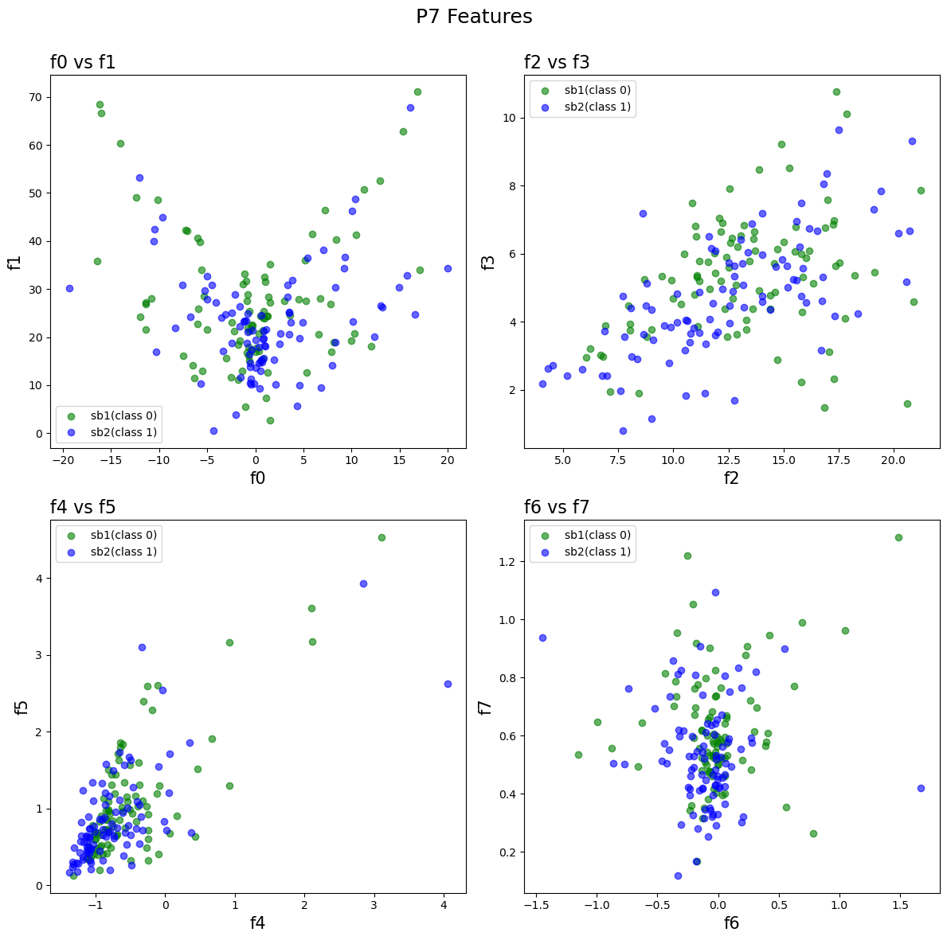
DESCRIPTION OF THE FEATURE DATA
Distribution of features:

Slide 12
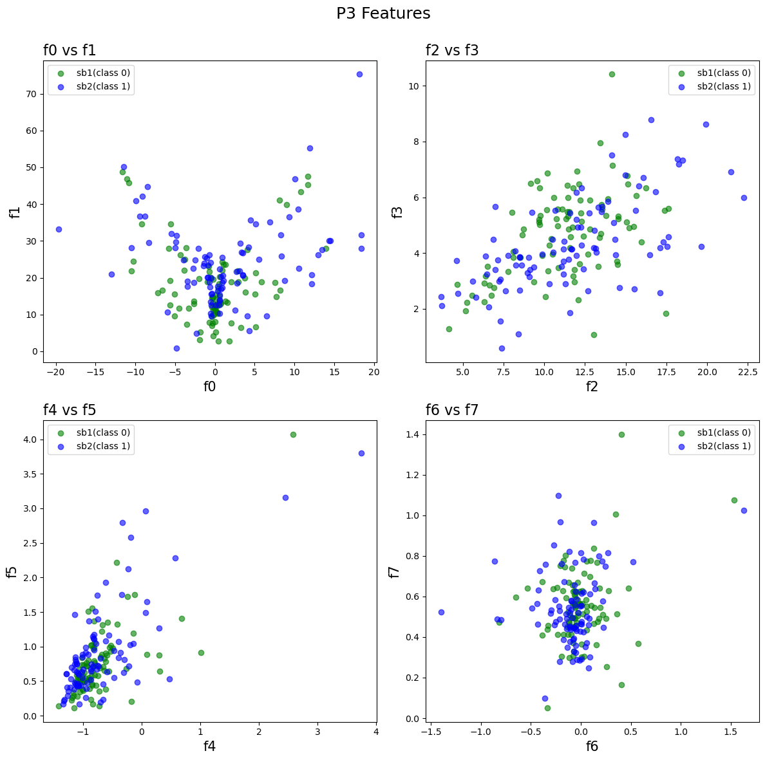
DESCRIPTION OF THE FEATURE DATA
Distribution of features:

Slide 13
KNN: DESCRIPTION OF THE MODEL
KNNClassifier model from sklearn
Model parameters:
Distance measured by Euclidean distance
Accuracy of validation data is compared for all k-values and the best k-value is used on test data

Slide 14
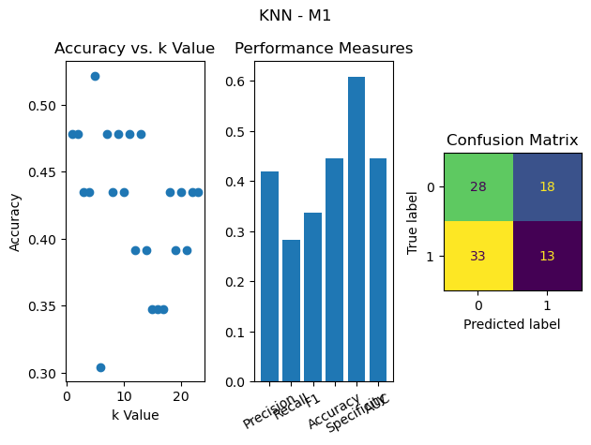
KNN: PERFORMANCE OF THE MODEL

Slide 15
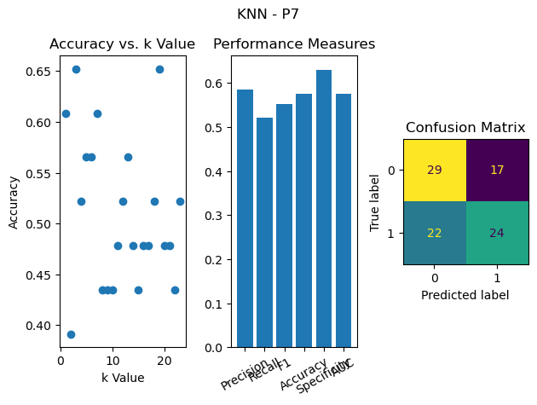
KNN: PERFORMANCE OF THE MODEL

Slide 16
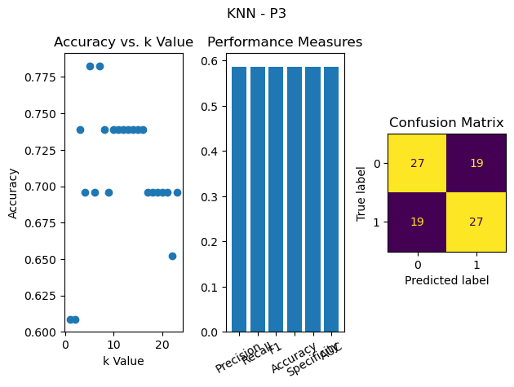
KNN: PERFORMANCE OF THE MODEL

Slide 17
DTree: DESCRIPTION OF THE MODEL
DecisionTreeClassifier model from sklearn
Model parameters:
Entropy used for measure of split quality
K-fold cross validation with k=5 used to find best model

Slide 18
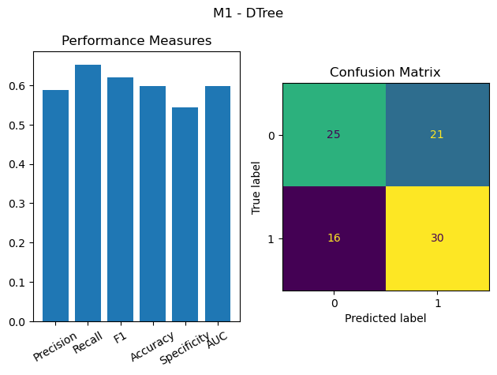
DTree: PERFORMANCE OF THE MODEL

Slide 19
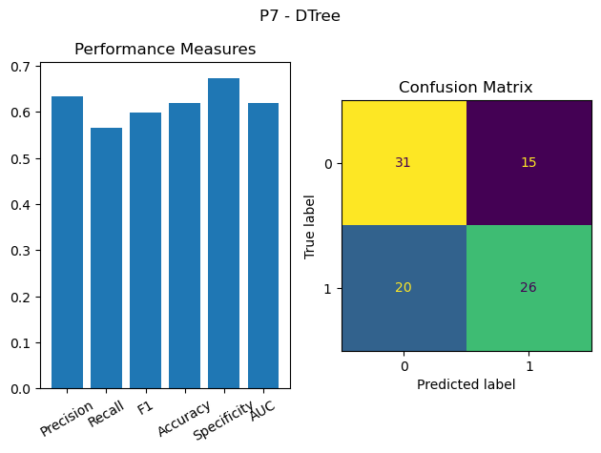
DTree: PERFORMANCE OF THE MODEL

Slide 20
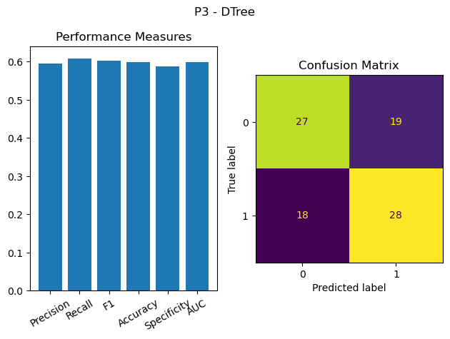
DTree: PERFORMANCE OF THE MODEL

Slide 21
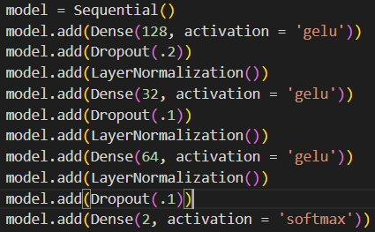
ANN: DESCRIPTION OF THE MODEL
Sequential ANN model from tensorflow
Model parameters:
4 layers
Gaussian error linear unit (GELU) activation function used for first 3 layers
Softmax activation function used for final layer

Slide 22
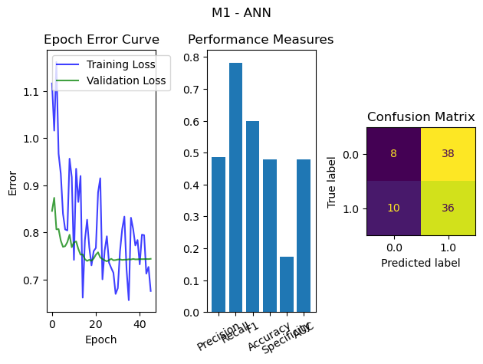
ANN: PERFORMANCE OF THE MODEL

Slide 23
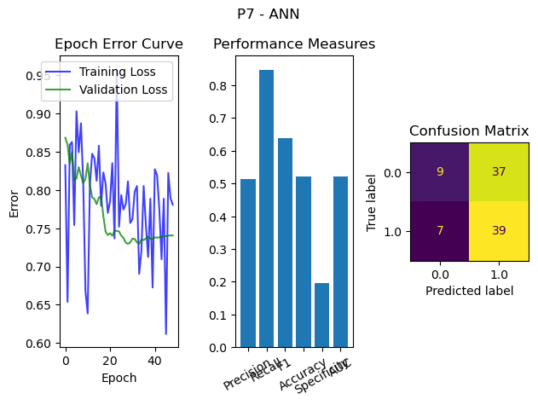
ANN: PERFORMANCE OF THE MODEL

Slide 24
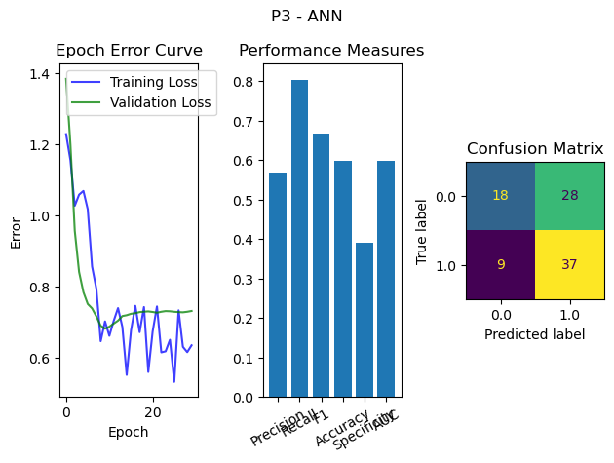
ANN: PERFORMANCE OF THE MODEL

Slide 25
SVM: DESCRIPTION OF THE MODEL
MLPClassifier model from sklearn
Model parameters:
Kernal = ‘rfb’
Gamma value = 1 / (n_features * X.var())
K-fold cross validation with k=5 used to find best model

Slide 26
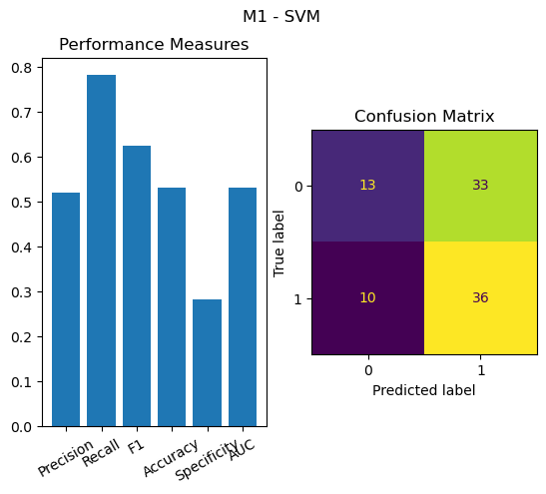
SVM: PERFORMANCE OF THE MODEL

Slide 27
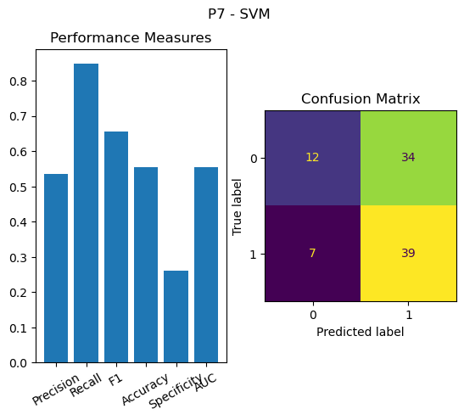
SVM: PERFORMANCE OF THE MODEL

Slide 28
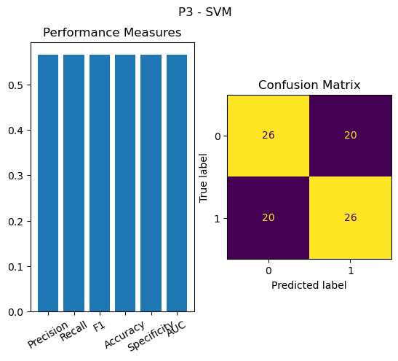
SVM: PERFORMANCE OF THE MODEL

Slide 29
Task Progress Report
DATE | TASK NAME | STATUS | PERSON
03/31 | PREPROCESSING DATA | DONE | MELINDA+BROOKS
04/07 | GET WINDOW STATS FROM STREAMS | DONE | MELINDA
04/08 | EXTRACT FEATURES FROM WINDOW STATS | DONE | BROOKS
04/10 | PLOT FEATURES | DONE | MELINDA+BROOKS
04/24 | ANN MODEL | DONE | MELINDA+BROOKS
05/01 | KNN MODEL | DONE | MELINDA+BROOKS
05/01 | DTREE MODEL | DONE | MELINDA+BROOKS
05/01 | SVM MODEL | DONE | MELINDA+BROOKS
05/02 | GET PERFORMANCE DATA | DONE | BROOKS
05/03 | PLOT PERFORMANCE DATA | DONE | MELINDA
05/04 | CLEAN UP CODE | DONE | MELINDA+BROOKS
05/04 | FINAL CHECK | DONE | MELINDA+BROOKS

