Slide 1
PHYSICS · DIRECT CURRENT
external load
Ohm's Law for
Closed Circuits
R
I
How a real source shares its voltage between the load and itself
+
−
r
source interior
E = I(R + r)
A compact English teaching edition based on the original lesson

Slide 2
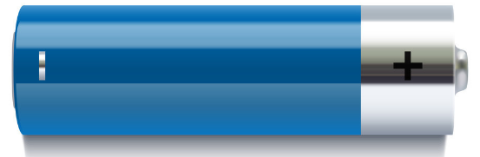
THE HIDDEN RESISTOR
Battery heating reveals resistance inside the source.
A real battery is not an ideal voltage source.
When current flows, the battery warms because charges also lose energy inside the source.
Internal heat = I^2 r t
r is the internal resistance of the source.
The load resistance R is outside the source.
02

Slide 3
ENERGY PER CHARGE
EMF measures how strongly a source can supply energy.
It is a property of the source, not a measure of stored charge.
E = W / q
chemical,
mechanical,
or light energy
electrical
energy
1 volt = 1 joule per coulomb
Non-electrostatic forces move charge from lower to higher electric potential inside the source.
03

Slide 4
TWO DIFFERENT IDEAS
EMF supplies energy; terminal voltage delivers what remains.
Both use volts, but they describe different energy transfers.
INSIDE THE SOURCE
ACROSS THE TERMINALS
EMF E
Terminal voltage U
energy added per coulomb by non-electrostatic forces
energy delivered per coulomb to the external circuit
U = E − Ir
04

Slide 5
ONE ENERGY BALANCE
Each coulomb receives E, then spends it across R and r.
The full-circuit equation follows directly from energy conservation.
SOURCE
EXTERNAL LOAD
SOURCE INTERIOR
energy supplied
useful energy
+
internal heating
E q
I R q
I r q
E q = I R q + I r q → E = I(R + r)
05

Slide 6
THE CORE MODEL
Current is limited by both the load and the source.
Treat a real source as an ideal EMF E in series with internal resistance r.
external load
R
I = E / (R + r)
I
Increasing R reduces the current.
Increasing r also reduces the current.
+
−
r
If R → 0, the short-circuit current approaches E/r.
source interior
06

Slide 7
VOLTAGE SHARING
The terminal voltage drops when the source supplies more current.
Part of the EMF is lost across the internal resistance.
E
Ir
U = E − Ir
internal voltage drop
voltage available to the load
Open circuit: I = 0, so U = E. Heavy load: I is large, so U is smaller.
07

Slide 8
READ THE SOURCE FROM A GRAPH
A U-I graph reveals both EMF and internal resistance.
For a source, U = E − Ir is a straight line.
U
vertical intercept = E
SLOPE
ΔU / ΔI = −r
I
horizontal intercept = E/r
08

Slide 9
WHERE THE POWER GOES
Internal resistance converts part of the source power into heat.
Efficiency improves when the load resistance is large compared with r.
source power
Psource = E I
=
I^2 R
+
I^2 r
USEFUL OUTPUT
EFFICIENCY
Pload = I^2 R
η = R / (R + r)
09

Slide 10
WORKED EXAMPLE
One model answers current, voltage, and heating questions.
Given E = 3.0 V, R = 2.0 Ω, and r = 1.0 Ω.
2 Ω
1
Current
I = E/(R+r) = 3.0/3.0 = 1.0 A
I
2
Terminal voltage
U = IR = 1.0 × 2.0 = 2.0 V
+
−
1 Ω
3
Internal heating
Pinternal = I^2r = 1.0 W
10

Slide 11
MEASURE E AND r
Two operating points are enough to determine the source.
Measure terminal voltage and current for two different loads.
Measurement 1
R
U1 = E − I1 r
I
Measurement 2
U2 = E − I2 r
+
−
r
Change R, then record (I, U).
r = (U1 − U2) / (I2 − I1)
11

Slide 12
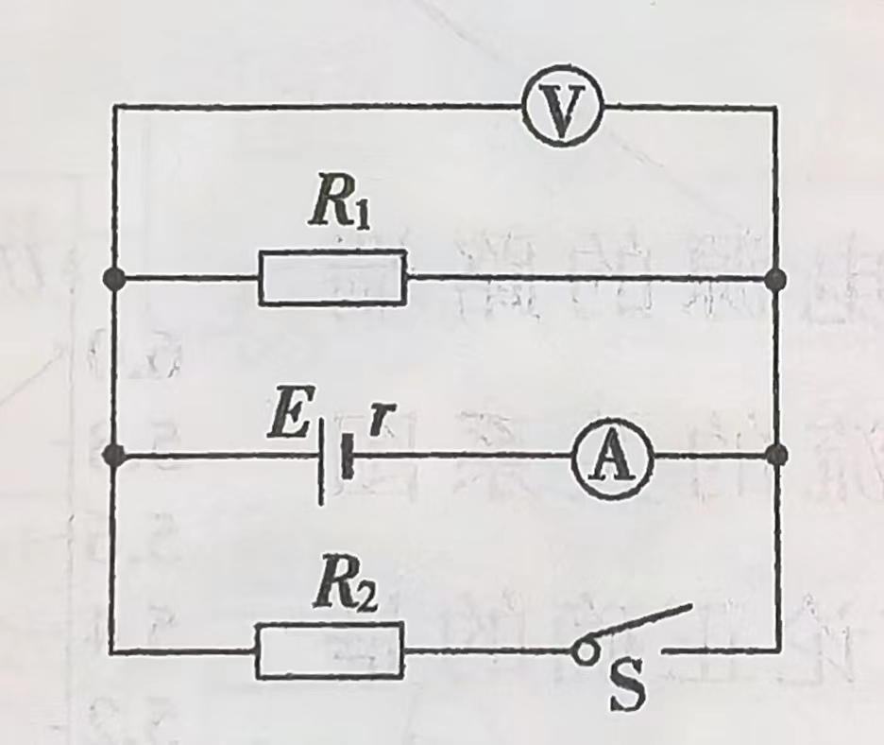
ORIGINAL PROBLEM · REWRITTEN
Use open-circuit voltage and loaded current to identify the source.
An ideal voltmeter and ammeter are connected as shown.
Data
Switch closed: U = 1.6 V, I = 0.4 A
Switch open: U = 2.0 V
Solution
E = 2.0 V
r = (E − U)/I = (2.0 − 1.6)/0.4 = 1.0 Ω
12

Slide 13
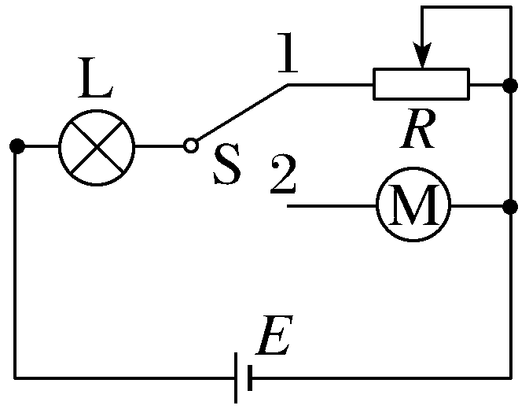
APPLICATION
A motor receives less voltage when internal loss is significant.
The original lamp-and-motor circuit becomes an energy-accounting problem.
Reasoning path
Use the lamp rating to find the circuit current.
Apply E = I(R_total + r) in each switch position.
Motor input: Pin = Umotor I.
Motor output = input − coil heating.
13

Slide 14
CONCEPT CHECK
Which statement about EMF is correct?
Choose one answer, then justify it using energy per charge.
A. EMF is simply the terminal voltage.
B. A larger EMF means the source must store more energy.
C. A larger EMF means the source must do work faster.
D. EMF equals the energy supplied by the source per unit charge.
Answer: D
14

Slide 15
THE COMPLETE PICTURE
A real source supplies energy and consumes some of it.
Model the source, conserve energy, then interpret the result.
MODEL
CURRENT
ideal EMF E
+ internal resistance r
I = E / (R + r)
TERMINAL VOLTAGE
EFFICIENCY
U = E − Ir = IR
η = R / (R + r)
The central question is always: where does each joule per coulomb go?
15

