Slide 1
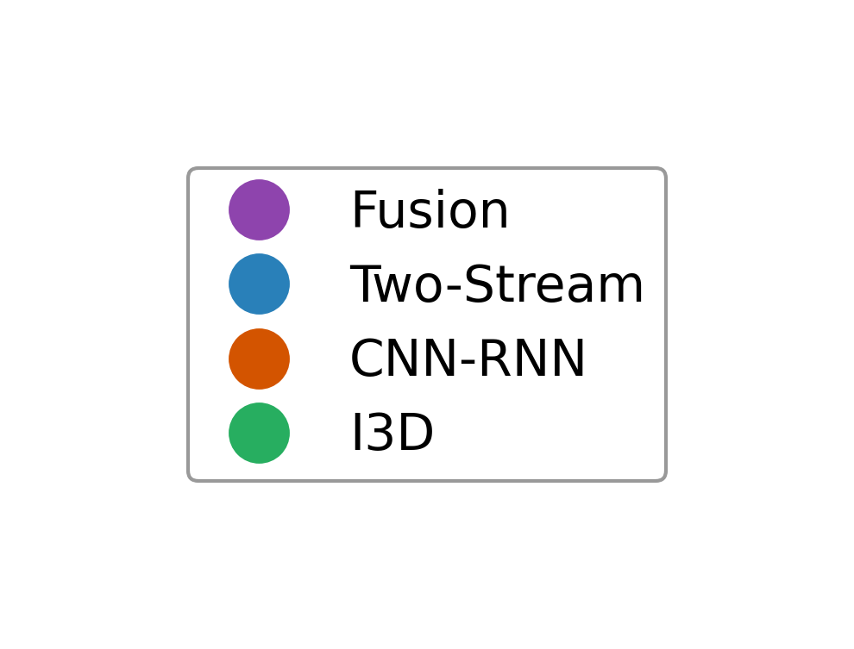
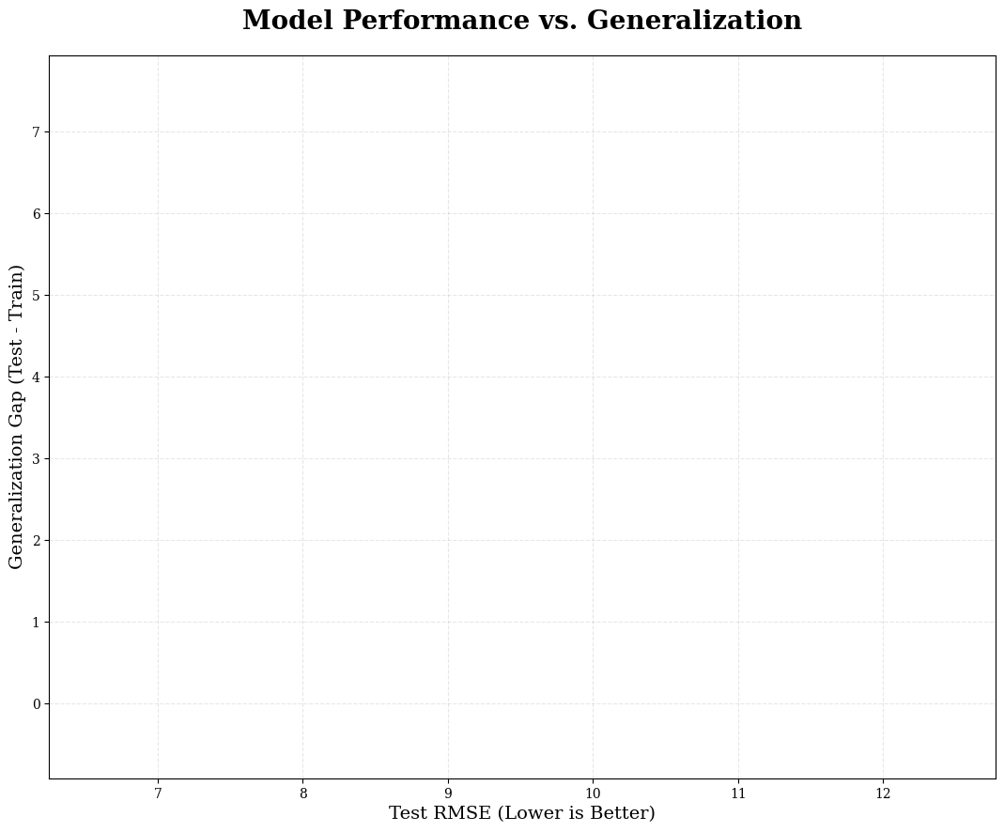
Two-Stream-L1
I3D OG-B2
Fusion NC-B1
CNN_RNN T(O)-b(7)
I3D Single-class A-4
I3D Mini-B4
Fusion DIT-1
Generalization Gap (Test - Train RMSE)
I3D Single-class A-2
CNN_RNN T(O)-a
I3D OG-B1
I3D Mini-B2
I3D Single-class A-3
Fusion DI-L1
Fusion-L1
I3D Mini-B3
I3D Single-class A-3 (B)
Fusion DIT-2
I3D Mini-L2
I3D Mini-L1
Fusion(S)-L1
Fusion-B1
CNN_RNN Scratch(LSTM)-B1
Fusion DI-L2
Fusion NC-L2
Two-Stream-B1
Fusion SI-L2
Fusion NC-L1
Fusion SI-B2
Fusion DI-B2
CNN_RNN Scratch(GRU)-B1
CNN_RNN T(O)-b(5)
Fusion SI-B1
Fusion SI-L1
Fusion DI-B1
CNN_RNN-1
I3D Single-class A-3 (A)
I3D Single-class A-3 (C)
CNN_RNN Scratch(LSTM)-Mixed1
Fusion NC-B2
CNN_RNN Scratch(LSTM)-L1
I3D OG-L1
I3D OG-L2
CNN_RNN Scratch(GRU)-L1
Model Performance (Test RMSE)

