Slide 1
pyLiquor
Record Keeping for Alcohol Enthusiasts

Slide 2
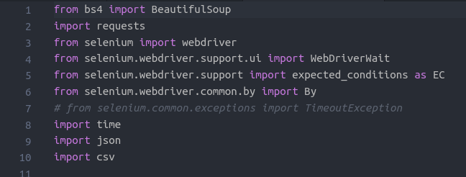
Web Scraping
Used BeautifulSoup and Selenium to scrape over 35000 different alcohols from LiquorConnect.com
This process took roughly 3 days. Selenium is slow.
Dynamically Creates CSV files from data gathered

Slide 3
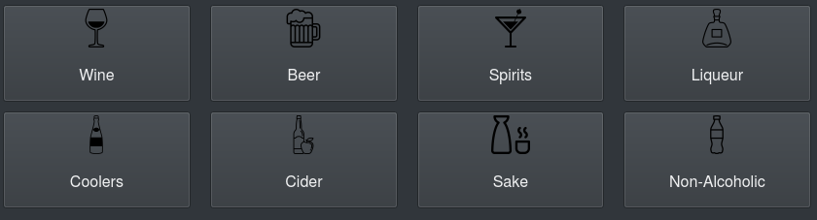
GUI
GUI is implemented with pyqt5, a framework built on top of the popular C++ GUI framework, Qt5

Slide 4
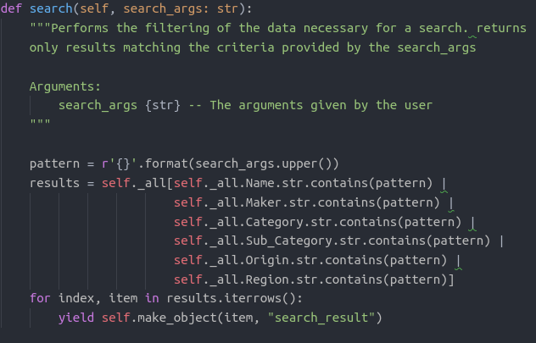
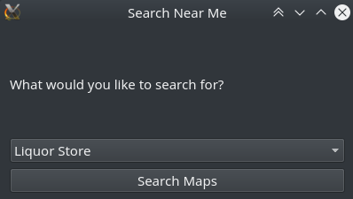
Features
View liquor database
Search and filter through different csv files
Add and remove items from your “cabinet”
View google search results for liquor store locations near you

Slide 5
Live Demo

