Slide 1
2011 DBF Winners
Georgia Tech
Uni of So. Cal
Purdue Uni
Technion (Best Report)

Slide 2
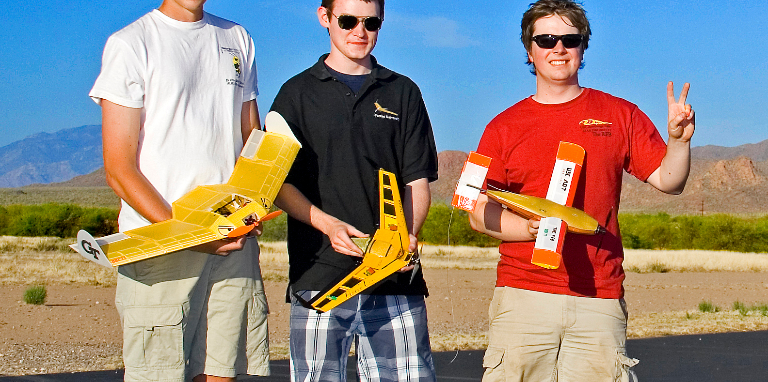

Slide 3
Design Goals
Hand Launch with NO assists
MUST Land in successfully
Max Number of Laps in 4 Minutes
3 lap flight with 3”x4” steel bar
3 lap flight with MAX number of Golf Balls

Slide 4
Georgia Tech Overview
Flying Wing / Easiest to Manufacture
Winglets / Stablization
Single Engine → Puller / Easy Hand Launch + Weight
Large Prop / Faster → able to complete more laps
Skid Pad (1 Wheel) / Simplicity
Balsa Wood w/ Monokote + Carbon Fiber / Foam

Slide 5
USC Overview
Conventional Wing / Various designs to study
Single Engine → Puller / Easy Hand Launch + Weight
Conventional Tail / Easy to Study + Manufacture
Skid Pad / Simple
Carbon Fiber Fuselage + Balsa over Foam Wing + Solid Balsa Tail

Slide 6
Purdue Overview
Flying Wing / Good Lift to Drag ratio
Winglets / Yaw Stablization
Single Engine → Puller / Easy Hand Launch + Weight
Skid Pad / Simple
Balsa Wood

