Slide 1
Chapter 9
Parity and Other Option Relationships

Slide 2
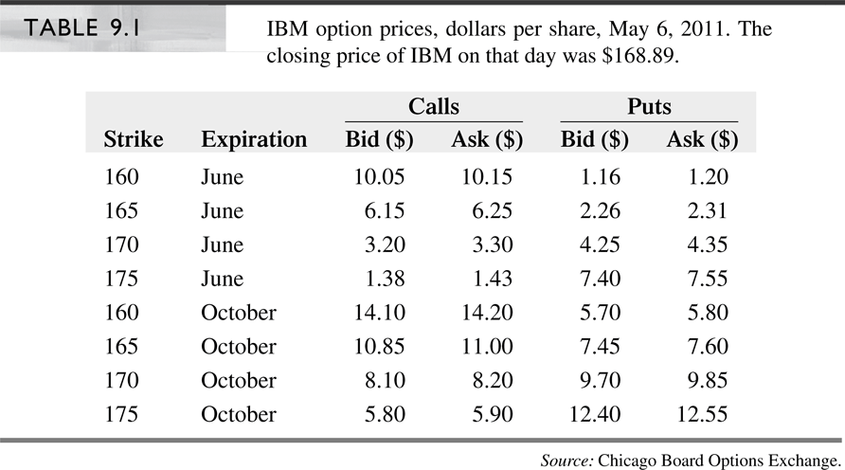
IBM Option Quotes

Slide 3
Put-Call Parity
For European options with the same strike price and time to expiration the parity relationship is
Call – put = PV (forward price – strike price)
or
Intuition
  Buying a call and selling a put with the strike equal to the forward price (F_{0,T} = K) creates a synthetic forward contract and hence must have a zero price

Slide 4
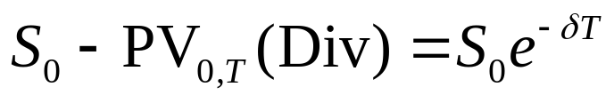
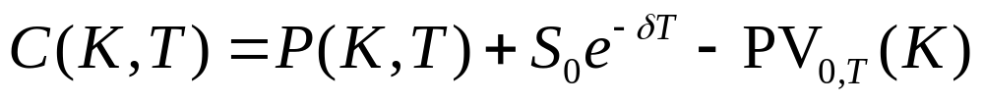
Parity for Options on Stocks
If underlying asset is a stock and PV_{0,T}(Div) is the present value of the dividends payable over the life of the option, then e^{-rT} F_{0,T} = S₀ – PV_{0,T} (Div), therefore
Rewriting above
For index options, , therefore

Slide 5
Parity for Options on Stocks (cont’d)
Examples 9.1 & 9.2
  Price of a non-dividend-paying stock: $40, r=8%, option strike price: $40, time to expiration: 3 months, European call: $2.78, European put: $1.99. $2.78=$1.99+$40 – $40e ^{-0.08x0.25}
  Additionally, if the stock pays $5 just before expiration, call: $0.74, and put: $4.85. $0.74-$4.85=($40 – $5e^{-0.08x0.25}) – $40e^{-0.08x0.25}
Synthetic security creation using parity
  Synthetic stock: buy call, sell put, lend PV of strike and dividends
  Synthetic T-bill: buy stock, sell call, buy put (conversion)
  Synthetic call: buy stock, buy put, borrow PV of strike and dividends
  Synthetic put: sell stock, buy call, lend PV of strike and dividends

Slide 6
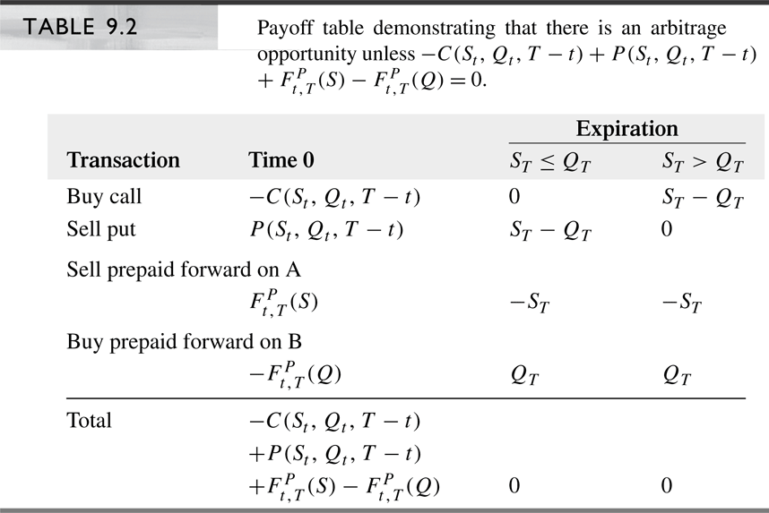
Generalized Parity Relationship

Slide 7
Properties of Option Prices
European versus American Options
  Since an American option can be exercised at anytime, whereas a European option can only be exercised at expiration, an American option must always be at least as valuable as an otherwise identical European option
  C_{Amer}(S, K, T) > C_{Eur}(S, K, T)
  P_{Amer}(S, K, T) > P_{Eur}(S, K, T)

Slide 8
Properties of Option Prices (cont’d)
Maximum and Minimum Option Prices
  Call price cannot
    be negative
    exceed stock price
    be less than price implied by put-call parity using zero
    for put price:
  Put price cannot
    be more than the strike price
    be less than price implied by put-call parity using zero for
    put price:

Slide 9
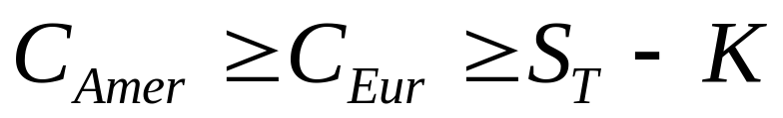
Properties of Option Prices (cont’d)
Early exercise for American options
  An American call option on a non-dividend-paying stock should not be exercised early, because
  That means, one would lose money be exercising early instead of selling the option
  If there are dividends, it may be optimal to
  exercise early, just prior to a dividend
  It may be optimal to exercise a non-dividend-paying put option early if the underlying stock price is sufficiently low

Slide 10
Properties of Option Prices (cont’d)
Time to Expiration
  An American option (both put and call) with more time to expiration is at least as valuable as an American option
  with less time to expiration. This is because the longer
  option can easily be converted into the shorter option by exercising it early
  A European call option on a non-dividend-paying stock will be more valuable than an otherwise identical option with less time to expiration.
  European call options on dividend-paying stock and European puts may be less valuable than an otherwise identical option with less time to expiration
  When the strike price grows at the rate of interest, European call and put prices on a non-dividend-paying stock increases with time to maturity

Slide 11



Properties of Option Prices (cont’d)
Different strike prices (K₁ < K₂ < K₃), for both European and American options
  A call with a low strike price is at least as valuable as an otherwise identical call with higher strike price
  A put with a high strike price is at least as valuable as an otherwise identical call with low strike price
  The premium difference between otherwise identical calls with different strike prices cannot be greater than the difference in strike prices

Slide 12

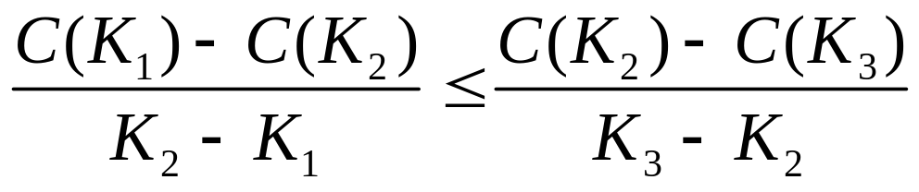
Properties of Option Prices (cont’d)
Different strike prices (K₁ < K₂ < K₃), for both European and American options
  The premium difference between otherwise identical puts with different strike prices cannot be greater than the difference in strike prices
  Premiums decline at a decreasing rate for calls with progressively higher strike prices. (Convexity of option price with respect to strike price)

Slide 13
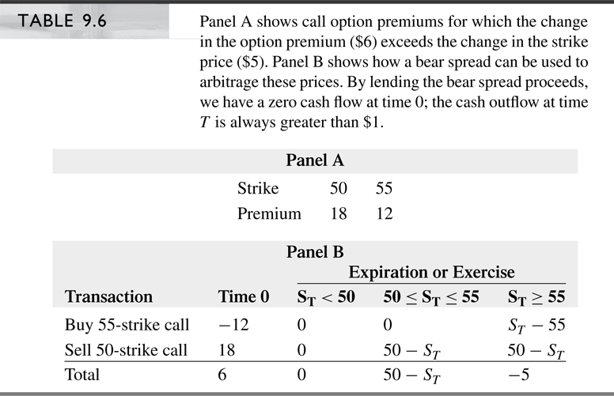
Properties of Option Prices (cont’d)

Slide 14
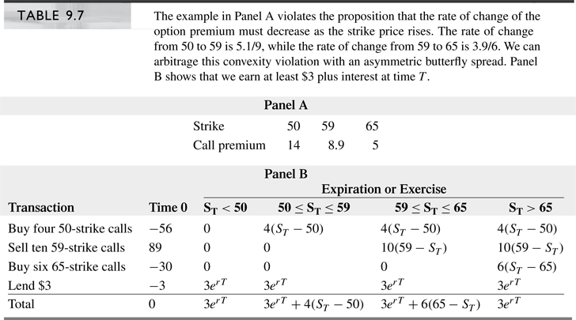
Properties of Option Prices (cont’d)

Slide 15
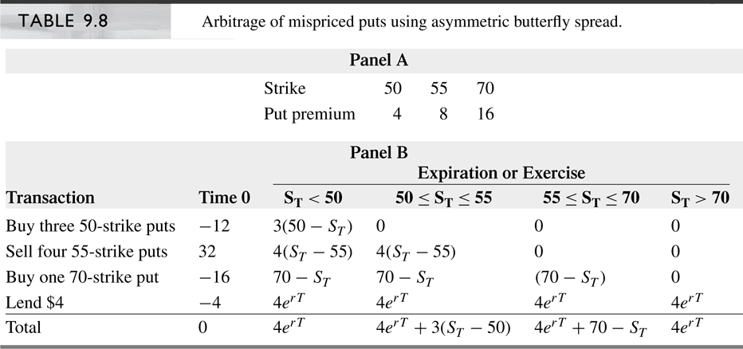
Properties of Option Prices (cont’d)

Slide 16
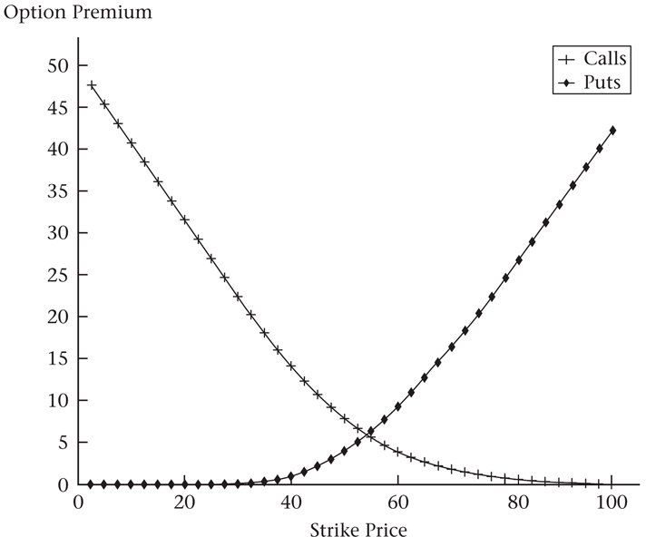
Properties of Option Prices (cont’d)

Slide 17
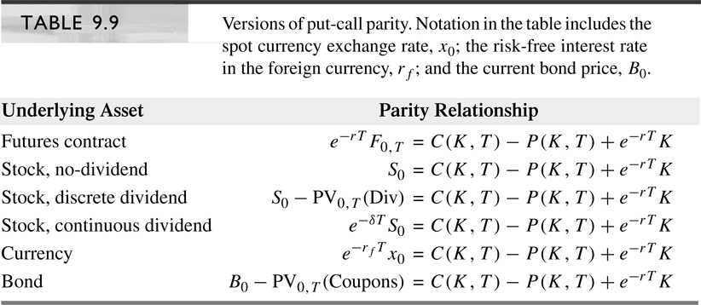
Summary of Parity Relationships

Slide 18
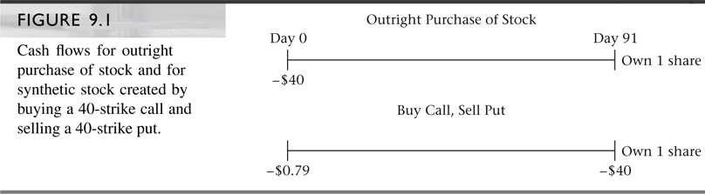

Slide 19
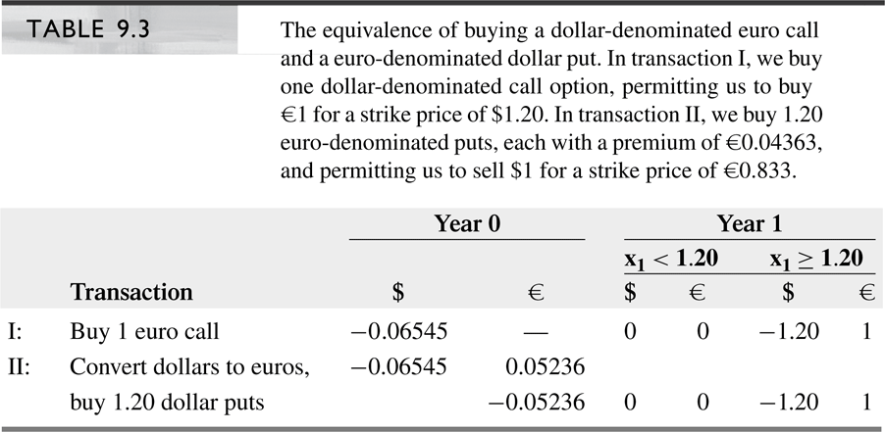

Slide 20
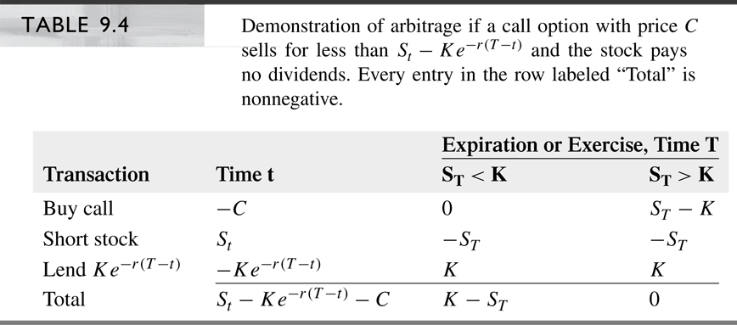

Slide 21
