Slide 1
Chapter 10
Binomial Option Pricing: Basic Concepts

Slide 2
Introduction to Binomial Option Pricing
The binomial option pricing model enables us to determine the price of an option, given the characteristics of the stock or other underlying asset
The binomial option pricing model assumes that the price of the underlying asset follows a binomial distribution—that is, the asset price in each period can move only up or down by a specified amount
The binomial model is often referred to as the “Cox-Ross-Rubinstein pricing model”

Slide 3
A One-Period Binomial Tree
Example
  Consider a European call option on the stock of XYZ, with a $40 strike and 1 year to expiration
  XYZ does not pay dividends, and its current price is $41
  The continuously compounded risk-free interest rate is 8%
  The following figure depicts possible stock prices over 1 year, i.e., a binomial tree
  $60
  $41
  $30

Slide 4
Computing the Option Price
Next, consider two portfolios
  Portfolio A: buy one call option
  Portfolio B: buy 2/3 shares of XYZ and borrow $18.462 at the risk-free rate
Costs
  Portfolio A: the call premium, which is unknown
  Portfolio B: 2/3 × $41 – $18.462 = $8.871

Slide 5
Computing the Option Price (cont’d)
Payoffs:
  Portfolio A: Stock Price in 1 Year
  $30 $60
  Payoff 0 $20
  Portfolio B: Stock Price in 1 Year
  $30 $60
  2/3 purchased shares $20 $40
  Repay loan of $18.462 – $20 –$20
  Total payoff 0 $20

Slide 6
Computing the Option Price (cont’d)
Portfolios A and B have the same
payoff. Therefore
  Portfolios A and B should have the same cost. Since Portfolio B costs $8.871, the price of one option must be $8.871
  There is a way to create the payoff to a call by buying shares and borrowing. Portfolio B is a synthetic call
  One option has the risk of 2/3 shares. The value 2/3 is the delta (Δ) of the option: the number of shares that replicates the option payoff

Slide 7
The Binomial Solution
How do we find a replicating portfolio consisting of Δ shares of stock and a dollar amount B in lending, such that the portfolio imitates the option whether the stock rises or falls?
  Suppose that the stock has a continuous dividend yield of δ, which is reinvested in the stock. Thus, if you buy one share at time t, at time t+h you will have e^{δh} shares
  If the length of a period is h, the interest factor per period
  is e^{rh}
  uS denotes the stock price when the price goes up, and dS denotes the stock price when the price goes down

Slide 8
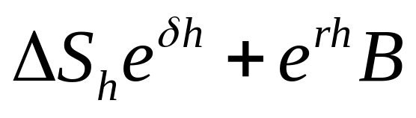
The Binomial Solution (cont’d)
Stock price tree: • Corresponding tree for
the value of the option:
uS C_{u}
S C
dS C_{d}
  Note that u (d) in the stock price tree is interpreted as one plus the rate of capital gain (loss) on the stock if it goes up (down)
The value of the replicating portfolio at time h, with stock
price S_{h}, is

Slide 9
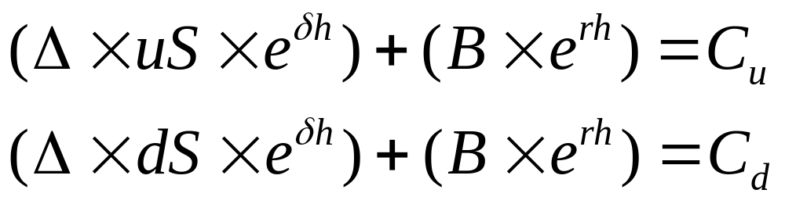
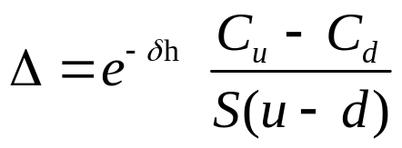
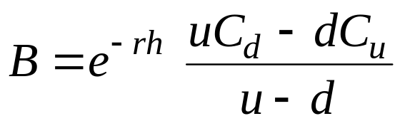
The Binomial Solution (cont’d)
At the prices S_{h} = uS and S_{h} = dS, a successful replicating portfolio will satisfy
Solving for Δ and B gives
(10.1)
(10.2)

Slide 10
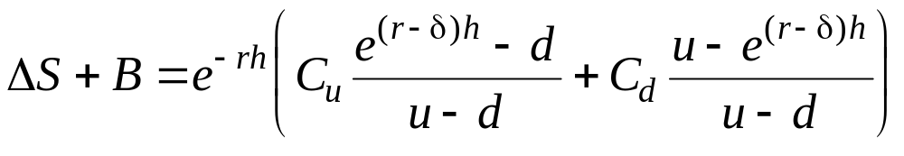
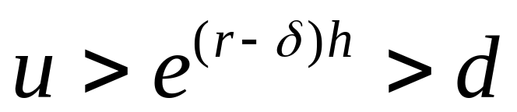
The Binomial Solution (cont’d)
The cost of creating the option is the net cash flow required to buy the shares and bonds. Thus, the cost of the option is ΔS+B
(10.3)
The no-arbitrage condition is
(10.4)

Slide 11
Arbitraging a Mispriced Option
If the observed option price differs from its theoretical price, arbitrage is possible
  If an option is overpriced, we can sell the option. However, the risk is that the option will be in the money at expiration, and we will be required to deliver the stock. To hedge this risk, we can buy
  a synthetic option at the same time we sell the actual option
  If an option is underpriced, we buy the option. To hedge the risk associated with the possibility of the stock price falling at expiration, we sell a synthetic option at the same time

Slide 12
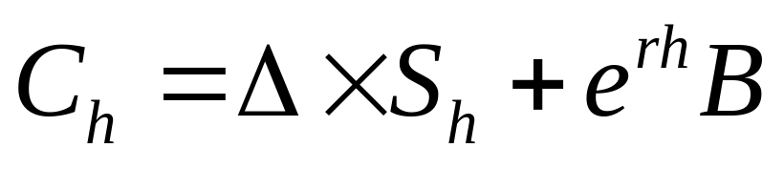
A Graphical Interpretation of the Binomial Formula
The portfolio describes a line with the formula
  Where C_{h} and S_{h} are the option and stock value after one binomial period, and supposing δ = 0
We can control the slope of a payoff diagram by varying the number of shares, Δ, and its height by varying the number of bonds, B
Any line replicating a call will have a positive slope (Δ > 0) and negative intercept (B < 0). (For a put, Δ < 0 and B > 0)

Slide 13
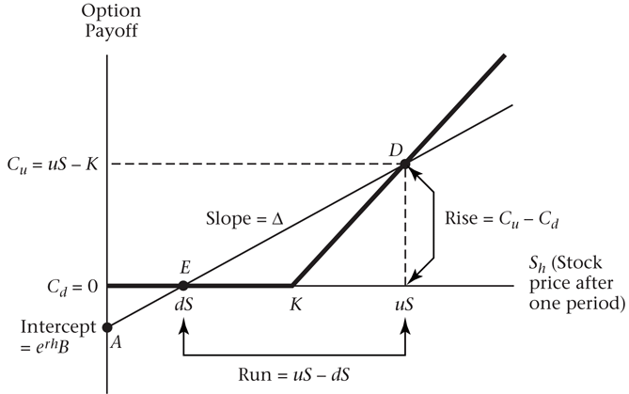
A Graphical Interpretation of the Binomial Formula (cont’d)

Slide 14
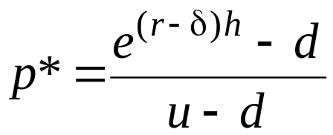
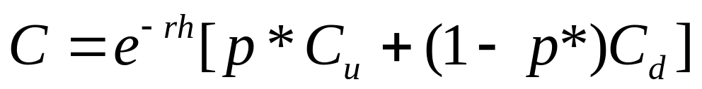
Risk-Neutral Pricing
We can interpret the terms (e^{(r–δ)h} – d )/(u – d) and
(u – e^{(r–δ)h} )/(u – d) as probabilities
Let
(10.5)
Then equation (10.3) can then be written as
(10.6)
  We call p* is the risk-neutral probability of an increase
  in the stock price

Slide 15
Summary
In order to price an option, we need to know
  Stock price
  Strike price
  Standard deviation of returns on the stock
  Dividend yield
  Risk-free rate
Using the risk-free rate and σ, we can approximate the future distribution of the stock by creating a binomial tree using equation (10.9)
Once we have the binomial tree, it is possible to price the option using equation (10.3)

Slide 16

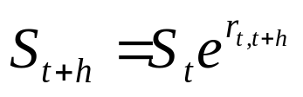
Continuously Compounded Returns
Some important properties of continuously compounded returns
  The logarithmic function computes returns from prices
  The exponential function computes prices from returns
  Continuously compounded returns are additive

Slide 17
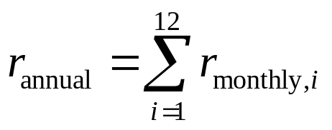
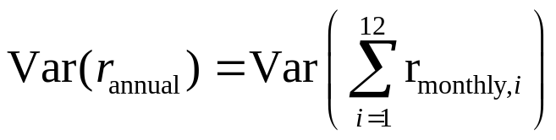
Volatility
Suppose the continuously compounded return over month i is r_{monthly},_{i}. Since returns are additive, the annual return is
The variance of the annual return is
(10.13)

Slide 18
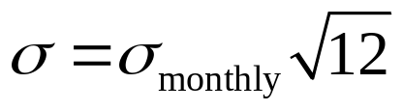
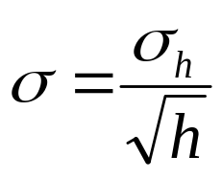
The Standard Deviation of Continuously Compounded Returns (cont’d)
Suppose that returns are uncorrelated over time and that each month has the same variance of returns. Then from equation (10.13) we have
σ² = 12 × σ²_{monthly}
where σ² denotes the annual variance
Taking the square root of both sides yields
To generalize this formula, if we split the year into n periods of length h (so that h = 1/n), the standard deviation over the period of length h, σ_{h}, is
(10.15)

Slide 19
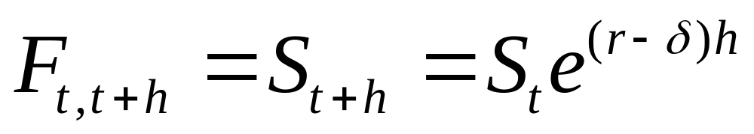
Constructing u and d
In the absence of uncertainty, a stock must appreciate at the risk-free rate less the dividend yield. Thus, from time t to time t+h, we have
The stock price next period equals the forward price

Slide 20
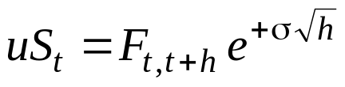
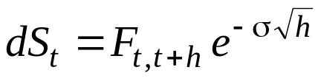


Constructing u and d (cont’d)
With uncertainty, the stock price evolution is
(10.17)
  Where σ is the annualized standard deviation of the continuously compounded return, and σ√h is standard deviation over a period of length h
We can also rewrite (10.17) as
(10.9)
  We refer to a tree constructed using equation (10.9) as a “forward tree.”

Slide 21
Estimating Historical Volatility
We need to decide what value to assign to σ, which we cannot observe directly
One possibility is to measure σ by computing the standard deviation of continuously compounded historical returns
  Volatility computed from historical stock returns is
  historical volatility
  For example, calculate the standard deviation with weekly data, then annualize the result by using equation (10.15)
  For standard options, the volatility that matters excludes dividends

Slide 22
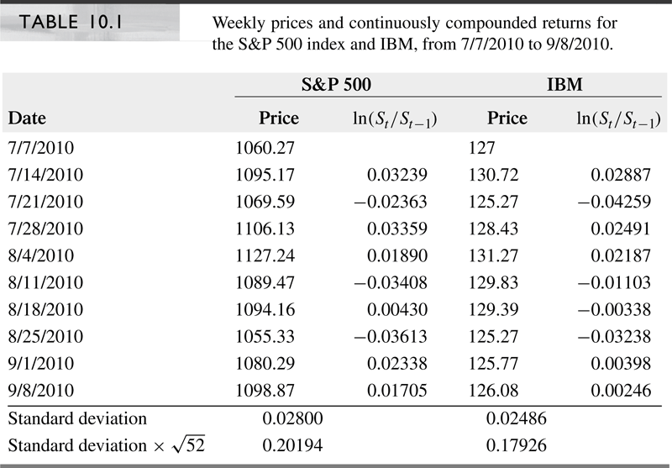
Estimating Historical Volatility (cont’d)
Example

Slide 23
One-Period Example with a
Forward Tree
Consider a European call option on a stock, with a $40 strike and 1 year to expiration. The stock does not pay dividends, and its current price is $41. Suppose the volatility of the stock is 30%
The continuously compounded risk-free interest rate is 8%
S = 41, r = 0.08, δ = 0, σ = 0.30, and h = 1
Use these inputs to
  calculate the final stock prices
  calculate the final option values
  calculate Δ and B
  calculate the option price

Slide 24
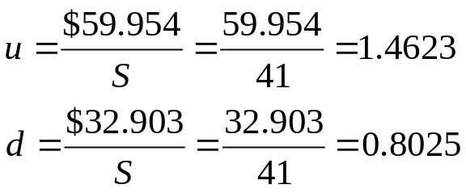
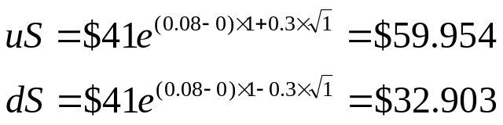


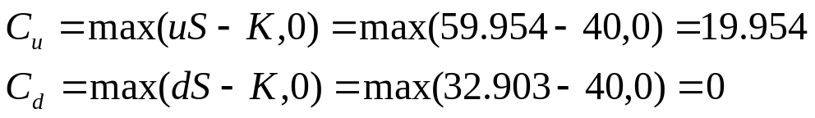
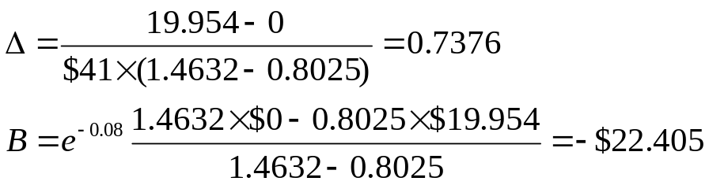
One-Period Example with a
Forward Tree (cont’d)
Calculate the final stock prices
Calculate the final option values
Calculate Δ and B
Calculate the option price

Slide 25
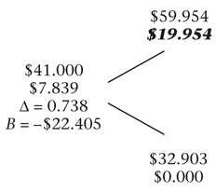
One-Period Example with a
Forward Tree (cont’d)
The following figure depicts the possible stock prices and option prices over 1 year, i.e., a binomial tree

Slide 26
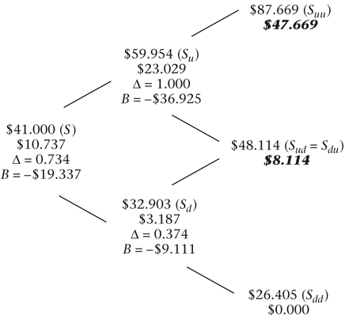
A Two-Period European Call
We can extend the previous example to price a 2-year option, assuming all inputs are the same as before

Slide 27
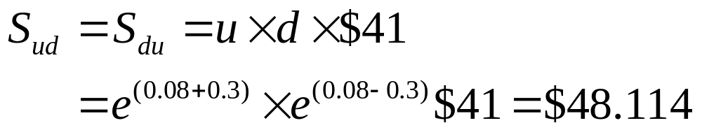
A Two-period European Call (cont’d)
Note that an up move by the stock followed by a down move (S_{ud}) generates the same stock price as a down move followed by an up move (S_{du}). This is called a recombining tree. Otherwise, we would have a nonrecombining tree

Slide 28
Pricing the Call Option
To price an option with two binomial periods, we work backward through the tree
  Year 2, Stock Price=$87.669:
  since we are at expiration, the option value
  is max (0, S – K) = $47.669
  Year 2, Stock Price=$48.114:
  similarly, the option value is $8.114
  Year 2, Stock Price=$26.405:
  since the option is out of the money, the value is 0

Slide 29
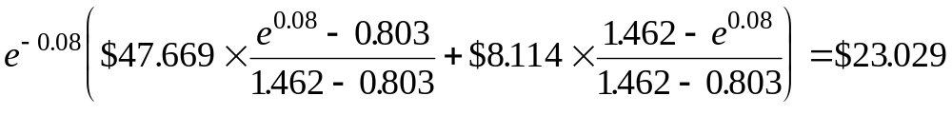
Pricing the Call Option (cont’d)
Year 1, Stock Price=$59.954:
at this node, we compute the option value
using equation (10.3), where uS is $87.669
and dS is $48.114
Year 1, Stock Price=$32.903:
again using equation (10.3), the option value is $3.187
Year 0, Stock Price = $41:
similarly, the option value is computed to be $10.737

Slide 30
Pricing the Call Option (cont’d)
Notice that
  The option price is greater for the 2-year than for the 1-year option
  The option was priced by working backward through the binomial tree
  The option’s Δ and B are different at different nodes. At a given point in time, Δ increases to 1 as we go further into the money
  Permitting early exercise would make no difference. At every node prior to expiration, the option price is greater than S – K; hence, we would not exercise even if the option had been American

Slide 31
Many Binomial Periods
Dividing the time to expiration into more periods allows us to generate a more realistic tree with a larger number of different values at expiration
  Consider the previous example of the 1-year European call option
  Let there be three binomial periods. Since it is
  a 1-year call, this means that the length of a
  period is h = 1/3
  Assume that other inputs are the same as before (so, r = 0.08 and σ = 0.3)

Slide 32
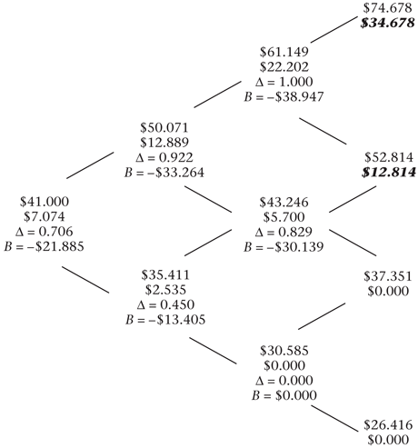
Many Binomial Periods (cont’d)
The stock price
and option price
tree for this option

Slide 33


Many Binomial Periods (cont’d)
Note that since the length of the binomial period is shorter, u and d are smaller than before: u = 1.2212 and d = 0.8637 (as opposed to 1.462 and 0.803 with h = 1)
  The second-period nodes are computed as follows
  The remaining nodes are computed similarly
Analogous to the procedure for pricing the 2-year option, the price of the three-period option is computed by working backward using equation (10.3)
  The option price is $7.074

Slide 34
Put Options
We compute put option prices using the same stock price tree and in almost the same way as call option prices
The only difference with a European put option occurs at expiration
  Instead of computing the price as
  max(0, S – K), we use max(0, K – S)

Slide 35
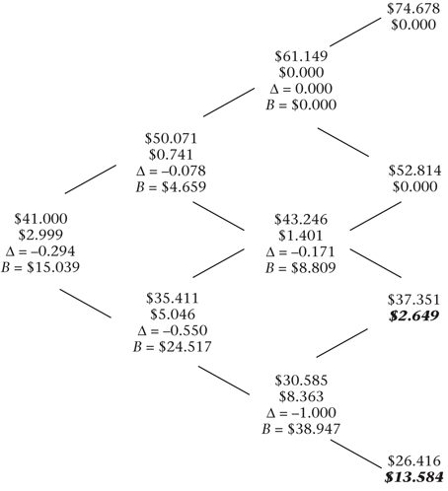
Put Options (cont’d)
A binomial tree for
a European put
option with 1-year
to expiration

Slide 36
American Options
The value of the option if it is left “alive” (i.e., unexercised) is given by the value of holding it for another period, equation (10.3)
The value of the option if it is exercised is given by max (0, S – K) if it is a call and max (0, K – S) if it is a put
For an American put, the value of the option at a node is given by

Slide 37
American Options (cont’d)
The valuation of American options proceeds as follows
  At each node, we check for early exercise
  If the value of the option is greater when exercised, we assign that value to the node. Otherwise, we assign the value of the option unexercised
  We work backward through the three as usual

Slide 38
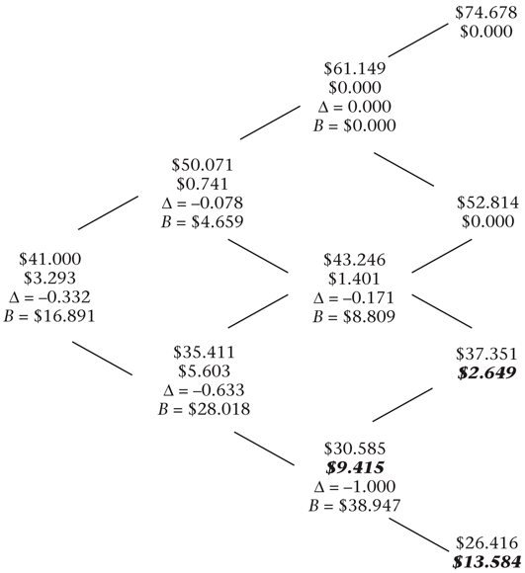
American Options (cont’d)
Consider an American
version of the put option
valued in the
previous example

Slide 39
American Options (cont’d)
The only difference in the binomial tree occurs at the S_{dd} node, where the stock price is $30.585. The American option at that point is worth $40 – $30.585 = $9.415, its early-exercise value (as opposed to $8.363 if unexercised). The greater value of the option at that node ripples back through the tree
Thus, the American option is more valuable than the otherwise equivalent European option

Slide 40
Options on Other Assets
The binomial model developed thus far can be modified easily to price options on underlying assets other than non-dividend-paying stocks
The difference for different underlying assets is the construction of the binomial tree and the risk-neutral probability
We examine options on
  Stock indexes
  Currencies
  Futures contracts
  Commodities
  Bonds

Slide 41
Options on a Stock Index
Suppose a stock index pays continuous dividends
at the rate δ
The procedure for pricing this option is equivalent to that of the first example, which was used for our derivation. Specifically
  the up and down index moves are given by equation (10.9)
  the replicating portfolio by equation (10.1) and (10.2)
  the option price by equation (10.3)
  the risk-neutral probability by equation (10.5)

Slide 42
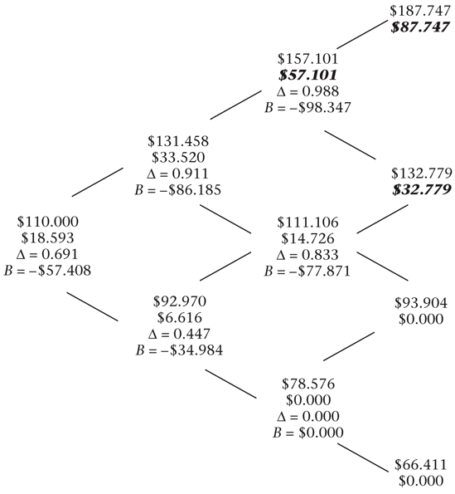
Options on a Stock Index (cont’d)
A binomial tree for an
American call option
on a stock index:

Slide 43
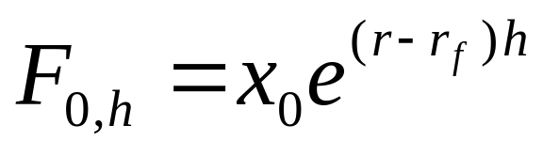
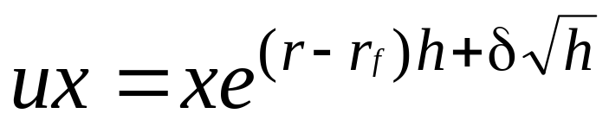
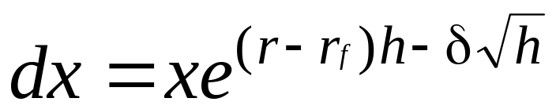
Options on Currencies
With a currency with spot price x₀, the forward price is
  Where r_{f} is the foreign interest rate
Thus, we construct the binomial tree using

Slide 44
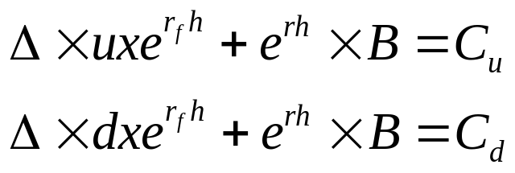
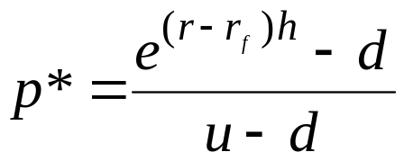
Options on Currencies (cont’d)
Investing in a “currency” means investing in a money-market fund or fixed income obligation denominated in that currency
Taking into account interest on the foreign-currency denominated obligation, the two equations are
The risk-neutral probability of an up move is
(10.20)

Slide 45
Options on Currencies (cont’d)
Consider a dollar-denominated American put option on the euro, where
  The current exchange rate is $1.05/€
  The strike is $1.10/€
  The euro-denominated interest rate is 3.1%
  The dollar-denominated rate is 5.5%

Slide 46
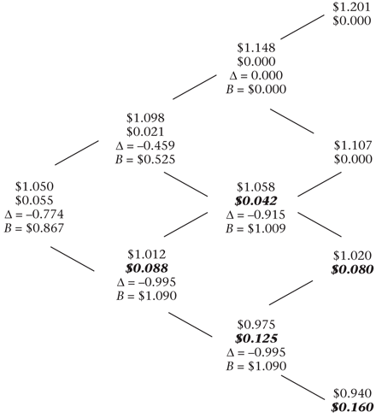
Options on Currencies (cont’d)
The binomial tree for
the American put
option on the euro

Slide 47
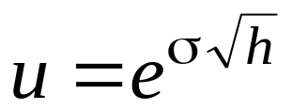
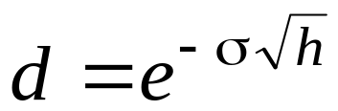
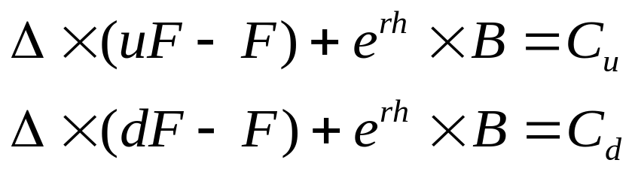
Options on Futures Contracts
Assume the forward price is the same as the
futures price
The nodes are constructed as
We need to find the number of futures contracts, Δ, and the lending, B, that replicates the option
  A replicating portfolio must satisfy

Slide 48
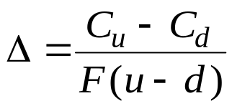
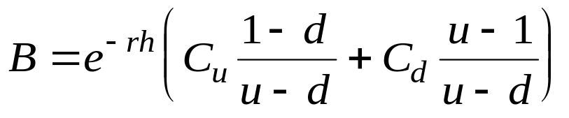
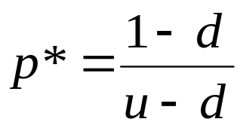
Options on Futures Contracts (cont’d)
Solving for Δ and B gives
  Δ tells us how many futures contracts to hold to hedge the option, and B is simply the value of the option
We can again price the option using equation (10.3)
The risk-neutral probability of an up move is given by
(10.21)

Slide 49
Options on Futures Contracts (cont’d)
The motive for early-exercise of an option on a futures contract is the ability to earn interest on the mark-to-market proceeds
  When an option is exercised, the option holder pays nothing, is entered into a futures contract, and receives mark-to-market proceeds of the difference between the strike price and the futures price

Slide 50
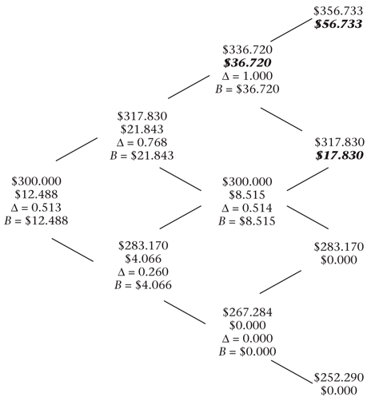
Options on Futures Contracts (cont’d)
A tree for an American
call option on a futures contract

Slide 51
Options on Commodities
It is possible to have options on a physical commodity
If there is a market for lending and borrowing
the commodity, then pricing such an option
is straightforward
  In practice, however, transactions in physical commodities often have greater transaction costs than for financial assets, and short-selling a commodity may not be possible
From the perspective of someone synthetically creating the option, the commodity is like a stock index, with the lease rate equal to the dividend yield

Slide 52
Options on Bonds
Bonds are like stocks that pay a discrete dividend (a coupon)
Bonds differ from the other assets in
two respects
  The volatility of a bond decreases over time as the bond approaches maturity
  The assumptions that interest rates are the same for all maturities and do not change over time are logically inconsistent for pricing options on bonds

Slide 53
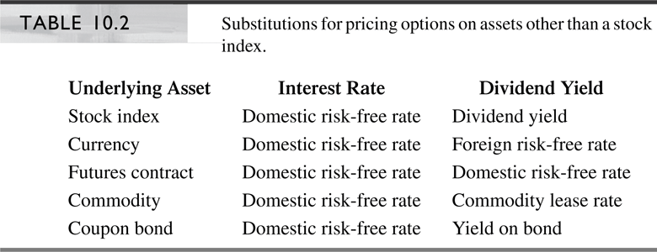
Summary
Pricing options with different underlying assets requires adjusting the risk-neutral probability for the borrowing cost or lease rate of the underlying asset
Thus, we can use the formula for pricing an option on a stock with an appropriate substitution for the dividend yield

Slide 54
