Slide 1
Chapter 12
The Black-
Scholes Formula

Slide 2
Black-Scholes Formula
The Black-Scholes formula is a limiting case of the binomial formula (infinitely many periods) for the price of a European option.
Consider an European call (or put) option written on a stock
Assume that the stock pays dividend
at the continuous rate δ

Slide 3
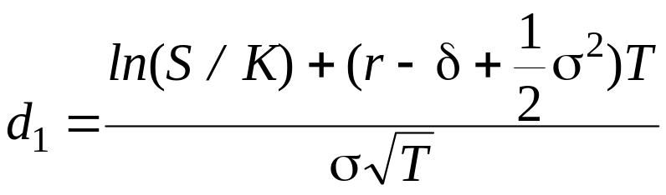

Black-Scholes Formula (cont’d)
Call Option price
Put Option price
where
and

Slide 4
Black-Scholes Assumptions
Assumptions about stock return distribution
  Continuously compounded returns on the stock are normally distributed and independent over time (no “jumps”)
  The volatility of continuously compounded returns is known and constant
  Future dividends are known, either as dollar amount or as a fixed dividend yield

Slide 5
Black-Scholes Assumptions (cont’d)
Assumptions about the economic environment
  The risk-free rate is known and constant
  There are no transaction costs or taxes
  It is possible to short-sell costlessly and to borrow at the risk-free rate

Slide 6
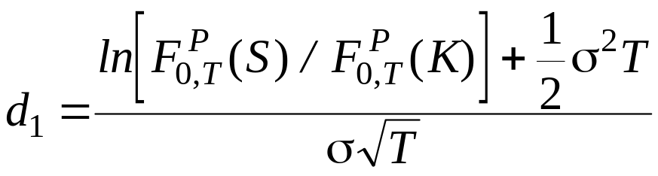
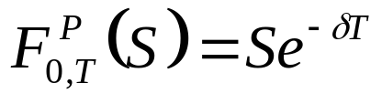
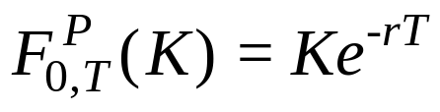
Applying the Formula to Other Assets
Call Options
where
,
and

Slide 7
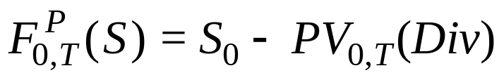
Options on Stocks with Discrete Dividends
The prepaid forward price for stock with discrete dividends is
Examples 12.3 and 12.1
  S = $41, K = $40, σ = 0.3, r = 8%, t = 0.25, Div = $3 in one month
  PV (Div) = $3e^{-0.08/12} = $2.98
  Use $41– $2.98 = $38.02 as the stock price in BS formula
  The BS European call price is $1.763
  Compare this to European call on stock without
  dividends: $3.399

Slide 8
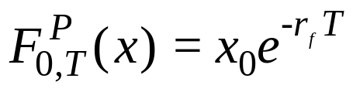

Options on Currencies
The prepaid forward price for the currency is
Where x₀ is domestic spot rate and r_{f} is foreign interest rate
Example 12.4
  x₀ = $1.25/ , K = $1.20, σ = 0.10, r = 1%, T = 1,
  and r_{f} = 3%
  The price of a dollar-denominated euro call is $0.061407
  The price of a dollar-denominated euro put is $0.03641

Slide 9
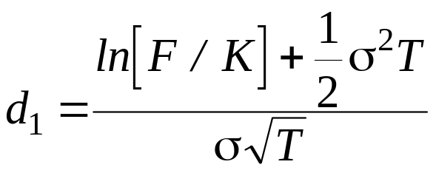
Options on Futures
The prepaid forward price for a futures contract is the PV of the futures price. Therefore
  where
  and
Example 12.5:
  Suppose 1-yr. futures price for natural gas is
  $6.50/MMBtu, r = 2%
  Therefore, F=$6.50, K=$6.50, and r = 2%
  If σ = 0.25, T= 1, call price = put price = $0.63379

Slide 10
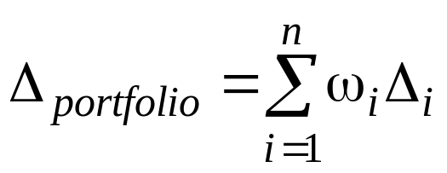
Option Greeks
What happens to the option price when one and only one input changes?
  Delta (Δ): change in option price when stock price increases by $1
  Gamma (Γ): change in delta when option price increases by $1
  Vega: change in option price when volatility increases by 1%
  Theta (θ): change in option price when time to maturity decreases
  by 1 day
  Rho (ρ): change in option price when interest rate increases by 1%
Greek measures for portfolios
  The Greek measure of a portfolio is weighted average of Greeks of individual portfolio components

Slide 11
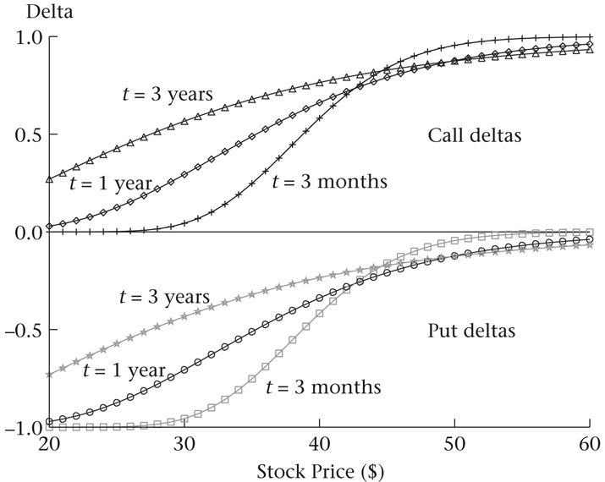
Option Greeks (cont’d)

Slide 12
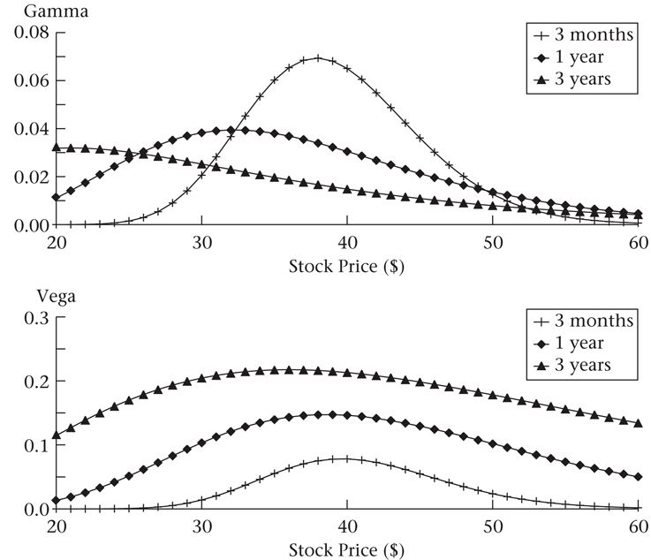
Option Greeks (cont’d)

Slide 13
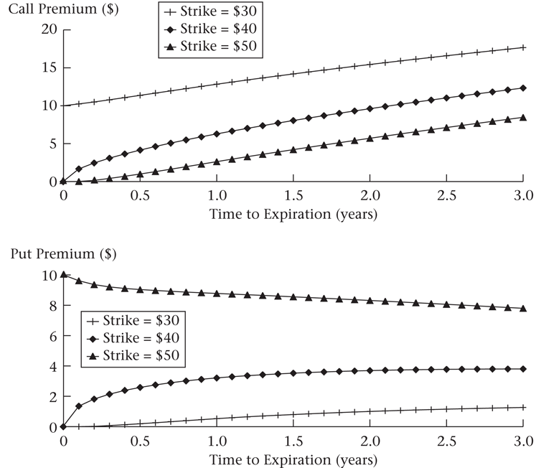
Option Greeks (cont’d)

Slide 14
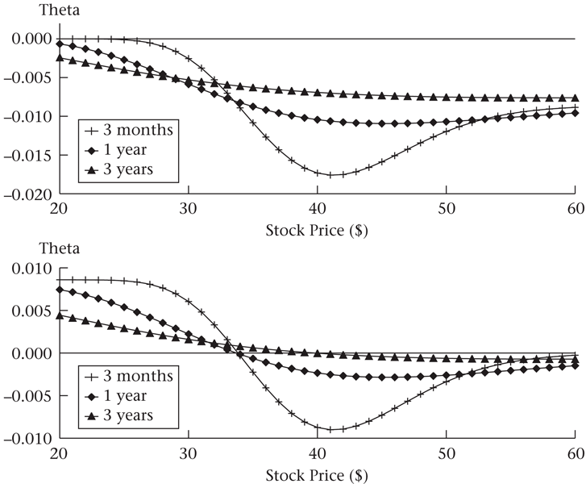
Option Greeks (cont’d)

Slide 15
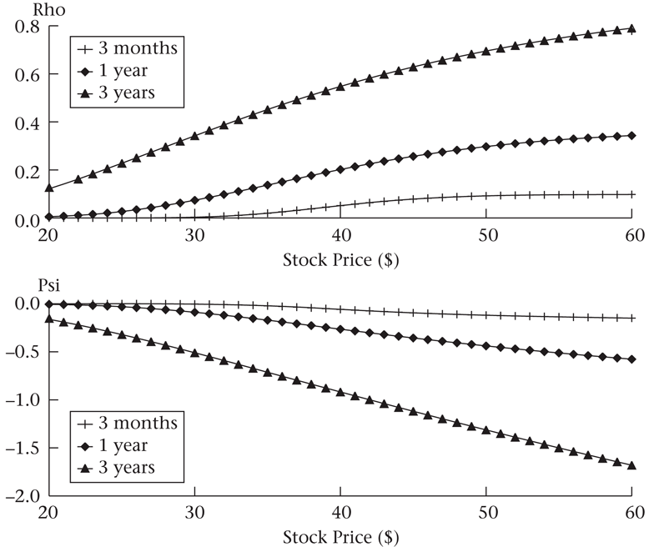
Option Greeks (cont’d)

Slide 16
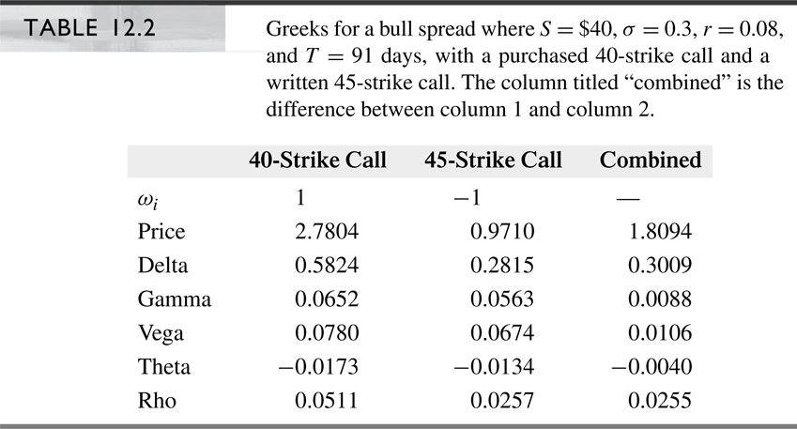
Option Greeks (cont’d)

Slide 17
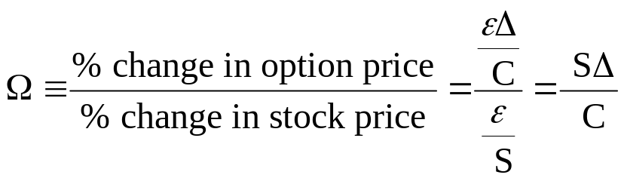
Option Greeks (cont’d)
Option elasticity (Ω)
  Ω describes the risk of the option relative to the risk of the stock in percentage terms: If stock price (S) changes by 1%, what is the percent change in the value of the option (C)?
  Example 12.8: S = $41, K = $40, σ = 0.30, r = 0.08, T = 1,
  δ = 0
    Elasticity for call: Ω = S Δ /C = $41 x 0.6911 / $6.961 = 4.071
    Elasticity for put: Ω = S Δ /C = $41 x – 0.3089 / $2.886 = – 4.389

Slide 18
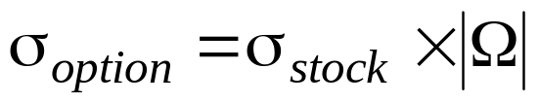

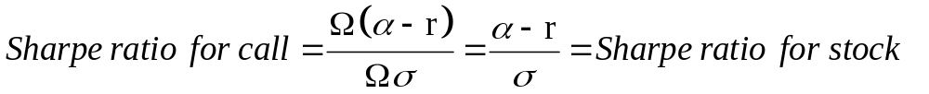
Option Greeks (cont’d)
Option elasticity (Ω) (cont’d)
  The volatility of an option
  The risk premium of an option
  The Sharpe ratio of an option
    where | . | is the absolute value, γ is the expected return on option, α is the expected return on stock, and r is the risk-free rate

Slide 19
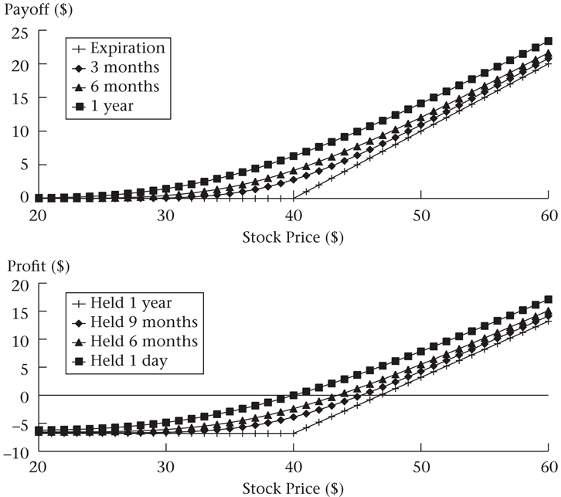
Profit Diagrams Before Maturity
For purchased call option

Slide 20
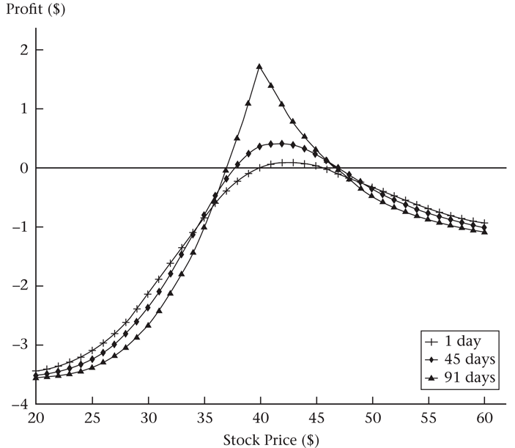
Profit Diagrams Before Maturity
For calendar spreads

Slide 21
Implied Volatility
Volatility is unobservable
Option prices, particularly for near-the-money options, can be quite sensitive to volatility
One approach is to compute historical volatility using the history of returns
A problem with historical volatility is that expected future volatility can be different from historical volatility.
Alternatively, we can calculate implied volatility, which is the volatility that, when put into a pricing formula (typically Black-Scholes), yields the observed option price.

Slide 22
Implied Volatility (cont’d)
In practice implied volatilities of in-, at-, and out-of-the money options are generally different
  A volatility smile refers to when volatility is symmetric, with volatility lowest for at-the-money options, and high for in-the-money and out-of-the-money options
  A difference in volatilities between in-the-money and out-of-the-money options is referred to as a volatility skew

Slide 23
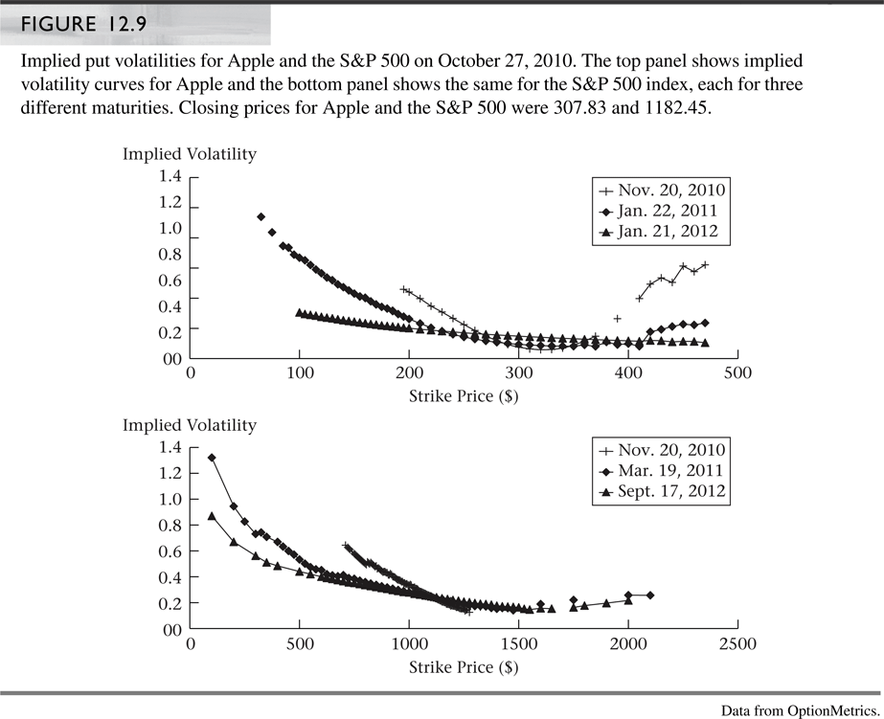
Implied Volatility (cont’d)

Slide 24
Implied Volatility (cont’d)
Some practical uses of implied volatility include
  Use the implied volatility from an option with an observable price to calculate the price of another option on the same underlying asset
  Use implied volatility as a quick way to describe the level of options prices on a given underlying asset: you could quote option prices in terms of volatility, rather than as a dollar price
  Checking the uniformity of implied volatilities across various options on the same underlying assets allows one to verify the validity of the pricing model in pricing those options

Slide 25
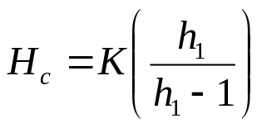
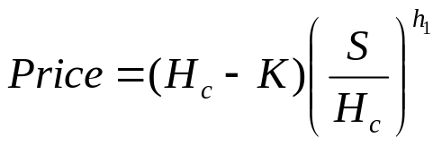
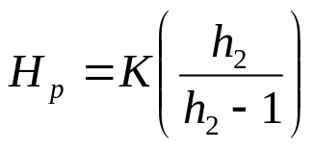
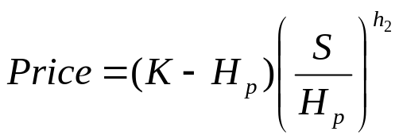
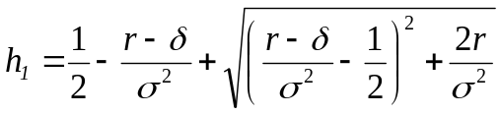
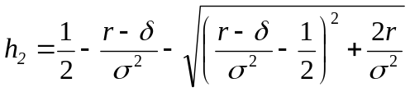
Perpetual American Options
Perpetual American options (options that never expire) are optimally exercised when the underlying asset ever reaches the optimal exercise barrier (H_{c} for a call and H_{p} for a put)
  For a perpetual call option the optimal exercise barrier and price are
  and
  For a perpetual put option the optimal exercise barrier and price are
  and
  where
  and

Slide 26
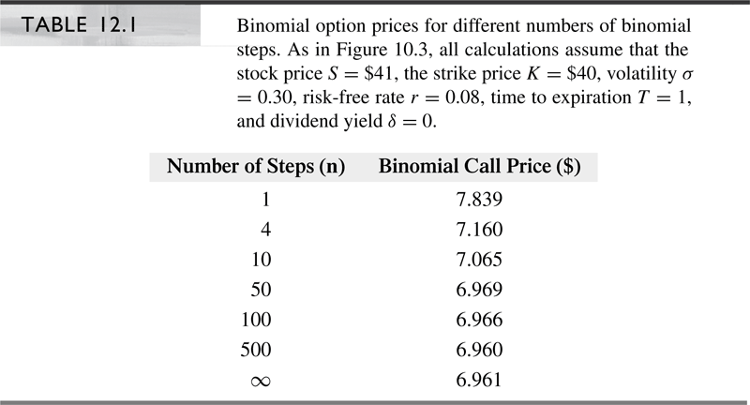

Slide 27
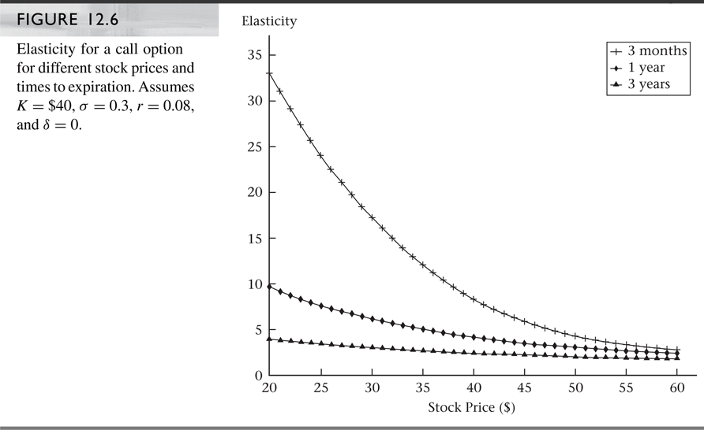

Slide 28
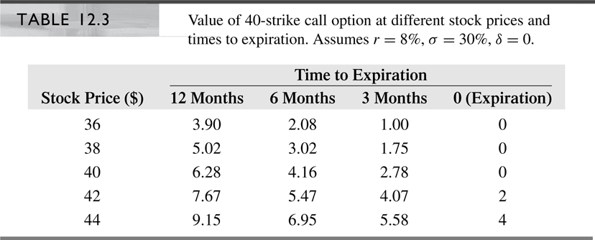

Slide 29
