Slide 1
Chapter 11
Binomial Option Pricing: Selected Topics

Slide 2
Understanding Early Exercise
Options may be rationally exercised prior
to expiration
By exercising, the option holder
  Receives the stock and thus receives dividends
  Pays the strike price prior to expiration (this has
  an interest cost)
  Loses the insurance implicit in the call against the possibility that the stock price will be less than the strike price at expiration

Slide 3

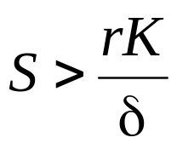
Understanding Early Exercise
If volatility is zero, the value of insurance is zero. Then, it is optimal to defer exercise as long as interest savings on the strike exceed dividends lost
Therefore, it is optimal to exercise when
In the special case when r = δ and σ = 0, any in-the-money
option should be exercised immediately
When volatility is positive, the implicit insurance has value that varies with time to expiration

Slide 4
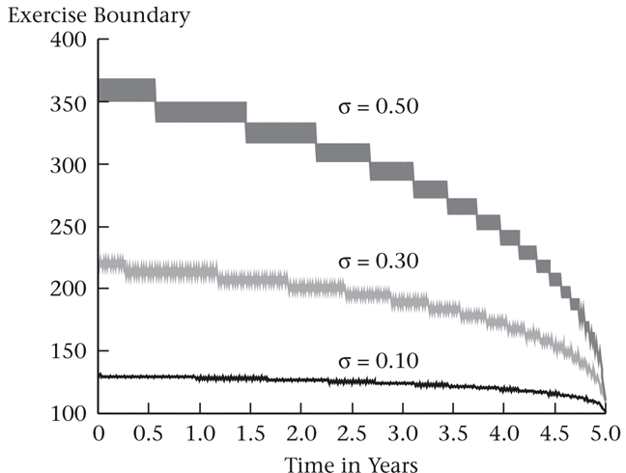
Understanding Early Exercise (Cont’d)
The following graph displays the price, above which early exercise is optimal for a 5-year call option with K = $100, r = 5%, and δ = 5%

Slide 5
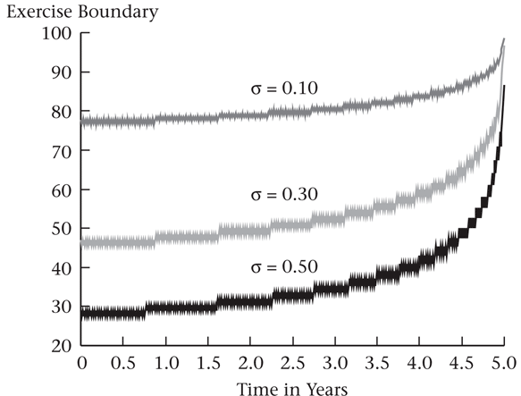
Understanding Early Exercise (Cont’d)
The following graph displays the price, below which early exercise is optimal for a 5-year put option with K = $100, r = 5%, and δ = 5%

Slide 6
Understanding Risk-Neutral Pricing
A risk-neutral investor is indifferent between a sure thing and a risky bet with an expected payoff equal to the value of the sure thing
p* is the risk-neutral probability that the stock price will go up

Slide 7
Understanding Risk-Neutral
Pricing (Cont’d)
The option pricing formula can be said to price options as if investors are risk-neutral
  Note that we are not assuming that investors are actually risk-neutral, and that risky assets are actually expected to earn the risk-free rate of return

Slide 8
Pricing an Option Using
Real Probabilities
Is option pricing consistent with standard discounted cash flow calculations?
  Yes. However, discounted cash flow is not used in practice to price options
  This is because it is necessary to compute the option price in order to compute the correct discount rate

Slide 9
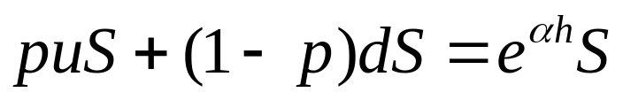
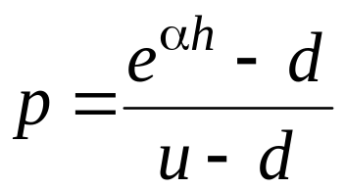
Pricing an Option Using
Real Probabilities (cont’d)
Suppose that the continuously compounded expected return on the stock is α and that the stock does not pay dividends
If p is the true probability of the stock going up, p must be consistent with u, d, and α
(11.3)
Solving for p gives us
(11.4)

Slide 10
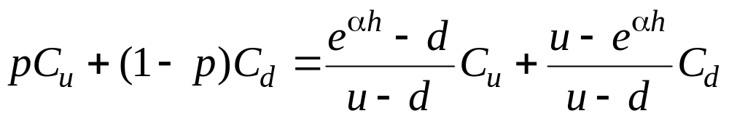
Pricing an Option Using
Real Probabilities (cont’d)
Using p, the actual expected payoff to the option one period hence is
(11.5)
At what rate do we discount this
expected payoff?
  It is not correct to discount the option at the expected return on the stock, α, because the option is equivalent to a leveraged investment in the stock and hence is riskier than the stock

Slide 11
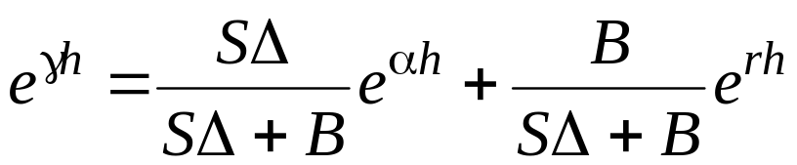
Pricing an Option Using
Real Probabilities (cont’d)
Denote the appropriate per-period discount rate for the option as γ
Since an option is equivalent to holding a portfolio consisting of Δ shares of stock and B bonds, the expected return on this portfolio is
(11.6)

Slide 12
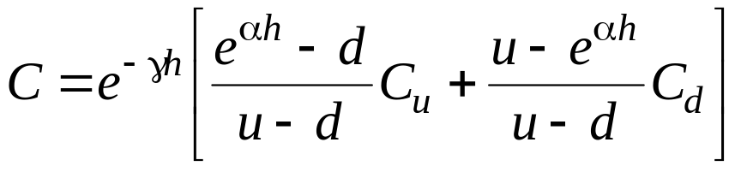
Pricing an Option Using
Real Probabilities (cont’d)
We can now compute the option price as the expected option payoff, equation(11.5), discounted at the appropriate discount rate, given by equation (11.6). This gives
(11.7)

Slide 13
Pricing an Option Using
Real Probabilities (cont’d)
It turns out that this gives us the same option price as performing the risk-neutral calculation
  Note that it does not matter whether we have
  the “correct” value of α to start with
  Any consistent pair of α and γ will give the
  same option price
  Risk-neutral pricing is valuable because setting
  α = r results in the simplest pricing procedure.

Slide 14
The Binomial Tree and Lognormality
The usefulness of the binomial pricing model hinges on the binomial tree providing a reasonable representation of the stock price distribution
The binomial tree approximates a lognormal distribution

Slide 15
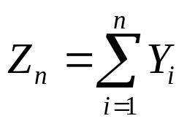
The Random Walk Model
It is sometimes said that stock prices follow a random walk
Imagine that we flip a coin repeatedly
  Let the random variable Y denote the outcome of the flip
  If the coin lands displaying a head, Y = 1; otherwise, Y = – 1
  If the probability of a head is 50%, we say the coin is fair
  After n flips, with the i^{th} flip denoted Y_{i}, the cumulative
  total, Z_{n}, is
  (11.8)
It turns out that the more times we flip, on average the farther we will move from where we start

Slide 16
The Random Walk Model (cont’d)
We can represent the process followed by Z_{n} in term of the change in Z_{n}
Z_{n} – Z_{n-1} = Y_{n}
or
Heads: Z_{n} – Z_{n-1} = +1
Tails: Z_{n} – Z_{n-1} = –1

Slide 17
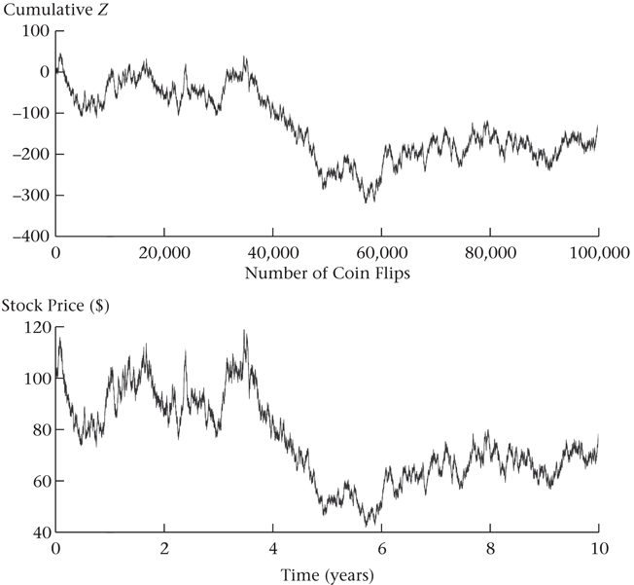
The Random Walk Model (cont’d)
A random walk, where with heads, the change in Z is 1, and with tails, the change in Z is – 1

Slide 18
The Random Walk Model (cont’d)
The idea that asset prices should follow
a random walk was articulated in
Samuelson (1965)
In efficient markets, an asset price should reflect all available information. In response
to new information the price is equally likely
to move up or down, as with the coin flip
The price after a period of time is the initial price plus the cumulative up and down movements due to informational surprises

Slide 19
Modeling Stock Prices As a Random Walk
The above description of a random walk is not a satisfactory description of stock price movements. There are at least three problems with this model
  If by chance we get enough cumulative down movements, the stock price will become negative
  The magnitude of the move ($1) should depend upon how quickly the coin flips occur and the level of the stock price
  The stock, on average, should have a positive return. The random walk model taken literally does not permit this
The binomial model is a variant of the random walk model that solves all of these problems at once

Slide 20
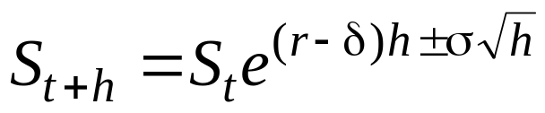

The Binomial Model
The binomial model is
Taking logs, we obtain
(11.11)
  Since ln(S_{t+h}/S_{t}) is the continuously compounded return from
  t to t + h, the binomial model is simply a particular way to model the continuously compounded return
  That return has two parts, one of which is certain, (r–δ)h, and the other of which is uncertain and generates the up and down stock prices moves (plus or minus σ√h)

Slide 21
The Binomial Model (cont’d)
Equation (11.11) solves the three problems in the random walk
  The stock price cannot become negative
  As h gets smaller, up and down moves get smaller
  There is a (r – δ)h term, and we can choose
  the probability of an up move, so we can
  guarantee that the expected change in the stock price is positive

Slide 22
Lognormality and the Binomial Model
The binomial tree approximates a lognormal distribution, which is commonly used to model
stock prices
The lognormal distribution is the probability
distribution that arises from the assumption that continuously compounded returns on the stock
are normally distributed
With the lognormal distribution, the stock price
is positive, and the distribution is skewed to the
right, that is, there is a chance that extremely high
stock prices will occur

Slide 23
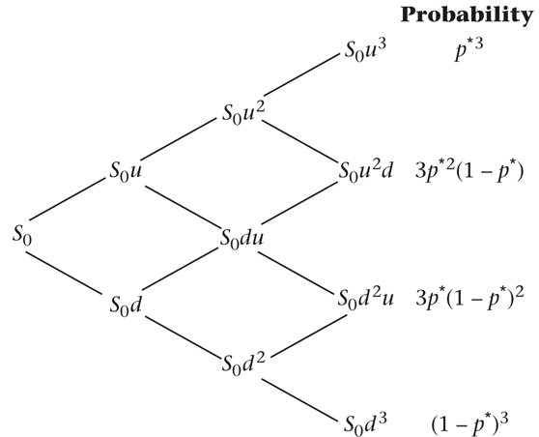
Lognormality and the Binomial
Model (cont’d)
The binomial model
implicitly assigns
probabilities to the
various nodes.

Slide 24
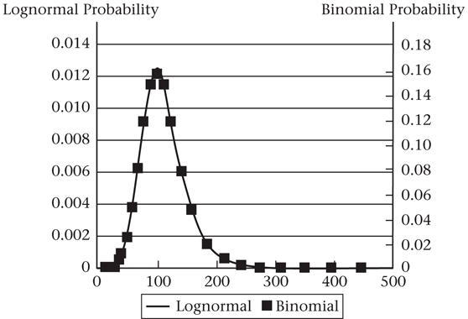
Lognormality and the Binomial
Model (cont’d)
The following graph compares the probability distribution for a 25-period binomial tree with the corresponding lognormal distribution

Slide 25
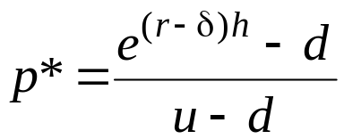

Alternative Binomial Trees
There are other ways besides equation (11.11) to construct a binomial tree that approximates a lognormal distribution
  An acceptable tree must match the standard deviation of the continuously compounded return on the asset and must generate an appropriate distribution as h → 0
  Different methods of constructing the binomial tree will result in different u and d stock movements
  No matter how we construct the tree, we use
  to determine the risk-neutral probability and
  to determine the option value

Slide 26




Alternative Binomial Trees (cont’d)
The Cox-Ross-Rubinstein binomial tree
  The tree is constructed as
  (11.13)
  A problem with this approach is that if h is large
  or σ is small, it is possible that , in which case the binomial tree violates the restriction of
  In real applications, h would be small, so the above problem does not occur

Slide 27


Alternative Binomial Trees (cont’d)
The lognormal tree
  The tree is constructed as
  (11.14)
All three methods of constructing a binomial tree yield different option prices for finite n, but they approach the same price as n → ∞

Slide 28
Is the Binomial Model Realistic?
The binomial model is a form of the random walk model, adapted to modeling stock prices. The lognormal random walk model in this section assumes among other things, that
  Volatility is constant
  “Large” stock price movements do not occur
  Returns are independent over time
All of these assumptions appear to be violated in the data

Slide 29
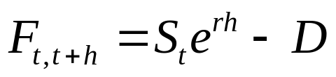
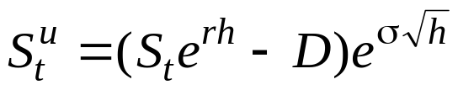
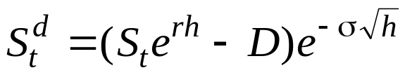
Stock Paying Discrete Dividends
Suppose that a dividend will be paid between times t and t + h and that its future value at time t + h is D
The time t forward price for delivery at t + h is
Since the stock price at time t + h will be ex-dividend, we create the up and down moves based on the ex-dividend stock price
(11.15)

Slide 30
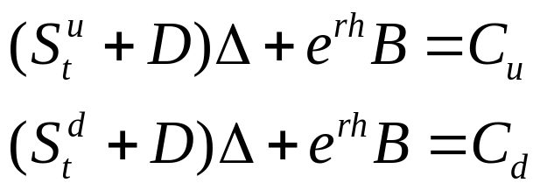
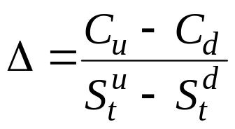
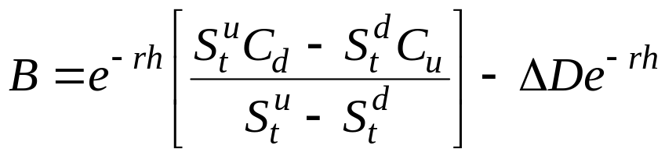
Stock Paying Discrete Dividends (cont’d)
When a dividend is paid, we have to account for the fact that the stock earns the dividend
The solution is
  Because the dividend is known, we decrease the bond position by the present value of the certain dividend

Slide 31
Problems With the Discrete Dividend Tree
The conceptual problem with equation (11.15) is that the stock price could in principle become negative if there have been large downward moves in the stock prior to the dividend
The practical problem is that the tree does not completely recombine after a discrete dividend
The following tree, where a $5 dividend is paid between periods 1 and 2, demonstrates that with a discrete dividend, the order of up and down movements affects the price
  In the third binomial period, there are six rather than four possible stock prices

Slide 32
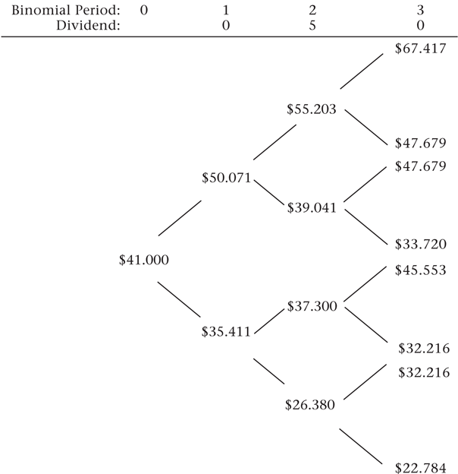
Problems With the Discrete
Dividend Tree (cont’d)

Slide 33
A Binomial Tree Using the Prepaid Forward
Schroder (1988) presents a method of constructing a tree for a dividend-paying stock that solves both problems
If we know for certain that a stock will pay a fixed dividend, then we can view the stock price as being the sum of two components
  The dividend, which is like a zero-coupon bond with zero volatility, and
  The present value of the ex-dividend value of the stock, i.e., the prepaid forward price

Slide 34
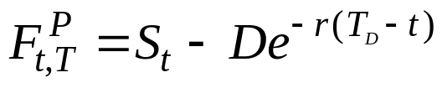



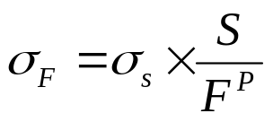
A Binomial Tree Using the Prepaid Forward (cont’d)
Suppose we know that a stock will pay a dividend D at time
T_{D} < T, where T is the expiration date of the option
  We base stock price movements on the prepaid forward price
  As before, we have up and down movements of
  The observed stock price at t + h < T_{D} is then
  Assign a volatility to the prepaid forward using the ad hoc adjustment

Slide 35
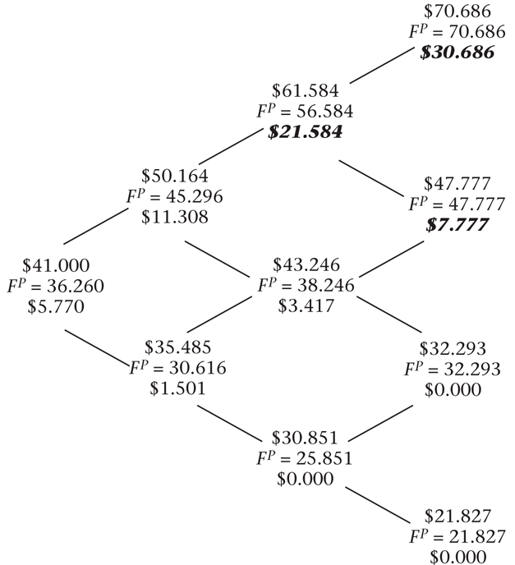
A Binomial Tree Using the Prepaid Forward (cont’d)
A binomial tree constructed
using the prepaid-
forward method

Slide 36
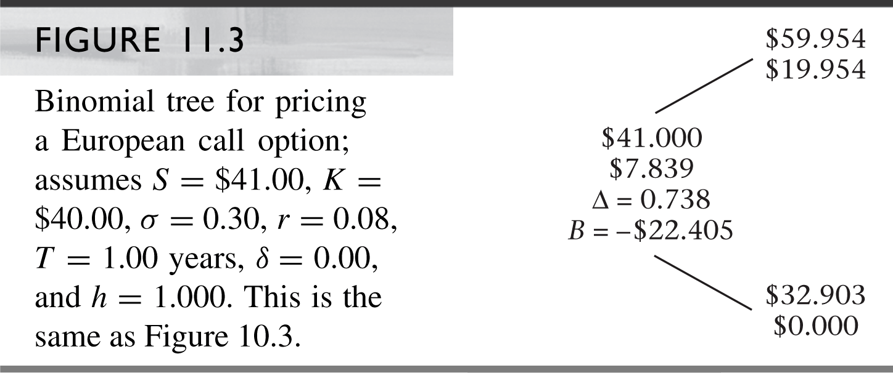

Slide 37
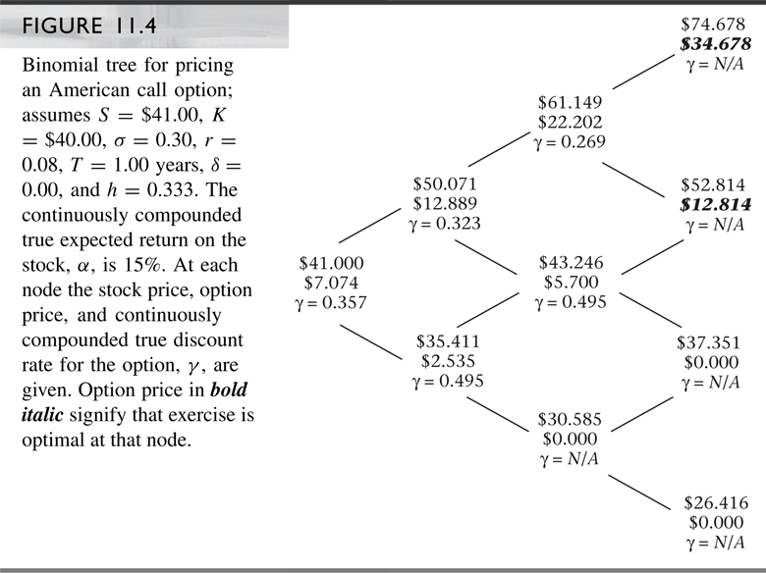

Slide 38
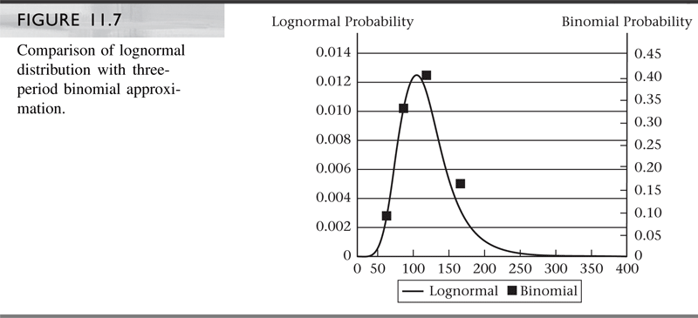

Slide 39
