Slide 1
Chapter 13
Market-Making and Delta-Hedging

Slide 2
What Do Market Makers Do?
Provide immediacy by standing ready to sell to buyers (at ask price) and to buy from sellers (at bid price)
Generate inventory as needed by short-selling
Profit by charging the bid-ask spread

Slide 3
What Do Market Makers Do? (cont’d)
The position of a market-maker is the result of whatever order flow arrives from customers
Proprietary trading, which is conceptually distinct from market-making, is trading to express an investment strategy

Slide 4
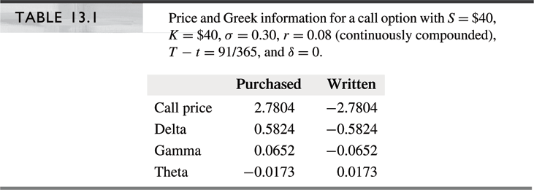
Market-Maker Risk
Market makers attempt to hedge in order to avoid
the risk from their arbitrary positions due to
customer orders
Market-makers can control risk by delta-hedging
Delta-hedged positions should expect to earn
risk-free return

Slide 5
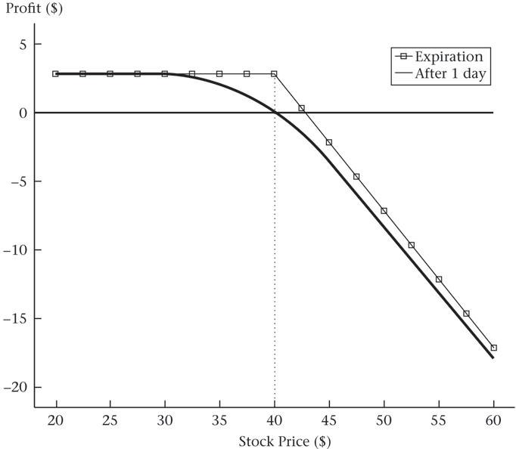
Market-Maker Risk (cont’d)

Slide 6
Market-Maker Risk (cont’d)
Delta (Δ) and gamma (Γ) as measures of exposure
  Suppose Δ is 0.5824, when S = $40 (Table 13.1 and
  Figure 13.1)
  A $0.75 increase in stock price would be expected to increase option price by $0.4368 (= $0.75 x 0.5824)
  The actual increase in the option’s value is higher: $0.4548
  This discrepancy occurs because Δ increases as stock price increases. Using the smaller Δ at the lower stock price understates the actual change
  Similarly, using the original Δ overstates the change in the option value as a response to a stock price decline
  Using Γ in addition to Δ improves the approximation of the option value change

Slide 7
Delta-Hedging
Suppose a market-maker sells one option, and buys Δ shares
Delta hedging for 2 days: (daily rebalancing and mark-to-market):
  Day 0: Share price = $40, call price is $2.7804, and Δ = 0.5824
    Sell call written on 100 shares for $278.04, and buy 58.24 shares.
    Net investment: (58.24x$40) – $278.04 = $2051.56
    At 8%, overnight financing charge is $0.45 [= $2051.56x(e^{0.08/365}-1)]
  Day 1: If share price = $40.5, call price is $3.0621, and Δ = 0.6142
    Overnight profit/loss: $29.12 – $28.17 – $0.45 = $0.50
    Buy 3.18 additional shares for $128.79 to rebalance
  Day 2: If share price = $39.25, call price is $2.3282
    Overnight profit/loss: – $76.78 + $73.39 – $0.48 = – $3.87

Slide 8
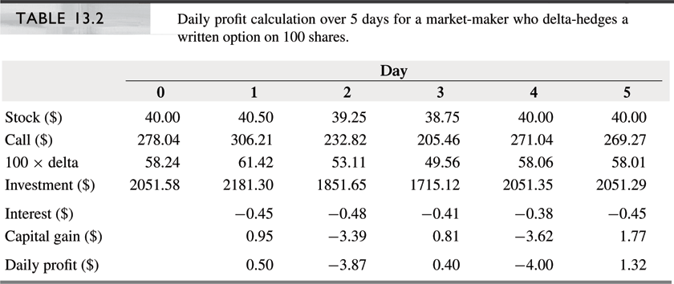
Delta-Hedging (cont’d)
Delta hedging for several days

Slide 9
Delta-Hedging (cont’d)
Delta hedging for several days (cont.)
  Γ: For large decreases in stock price, Δ decreases, and the option increases in value slower than the loss in stock value. For large increases in stock price Δ increases, and the option decreases in value faster than the gain in stock value. In both cases the net loss increases and the market-maker loses money. For small moves in the stock price, the market-maker makes money.
  θ : If a day passes with no change in the stock price, the option becomes cheaper. Since the option position is short, this time decay increases the profits of the market-maker.
  Interest cost: In creating the hedge, the market-maker purchases the stock with borrowed funds. The carrying
  cost of the stock position decreases the profits of the
  market-maker.

Slide 10
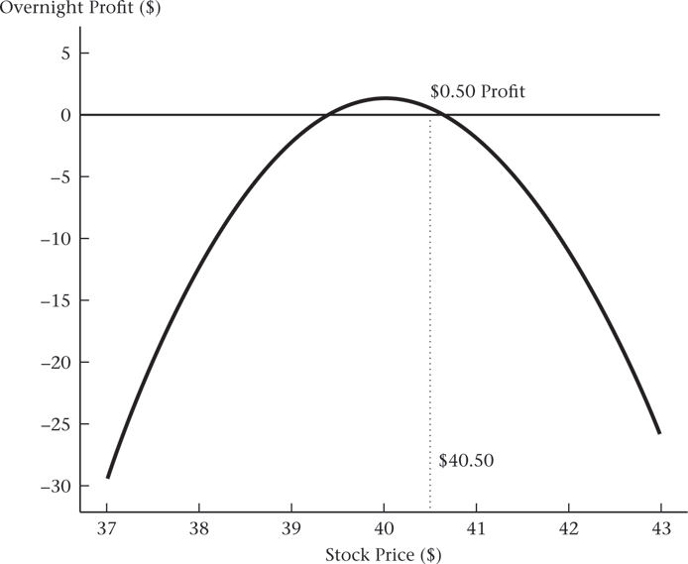
Delta-Hedging (cont’d)

Slide 11
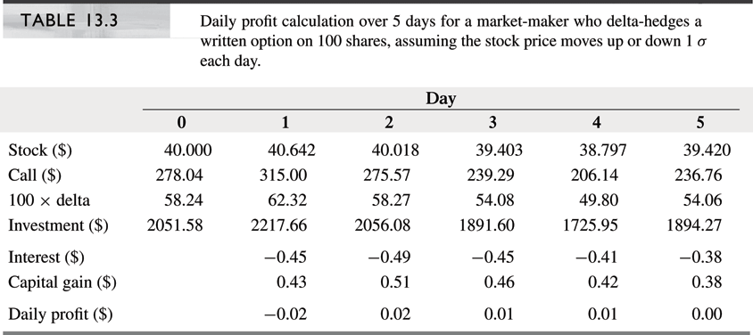
Delta-Hedging (cont’d)

Slide 12
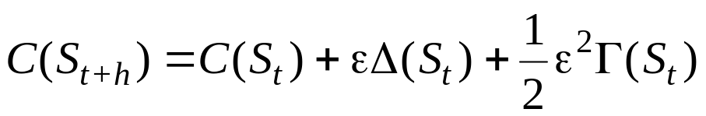
Mathematics of ∆-Hedging
Δ−Γ approximations
  Recall the under (over) estimation of the new option value using Δ alone when stock price moved up (down) by ε. (ε = S_{t+h} – S_{t})
  Using the Δ−Γ approximation the accuracy can be improved a lot
  Example 13.1: S: $40 $40.75, C: $2.7804 $3.2352, Γ: 0.0652
    Using Δ approximation
    C($40.75) = C($40) + 0.75 x 0.5824 = $3.2172
    Using Δ−Γ approximation
    C($40.75) = C($40) + 0.75 x 0.5824 + 0.5 x 0.75² x 0.0652 = $3.2355
    Similarly, for a stock price decline to $39.25, the true option price is $2.3622. The Δ approximation gives $23436, and the Δ−Γ approximation gives $2.3619.

Slide 13
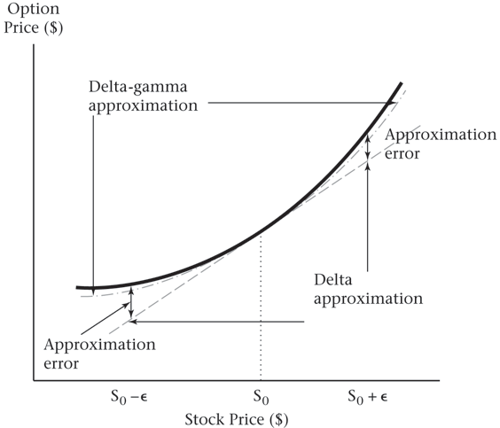
Mathematics of ∆-Hedging (cont’d)
Δ−Γ approximation (cont’d)

Slide 14
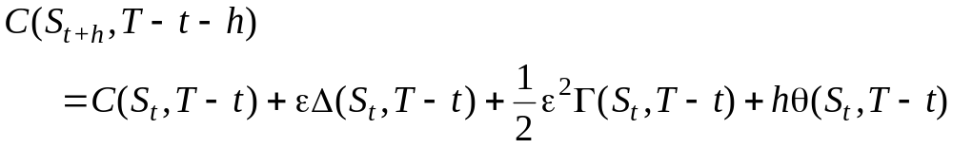
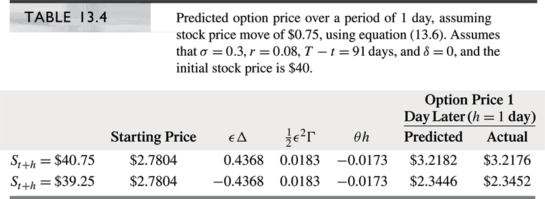
Mathematics of ∆-Hedging (cont’d)
θ: Accounting for time

Slide 15
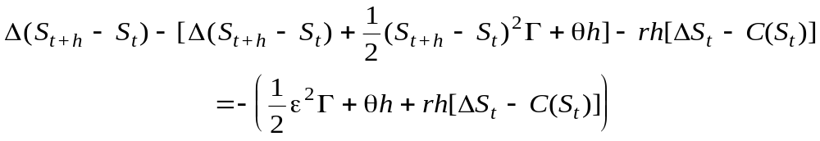
Mathematics of ∆-Hedging (cont’d)
Market-maker’s profit when the stock price changes by ε over an interval h:
Change in value
of stock
Change in value
of option
Interest
expense
The
effect
of Γ
The
effect
of θ
Interest cost

Slide 16
Mathematics of ∆-Hedging (cont’d)
Note that Δ, Γ and θ are computed at t
For simplicity, the subscript “t” is omitted in the above equation

Slide 17

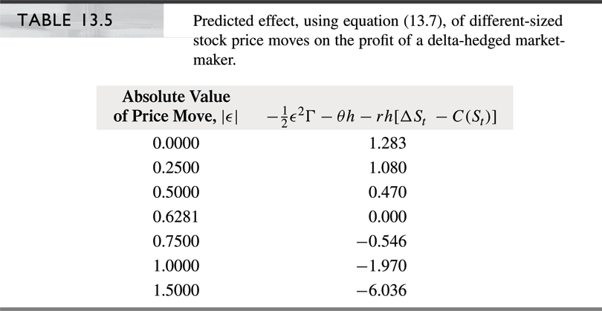
Mathematics of ∆-Hedging (cont’d)
If σ is measured annually, then a one-standard-deviation move ε over a period of length h is Therefore,

Slide 18
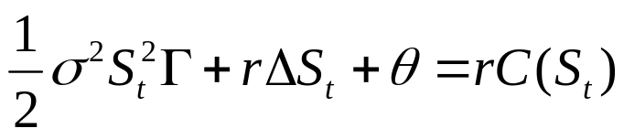
The Black-Scholes Analysis
Black-Scholes partial differential equation
  where Γ, Δ, and θ are partial derivatives of the option price computed at t
Under the following assumptions:
  Underlying asset and the option do not pay dividends
  Interest rate and volatility are constant
  The stock does not make large discrete moves
The equation is valid only when early exercise is not optimal

Slide 19
The Black-Scholes Analysis (cont’d)
Advantage of frequent re-hedging
  Var_{hourly} = 1/24 x Var_{daily}
  By hedging hourly instead of daily, total return variance is reduced by a factor of 24
  The more frequent hedger benefits from diversification
  over time
Three ways for protecting against extreme price moves
  Adopt a Γ-neutral position by using options to hedge
  Augment the portfolio by buying deep-out-of-the-money puts and calls as insurance
  Use static option replication according to put-call parity to form a Γ- and Δ-neutral hedge

Slide 20
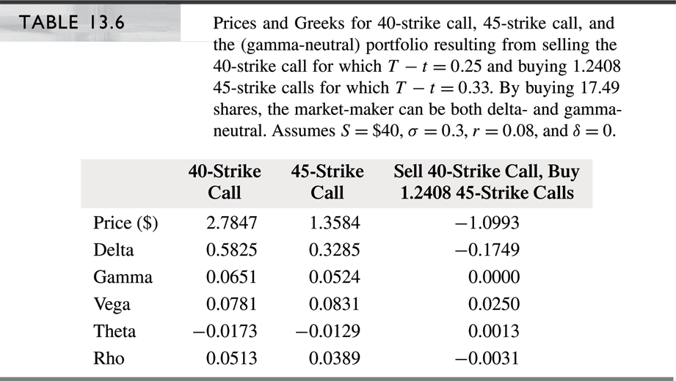
The Black-Scholes Analysis (cont’d)
Γ-neutrality: Let’s Γ-hedge a 3-month 40-strike call with a 4-month 45-strike put:

Slide 21
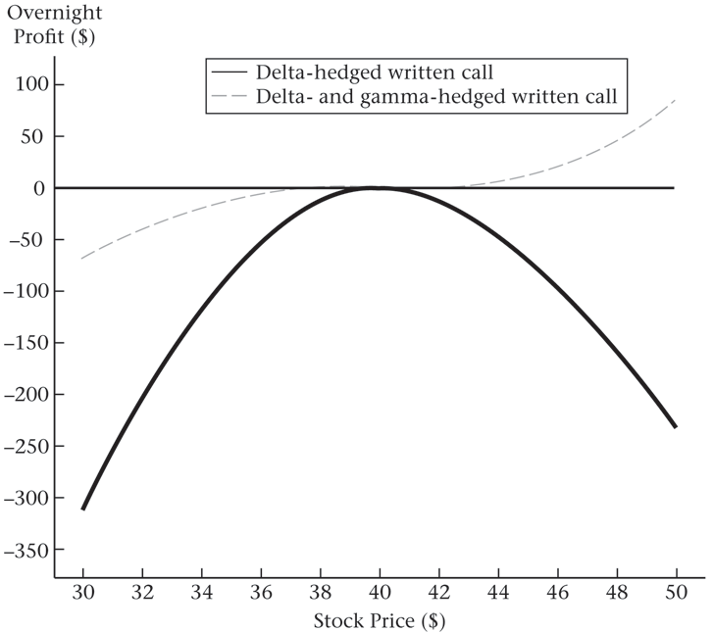
The Black-Scholes Analysis (cont’d)

Slide 22
Market-Making As Insurance
Insurance companies have two ways of dealing with unexpectedly large loss claims:
  Hold capital reserves
  Diversify risk by buying reinsurance
Market-makers also have two analogous ways to deal with excessive losses:
  Hold capital to cushion against less-diversifiable risks
  Reinsure by trading in out-of-the-money options
When risks are not fully diversifiable, holding capital
is inevitable

Slide 23
