Slide 1
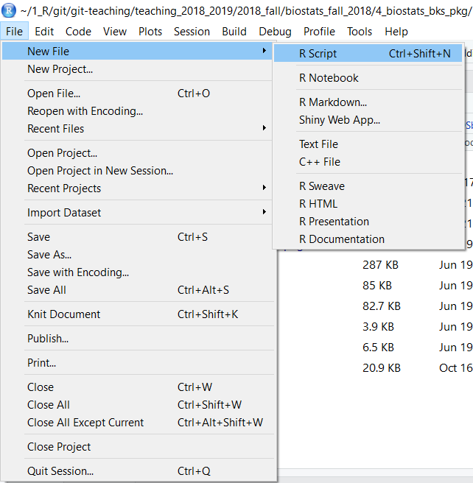

Slide 2
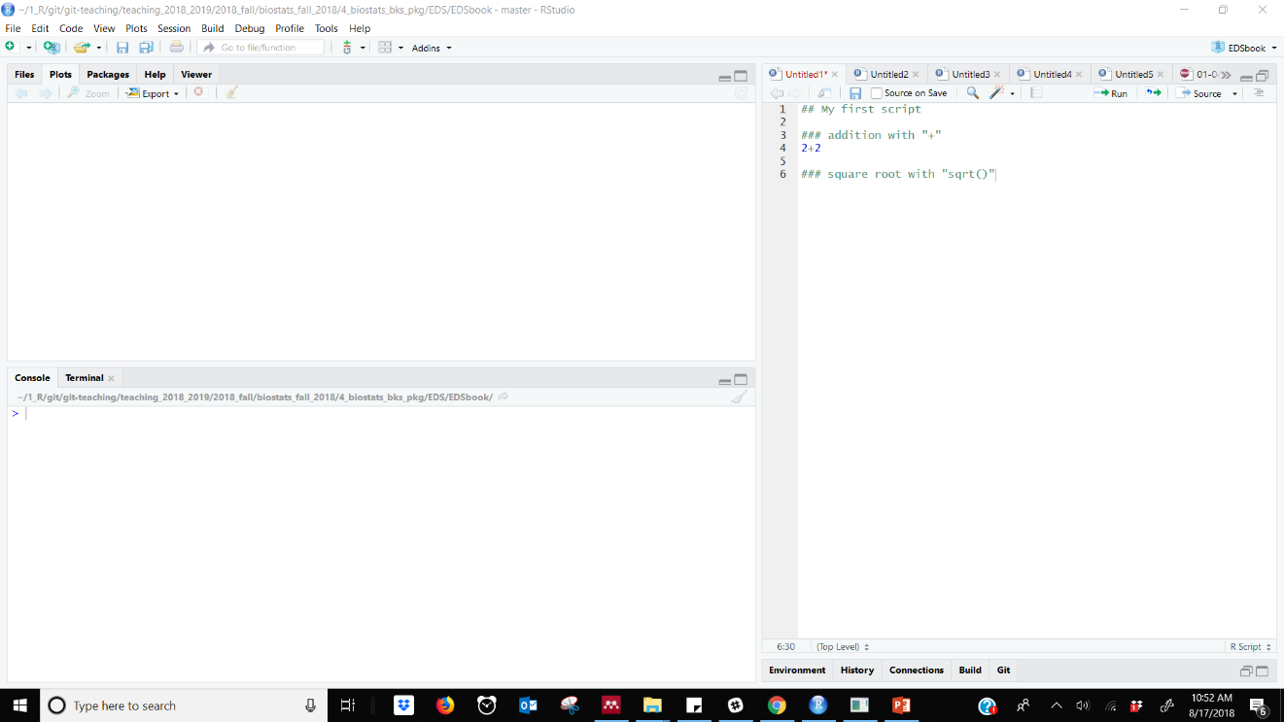

Slide 3
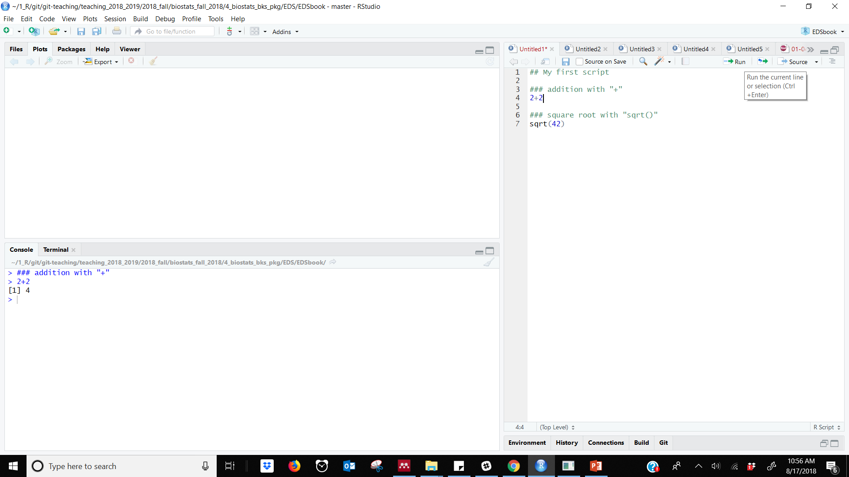

1) Cursor after code
2) “Run” button
3) Executed code

Slide 4
