Slide 1
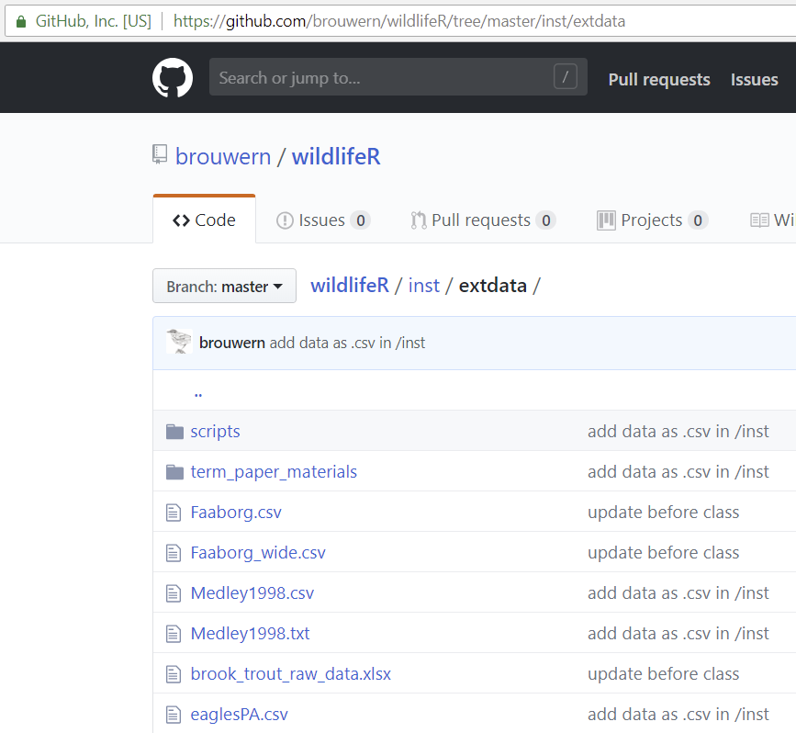
Target file:
Medley1998.csv

Slide 2
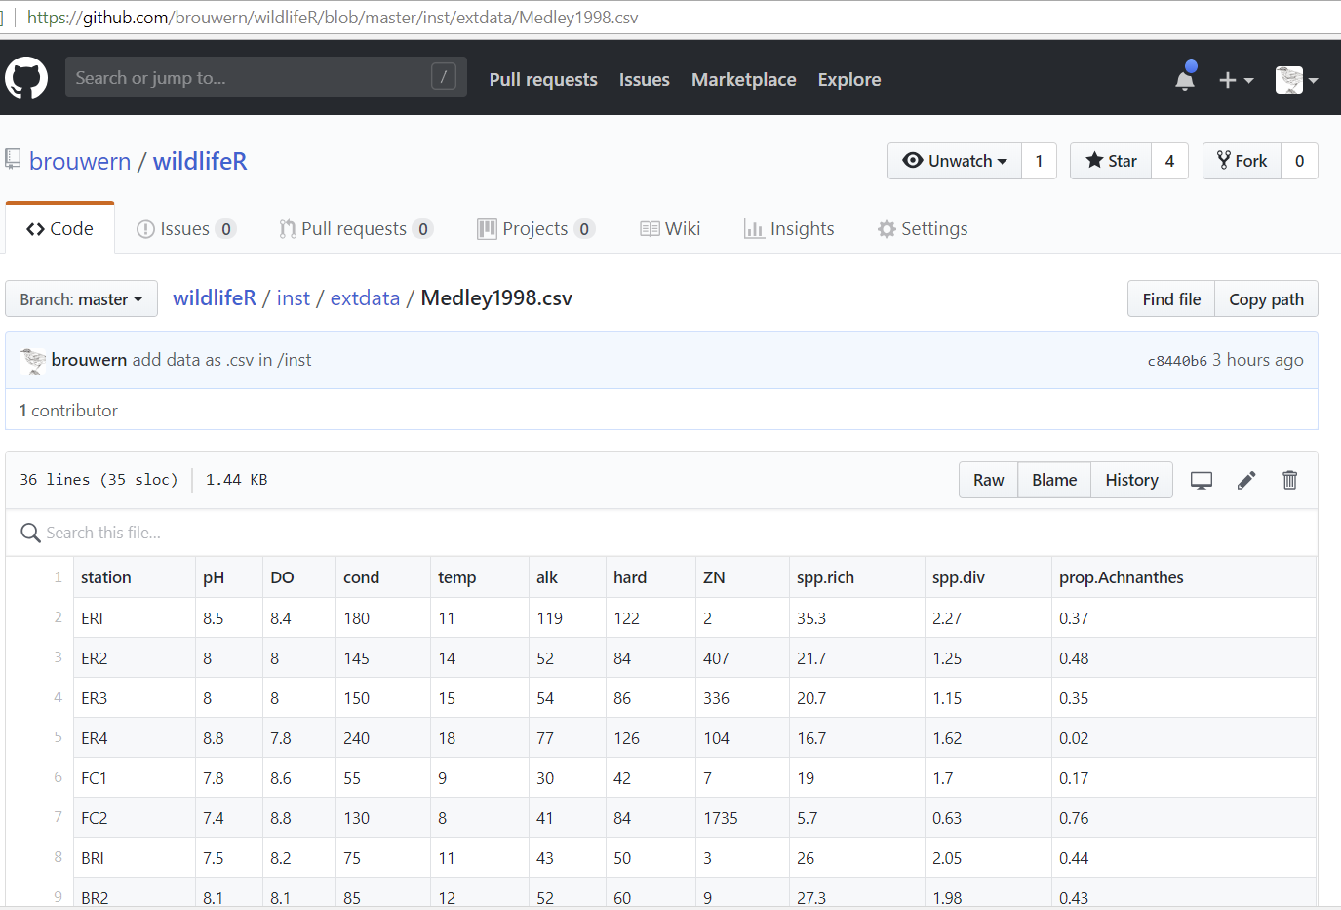
“Raw” Button accesses raw data

Slide 3
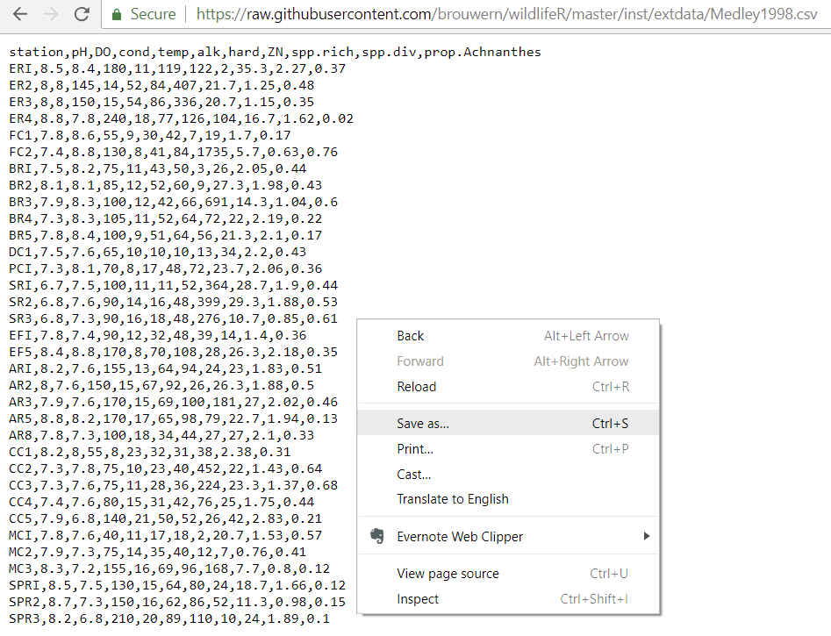
Target file:
Medley1998.csv
“Save as…”

