Slide 1
-
Predator
Bird
+
+
+
-
Parasite

Slide 2
Key concepts in Disease Ecology: Acute infection
Impacts of acute avian malaria infection
Acute phase – intense, fairly short
During acute phase malaria can kill birds directly due to physiological effects
Can also make it harder for birds to forage and evade predators.
Physiological impacts during acute phase
Parasitemia
Oxygen use
Body temperature
Survival rates during acute phase
Mortality due to direct effects of malaria can be 20-40%
Males vs. females

Slide 3
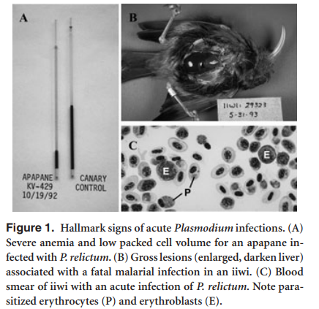
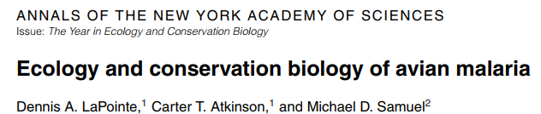
A)Shows *microcapillary tubes* from a bird with low *hematocrit* (left) and higher hematocrit (right)
B)A bird that has died from an acute infection
Notes:
A)Shows *microcapillary tubes* from a bird with low *hematocrit* (left) and higher hematocrit (right)
B)A bird that has died from an acute infection

Slide 4
“In wild animals, the cost of disease is most apparent during acute infection, when the host shows sickness behaviors and becomes inefficient in avoiding predators, finding food, and defending territory. After surviving the acute phase, either the infection is cleared or it may become chronic, often without apparent clinical signs.” (Asghar et al 2015 Science
“Hidden costs of infection: chronic malaria accelerates telomere degradation & senescence in wild birds”

Slide 5
*Acute phase of malaria, lasting about 25 days
*Physiological rates (oxygen, temperature) impact strongly for about 2 weeks before recovery)

Slide 7
*Acute phase of malaria
*”Crisis” period is when birds are being most impacted by parasite
*Unlike humans, birds’ body temperatures decline while sick with malaria

Slide 8
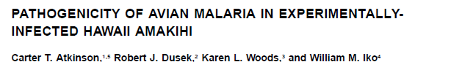
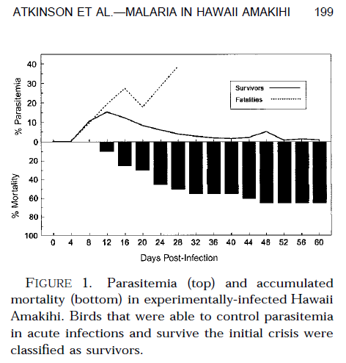
Birds die when Parasitemia reaches it peak
Parasitemia
These birds “cleared” the parasite from their system
Deaths
*Acute phase of malaria
*Parasitemia increases steadily after infected

Slide 9
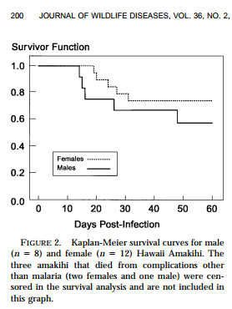
*”Survivor function” = “survivorship curve” showing how survival rate changes during acute phase of infection.
*2 curves shown – one for males, one for females.
*Males have lower survival rates. While females have almost an 0.8 survivorship (80%) males are closer to 0.6 (60%).
*Males are thought to have lower survival rates due to the negative impacts of testosterone on the immune system.

