Slide 1
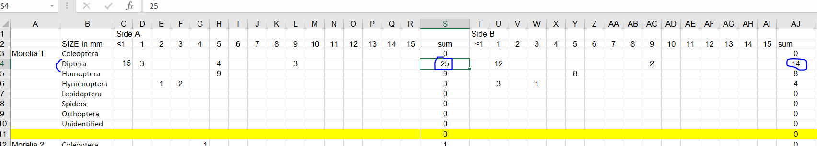
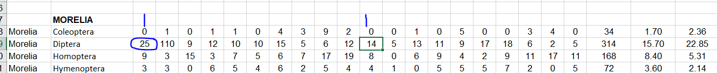
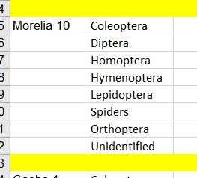
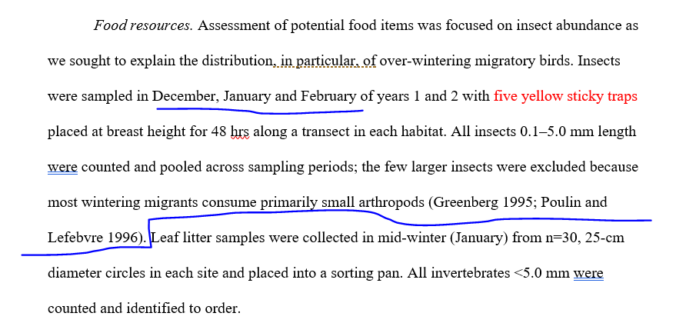
Sticky traps has 2 sides w/ separate counts
Side 1
Side 2
10 columns =
10 sticky traps?
Method say 5
5 per year = 10 totals??
Methods say sampled in Dec-Jan-Feb; this only shown for Aceitilar

