Slide 1
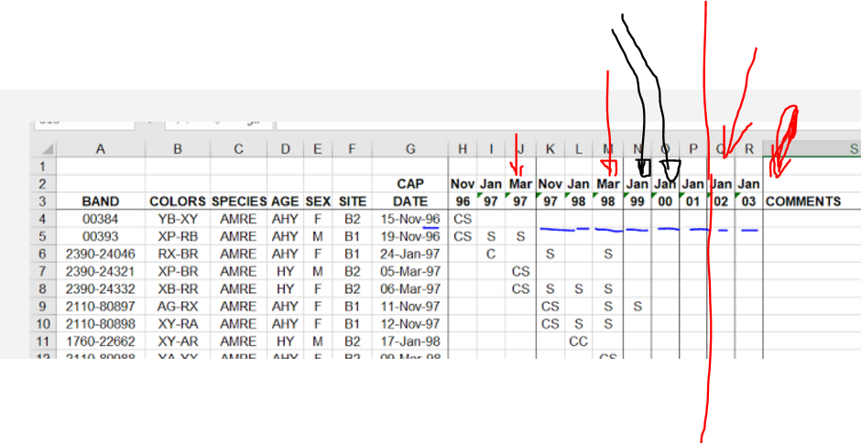
Current methods say:
“Sampling birds. We conducted mist-netting in early- (November), mid- (December-January), and late-winter (January-February ).”
The Aceitillar spreadsheet I have 1)indicates Nov-Jan-March sampling
2)Only has March data for 1996-1997 and 1997-1998, not subsequent years
This is mostly important b/c it impacts the number of recaptures for analyses of trends.
Methods also indicate different amounts of effort and number of nets for the pasture sites vs. Aceitillar.
Also, Orig paper says data from 1996-2001 used, but data through 2003 available. My models can easily accommodate these additional years but I can remove them if that’s best.

