Slide 1
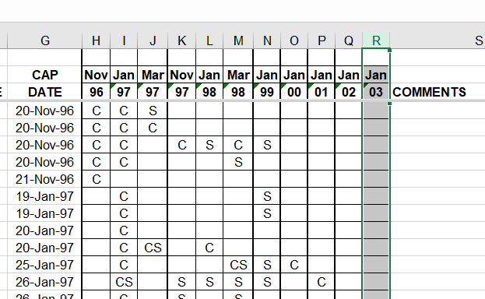
Need net hours – should be in main Aceitillar file
1996-1997
3x per yr
1997-1998
3x per yr
1x per yr – Jan only
1999-2003

Slide 2
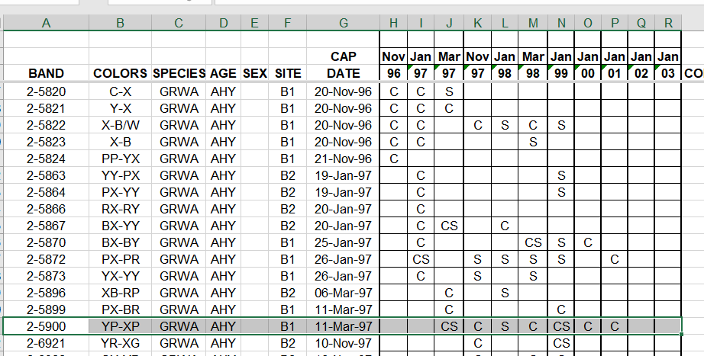
How was this assigned as nomial year, (eg 1996-1997)
Was this accidentlly assigned 1997-1998? That is, do I fail to recognize the intial session vs. that latter s
Use only 1st capture or
Recapture each year
(recapture = caught originally in previous year)
Did I deal with this already for
Table 5 / Table 6 workup?
w/ match() and unique()
Should check to make sure I am grabbing 1st entry each year
Remove re-sights (easy)

Slide 3
2002 captures really really low!

