Slide 1
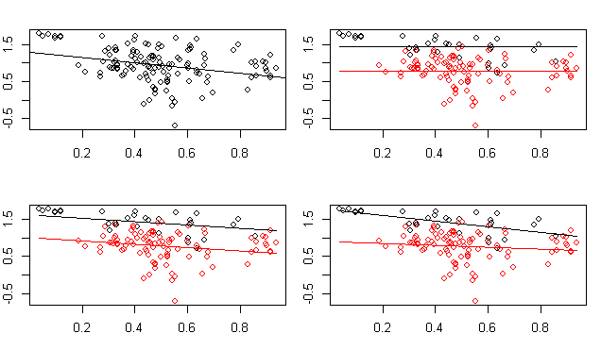
Models: % fat in milk ~ …
Predictors include: relative duration of lactation, diet (2 levels), and diet*lactation (interaction)
Notes:
Models: % fat in milk ~ …
Predictors include: relative duration of lactation, diet (2 levels), and diet*lactation (interaction)

Slide 2
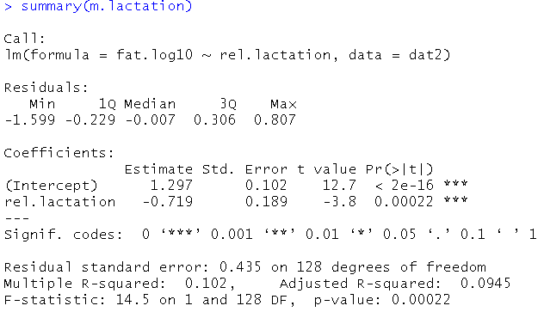
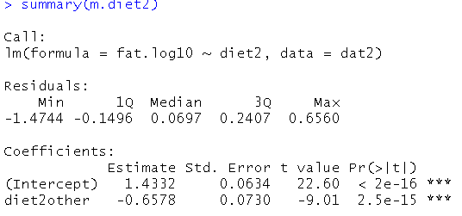
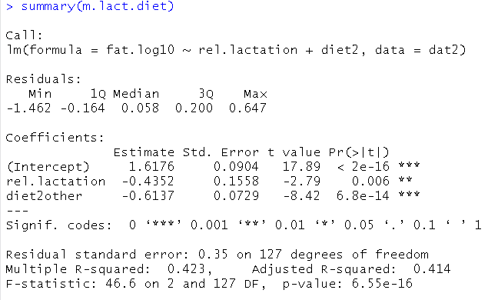
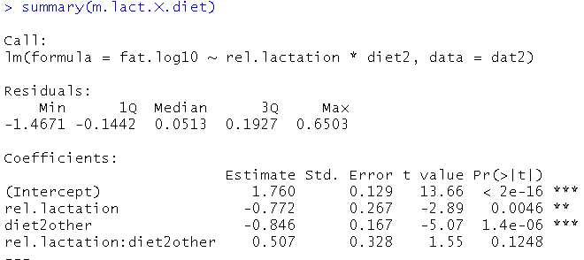
Notes:
Models: % fat in milk ~ …
Predictors include: relative duration of lactation, diet (2 levels), and diet*lactation (interaction)

Slide 3
Models: % fat in milk ~ …
Predictors include: relative duration of lactation, diet (2 levels), and diet*lactation (interaction)

Slide 4
Models: % fat in milk ~ …
Predictors include: relative duration of lactation, diet (2 levels), and diet*lactation (interaction)
Single continuous predictor (“regression”)
rel.lactation = continuous predictor
fat = Intercept + rel.lactation
fat = 1.3 + -0.72*rel.lactation
Single categorical predictor (“ANOVA”)
diet2 = factor w/2 levels: carnivore and “other”
carnivore = baseline level = intercept
fat = Intercept + diet2
fat = 1.43 + -0.66*(diet = Other?)
fat = 1.43 + -0.66*(1 if diet = Other, 0 if = carnivore)
Continuous + Categorical predictor (“ANCOVA”)
fat = Intercept + rel.lactation + diet2
fat = 1.3 + -0.44*rel.lactation + -0.43*(diet = Other?)
fat = 1.3 + -0.44*rel.lactation + -0.43*(1 if diet = Other, 0 if = carnivore
Interaction
fat = Int + rel.lact + diet2 + rel.lact*diet2
fat = 1.3 + -0.44*rel.lact + -0.85*(diet = Other?) + 0.51*rel.lact*(diet = Other?)
fat = 1.3 + -0.44*rel.lact + -0. 85*(1 if diet = Other, + -0. 51*rel.lact(1 if diet = Other,
0 if = carn) 0 if = carn)

Slide 5
Models: % fat in milk ~ …
Predictors include: relative duration of lactation, diet (2 levels), and diet*lactation (interaction)
Notes:
Models: % fat in milk ~ …
Predictors include: relative duration of lactation, diet (2 levels), and diet*lactation (interaction)

