Slide 1
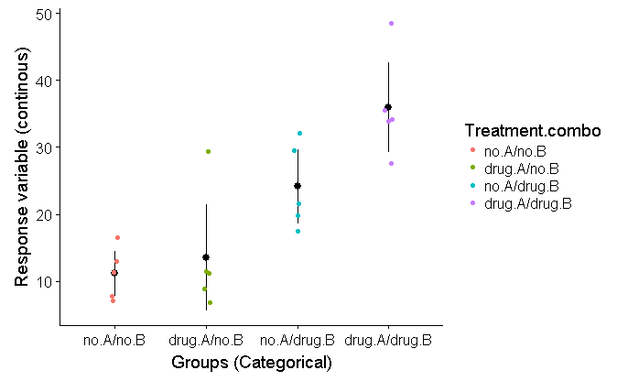
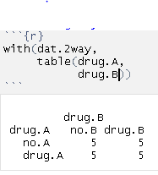
2-way ANOVA
Simulated study of the effect of 2 drugs
4 groups
1)Control: neither drug
2)Drug A only
3)Drug B only
4)Both Drugs
1)Control:
neither drug
2)Drug A only
2)Drug B only
4)Both Drugs

Slide 2
2-way ANOVA
Questions:
1)Does drug A effect the response variable (y)?
2)Does drug B effect the response variable?
3)If you take drug A AND drug B, what happens?
Simple “Additive” effect:
Response = effect of A + effect of B
“Interaction”
A and B combined results in something new (synergy)
1)Control:
neither drug
2)Drug A only
2)Drug B only
4)Both Drugs

Slide 3
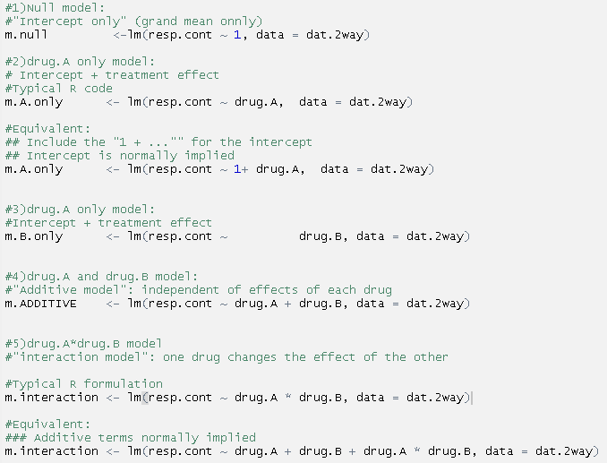
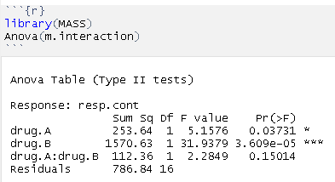
Typical 2-way ANOVA

Slide 4
There are FIVE hypotheses that can be considered
Ho: neither drug has an effect
Ha1-A: drug A has an effect,
but not drug B
Ha2-B: drug B has an effect,
but not A
Ha3-A+B: both drugs have effects, but
they are separate & independent
(additive model)
Ha4-A*B: both drugs have an effect, AND
the presence of one changes the
effect of the other (multiplicative
model)

Slide 5
There are FIVE hypotheses that can be considered
Ho: neither drug has an effect
Ha1-A: drug A has an effect,
but not drug B
Ha2-B: drug B has an effect,
but not A
Ha3-A+B: both drugs have effects, but
they are separate & independent
(additive model)
Ha4-A*B: both drugs have an effect, AND
the presence of one changes the
effect of the other (multiplicative
model)

Slide 6
There are FIVE hypotheses that can be considered
Ho: neither drug has an effect
Ha1-A: drug A has an effect,
but not drug B
Ha2-B: drug B has an effect,
but not A
Ha3-A+B: both drugs have effects, but
they are separate & independent
(additive model)
Ha4-A*B: both drugs have an effect, AND
the presence of one changes the
effect of the other (multiplicative
model)

Slide 7
There are FIVE hypotheses that can be considered
Ho: neither drug has an effect
Ha1-A: drug A has an effect,
but not drug B
Ha2-B: drug B has an effect,
but not A
Ha3-A+B: both drugs have effects, but
they are separate & independent
(additive model)
Ha4-A*B: both drugs have an effect, AND
the presence of one changes the
effect of the other (multiplicative
model)

Slide 8
There are FIVE hypotheses that can be considered
Ho: neither drug has an effect
Ha1-A: drug A has an effect,
but not drug B
Ha2-B: drug B has an effect,
but not A
Ha3-A+B: both drugs have effects, but
they are separate & independent
(additive model)
Ha4-A*B: both drugs have an effect, AND
the presence of one changes the
effect of the other (multiplicative
model)

Slide 10
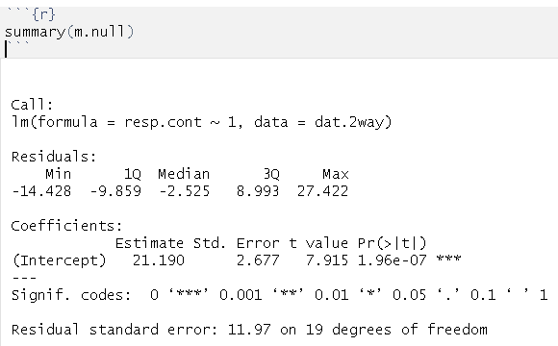
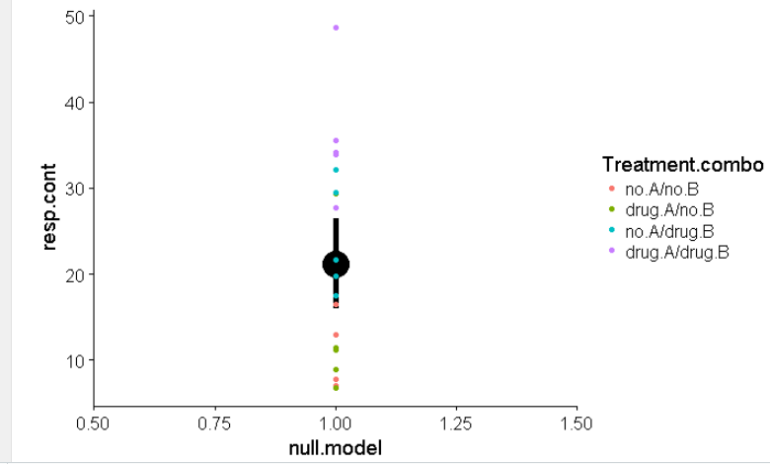
The Null Model
lm(resp.cont ~ 1, data = dat.2way)
Intercept = Overall mean

Slide 11
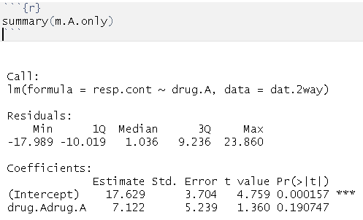
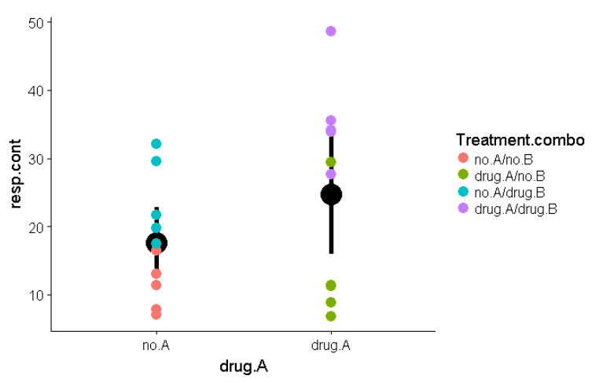
Drug A only model:
lm(resp.cont ~ drug.A, data = dat.2way)
Mean of
samples r
eceiving no
drug A
(no A/No B
AND
no A/
Drug B)
Effect of A, assuming B
has no effect
(Drug A/No B
AND
Drug A/
Drug B)
A effect
=7.12

Slide 12
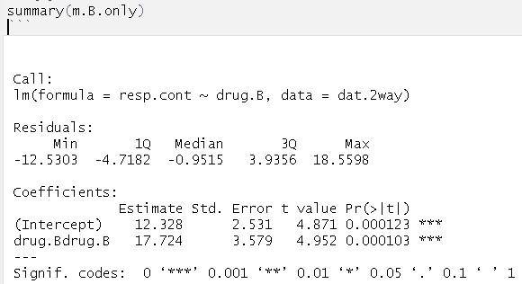
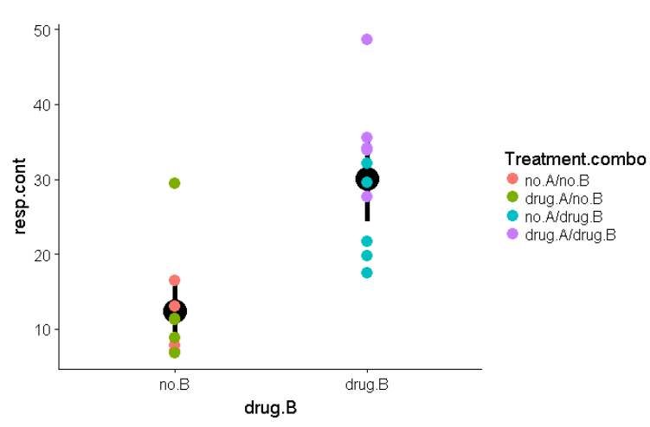
Drug B only model:
lm(resp.cont ~ drug.B, data = dat.2way)
B effect
=17.12

Slide 13
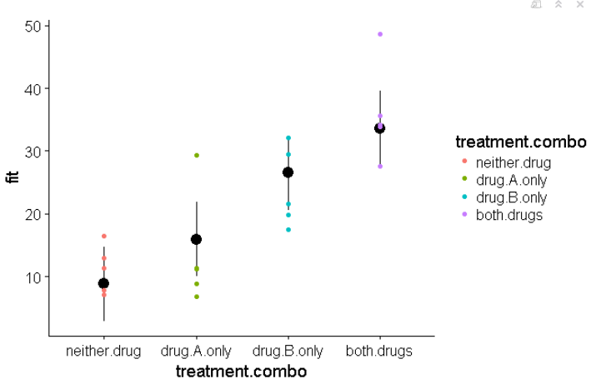
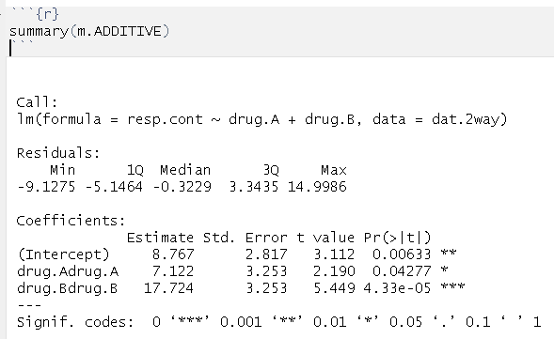
ADDITIVE MODEL: drug A + drug B
8.8+7.1+17.7=33.5ish
7.1
8.8

Slide 14
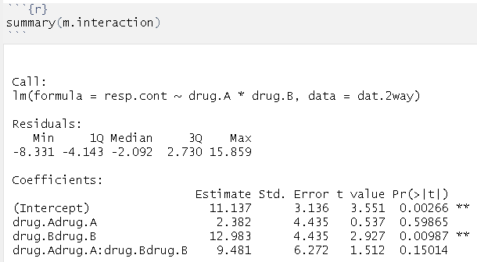
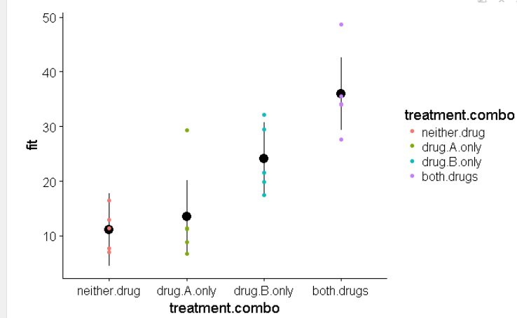
INTERACTION MODEL: drug A + drug B + drug A*drugB
Interaction
drug A*drug B
=9.5
drug B
=13
drug A
= 2.4

Slide 15
INTERACTION MODEL: drug A + drug B + drug A*drug B
What does the interaction term mean?
This represent the MATHEMATICAL representation of the interaction
Does this represent the biological reality?
When Drug B is present, could we separate out the “Drug A effect” from the “Drug A interaction with Drug B” effect?
Interaction
drug A*drug B
=9.5
drug B
=13
drug B
=13
drug A
2.4
drug B
2.4

Slide 16
INTERACTION MODEL: drug A + drug B + drug A*drug B
What if there is a “negative interaction”
Is there a “real” positive effect of A + real positive effect of B being “canceled out by a biological separate “interaction”
drug B
=13
drug B
=13
drug A
2.4
drug B
2.4

Slide 17
