Slide 1
Statistical Models*: Defined by Response & Predictors variables
2 Categories
2-sample
t-test (t.test)
3+ Categories
ANOVA
3+ Categories
ANOVA
Numeric
Response
~ Predictors
3+ Categories
*Assuming all samples independent, no pairing, nesting, repeated measures, etc

Slide 2
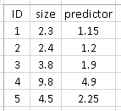
Statistical Models*: Defined by Response & Predictors variables
2 Categories
2-sample
t-test (t.test)
1 Response
“Univariate statistics”
size OR
mass OR
RBC count
3+ Categories
ANOVA
~ predictor
3+ Categories
ANOVA
Numeric
Response
~ Predictors
3+ Categories
*Assuming all samples independent, no pairing, nesting, repeated measures, etc

Slide 3
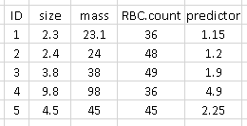
Statistical Models*: Defined by Response & Predictors variables
2 Categories
2-sample
t-test (t.test)
1 Response
“Univariate statistics”
size OR
mass OR
RBC count
3+ Categories
ANOVA
~ predictor
3+ Categories
ANOVA
Numeric
Response
~ Predictors
3+ Categories
2+ Reponses
“Multivariate statistics”
Size AND mass AND RBC ~ predictor
*Assuming all samples independent, no pairing, nesting, repeated measures, etc

Slide 4
Statistical Models*: Defined by Response & Predictors variables
2 Categories
2-sample
t-test (t.test)
1 Response
“Univariate statistics”
size OR
mass OR
RBC count
3+ Categories
ANOVA
~ predictor
3+ Categories
ANOVA
Numeric
Response
~ Predictors
3+ Categories
Continuous / Numeric
Regression
*Assuming all samples independent, no pairing, nesting, repeated measures, etc

Slide 5
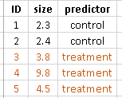
Statistical Models*: Defined by Response & Predictors variables
2 Categories
2-sample
t-test (t.test)
1 Response
“Univariate statistics”
size OR
mass OR
RBC count
Categories / Groups / “Factors”
3+ Categories
ANOVA
t-test, ANOVA
Analysis of variance
~ predictor
3+ Categories
ANOVA
Numeric
Response
~ Predictors
3+ Categories
Continuous / Numeric
Regression
*Assuming all samples independent, no pairing, nesting, repeated measures, etc

Slide 6
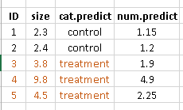
Statistical Models*: Defined by Response & Predictors variables
2 Categories
2-sample
t-test (t.test)
1 Response
“Univariate statistics”
size OR
mass OR
RBC count
Categories / Groups / “Factors”
3+ Categories
ANOVA
t-test, ANOVA
Analysis of variance
~ predictor
3+ Categories
ANOVA
Both Cat. & Numeric
Numeric
Response
ANCOVA
(Analysis of Covariance)
Multiple Regression
~ Predictors
3+ Categories
Continuous / Numeric
Regression
*Assuming all samples independent, no pairing, nesting, repeated measures, etc

Slide 7
Statistical Models*: Defined by Response & Predictors variables
2 Categories
2-sample
t-test (t.test)
1 Response
“Univariate statistics”
size OR
mass OR
RBC count
Categories / Groups / “Factors”
3+ Categories
ANOVA
t-test, ANOVA
Analysis of variance
~ predictor
3+ Categories
ANOVA
Both Cat. & Numeric
Numeric
Response
ANCOVA
(Analysis of Covariance)
Multiple Regression
~ Predictors
3+ Categories
2+ Reponses
“Multivariate statistics”
Size AND mass AND RBC ~ predictor
Continuous / Numeric
Regression
*Assuming all samples independent, no pairing, nesting, repeated measures, etc

Slide 8
Aside: Multivariate statistics
“Ordination:”
Goals:
1)Visualization
-visualize complex data in 2D or 3D
Principal components analysis
2)Simplification
-reduce multiple variables, many likely to be correlated, into fewer variables
3)Pattern recognition
Common types:
-PCA (principal components analysis)
-PCoA (principal coordinates analysis)
-NMDS (non-metric multidimentional scaling)
-CA, DA…
-Bayesian ordination
Hypothesis testing
Goals:
1)Test hypotheses with multiple response variables
Common types:
-MANOVA (multivariate-ANOVA)
-MANCOVA (multivar-ANCOVA)
-perMANOVA (permutational ANOVA)
-multiple response GLMs
-multiple response Bayesian models
2+ Reponses
“Multivariate statistics”
Size AND mass AND RBC ~ predictor

Slide 9
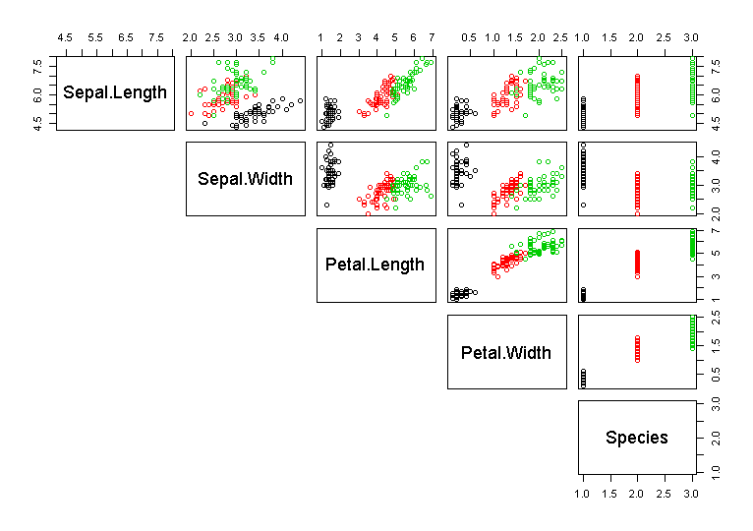
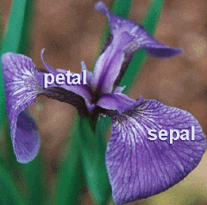
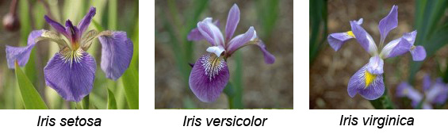

Slide 10
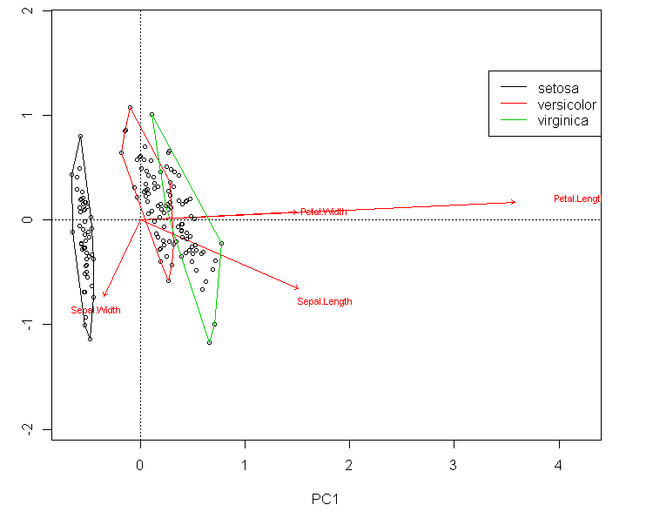

Slide 11
Quotes / Notes on multivariate stats
“The aim of ordination is twofold. First, it tries to reduce a large number of variables into a smaller number of variables. And Secondly, it can be used to reveal patterns in multivariate data that would not be identified in univariate analyses” (Zuur, Ienno, Smith 2007, pg 189).
“Multivariate analysis provide methods to identify and summarize joint relationships in variables in large dataset” (Dray and Dufour 2007)

Slide 12
Statistical Models*: Defined by Response & Predictors variables
2 Categories
2-sample
t-test (t.test)
Categories / Groups / “Factors”
3+ Categories
ANOVA
t-test, ANOVA
Analysis of variance
1 Response
“Univariate statistics”
size OR
mass OR
RBC count
3+ Categories
ANOVA
Both Cat. & Numeric
Numeric
Response
ANCOVA
(Analysis of Covariance)
Multiple Regression
~ Predictors
~ predictor
3+ Categories
Continuous / Numeric
Regression
*Assuming all samples independent, no pairing, nesting, repeated measures, etc

Slide 13
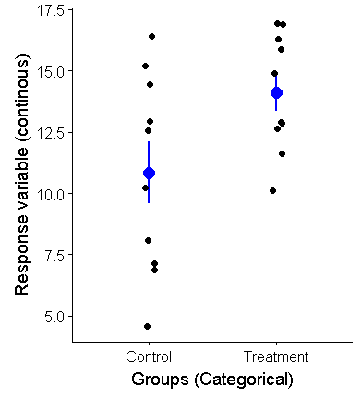
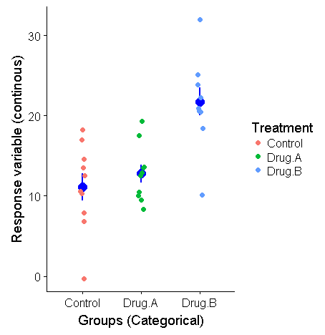

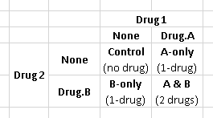
1-way ANOVA
Categories mutually exclusive /
Cannot be or are not combined
2 Groups:
2-sample t-test
Categories / Groups / “Factors”
3+ Groups:
ANOVA
Multi-way/Factorial ANOVA
Categories can be combined /”crossed”

Slide 14
1-way ANOVA
Categories mutually exclusive /
Cannot be or are not combined
“Classic” Biology Approach
Conduct ANOVA F-test
(global test, omnibus test)
Ho: ALL means are equal
Control = Drug.A = Drug.B
If p > 0.05 (F small),
Fail to reject Ho
STOP!
(but who would ever
actually do that?)
Ha: At least 1 mean ≠ the others
(could be more)
If p < 0.05 (F big)
Reject Ho, have evidence for Ha
One mean is not like the others
But which one?
Follow up / Focused analyses
“Planned comparisons”
“Thoughtless
comparisons”
“Unplanned comparisons”

Slide 15
1-way ANOVA Follow up analyses
“Planned comparisons/tests”
“a priori”
A focused subset of possible comparisons
ie, each drug vs control
How Planned:
Ideally: explicitly registered
Not bad: implied by the experimental design
-Common: ”planned” post hoc…
“Thoughtless comparisons”
B/c that’s what the software gives you…
“Unplanned comparisons”
“post hoc”
Many/Most/All pairwise comparisons
-not originally intended; exploratory
-all pairwise

Slide 16
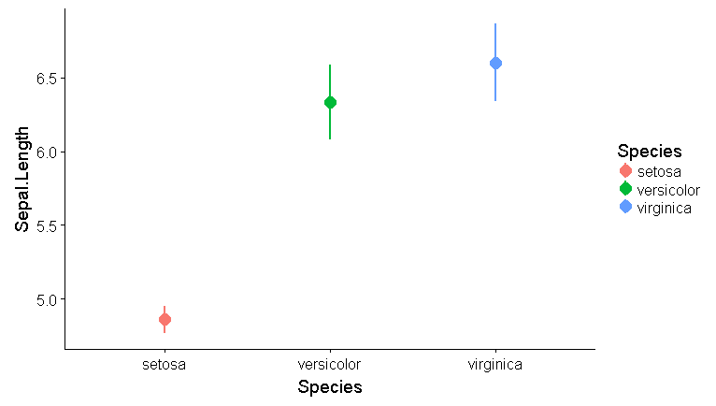
Fishers irises: 3 possible comparisons
-With a limited number of comparisons, all of them often flow naturally from the design
-some would say you don’t need to adjust p-values at all in this case
-not many comparisons, so the change to your p-values not huge
Easy to do in R
pairwise.t.test()
TukeysHSD()
ve vs vi
“of the 2 big ones, is vi bigger?”
s vs ve
“is ve really bigger than the smallest one?
s vs vi
“is vi really bigger than the smallest one?

Slide 17
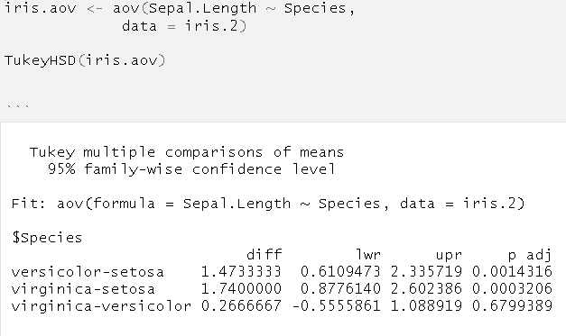
TukeyHSD()
Diff = 0.267
P = 0.678
Diff = 1.47
P = 0.0014
Difference between means (Effect size)
Confidence interval for difference between means
Adjusted p-value
R ANNOYANCE ALERT: MUST fit model with aov(), NOT lm()

Slide 18
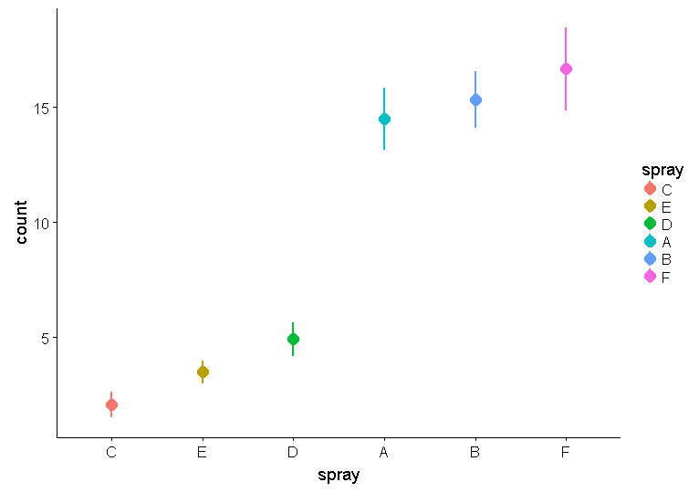
Beal’s insect spray data
Planned / Focused comparisons:
-Test each spray against “C”, the control
C vs E
C vs D
….
C vs F
Not easy in R (?)
-requires hand computation
of tests and corrections
-or use of advanced package (multcomp)
Thoughtless:
-Everything against everything else
Very easy to do in R, but…
1)Each comparison incurs a
Penalty again your p-values
2)Most of these are of no
Real interest
Not all combos shown

Slide 19
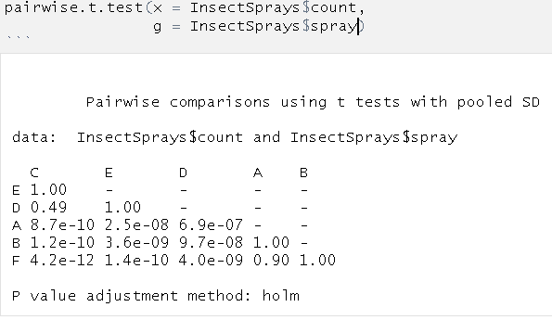
15 tests!
Holm = “holm-Bonferroni” = “sequential bonferonni”
Common approach in Biology

Slide 20
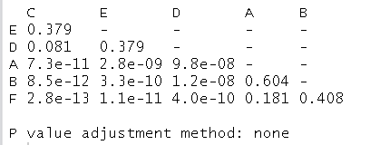
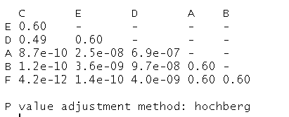
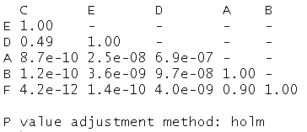
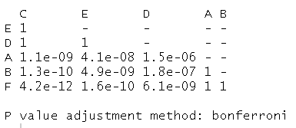
No adjustment
p.adjust = “none”
Similar to separate t-test with t.test, but not exactly (no Welche’s correction, pooled SD)
“Hochberg's step up procedure”
p.adjust = “Hochberg”
Fairly new-ish Approach (1980s or 1990s?)
Sequential Bonferroni
(Holm, Holm’s Step-down, Holm-Bonferroni)
p.adjust = “holm”; is pairwise.t.test’s default
Very population in Ecology & Evolution
Bonferroni
p.Adjusted = (p-value)*(# of tests)
Very very very conservative
Sometimes still done b/c its really easy and can be used in any sitatuion, but nobody recommends using this anymore
Note the p-value in the dashed box
= 2.8e-09 for no adjustment.
= 2.8e-09/15 = 4.1e-08 for Bonferroni

Slide 21
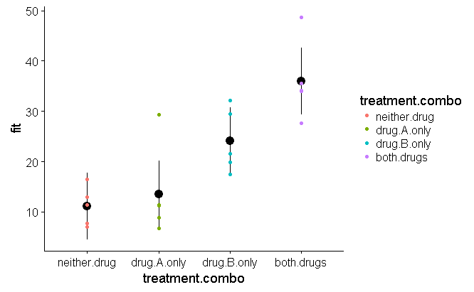
Multi-way/Factorial ANOVA
Categories can be combined /”crossed”

