Slide 1

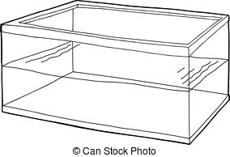



An aside that isn’t an aside: the paired t-test
“Control”
time
“Treated”
time
Subjects
Expose to vaccine
1
1
2
1
1
3
4
5
. . .
18

Slide 2
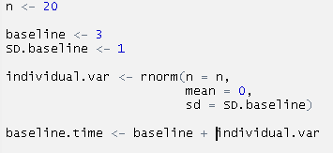
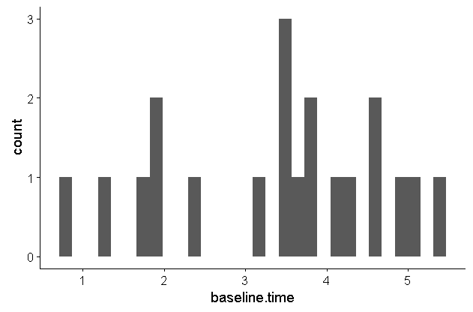
“Control”
time
Subjects
1
2
1
3
4
5
. . .
18

Slide 3
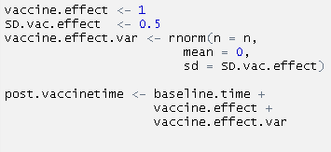
“Treated”
time
Subjects
Expose to vaccine
1
1

Slide 4
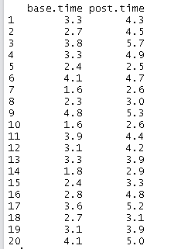
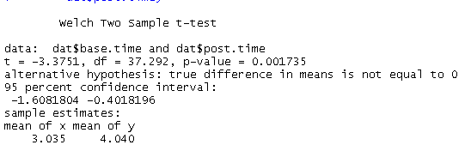
Incorrect Analysis
t.test(dat$base.time,
dat$post.time)
df = 37.292
(38 b/f Welch’s correction)
Mean = 3.035 4.040
Diff. = 1.005

Slide 5
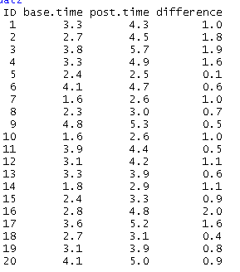
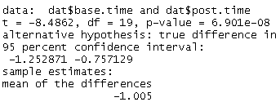
correct Analysis
t.test(dat$base.time,
dat$post.time,
paired = TRUE)
df = 19
Mean = 3.035 4.040 1.005
Diff. = 1.005

Slide 6
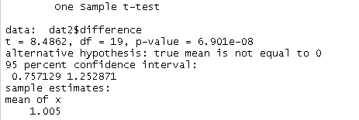
2-sample t-test vs. paired t-test
(2-sample) t-test
Paired t-test
Ho: difference between means = 0.0
Ho: mean of the differences = 0.0
A paired t-test is actually a “1-sample t-test” against a mean of 0

Slide 7
Paired t-test is the simplest form of “blocking”
Definition
“Blocked by…”
“blocking is the arranging of experimental units in groups (blocks) that are similar to one another.’
Experimental trial (in a study conducted more than once)
Lab (study conducted at multiple places)
Species
Farm

Slide 8

Blocking and nesting often occur together
Environmental Chamber 1
Environmental Chamber 2
Environmental Chamber 3
C
T
C
T
C
T
C
T
C
T
C
T
T
T
C
T
T
T
C
T
T
T
C
T
aov(response.y ~ treatment
+ Error(Chamber.ID),
data = dat)

