Slide 1
Advanced statistical models
This week
Next week
Review typical modeling assumptions
Nesting, clusters
Random effects
Mixed effects models
Pseudoreplication
Multiple levels of nesting
Hierarchical / multilevel models
Repeated measures
Longitudinal studies
Random slopes / random coefficients

Slide 2
Assumptions of basic statistical models
1) Residuals/Variation normally distributed
ANOVA/t-test: w/in any distinct group/treatment, variation is normally distribution
Regression: along the regression line, variation in normally distributed
2) Random sampling / assignment
If sampling from a population, individuals randomly selected
If assigning treatments to a fixed group of individuals, treatments randomly assigned
3) Variance is homogenous (homoscedastic, not heteroskedastic)
ANOVA/t-test: the variance/SD/SE of each distinct group is equal
Regression: along the regression line, variance is constant
4) All individuals independent of each other
Variation is independent, “residuals are independent”, individuals not correlated

Slide 3
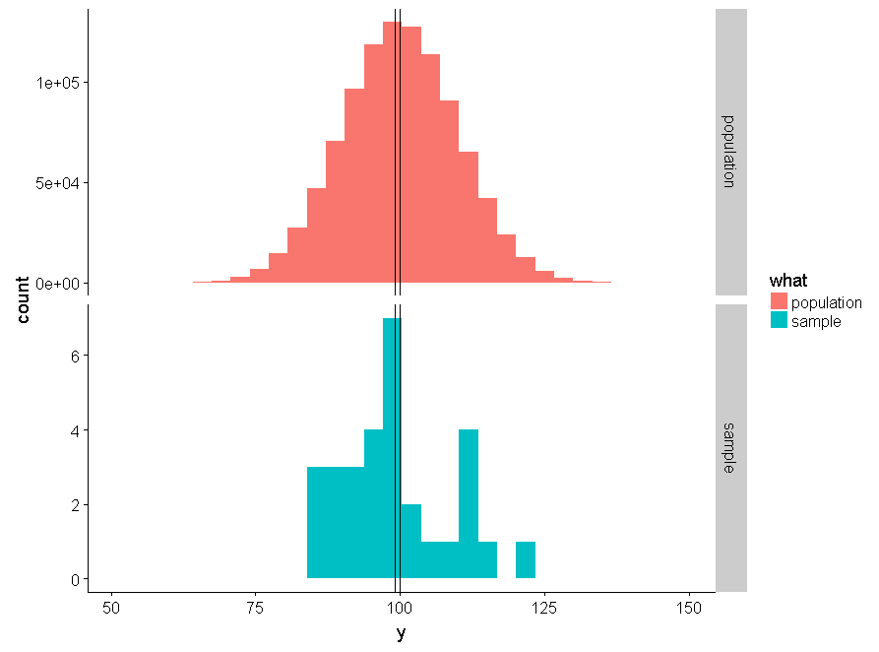

Residuals/Variation normally distributed
ANOVA/t-test: within any distinct group/treatment, variation is normally distribution
Regression: along the regression line, variation in normally distributed
“Data is normally distributed”
This is especially wrong in the context of regression/ANCOVA
“Residuals normally distributed”
rnorm() randomly samples from normal distribution

Slide 4
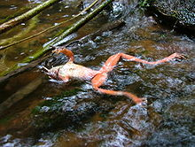
Running example: Chytridiomycosis (Bd) Batrachochytrium dendrobatidis
Let’s pretend we can develop a vaccine or other treatment for Bd…

Slide 5




Random sampling / assignment
If sampling from a population, individuals randomly selected
If assigning treatments to a fixed group of individuals, treatments randomly assigned
Control response variable (y) = population mean
Vaccine response variable (y) =
Pop. mean + vaccine effect
Defined Population*
C
V
C
V
V
V
V
V
V
C
Control
C
C
C
V
C
V
V
C
C
V
Vaccine
C
V
C
C
V
V
C
V
C
C
*Strictly speaking, inference about treatment effects is limited to the population you sampled from

Slide 6

1) Random sampling / assignment
If sampling from a population, individuals randomly selected
If assigning treatments to a fixed group of individuals, treatments randomly assigned
Control response variable (y) = population mean
Vaccine response variable (y) =
Pop. mean + vaccine effect
Defined Population
C
V
C
V
V
V
V
V
V
C
Control
C
C
C
V
C
V
V
C
C
V
Vaccine
C
V
C
C
V
V
C
V
C
C
*Strictly speaking, inference about treatment effects is limited to the population you sampled from

Slide 7

1) Random sampling / assignment
If sampling from a population, individuals randomly selected
If assigning treatments to a fixed group of individuals, treatments randomly assigned
Control response variable (y) = population mean
Vaccine response variable (y) =
Pop. mean + vaccine effect
Defined Population
C
V
C
V
V
V
V
V
V
C
Control
C
C
C
V
C
V
V
C
C
V
Vaccine
C
V
C
C
V
V
C
V
C
C
*Strictly speaking, inference about treatment effects is limited to the population you sampled from

Slide 8
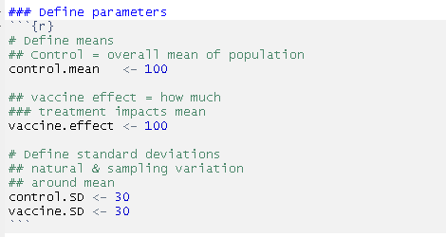
Random sampling / assignment
Simulating in R
Control response variable (y) = population mean
Vaccine response variable (y) =
Pop. mean + vaccine effect

Slide 9
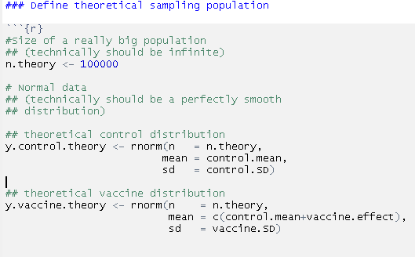
1) Random sampling / assignment
Simulating in R
Sample size
Control mean
Variation around mean

Slide 10
1) Random sampling / assignment
Simulating in R
Sample size
Control mean
Vaccine response variable (y) =
Control mean +
vaccine effect
Variation around mean

Slide 11

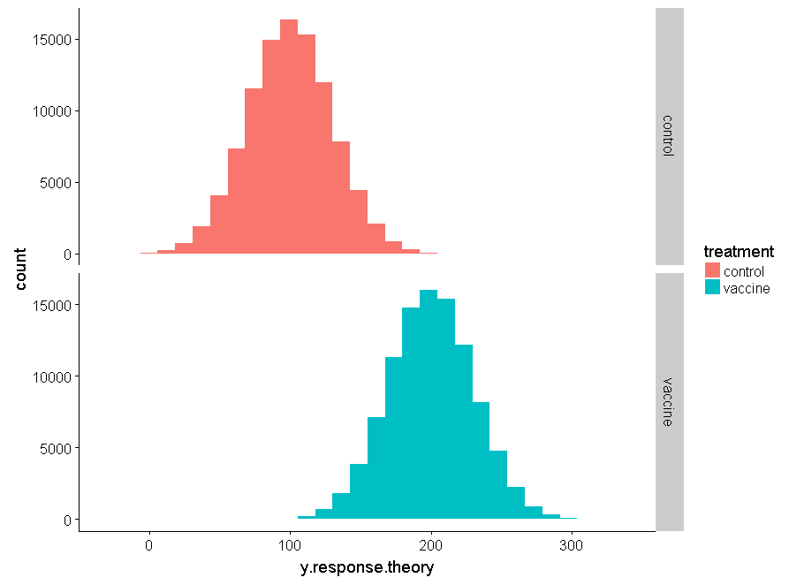

Random sampling / assignment
Theoretical variation within population
Control
Vaccine

Slide 12
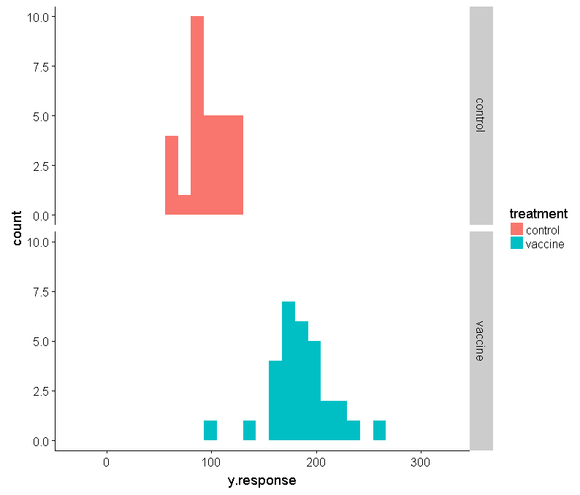
Control
Vaccine

Slide 13
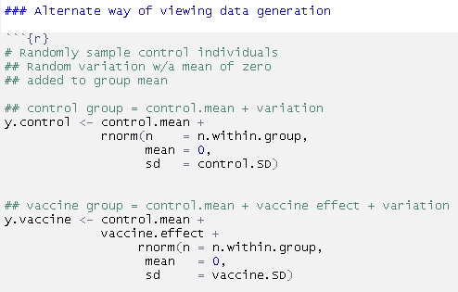
Alternate way of viewing data generation process
Control mean
Sample size
Noise varies positively and negatively, w/ mean 0.0
Variation around mean
Control mean
Vaccine effect

Slide 14
Control mean +
Treatment effect +
Random noise
Control mean +
Treatment effect
Control mean
Control mean
Vaccine effect
Noise varies positively and negatively, w/ mean 0.0

Slide 15
Typical linear model formulation
General:
Response ~ “fixed effects” + random noise
More math-y
Response ~ intercept + (treatment effect) + random noise
Current example:
y.control ~ control.mean + random noise
y.vaccine ~ control.mean + vaccine.effect + random noise

Slide 16
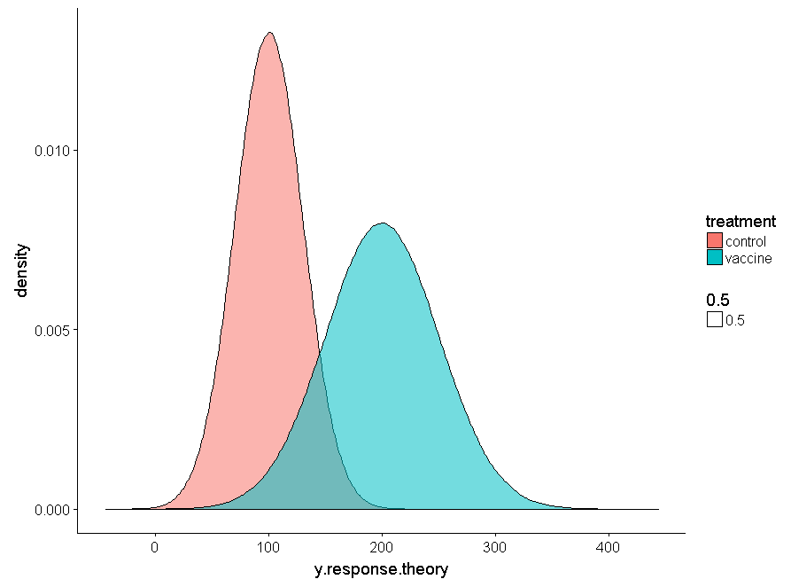
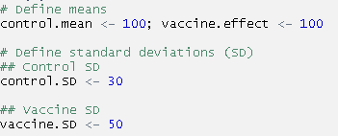
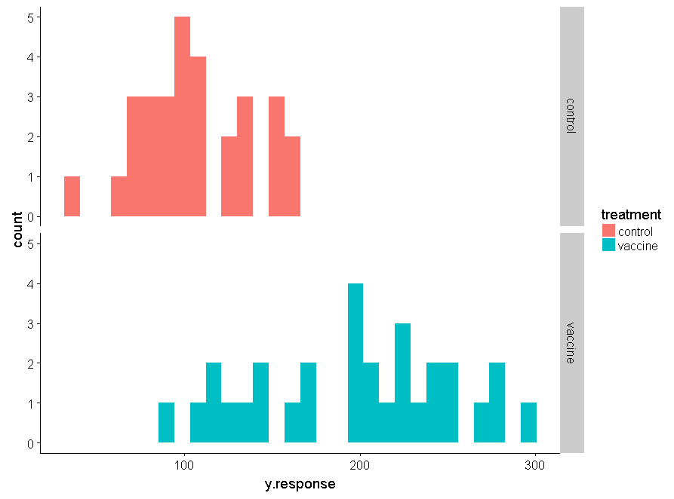
Variance is homogenous
(homoscedastic, not heteroskedastic)
ANOVA/t-test: the variance/SD/SE
of each distinct group is equal

Slide 17
Modeling non-constant Variation
2-groups
Regression, ANOVA, ANCOVA
t.test() w/ Welch’s correction (default)
nlme::gls
“generalized least squares”
Can allow variance to vary between groups, with a covariate, etc.
Multiple groups, 1-way ANOVA
oneway.test()
Essentially Welch’s correction for 1-way ANOVA
Not well known, only does overall F-test, so not very useful

Slide 18
All individuals independent of each other
Variation is independent, residuals are independent, individuals not correlated

Slide 19

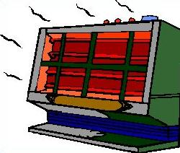



All individuals independent of each other
Variation is independent, residuals are independent, individuals not correlated
Aquarium 1
Aquarium 2
*Individuals from aquarium 2 are not independent b/c they shared a common environment
*This variation is “structured”, but is not model so it “ends up in the error term” (modifies the distribution of the residuals, in this case changes their mean)
*Stats lingo: the common environment “induces correlation” among individuals from that environment
Control
Vaccine

Slide 20
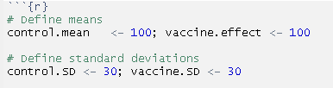
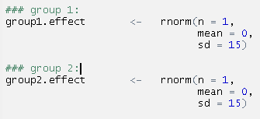
All individuals independent of each other
Variation is independent, residuals are independent, individuals not correlated
*New, “hidden” effects
*unknown, random variation

Slide 21
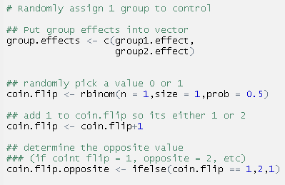
All individuals independent of each other
Variation is independent, residuals are independent, individuals not correlated
*New, “hidden” effects
*unknown, random variation
Binomial “coin flip”
(0 or 1)
Convert “coin flip”
To index values (1 or 2)

Slide 22
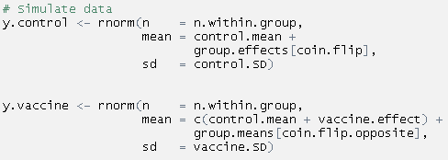
Control mean
Unknown, random effect of source aquarium
Vaccine effect
Control mean
Unknown, random effect of other source aquarium

Slide 23
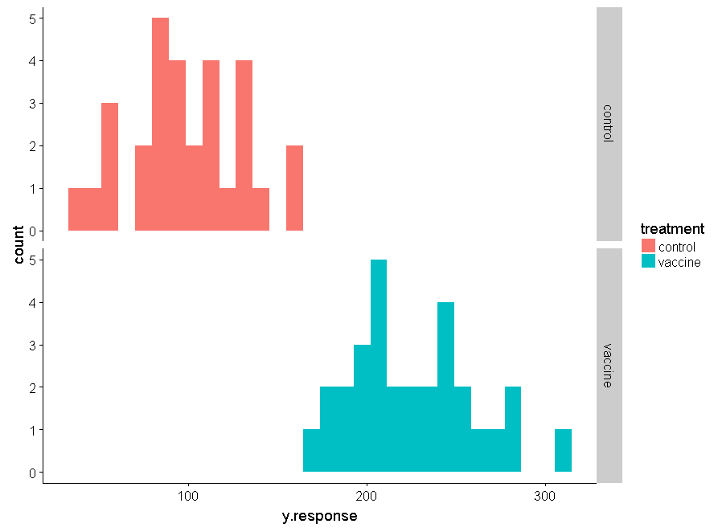
*By looking at the data you can’t tell that anything is amiss
*However, the vaccine effect is now “confounded” with the effect of the
*Could overestimate, underestimate, or miss treatment effect altogether

Slide 24
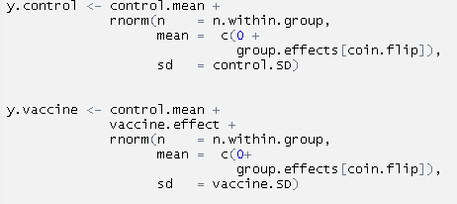
Overall baseline
Mean of random aviation shifted away from zero by a random amount
Random variation

Slide 25
How to overcome this problem?
Aquarium 1
Aquarium 2

Slide 26
How to overcome this problem?
“Stratified” random assignment:
Randomly selection ½ from each aquarium
If Aquarium effect is strong, use 2-way ANOVA
Aquarium 1
Aquarium 2

Slide 27


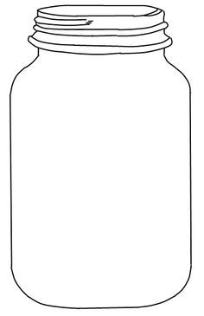

A common type of non-independence:
nesting
Holding tank
N = 30 organisms
Vaccine + Bd
Vaccine + Bd
Vaccine + Bd
Vaccine
Vaccine
Vaccine
n = 5 organisms in a “cluster”

Slide 28
The incorrect analysis:
Why is this wrong?
What type of experimental design does this imply?
lm(response.y ~ treatment, data = dat)

Slide 29

The incorrect analysis:
Holding tank
What type of experimental design does this imply?
This implies an experimental design where each organism is independent from the others?
lm(response.y ~ treatment, data = dat)
Defined Population*
Vaccine
Vaccine +
Bd
N = 30 organisms
N = 30 independent cups

Slide 30
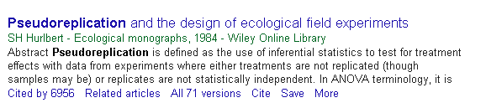
“Pseudoreplication”
“"the use of inferential statistics to test for treatment effects with data from experiments where either treatments are not replicated (though samples may be) or replicates are not statistically independent."

Slide 31
Why does independence matter?

Slide 32
Why does independence matter?
Behavioral interactions between organisms
Shared but unknown environmental conditions (heat, light, contamination)
Inflated sense of precision: SE = SD/sqrt(N)

Slide 33
Potential Causes of clustering / nesting
Real science
Other science
Animals in same cage
Bacteria on separate plates from single culture
Fields on a slide
Plants in a deer exclosure
Neurons in a mouse
Families of organism
Nestlings in a nest
Experiments conducted in a single lab
Students in a classroom
Patients in a clinic

Slide 34
Correct analysis
Only If data is normal-ish, “balanced”,
w/ any number of clusters*
If data not balanced & clusters > 5*,
or if data non-normal**
Base R:
aov(response.y ~ treatment +
Error(jar.ID),
data = dat)
packages: nlme::lme, lme4::lmer
lmer(response.y ~ treatment +
(1|jar.ID),
data = dat)
*and all other typical assumptions valid (normality, constant variance)
Vaccine + Bd
Vaccine + Bd
Vaccine + Bd
**lme, lmer can do balanced designs too; some people still prefer aov(), many use lme/lmer; lme can also accommodate non-constant variance
Vaccine
Vaccine
Vaccine
n = 5 organisms in a “cluster”

Slide 35

Un-balanced data
If data not balanced & clusters > 5*,
or if data non-normal**
packages: nlme::lme, lme4::lmer
lmer(response.y ~ treatment +
(1|jar.ID),
data = dat)
Vaccine + Bd
Vaccine + Bd
Vaccine + Bd
**lme, lmer can do balanced designs too; some people still prefer aov(), many use lme/lmer; lme can also accommodate non-constant variance
Vaccine
Vaccine
Vaccine
n=4
n=3
n=4
n=4
n = 3-5 organisms in a “cluster”

Slide 36
Alternative analysis: balanced designs
Vaccine + Bd
Vaccine + Bd
Vaccine + Bd
Vaccine
Vaccine
Vaccine
n = 5 organisms in a “cluster”
Cluster 1 mean
Cluster 2 mean
Cluster 3 mean
Cluster 4 mean
Cluster 5 mean
Cluster 6 mean
N = 6 independent data points
lm(cluster.mean ~ treatment, data = dat)

Slide 37
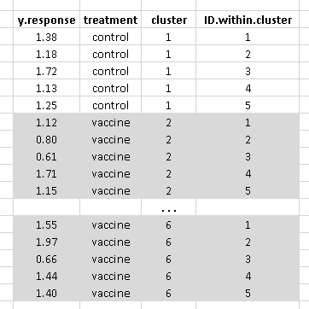
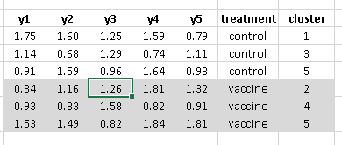
Alternative analysis: manov() for balanced designs
Data table for aov(), lme(), lmer()
Data table for manova()

Slide 38
Alternative analysis: un-balanced designs
Vaccine + Bd
Vaccine + Bd
Vaccine + Bd
Vaccine
Vaccine
Vaccine
Weighted regression:
*Cluster gets “weighted” by the variability within that cluster
w/in the cluster
*Analogous to “meta-analysis”
Cluster 1 mean,
sd
Cluster 2 mean,
sd
Cluster 3 mean,
sd
Cluster 4 mean,
sd
Cluster 5 mean,
sd
Cluster 6 mean,
sd
*Cluster w/large SD has less influence on the results; SD is proportional to n
lm(cluster.mean ~ treatment,
weights = 1/sd,
data = dat)

Slide 39

Public service announcement: Un-balanced designs
In general
For complex models/experiments
Balanced experiments = happiness
When you don’t have nesting, lm() can fit models to balanced data
BUT, some people have strong opinions about how to interpret these results
R developers: “Type II sum of squares”
SAS: “Type III sum of squares"
Can’t use aov() or manova() when things aren’t balanced
lme, lmer, glmer can fit just about anything
BUT, p-values and confidence intervals can be tricky with these models

Slide 40
Blocking

Slide 41
Fixed effects vs. Random effects
“Fixed” effects
“Random effects”
Defined explicitly by investigator
Or, are of major concern in study (gender, color)
Usually not of scientific interest
Can be conceived of as coming from a theoretical random distribution
Sometimes selected randomly: randomly selected study plots
BUT, rarely actually selected randomly

Slide 42
Fixed vs. Mixed effects models
Fixed-effects models
Mixed effects models
Contain both fixed and random effects
Paired-tests / before after / crossover
Nesting/clusters
Blocking
Repeated measure / Longitudinal

Slide 43
Mixed effects models in R
Package | function | What it does
base | t.test() | paired data, before-after, crossover
 | aov() | Balanced, normal, meets all assumption
nlme | lme() | normal data; can handle non-constant variance like gls()
 | nlme() | non-linear models
lme4 | lmer() | normal data; can handle "crossed" random effects
 |  | cannot model non-constant variance
 | glmer() | non-normal data: binomial (logistic regression)
 |  | counts (poisson regression)
 | glmer.nb() | negative-binomial count data
blme | blme() | fancy Bayesian extension of lme4
MCMCglmm | MCMCglmm() | fancy Bayesian stuff
glmmADMB | glmmADMB() | fancy non-normal count models

Slide 44
Non-R
SAS
PROC MIXED
PROC GLIMMIXED
Bayesian
WinBUGs
OpenBUGs
JAGS
Stan

Slide 45
“Pseudoreplication”
“"the use of inferential statistics to test for treatment effects with data from experiments where either treatments are not replicated (though samples may be) or replicates are not statistically independent."

Slide 46
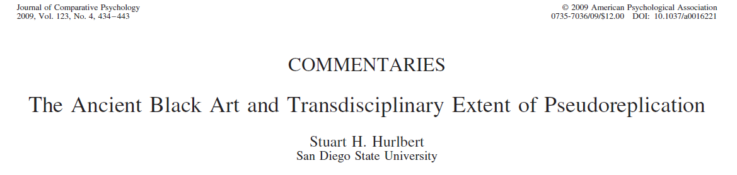
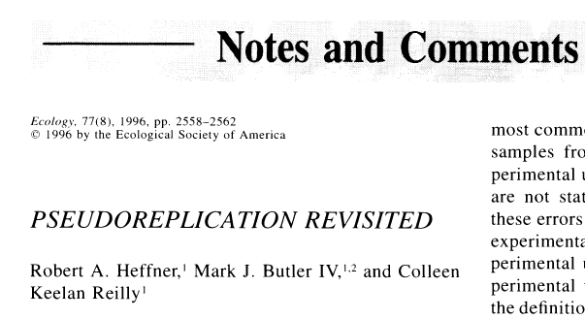
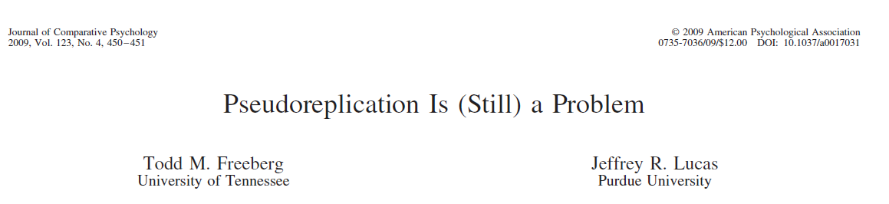
Dogmastist: Hurlbert, Lombardi, others

Slide 47
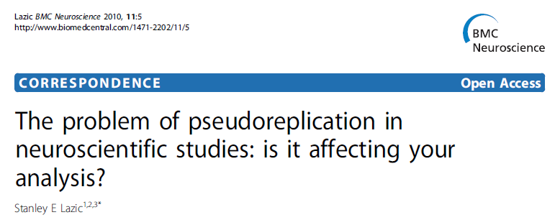
In neurobiology:

Slide 48
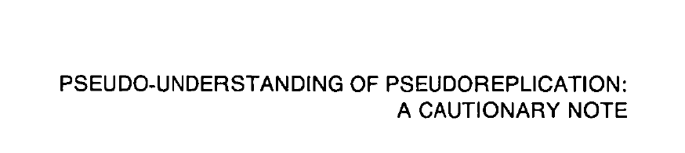

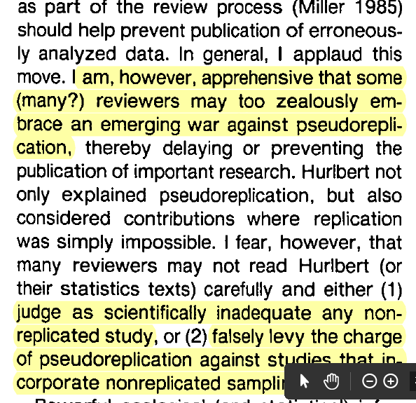

Slide 49
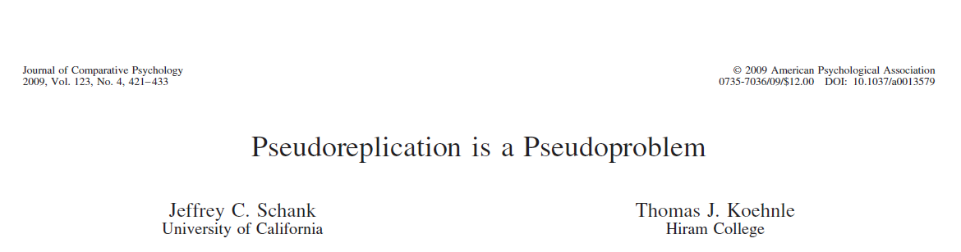
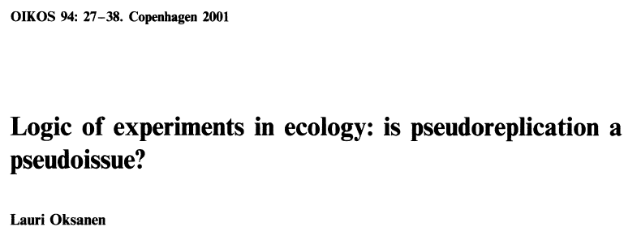
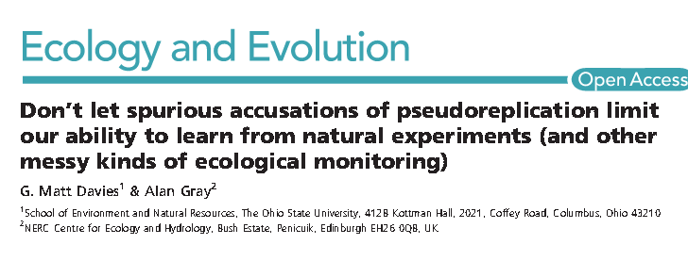
Dissenters

Slide 50
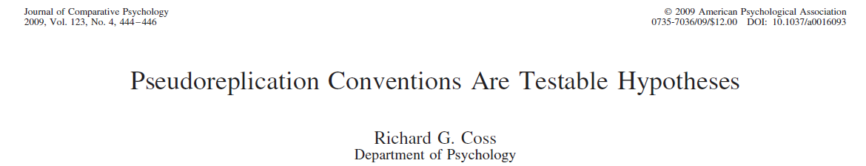
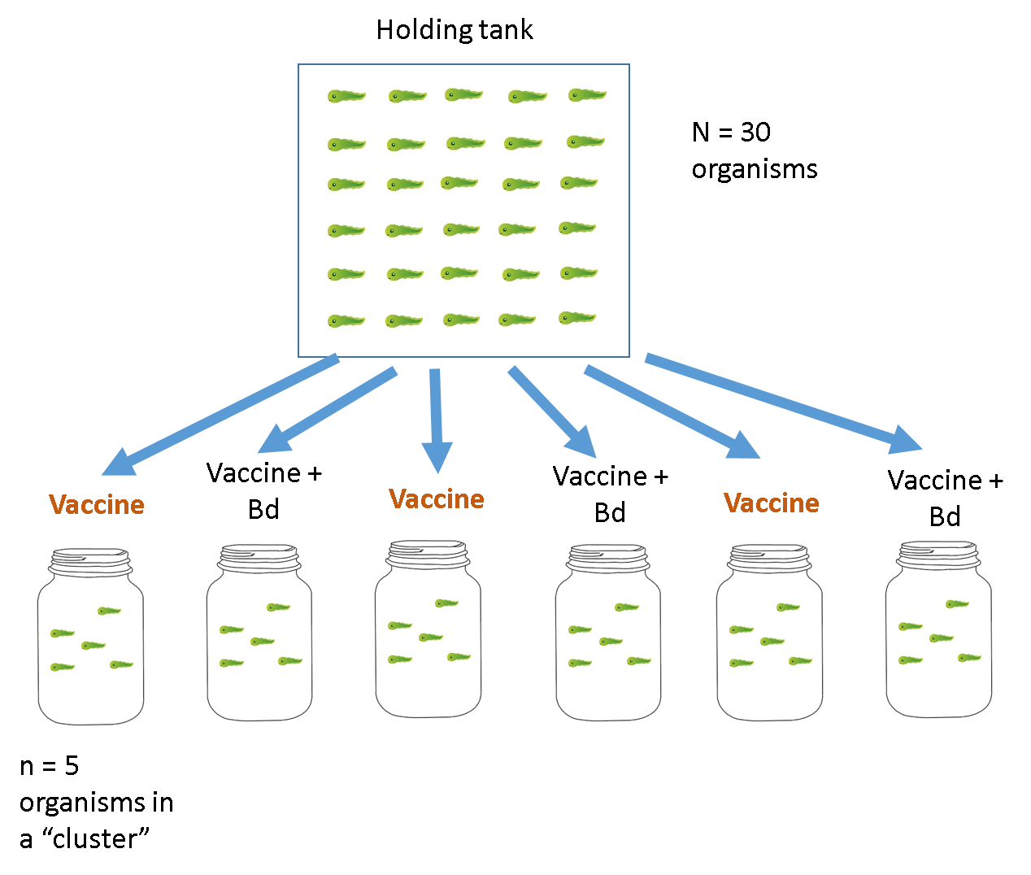
A current approach:
m.wo.ranef <- gls(response.y ~ treatment,
data = dat)
m.w.ranef <- lmer(response.y ~ treatment +
(1|jar.ID),
data = dat)
anoova(m.wo.ranef , m.w.ranef )

Slide 51

Consensus: include pseudoreplication in the model

