Slide 1



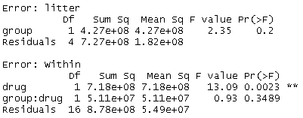
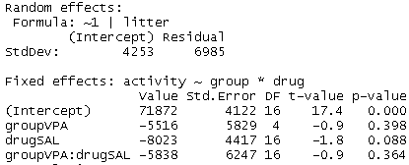
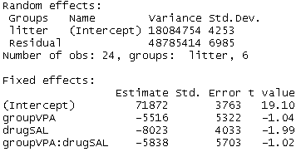


Mixed effects models in R
aov() vs. nlme::lme() vs. lm4::lmer()
aov( ): traditional least-squares
lme( ): modern likelihood
lmer( ): modern likelihood
Random effects in terms of SD
Ranefs in terms of var & SD
summary( )
Ranefs in terms of SS
No estimates of parameters from aov();
[Can get from post-hoc test(?)]
anova( )
?
p values similar to aov( ) but not exact due to differences between least squares vs maximum likelihood (?; does num of levels matter?)
F-statistics similar to lme( ) [why not exact?] but no p-values!
-aov() is less frequently used than lme()
-works best for balanced data (best not to use for unbalanced ever[?])
-assumes homogeneity of variance between treatment groups (no heteroskedasticity)
-assumes sphericity for repeated measures
-lme() is the best choice for a continuous response variable (y) that is or can be transformed to be normal-ish
-handles un-balanced data (different number of observations w/in treatment groups or random effects levels)
-can handle heterogeneity of variance and other complexities that violate traditional ANOVA/regression assumptions
-cannot handle “crossed” random effects (w/o a lot of effort)
-lmer() is similar to lme() but cannot accommodate heterogeneity of variance (perhaps with some effort?)
-the lme4 package is primarily used for its function glmer(), which is used for logistic regression & other generalized linear mixed models (GLMMs)
-lmer() can handle “crossed random effects”

Slide 2
Mixed effects models in R
aov() vs. nlme::lme() vs. lm4::lmer()
aov( ): traditional least-squares
lme( ): modern likelihood
lmer( ): modern likelihood
Random effects in terms of SD
Ranefs in terms of var & SD
summary( )
Ranefs in terms of SS
No estimates of parameters from aov();
[Can get from post-hoc test(?)]
anova( )
?
p values similar to aov( ) but not exact due to differences between least squares vs maximum likelihood (?; does num of levels matter?)
F-statistics similar to lme( ) [why not exact?] but no p-values!
-aov() is less frequently used than lme()
-works best for balanced data (best not to use for unbalanced ever[?])
-assumes homogeneity of variance between treatment groups (no heteroskedasticity)
-assumes sphericity for repeated measures
-lme() is the best choice for a continuous response variable (y) that is or can be transformed to be normal-ish
-handles un-balanced data (different number of observations w/in treatment groups or random effects levels)
-can handle heterogeneity of variance and other complexities that violate traditional ANOVA/regression assumptions
-cannot handle “crossed” random effects (w/o a lot of effort)
-lmer() is similar to lme() but cannot accommodate heterogeneity of variance (perhaps with some effort?)
-the lme4 package is primarily used for its function glmer(), which is used for logistic regression & other generalized linear mixed models (GLMMs)
-lmer() can handle “crossed random effects”

Slide 3
Mixed effects models in R
aov() vs. nlme::lme() vs. lm4::lmer()
aov( ): traditional least-squares
lme( ): modern likelihood
lmer( ): modern likelihood
Random effects in terms of SD
Ranefs in terms of var & SD
summary( )
Ranefs in terms of SS
No estimates of parameters from aov();
[Can get from post-hoc test(?)]
anova( )
?
p values similar to aov( ) but not exact due to differences between least squares vs maximum likelihood (?; does num of levels matter?)
F-statistics similar to lme( ) [why not exact?] but no p-values!
-aov() is less frequently used than lme()
-works best for balanced data (best not to use for unbalanced ever[?])
-assumes homogeneity of variance between treatment groups (no heteroskedasticity)
-assumes sphericity for repeated measures
-lme() is the best choice for a continuous response variable (y) that is or can be transformed to be normal-ish
-handles un-balanced data (different number of observations w/in treatment groups or random effects levels)
-can handle heterogeneity of variance and other complexities that violate traditional ANOVA/regression assumptions
-cannot handle “crossed” random effects (w/o a lot of effort)
-lmer() is similar to lme() but cannot accommodate heterogeneity of variance (perhaps with some effort?)
-the lme4 package is primarily used for its function glmer(), which is used for logistic regression & other generalized linear mixed models (GLMMs)
-lmer() can handle “crossed random effects”
-most actively developed mixed effects package in R
-has powerful tools for confidence intervals

Slide 4
Mixed effects models in R
aov() vs. nlme::lme() vs. lm4::lmer()
aov( ): traditional least-squares
lme( ): modern likelihood
lmer( ): modern likelihood
Random effects in terms of SD
Ranefs in terms of var & SD
summary( )
Ranefs in terms of SS
No estimates of parameters from aov();
[Can get from post-hoc test(?)]
anova( )
?
p values similar to aov( ) but not exact due to differences between least squares vs maximum likelihood (?; does num of levels matter?)
F-statistics similar to lme( ) [why not exact?] but no p-values!
-aov() is less frequently used than lme()
-works best for balanced data (best not to use for unbalanced ever[?])
-assumes homogeneity of variance between treatment groups (no heteroskedasticity)
-assumes sphericity for repeated measures
-lme() is the best choice for a continuous response variable (y) that is or can be transformed to be normal-ish
-handles un-balanced data (different number of observations w/in treatment groups or random effects levels)
-can handle heterogeneity of variance and other complexities that violate traditional ANOVA/regression assumptions
-cannot handle “crossed” random effects (w/o a lot of effort)
-lmer() is similar to lme() but cannot accommodate heterogeneity of variance (perhaps with some effort?)
-the lme4 package is primarily used for its function glmer(), which is used for logistic regression & other generalized linear mixed models (GLMMs)
-lmer() can handle “crossed random effects”
-most actively developed mixed effects package in R
-has powerful tools for confidence intervals

Slide 5

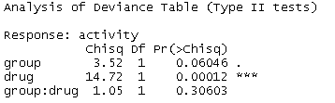

Why mixed models suck in R: confusion over hypothesis testing
lme( ): modern likelihood
Good:
Gold standard:
F-tests via anova(model)
“Parametric bootstrapping”
Requires custom coding
(for lmer() can use bootmer()
pbkrtest::PBmodcomp)
t-tests via summary(model)
Likelihood ratio test (LRT) anova(model, nested.model)
Test interaction: groupVPA:drugSAL
https://datascienceplus.com/introduction-to-bootstrap-with-applications-to-mixed-effect-models/
NS!
(directly comparable?)
Test drug effect: drugSAL
All suboptimal
Versus 0.029 for F-test
Chisq test via car::Anova(model)
AIC model comparison of all nested models
1) Fit all nested models
2) make table w/bbmle::ICtab();
NB: AICc requires specifying sample site
Versus 0.029 for F-test, 0.0013 for LRT!
Notes:
https://datascienceplus.com/introduction-to-bootstrap-with-applications-to-mixed-effect-models/

Slide 6
Why mixed models suck in R: confusion over hypothesis testing
lme( ): modern likelihood
Good:
Gold standard:
F-tests via anova(model)
“Parametric bootstrapping”
Requires custom coding
(for lmer() can use bootmer()
pbkrtest::PBmodcomp)
t-tests via summary(model)
Likelihood ratio test (LRT) anova(model, nested.model)
Test interaction: groupVPA:drugSAL
NS!
(directly comparable?)
Test drug effect: drugSAL
All suboptimal
Versus 0.029 for F-test
Chisq test via car::Anova(model)
AIC model comparison of all nested models
1) Fit all nested models
2) make table w/bbmle::ICtab();
NB: AICc requires specifying sample site
Versus 0.029 for F-test, 0.0013 for LRT!
Notes:
https://datascienceplus.com/introduction-to-bootstrap-with-applications-to-mixed-effect-models/

Slide 7


Mixed effects models in R
nlme::lme( ) vs. lm4::lmer( )
lme( ):
Fixed effects
(interaction)
Fixed effects
(interaction)
lmer( ):
comma
Plus symbol (“+”)
Random effects
Random efffects
ML = “maximum likelihood”
REML turned off, so ML used
“variance of the random effects” (var = SD^2)
Random effects results
“Standard deviation of the random effects”
Random effects results
“SD of the random effects”
SD of unexplained (residual) variation
SD of unexplained (residual) variation
summary( )
Fixed
effects results
P-values from t-stats are not reliable
Fixed
effects results
F-statistics similar to lme( ) [why not exact?!
anova( )
2-way interaction
not sig.
aov( ):
p = 0.35
Getting p values from lmer( ):
-There are several ways to this (ugh!)
-This approaches matchs aov() & lme(), and is probably similar to the defaults in SAS/SPSS.
-Note that for unbalanced data issues w/ Type II vs. Type III also apply (ugh!)
1)Fit Simpler model “nested” within “full” model
2)Use KRmodecomp() function in pbkrtest package to implement F-test with Kenward Rodgers correction to denominator degrees of freedom (df)
3) Get P-value for parameters that differs between the two nested models

Slide 8
Mixed effects models in R
nlme::lme( ) vs. lm4::lmer( )
lme( ):
Fixed effects
(interaction)
Fixed effects
(interaction)
lmer( ):
comma
Plus symbol (“+”)
Random effects
Random efffects
ML = “maximum likelihood”
REML turned off, so ML used
“variance of the random effects” (var = SD^2)
Random effects results
“Standard deviation of the random effects”
Random effects results
“SD of the random effects”
SD of unexplained (residual) variation
SD of unexplained (residual) variation
summary( )
Fixed
effects results
P-values from t-stats are not reliable
Fixed
effects results
F-statistics similar to lme( ) [why not exact?!
anova( )
2-way interaction
not sig.
aov( ):
p = 0.35
Getting p values from lmer( ):
-There are several ways to this (ugh!)
-This approaches matchs aov() & lme(), and is probably similar to the defaults in SAS/SPSS.
-Note that for unbalanced data issues w/ Type II vs. Type III also apply (ugh!)
1)Fit Simpler model “nested” within “full” model
2)Use KRmodecomp() function in pbkrtest package to implement F-test with Kenward Rodgers correction to denominator degrees of freedom (df)
3) Get P-value for parameters that differs between the two nested models

Slide 9
Mixed effects models in R
nlme::lme( ) vs. lm4::lmer( )
lme( ):
Fixed effects
(interaction)
Fixed effects
(interaction)
lmer( ):
comma
Plus symbol (“+”)
Random effects
Random efffects
ML = “maximum likelihood”
REML turned off, so ML used
“variance of the random effects” (var = SD^2)
Random effects results
“Standard deviation of the random effects”
Random effects results
“SD of the random effects”
SD of unexplained (residual) variation
SD of unexplained (residual) variation
summary( )
Fixed
effects results
P-values from t-stats are not reliable
Fixed
effects results
F-statistics similar to lme( ) [why not exact?!
anova( )
2-way interaction
not sig.
aov( ):
p = 0.35
Getting p values from lmer( ):
-There are several ways to this (ugh!)
-This approaches matchs aov() & lme(), and is probably similar to the defaults in SAS/SPSS.
-Note that for unbalanced data issues w/ Type II vs. Type III also apply (ugh!)
1)Fit Simpler model “nested” within “full” model
2)Use KRmodecomp() function in pbkrtest package to implement F-test with Kenward Rodgers correction to denominator degrees of freedom (df)
3) Get P-value for parameters that differs between the two nested models

Slide 10
Fixed effects
“factors whose levels are experimentally determined or whose interest lies in the specific effects of each level, such as effects of covariates, differences among treatments, and interactions” (Bolker et al 2008 TREE)”
Key diagnostics: Simpson et al (1960) rule of thumb: “if you were going to repeat the experiment as new test of the hypothesis, would you have to use the same levels of the treatment? (Underwood 1997, pg 201)
treatments,
covariates,
things you’re most interested in

Slide 11
Random effects
Groups variables that you need to control for but probably aren’t interested in
Cages containing multiple animals from different treatments (block)
Moms of multiple pups (nesting)
Individuals being measured repeatedly (repeated-measures)

Slide 12
Lazic (2010) on Fixed vs. Random effects
Fixed effects
Random effects
“the familiar explanatory variables such as treatment, sex, condition, and dose, and are usually something that the experimenter is interested in testing directly. Fixed effects affect the mean of the outcome variable; for example, the effect of a treatment is to increase the value of the outcome variable compared to a control condition by a certain number of units. “
“Random effects are less familiar and are usually something that the experimenter is not interested in directly (litter effects, cage effects, differences between incubators, differences between individual rats, etc.) but must be taken into account. “

Slide 13
Random effects: Old school vs. New school
Old School: Random sampling
(traditional ANOVA-ists,
degrees of freedom counters)
New school: Sampled, or interest is in variance
(multilevelers & Bayesisans ;
Gelman, Bolker)
Emphasizes random selection or allocation
Random selection of moms from a colony, random selection of sites w/in a forest for a deer exclosure
What about cages? – random allocation?
“An effect is considered ‘random’ if the experimenter has not specifically chosen the levels of the effect to be in the experiment, but has drawn a random sample from a larger population of possible levels.” (Bennington & Thayne 1994 Ecology)
“a random factor is sampled in the experiment. A number of levels (places, sites, species, whatever) is chosen to represent those available and defined as relevant…” (Underwood 1997 pg 205)
Encompasses “random selection” definition and allow for general situation when you are interested in variance or variability
If you can imagine something coming from a normal-ish distribution, even if you didn’t select that thing randomly, it can be a random effect
Models of cars, species, states in USA
“factors whose levels are sampled from a larger population, or whose interest lies in the variation among them rather than the specific effects of each level…” (Bolker et al 2008 TREE)

Slide 14
Old school and new school agree: definitions tricky
Bolker et al 2008 TREE
“The precise definition of ‘fixed’ and ‘random’ effects is controversial; the status of particular variables depends on experimental design and context”
“A variable can be treated as being either fixed or random, but usually one is more appropriate, and the interpretation of the results is different. “ (Lazic 2010)

Slide 15
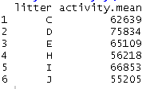
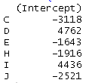
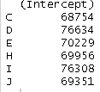
Mixed effects models in R
What is a “random effect”
lme():
Fixed effects
(interaction)
What are the means of each litter?
comma
Random effects
ML = “maximum likelihood”
Random effects results
“Standard deviation of the random effects”
SD of unexplained (residual) variation
summary()
What is a “random effect”
The ranef() function “extracts the random effects”; more precisely, estimates the estimates of the random effects
Fixed
effects results
The SD of these estimated random effects = 3600, which is similar to the value of 4253 in the main output. If there were more litters, these values would begin to converge (?)
anova()
The random effects are estimates of the litter means, just re-centered around zero by subtracting the intercept term

Slide 16
Mixed effects models in R
What is a “random effect”
lme():
Fixed effects
(interaction)
What are the means of each litter?
comma
Random effects
ML = “maximum likelihood”
Random effects results
“Standard deviation of the random effects”
SD of unexplained (residual) variation
summary()
What is a “random effect”
The ranef() function “extracts the random effects”; more precisely, estimates the estimates of the random effects
Fixed
effects results
The SD of these estimated random effects = 3600, which is similar to the value of 4253 in the main output. If there were more litters, these values would begin to converge (?)
anova()
The random effects are estimates of the litter means, just re-centered around zero by subtracting the intercept term

Slide 17
Mixed effects models in R
What is a “random effect”
lme():
Fixed effects
(interaction)
What are the means of each litter?
comma
Random effects
ML = “maximum likelihood”
Random effects results
“Standard deviation of the random effects”
SD of unexplained (residual) variation
summary()
What is a “random effect”
The ranef() function “extracts the random effects”; more precisely, estimates the estimates of the random effects
Fixed
effects results
The SD of these estimated random effects = 3600, which is similar to the value of 4253 in the main output. If there were more litters, these values would begin to converge (?)
anova()
The random effects are estimates of the litter means, just re-centered around zero by subtracting the intercept term

Slide 18
Two meanings of the term “random effect”
The grouping/nesting terms and its SD/var
The estimates of each level of the grouping variable
Random effects
There the “BLUPs”
Best-linear-unbiased parameters”
AKA the estimates “Random intercept”
“Standard deviation of the random effects”
SD of unexplained (residual) variation

Slide 19
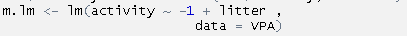

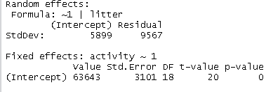
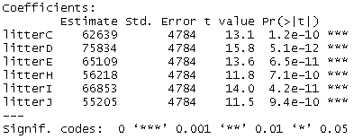
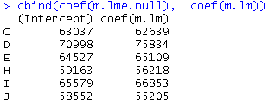
“Random intercepts” Models in R
Comparing lme() to lm()
lme() random intercepts model
Pure fixed effects model w/ lm()
Pure random effects model w/ lme()
Intercept-only model
comma
Random intercept for litter
We will be focusing on random effects, so best to use REML, not ML
summary()
summary()
“Standard deviation of the random effects”
coef( ) extracts the REs and adds the intercept.
(ranef() extract just the random intercepts, centered on 0).
“Random intercepts” estimated by lme(), for each litter, assuming that litters drawn from a normally distributed population. Requires 2 df, 1 for intercept, 1 for SD.
True intercepts estimated using raw data. Requires 1 df for each litters.

Slide 20
“Random intercepts” Models in R
Comparing lme() to lm()
lme() random intercepts model
Pure fixed effects model w/ lm()
Pure random effects model w/ lme()
Intercept-only model
comma
Random intercept for litter
We will be focusing on random effects, so best to use REML, not ML
summary()
summary()
“Standard deviation of the random effects”
coef( ) extracts the REs and adds the intercept.
(ranef() extract just the random intercepts, centered on 0).
“Random intercepts” estimated by lme(), for each litter, assuming that litters drawn from a normally distributed population. Requires 2 df, 1 for intercept, 1 for SD.
True intercepts estimated using raw data. Requires 1 df for each litters.

Slide 21
What is “the standard deviation (SD) of the random effects” means
lme() random intercepts model
Pure random effects model w/ lme()
Pure fixed effects model w/ lm()
Intercept-only model
comma
Random intercept for litter
We will be focusing on random effects, so best to use REML, not ML
summary()
“Standard deviation (SD) of the random effects”
Squaring these values converts them to variances
5899^2 = 3.5e+07
9567^2 = 9.2e+07
3.5e+07/(3.5e+07 + 9.2e+07)*100
= 28%
Therefore, 28% of the variance in the data can be explained by variation between litters.
SD of the residual variation
“Standard deviation (SD) of the random effects”
The SD of the random effects is an estimate of the amount of variation in the data that is due to variation between different litters.
The residual SD is the amount of variation in the data that cannot be explained by variation between litters.

Slide 22


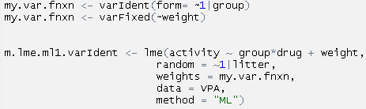
Mixed effects models in R
Modeling variance heterogeneity with lme()
Situation causing heterogeneous variance
Full lme() code
Function passed to weights =
Random effect for litter
What if the administration of VPA (which is part of the “group” variable) changed mean mouse “activity”, but also changed variability in activity? The “homogeneity of variance” assumption would be violated (=heteroscedasticity)?
“variance – identity”
varIdent( ) function passed to “weights” argument allows variance to be different between different treatment groups. Variance gets “weighted” by group
Form =
~
Bar (“|”)
Categorical variable
“variance – fixed”
What we were include the weight of each mouse as a covariate (ie, “controlling for” weight; doing ANCOVA) and activity changed with mouse weight and variability in activity also changed? (this would typically be revealed via a fan shapef residual plot)
No “form = “
~ but no “1” or “|”
varFixed( ) function passed to “weights” argument allows variance to be different between different treatment groups
Continuous variable
varIdent et al are functions and some authors will store calls to them as an object, then this object to the weights argument
There are numerous options and alternatives for accounting for heterogeneity of variance (and a lack of good advice…). See Zuur et al. and help file (ie ?varPower) for information
Modeling correlation structures for temporal and spatial autocorrelation:
lme() also has an argument “correlation = “
That can take function for “autocorrelation.” These can be important for repeated measures studies and studies where spatial positions are known. This is a complex area of modeling without much good advice in textbooks. See Zuur et al. for some information.
Variance function
Saved as object
Heterogeneity structured by
Categorical variable Continuous Variable Both
varIdent varFixed varPower
varExp varPower varCombPower
varComb
Some people advocate using hypothesis tests or AIC for determining appropriate variance structured

Slide 23
Mixed effects models in R
Modeling variance heterogeneity with lme()
Situation causing heterogeneous variance
Full lme() code
Function passed to weights =
Random effect for litter
What if the administration of VPA (which is part of the “group” variable) changed mean mouse “activity”, but also changed variability in activity? The “homogeneity of variance” assumption would be violated (=heteroscedasticity)?
“variance – identity”
varIdent( ) function passed to “weights” argument allows variance to be different between different treatment groups. Variance gets “weighted” by group
Form =
~
Bar (“|”)
Categorical variable
“variance – fixed”
What we were include the weight of each mouse as a covariate (ie, “controlling for” weight; doing ANCOVA) and activity changed with mouse weight and variability in activity also changed? (this would typically be revealed via a fan shapef residual plot)
No “form = “
~ but no “1” or “|”
varFixed( ) function passed to “weights” argument allows variance to be different between different treatment groups
Continuous variable
varIdent et al are functions and some authors will store calls to them as an object, then this object to the weights argument
There are numerous options and alternatives for accounting for heterogeneity of variance (and a lack of good advice…). See Zuur et al. and help file (ie ?varPower) for information
Modeling correlation structures for temporal and spatial autocorrelation:
lme() also has an argument “correlation = “
That can take function for “autocorrelation.” These can be important for repeated measures studies and studies where spatial positions are known. This is a complex area of modeling without much good advice in textbooks. See Zuur et al. for some information.
Variance function
Saved as object
Heterogeneity structured by
Categorical variable Continuous Variable Both
varIdent varFixed varPower
varExp varPower varCombPower
varComb
Some people advocate using hypothesis tests or AIC for determining appropriate variance structured

Slide 24
Mixed effects models in R
Modeling variance heterogeneity with lme()
Situation causing heterogeneous variance
Full lme() code
Function passed to weights =
Random effect for litter
What if the administration of VPA (which is part of the “group” variable) changed mean mouse “activity”, but also changed variability in activity? The “homogeneity of variance” assumption would be violated (=heteroscedasticity)?
“variance – identity”
varIdent( ) function passed to “weights” argument allows variance to be different between different treatment groups. Variance gets “weighted” by group
Form =
~
Bar (“|”)
Categorical variable
“variance – fixed”
What we were include the weight of each mouse as a covariate (ie, “controlling for” weight; doing ANCOVA) and activity changed with mouse weight and variability in activity also changed? (this would typically be revealed via a fan shapef residual plot)
No “form = “
~ but no “1” or “|”
varFixed( ) function passed to “weights” argument allows variance to be different between different treatment groups
Continuous variable
varIdent et al are functions and some authors will store calls to them as an object, then this object to the weights argument
There are numerous options and alternatives for accounting for heterogeneity of variance (and a lack of good advice…). See Zuur et al. and help file (ie ?varPower) for information
Modeling correlation structures for temporal and spatial autocorrelation:
lme() also has an argument “correlation = “
That can take function for “autocorrelation.” These can be important for repeated measures studies and studies where spatial positions are known. This is a complex area of modeling without much good advice in textbooks. See Zuur et al. for some information.
Variance function
Saved as object
Heterogeneity structured by
Categorical variable Continuous Variable Both
varIdent varFixed varPower
varExp varPower varCombPower
varComb
Some people advocate using hypothesis tests or AIC for determining appropriate variance structured

Slide 25
Mixed effects models in R
Modeling variance heterogeneity with lme()
Situation causing heterogeneous variance
Full lme() code
Function passed to weights =
Random effect for litter
What if the administration of VPA (which is part of the “group” variable) changed mean mouse “activity”, but also changed variability in activity? The “homogeneity of variance” assumption would be violated (=heteroscedasticity)?
“variance – identity”
varIdent( ) function passed to “weights” argument allows variance to be different between different treatment groups. Variance gets “weighted” by group
Form =
~
Bar (“|”)
Categorical variable
“variance – fixed”
What we were include the weight of each mouse as a covariate (ie, “controlling for” weight; doing ANCOVA) and activity changed with mouse weight and variability in activity also changed? (this would typically be revealed via a fan shapef residual plot)
No “form = “
~ but no “1” or “|”
varFixed( ) function passed to “weights” argument allows variance to be different between different treatment groups
Continuous variable
varIdent et al are functions and some authors will store calls to them as an object, then this object to the weights argument
There are numerous options and alternatives for accounting for heterogeneity of variance (and a lack of good advice…). See Zuur et al. and help file (ie ?varPower) for information
varIdent
varFixed
varExp
varPower
varComb
varCombPower
Modeling correlation structures for temporal and spatial autocorrelation:
lme() also has an argument “correlation = “
That can take function for “autocorrelation.” These can be important for repeated measures studies and studies where spatial positions are known. This is a complex area of modeling without much good advice in textbooks. See Zuur et al. for some information.
Variance function
Saved as object
Heterogeneity structured by
Categorical variable Continuous Variable Both
varIdent varFixed varPower
varExp varPower varCombPower
varComb
Some people advocate using hypothesis tests or AIC for determining appropriate variance structured

Slide 26
Mixed effects models in R
Modeling variance heterogeneity with lme()
Situation causing heterogeneous variance
Full lme() code
Function passed to weights =
Random effect for litter
What if the administration of VPA (which is part of the “group” variable) changed mean mouse “activity”, but also changed variability in activity? The “homogeneity of variance” assumption would be violated (=heteroscedasticity)?
“variance – identity”
varIdent( ) function passed to “weights” argument allows variance to be different between different treatment groups. Variance gets “weighted” by group
Form =
~
Bar (“|”)
Categorical variable
“variance – fixed”
What we were include the weight of each mouse as a covariate (ie, “controlling for” weight; doing ANCOVA) and activity changed with mouse weight and variability in activity also changed? (this would typically be revealed via a fan shapef residual plot)
No “form = “
~ but no “1” or “|”
varFixed( ) function passed to “weights” argument allows variance to be different between different treatment groups
Continuous variable
varIdent et al are functions and some authors will store calls to them as an object, then this object to the weights argument
There are numerous options and alternatives for accounting for heterogeneity of variance (and a lack of good advice…). See Zuur et al. and help file (ie ?varPower) for information
Modeling correlation structures for temporal and spatial autocorrelation:
lme() also has an argument “correlation = “
That can take function for “autocorrelation.” These can be important for repeated measures studies and studies where spatial positions are known. This is a complex area of modeling without much good advice in textbooks. See Zuur et al. for some information.
Variance function
Saved as object
Heterogeneity structured by
Categorical variable Continuous Variable Both
varIdent varFixed varPower
varExp varPower varCombPower
varComb
Some people advocate using hypothesis tests or AIC for determining appropriate variance structured

Slide 27
Lingo alert: Restricted Maximum likelihood vs Maximum Likelihood
Restricted Maximum Likelihood (REML)
Maximum likelihood (ML)
Provides less biased estimates of variance parameters (random effects)
If you’re fitting a pure-random effects model, use REML
If/when you carrying out hypothesis testing/model selection on your random effects, use REML, then switch to ML when looking at fixed effects
“an alternative to ML that estimates the random-effect parameters (i.e. standard deviations) averaged over the values of the fixed-effects parameters; REML estimates of standard deviations are generally less biased than corresponding ML estimates.” (Bolker et al 2008 TREE)
Typical way generalized linear mixed models (GLMs) are fit (ie logistic regression, Poisson regression for counts
Also allows mixed models to be fit to unbalanced data
ML is “a statistical framework that finds the parameters of a model that maximized the probability of the observed data (the likelihood)” (Bolker et al 2008 TREE)

Slide 28
Key issues when running mixed models
ML vs REML: maximum likelihood vs. restricted maximum likelihood
REML: provides better estimates of random effects parameters
P-values: how to do hypothesis tests
The math of random effects makes it difficult to calculate “denominator degrees of freedom” which are essential to calculating F-statistics, etc
Controversial for LMMs, even more so for GLMMs (?)
Less controversy if data is balanced and fits a standard experimental design (randomized block, split plot)
F-test vs. Chi-squared test vs. Likelihood ratio test (?)
Can depend on ML vs REML
AIC: should you use it?
Many people do, but some argue that you should not use AIC with mixed effects models (LMMs vs GLMMs?)
Should you do hypothesis tests on random effects? (test whether a random effect should be in a model)
Many people do; mind ML vs. REML distinction
Some argue that you should not, especially if it’s a blocking factor in an experiment
Variance heterogeneity
Many people include random affects, but don’t model variance heterogeneity via the weights = argument in lme()
Random intercepts vs random slopes
Many people only include random intercepts; should usually consider including random slopes
GLMMs: generalized linear mixed models for non-normal data
LMMs are hard, GLMMs are even harder!

Slide 29
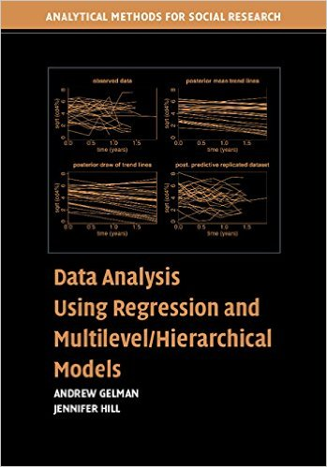
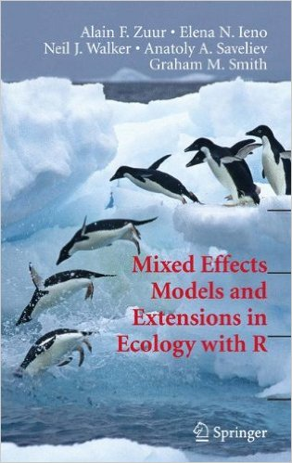
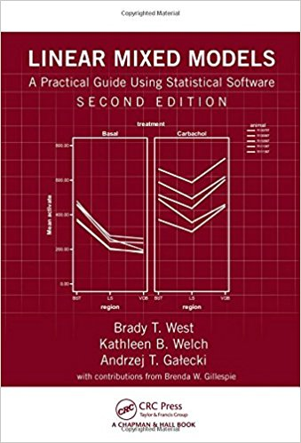



“Gelman’s book”
Excellent for everything
“The penguin book”
Excellent for a lot of stuff
“Then dental veneer book”
Very good, has SAS too!
Looks good, written for SAS, R code online
Basically Penguin book w/o R code
The “dog book”

Slide 30
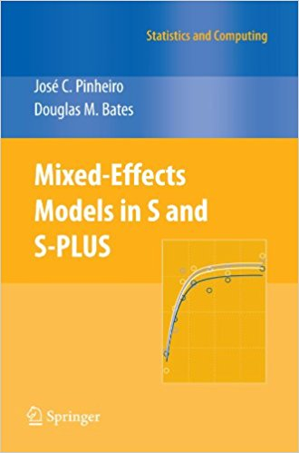
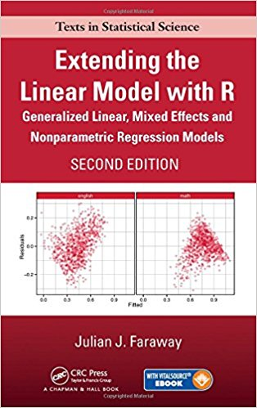
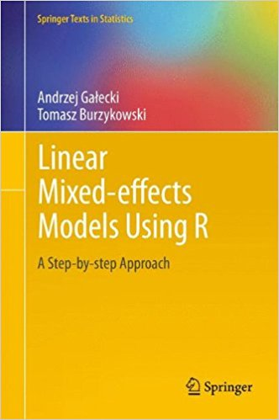
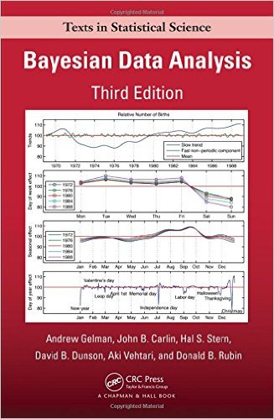
If you like math
Standard nlme reference
Not too mathy; also not too well written
If you wanna go whole hog bayesian

