Slide 1
Random effects models for hierarchical / multilevel experiments

Slide 2
Outline
Introduce case study: mouse model of autism
Review experimental design/models
Elaborate on blocking
Introduce hierarchical / multilevel models
nlme::lme() and lme4::lmer() syntax
Complexities and nuanaces of mixed effects models

Slide 3
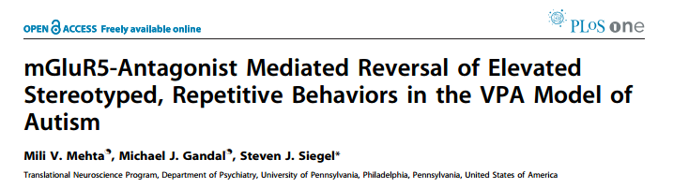

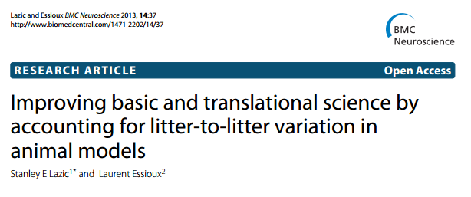
Case study: “VPA model of autism”

Slide 4
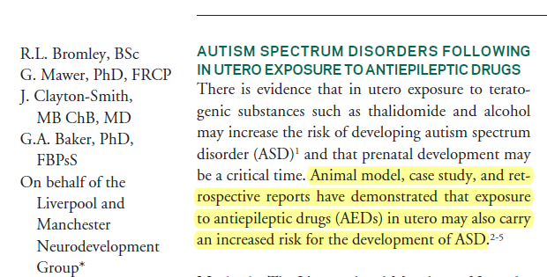
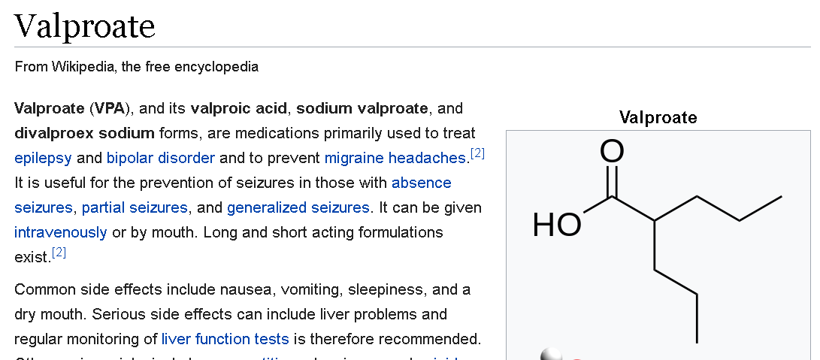
Prenatal exposure to drugs used to treat epilepsy (anticonvulsants) linked to autism

Slide 5

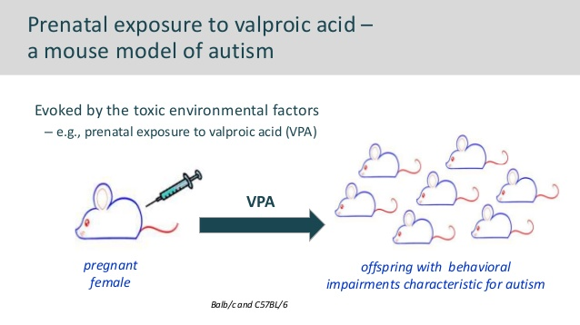
Animal model of autism
Mother injected to expose embryos
Key physiological & behavioral features of human disease replicated
Therapeutic treatments tested on offspring

Slide 6
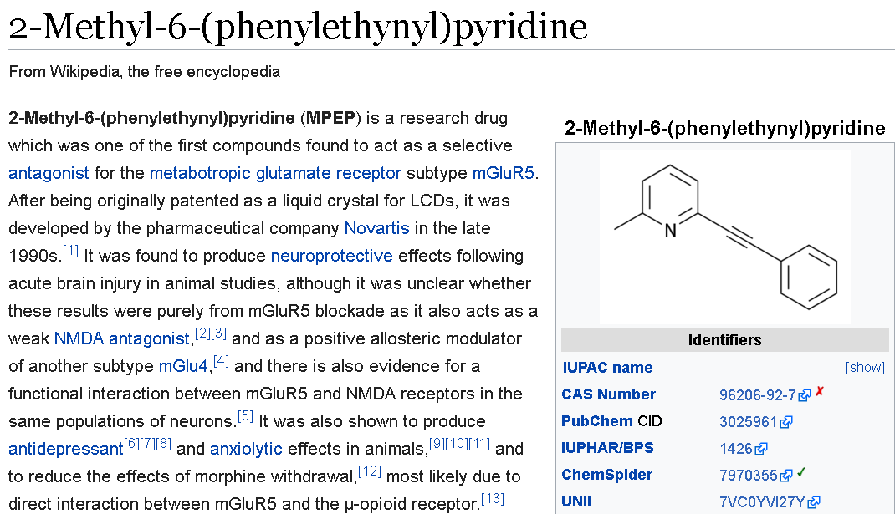
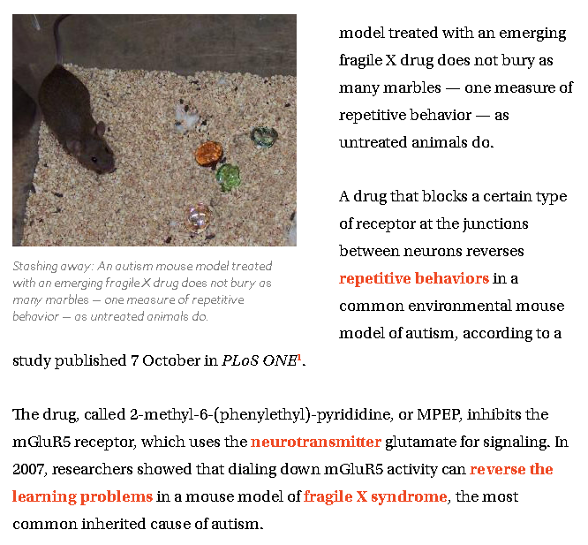
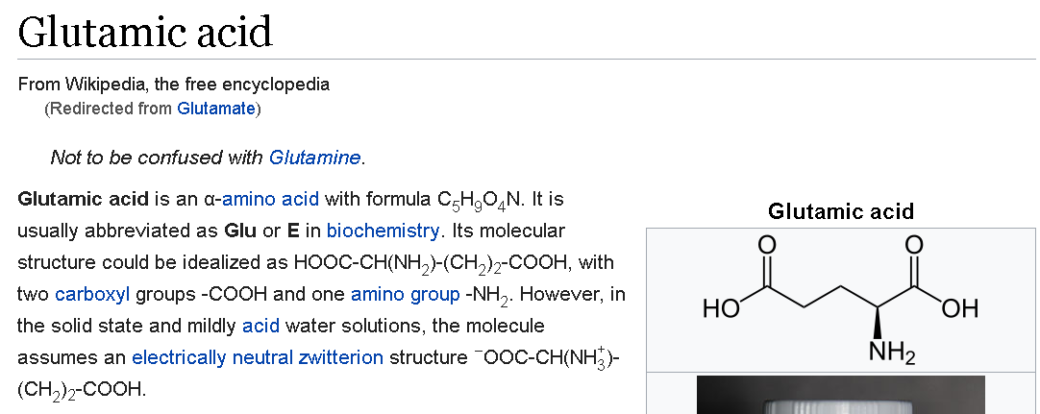
MPEP is potential drug to treat autism
Inhibits mGluR5 receptors, which bind glutamate

Slide 7
Easy experiment: test effects of VPA
Treatment
Group 1
Treatment
Group 2
saline

Slide 8
Treatment “confounded” with mom
“Confounding”:
Characteristics of mom (size, housing, random environmental exposure, animal handling experience) could result in increases or decreases in response variable of interest
Treatment
Group 1
saline
Treatment
Group 2

Slide 9
Better experiment
saline
Group 1
Group 2
saline
saline
-Effects of experimental treatment can be averaged across multiple females
-Sample size = number of moms

Slide 10
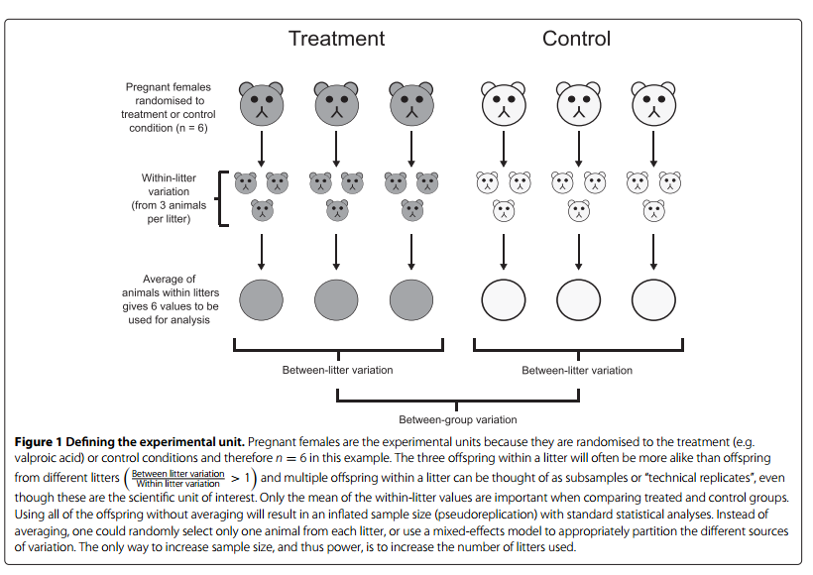
Group
Group
Lingo:
“pups nested within litter/mom”
Sample size (n) =number of moms / litters

Slide 11
Correct Analyses of nested data
 | MANOVA | Select 1 subunit | Mean of all subunits | Weighted Regression | Traditional ANOVA | Mixed Model
Function: | manova() | lm(), t.test() | lm(), t.test() | lm(… , weights = 1/SD ) (?) | aov() | lme(), lmer(), glmer()
 | Don’t use this – low powder | Not very efficient | Ok if you have balanced data | Ok if you have unbalanced data | What your advisor was taught | What the cool kids use
-Murtaugh 2007 and Bolker 2015 explain how and when these can be equivalent.
-When/why would you want to use more complex approach?
1)individual-level covariates (mass, sex, etc)
2)Non-normal data (counts, discrete events)
Murtaugh 2007. Simplicity & complexity in ecological data analysis. Ecology.

Slide 12
How to test the effects of the potential drug MPEP?

Slide 13
Test effects of MPEP
Treatment
Group 1
saline
Treatment
Group 2

Slide 14
Basic structure: crossed/factorial design
 |  | Treatment 1: control vs. VPA (applied to moms)
 |  | saline | VPA
Treatment 2: control vs MPEP (applied to pups) | saline | sal + sal | VPA + sal
 | MPEP | sal + MPEP | VPA + MPEP

Slide 15
labstats::VPA
-6 moms (randomly?) chosen
-3 Assigned to Saline control,
3 to VPA
Lab Colony
Mom
C
Mom
D
Mom
E
Mom
H
Mom
I
Mom
J
Saline
Saline
Saline
VPA
VPA
VPA
Litter
C
Litter
D
Litter
E
Litter
H
Litter
I
Litter
J
Pup1:
Saline
Treatment combo
VPA+sal
Pup2
Saline
Pup4:
MPEP
Pup1:
Saline
Treatment Combo:
sal+sal
Pup2
Saline
Pup4:
MPEP
Pup3:
MPEP
Treatment Combo
VPA +MPEP
Pup3:
MPEP
Treatment combo
sal+MPEP
-4 pups from each litter (randomly?) selected.
-2 randomly assigned to saline (sal) control,
2 randomly assigned to MPEP treatment
Abbreviations
sal = saline (method/vehicle control)
VPA: valproic acid
MPEP: glutamate receptor antagonist

Slide 16
labstats::VPA
-6 moms (randomly?) chosen
-3 Assigned to Saline control,
3 to VPA
Lab Colony
Mom
C
Mom
D
Mom
E
Mom
H
Mom
I
Mom
J
Saline
Saline
Saline
VPA
VPA
VPA
Litter
C
Litter
D
Litter
E
Litter
H
Litter
I
Litter
J
Pup1:
Saline
Treatment combo
VPA+sal
Pup2
Saline
Pup4:
MPEP
Pup1:
Saline
Treatment Combo:
sal+sal
Pup2
Saline
Pup4:
MPEP
Pup3:
MPEP
Treatment Combo
VPA +MPEP
Pup3:
MPEP
Treatment combo
sal+MPEP
-4 pups from each litter (randomly?) selected.
-2 randomly assigned to saline (sal) control,
2 randomly assigned to MPEP treatment
Abbreviations
sal = saline (method/vehicle control)
VPA: valproic acid
MPEP: glutamate receptor antagonist

Slide 17
labstats::VPA
-6 moms (randomly?) chosen
-3 Assigned to Saline control,
3 to VPA
Lab Colony
Mom
C
Mom
D
Mom
E
Mom
H
Mom
I
Mom
J
Saline
Saline
Saline
VPA
VPA
VPA
Litter
C
Litter
D
Litter
E
Litter
H
Litter
I
Litter
J
Pup1:
Saline
Treatment combo
VPA+sal
Pup2
Saline
Pup4:
MPEP
Pup1:
Saline
Treatment Combo:
sal+sal
Pup2
Saline
Pup4:
MPEP
Pup3:
MPEP
Treatment Combo
VPA +MPEP
Pup3:
MPEP
Treatment combo
sal+MPEP
-4 pups from each litter (randomly?) selected.
-2 randomly assigned to saline (sal) control,
2 randomly assigned to MPEP treatment
Abbreviations
sal = saline (method/vehicle control)
VPA: valproic acid
MPEP: glutamate receptor antagonist

Slide 18
labstats::VPA
-6 moms (randomly?) chosen
-3 Assigned to Saline control,
3 to VPA
Lab Colony
Mom
C
Mom
D
Mom
E
Mom
H
Mom
I
Mom
J
Saline
Saline
Saline
VPA
VPA
VPA
Litter
C
Litter
D
Litter
E
Litter
H
Litter
I
Litter
J
Pup1:
Saline
Treatment combo
VPA+sal
Pup2
Saline
Pup4:
MPEP
Pup1:
Saline
Treatment Combo:
sal+sal
Pup2
Saline
Pup4:
MPEP
Pup3:
MPEP
Treatment Combo
VPA +MPEP
Pup3:
MPEP
Treatment combo
sal+MPEP
-4 pups from each litter (randomly?) selected.
-2 randomly assigned to saline (sal) control,
2 randomly assigned to MPEP treatment
Abbreviations
sal = saline (method/vehicle control)
VPA: valproic acid
MPEP: glutamate receptor antagonist

Slide 19
labstats::VPA
-6 moms (randomly?) chosen
-3 Assigned to Saline control,
3 to VPA
Lab Colony
Mom
C
Mom
D
Mom
E
Mom
H
Mom
I
Mom
J
Saline
Saline
Saline
VPA
VPA
VPA
Litter
C
Litter
D
Litter
E
Litter
H
Litter
I
Litter
J
Pup1:
Saline
Treatment combo
VPA+sal
Pup2
Saline
Pup4:
MPEP
Pup1:
Saline
Treatment Combo:
sal+sal
Pup2
Saline
Pup4:
MPEP
Pup3:
MPEP
Treatment Combo
VPA +MPEP
Pup3:
MPEP
Treatment combo
sal+MPEP
-4 pups from each litter (randomly?) selected.
-2 randomly assigned to saline (sal) control,
2 randomly assigned to MPEP treatment
Abbreviations
sal = saline (method/vehicle control)
VPA: valproic acid
MPEP: glutamate receptor antagonist

Slide 20
labstats::VPA
-6 moms (randomly?) chosen
-3 Assigned to Saline control,
3 to VPA
Lab Colony
Mom
C
Mom
D
Mom
E
Mom
H
Mom
I
Mom
J
Saline
Saline
Saline
VPA
VPA
VPA
Litter
C
Litter
D
Litter
E
Litter
H
Litter
I
Litter
J
Pup1:
Saline
Treatment combo
VPA+sal
Pup2
Saline
Pup4:
MPEP
Pup1:
Saline
Treatment Combo:
sal+sal
Pup2
Saline
Pup4:
MPEP
Pup3:
MPEP
Treatment Combo
VPA +MPEP
Pup3:
MPEP
Treatment combo
sal+MPEP
-4 pups from each litter (randomly?) selected.
-2 randomly assigned to saline (sal) control,
2 randomly assigned to MPEP treatment
Abbreviations
sal = saline (method/vehicle control)
VPA: valproic acid
MPEP: glutamate receptor antagonist

Slide 21
Hierarchical / Multilevel Model
Lab Colony
Level 1: Litter Level
Saline vs. VPA
Saline
VPA
Litter
C
Litter
J
Abbreviations
sal = saline (method/vehicle control)
VPA: valproic acid
MPEP: glutamate receptor antagonist
Pup1:
Saline
Treatment combo
VPA+sal
Pup2
Saline
Pup4:
MPEP
Level 2: Pup Level
Saline vs. MPEP
Pup1:
Saline
Treatment Combo:
sal+sal
Pup2
Saline
Pup4:
MPEP
Pup3:
MPEP
Treatment Combo
VPA +MPEP
Pup3:
MPEP
Treatment combo
sal+MPEP
Notes:
Abbreviations
sal = saline (method/vehicle control)
VPA: valproic acid
MPEP: glutamate receptor antagonist

Slide 22
Hierarchical / Multilevel Model w/
Continuous predictors
Lab Colony
Saline
VPA
Level 1: Litter Level
Categorical: Saline vs. VPA
Continuous: Mom mass
Litter
C
Litter
J
Abbreviations
sal = saline (method/vehicle control)
VPA: valproic acid
MPEP: glutamate receptor antagonist
Pup1:
Saline
Treatment combo
VPA+sal
Pup2
Saline
Pup4:
MPEP
Level 2: Pup Level
Categorical:
Saline vs. MPEP
Continuous:
Pup mass
Pup1:
Saline
Treatment Combo:
sal+sal
Pup2
Saline
Pup4:
MPEP
Pup3:
MPEP
Treatment Combo
VPA +MPEP
Pup3:
MPEP
Treatment combo
sal+MPEP
Notes:
Abbreviations
sal = saline (method/vehicle control)
VPA: valproic acid
MPEP: glutamate receptor antagonist

Slide 23
Hierarchical / Multilevel Model w/
3 levels
Lab Colony
Saline
VPA
Level 1: Litter Level
Categorical: Saline vs. VPA
Continuous: Mom mass
Litter
C
Litter
J
Abbreviations
sal = saline (method/vehicle control)
VPA: valproic acid
MPEP: glutamate receptor antagonist
Pup1:
Saline
Pup2
Saline
Pup4:
MPEP
Level 2: Pup Level
Pup1:
Saline
Pup2
Saline
Pup4:
MPEP
Pup3:
MPEP
Pup3:
MPEP
Level 3:
Lower biological level:
Cells, neurons, organs, offspring,
Same biological level
Repeated measures over lifespan
Notes:
Abbreviations
sal = saline (method/vehicle control)
VPA: valproic acid
MPEP: glutamate receptor antagonist

Slide 24
labstats::VPA
Alternative presentations
“Split-plot” design (?)
Mom C: Saline
Pup1: Pup2:
saline saline
Pup3: Pup4:
MPEP MPEP
Mom D: Saline
Pup1: Pup2:
saline saline
Pup3: Pup4:
MPEP MPEP
Mom E: Saline
Pup1: Pup2:
saline saline
Pup3: Pup4:
MPEP MPEP
Split plot: “when designed experiments have different treatments applied to plots of different sizes (mostly fixed effects)” (Crawley 2013, The R Book)
Terminology mostly used in agricultural and ecological experiments, but concept correspond to designs in other kinds of research
“Whole-plot treatment”
Mom H: VPA
Pup1: Pup2:
saline saline
Pup3: Pup4:
MPEP MPEP
Mom I: VPA
Pup1: Pup2:
saline saline
Pup3: Pup4:
MPEP MPEP
Mom J: VPA
Pup1: Pup2:
saline saline
Pup3: Pup4:
MPEP MPEP
“Sub-plot treatment”
Abbreviations
sal = saline (method/vehicle control)
VPA: valproic acid
MPEP: glutamate receptor antagonist

Slide 25
Why the goofy name?
Irrigation
Compost
No compost
No irrigation
Compost
No compost
Irrigation
Compost
No compost
Irrigation
No compost
Compost
No irrigation
No irrigation
No compost
Compost
Compost
No compost
Notes:
Split plot: “when designed experiments have different treatments applied to plots of different sizes (mostly fixed effects)” (Crawley 2013, The R Book)
Terminology mostly used in agricultural and ecological experiments, but concept correspond to designs in other kinds of research

Slide 26
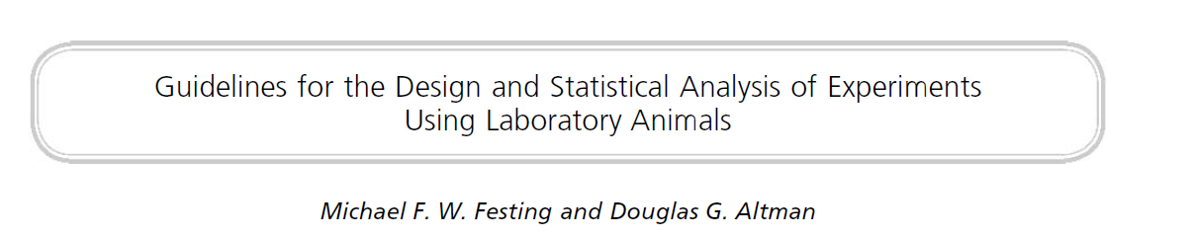

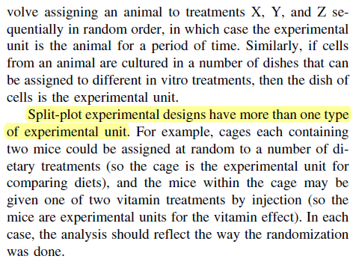
Another example of split-plot:
Diet at cage level, vitamin treatment at individual level

Slide 27
Repeated measures as nested data
Individual 1
Individual 2
Individual 3
Individual 4
Individual 5
Day 1
Day 2
Day 3
Day 4
Key assumption of ANOVA applied to repeated measures:
-Measurements close to each other in time are not correlated
(assumption of “sphericity”)
-can correct degrees of freedom in anova
-use MANOVA
-use mixed model and model “autocorrelation”

Slide 28

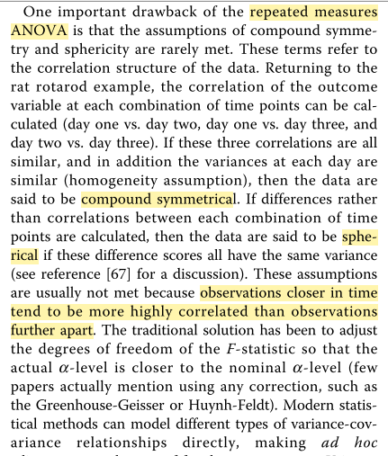
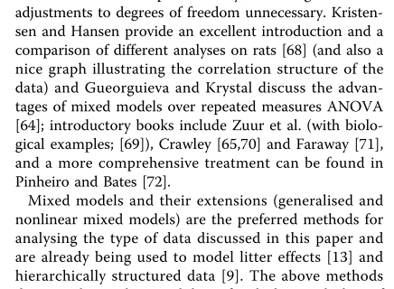

Repeated measures ANOVA & sphericity

Slide 29
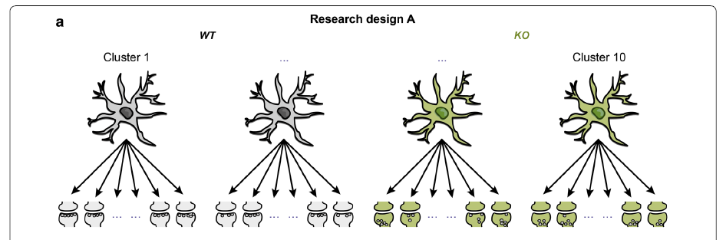

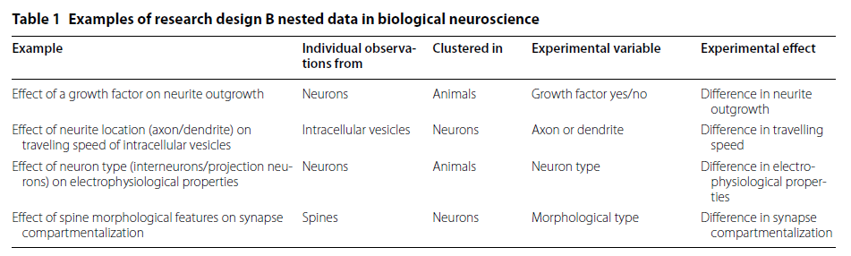
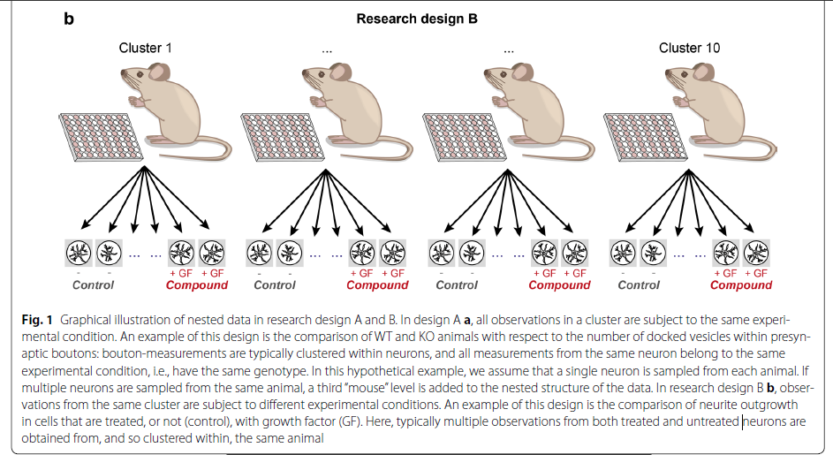
Other examples of hierarchical data
Nested
“Synapse nested w/in neuron”
Blocked
Blocked
“GP treatment blocked by rat”
There might be a problem with this design …

Slide 30

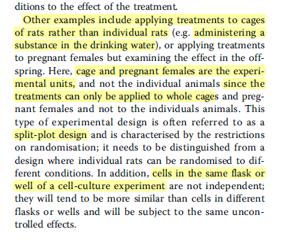
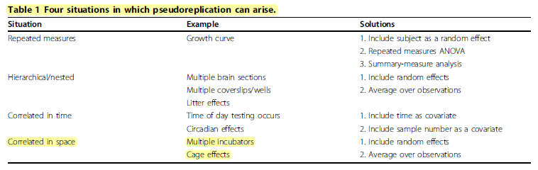
Lazic on blocking by cage
Blocking by cage:
Can be nest, or split plot
-Blocking by cage (or aquarium, or mason jar) appears to be most appropriate when treatment is administered to entire cage (food bowl in cage, chemicals added to water in aquarium)
-Groups of cages are sometimes blocks to control for variation in animal care room

Slide 31
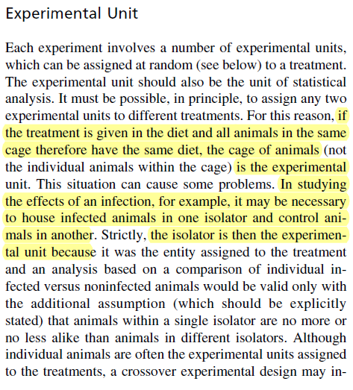
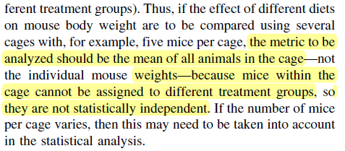
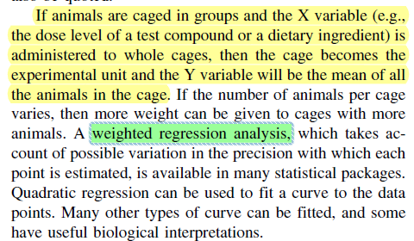
Similar idea as Lazic
(when treatment delivered at cage level)
Use of weighted regression for unbalanced data
-Blocking by cage (or aquarium, or mason jar) appears to be most appropriate when treatment is administered to entire cage (food bowl in cage, chemicals added to water in aquarium)
-Groups of cages are sometimes blocks to control for variation in animal care room

Slide 32

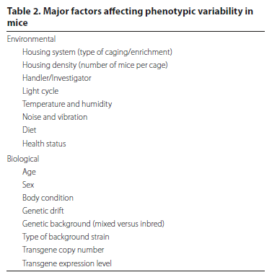
Housing impacts on mice
Factors I’ve seen associated with variation in mice:
-position relative heating/cooling system
-position on shelf (bottom vs. top)
-positon relative to doors/walkways (human traffic)
-sex ratio w/in cage
Blocking often (sometimes?) occurs among groups of cages sharing similar environmental conditions

Slide 33

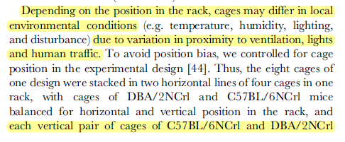

Example of blocking multiple cages to control for variation w/in animal care facility

Slide 34
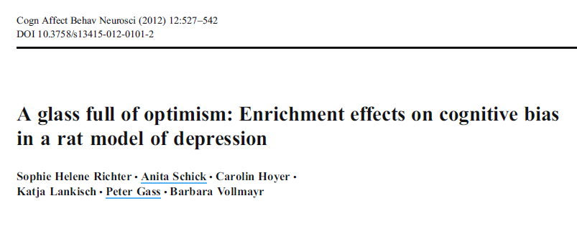
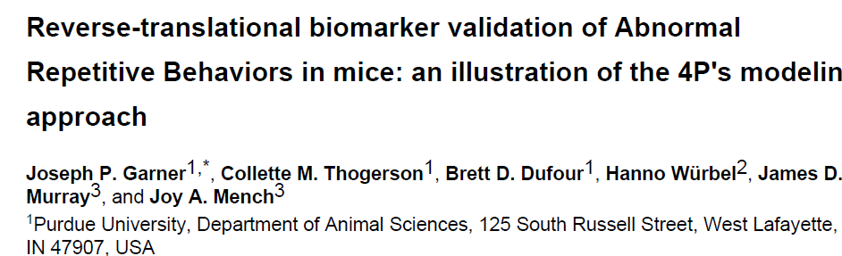
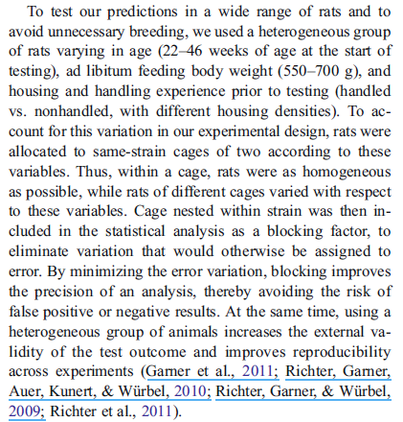
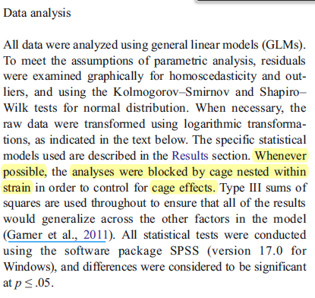
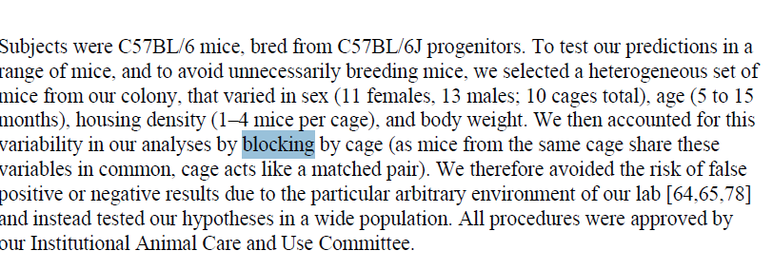
Interesting application of blocking (that I don’t totally understand)

Slide 35

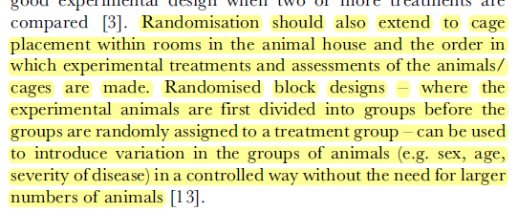

Interesting application of blocking (that I don’t totally understand)

